Slide 1
HappyLLM Project
Mastering LLM Core Technologies
From Intuition to Implementation

Slide 2
Project Overview
Goal: Help you master Large Language Model (LLM) core technologies.
Combines code practice with in-depth theoretical explanations.
Covers NLP basics, Neural Components, and complete Transformer architecture.

Slide 3
Prerequisites
To get the most out of this project, you should have:
Mathematics: Linear Algebra (Matrix operations, Vector spaces)
Programming: Python 3.x
Framework: PyTorch Basics

Slide 4
Part 1: HappyLLM Code Basics
chp1/ - NLP Basics
One-Hot Encoding, Tokenizer, Word Embedding
PCA Visualization of Embeddings
chp2/ - Neural Components
Softmax Implementation
Layer Normalization Implementation

Slide 5
Part 2: Transformer Introduction
Complete Book: Transformer Architecture - From Intuition to Implementation
30+ Chapters covering:
- History (GPT, AlphaGo)
- Core Mechanics (Attention, QKV, Multi-Head)
- Architecture (Residuals, FeedForward)
- Optimization (Flash Attention, KV Cache, LoRA)
Hand-written implementation (Model.py, Train.py)

Slide 6
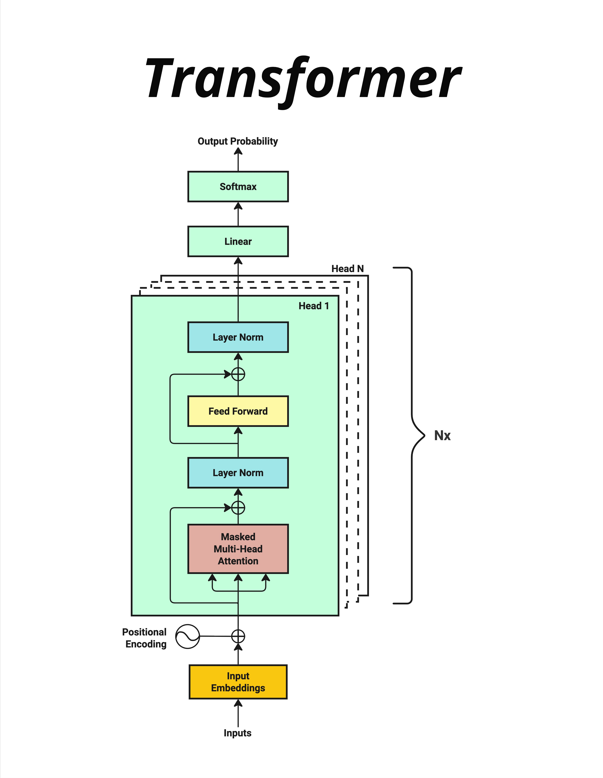
Transformer Architecture

Slide 7
How to Start
1. Environment Setup
Install Python 3.x and PyTorch
2. Basics (chp1)
Run code to understand inputs (Tokenizer, Embedding)
3. Deep Dive (Transformer Book + chp2)
Read docs and run component code (Softmax, LayerNorm)
4. Implementation
Follow the guide to build your own Transformer

Slide 8
Happy Coding!
Explore the code on GitHub

