Slide 1
Muse and the
SAP UI Roadmap
Reiner Hammerich
Chief Development Architect, SAP AG

Slide 2

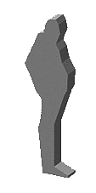




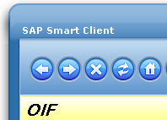







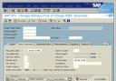



Market Trends
The New Face of The Enterprise SOA Era
WEB APPLICATIONS ERA (WEB 1.0)
2006
2000
“Low” Operational Excellence “High”
MAINFRAME ERA
COMPOSITES and ESOA ERA (WEB 2.0)
1994
CLIENT-SERVER ERA – R/3 AND SAP GUI
“Text UI” Experience Excellence
“High-Performance,
Rich UI”

Slide 3
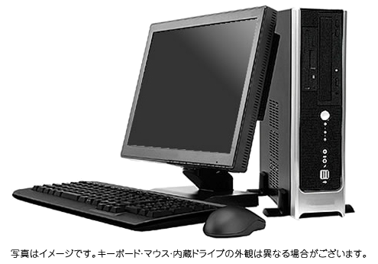

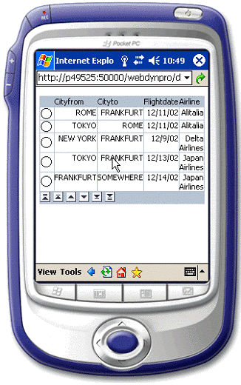

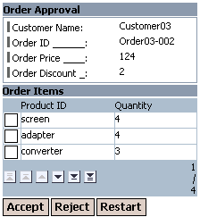
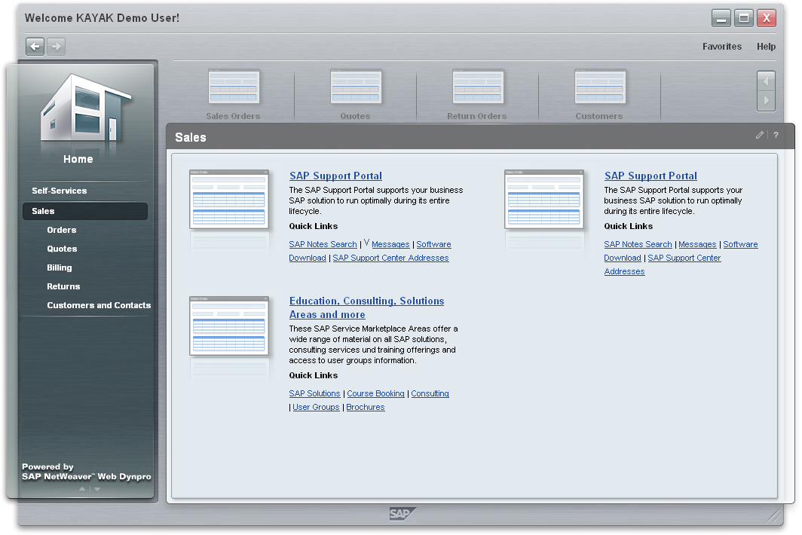
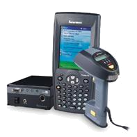
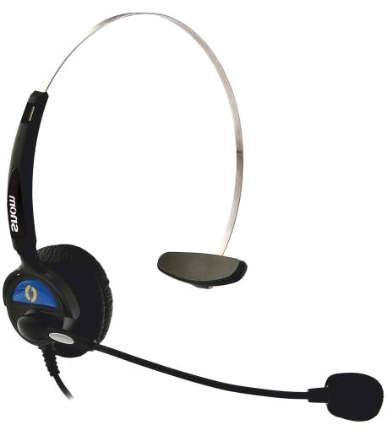
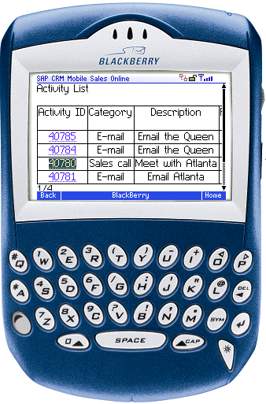

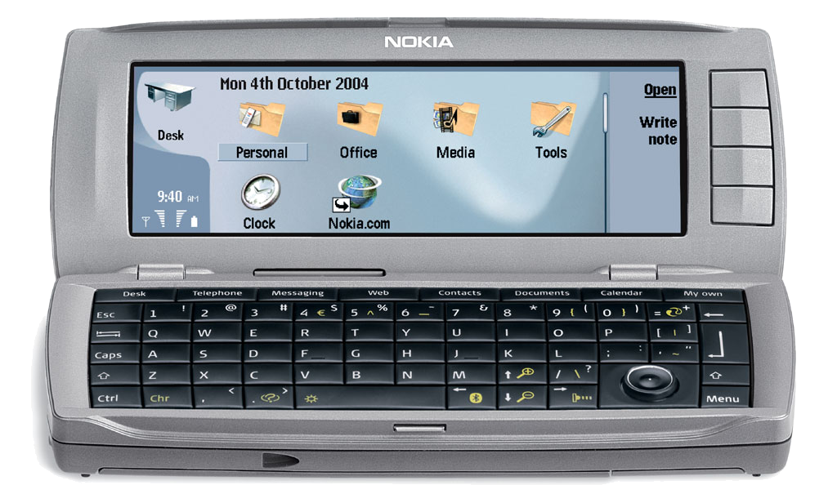

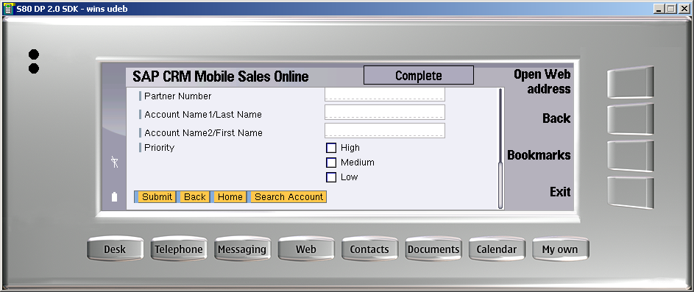
Multiple Channels
…allows the user to access the right information, services and applications: from any place at any time
Voice
Forms
RFID

Slide 4
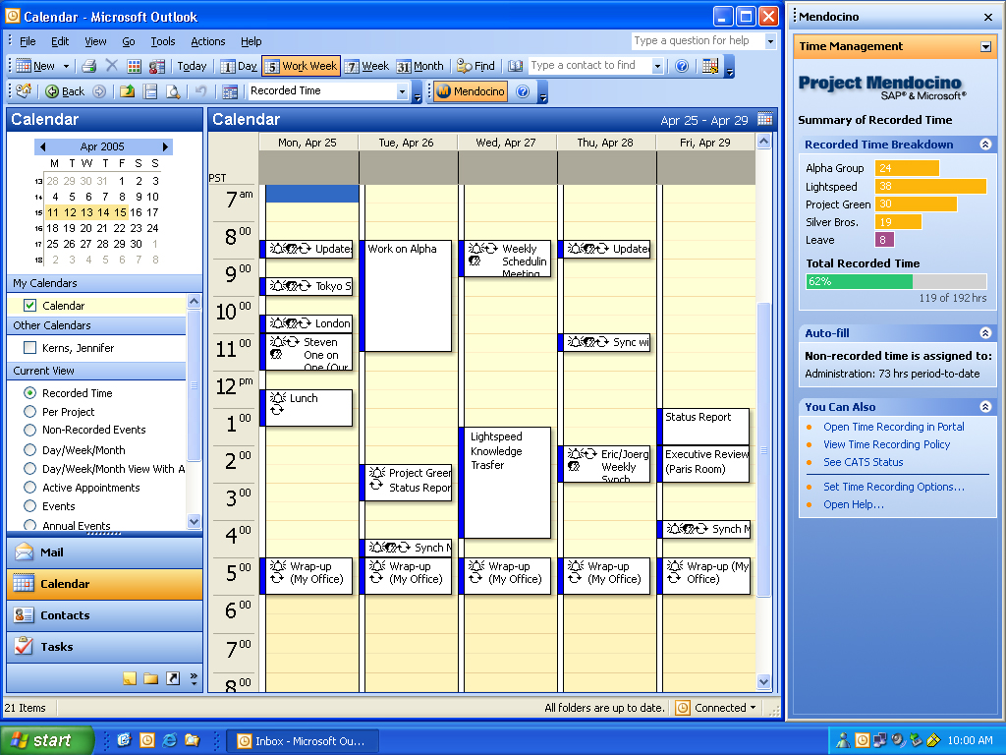

Different Approaches
Design Integrate Automate
MUSE Duet RFID
SAP will always be looking for opportunities to place UI within existing work context or provide automated solutions.
This is the natural evolution of technology

Slide 5
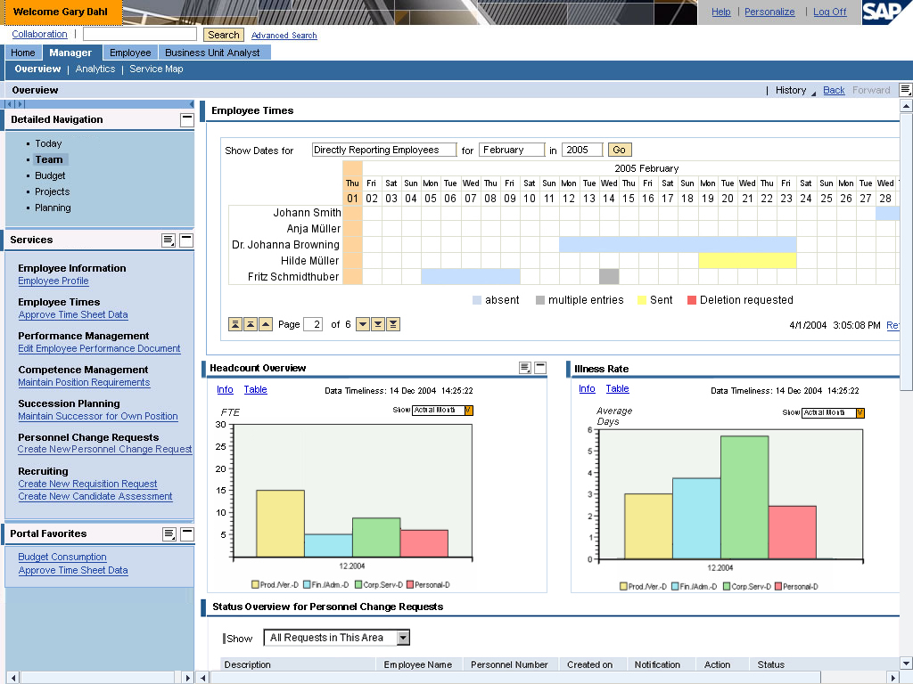
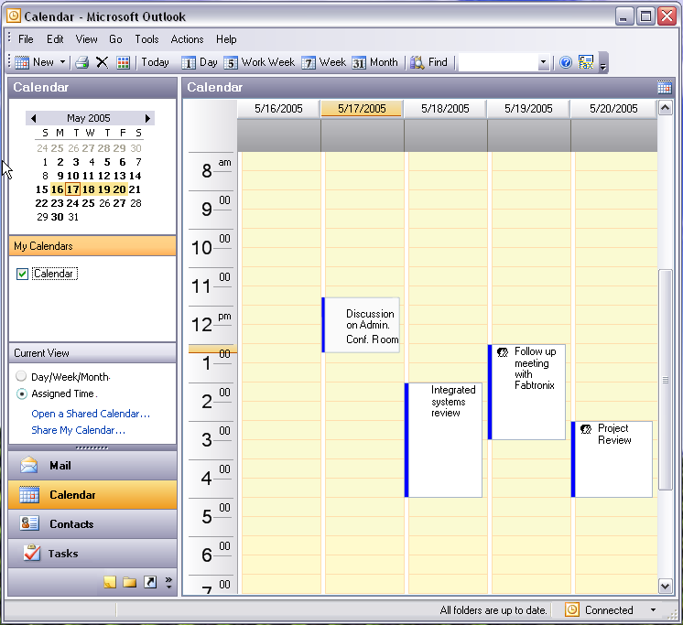
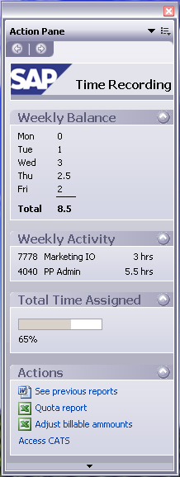
Multiple User Interface
…allows the user to access the right information, services and applications: from within the appropriate environment
Web Browser
Muse
Microsoft Office
SAP Business Process
Application Platform
Enterprise
Services
Repository
SAP CRM
SAP ERP
MS
Exchange
3rd Party
Internal
Notes:
As you can see Mendocino is one way to add an additional user interface to participate through ESA in the SAP business processes. SAP offers alternative user interfaces which allow the end user to select the right interface for their tasks. This does not mean that every application will be available in every user interface. E.g. a Microsoft Word document might be not the right place for an end user to enter line items from an invoice in an accounts payable process.
As you can see Mendocino is an extension to the existing IT landscape focused on delivering SAP business process and data in real-time, in context and everywhere (offline) to additional end users.
[presenter notes]
This slide is used to fit Mendocino in the overall landscape. Emphasis also on Mendocino is on example of ESA live and now the end user has more option to choose the right UI for to tackle their tasks.

Slide 6
What is Muse?
First of all Muse is a code name for a project! However, this project will deliver:
1. The new NetWeaver Business Client
  A local client that dramatically improves user experience and user efficiency.
  Build on top of state of the art UI technology such as Adobe.
2. Simplification of the UI for SAP’s business suite
  UIs are based on Web Dynpro Technology.
  Main mySAP ERP 2005 UIs will be redone using a floor plan and UI building block methodology.
  Harmonization and consolidation of UIs and UI technologies centered around Web Dynpro. This will deprecate various UI technologies. However, deprecated UI technologies still continue to work!
  Additional Smart services and “smartened-up” transaction will drastically reduce TCO for customers running mySAP ERP 2005.

Slide 7
The concepts driving the NetWeaver Business Client
User Centric & Simplification
  → Context aware smart services
  → Improve end user performance
  → Optimized environment for business applications
Portal UI Services
  → UI level integration
  → Roles
  → Document Management
  → Single Entry point
  → Aggregation & Federation
Shell
Canvas
Openness
  →Open APIs for next generation of UI technologies
  →Pluggable smart services
  → Integration of existing UI technologies like SAPGUI, HTML, Flex
Web 2.0 concepts
  → Lean Deployment
  → Mashups
  → Desktop like behavior
  → Communities
  → Collaboration
SAPGUI
  → Efficiency / performance
  → Deep OS level integration
  → Branding
  → Security
  → Platform covering

Slide 8
Highlevel Architecture
NetWeaver Business Client
Shell
Data Access
Data View
Search
Offline
Support
…
Collaboration
R
Canvas for Web Dynpro, Flash, HTML, Dynpro…
Navigation
R
R
UI Services
Applications
UI Metadata
…
Portal Platform
(Work Center,
Control Center
Roles, OBN,…)
Search
WD ABAP Runtime
WD Java Runtime
Collaboration
Dynpro Runtime
HTML Runtime

Slide 9
Muse and the
SAP UI Roadmap
Reiner Hammerich
Chief Development Architect, SAP AG

Slide 10
Web 2.0 and ESA are related…
Definitions from Wikipedia
Web 2.0: The phrase Web 2.0 was coined by O'Reilly Media to refer to a supposed second generation of Internet-based services that let people collaborate and share information online in a new way—such as social networking sites, wikis, communication tools, and folksonomies. O'Reilly Media, in collaboration with MediaLive International, used the phrase as a title for a series of conferences and since then it has become a popular, if ill-defined and often criticized, buzzword amongst the technical and marketing communities. [People but also Application]
Includes - Rich Internet Applications e.g. Ajax (Web Dynpro is Ajax +++), Web Services – SOAP, XML, WSDL
Mashup: Mashup (web application hybrid), a website or web application that combines content from more than one source
SAP’s ESOA is the WEB 2.0 equivalent for Enterprise Software – Composite Applications, Enterprise Services, A2A, B2B, Device Collaboration (A2D) not only via a browser, but via multiple interfaces.

Slide 11
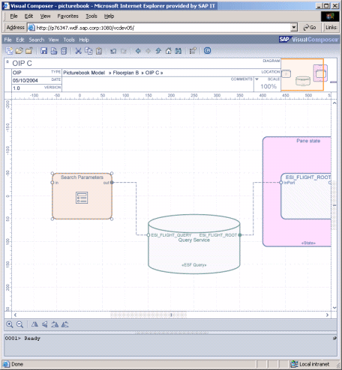
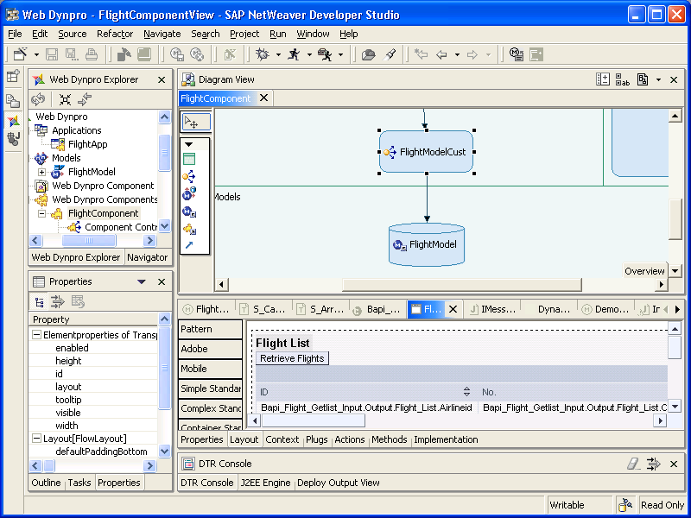
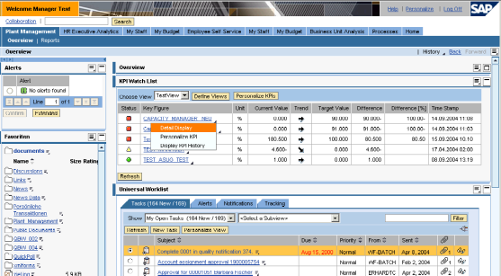
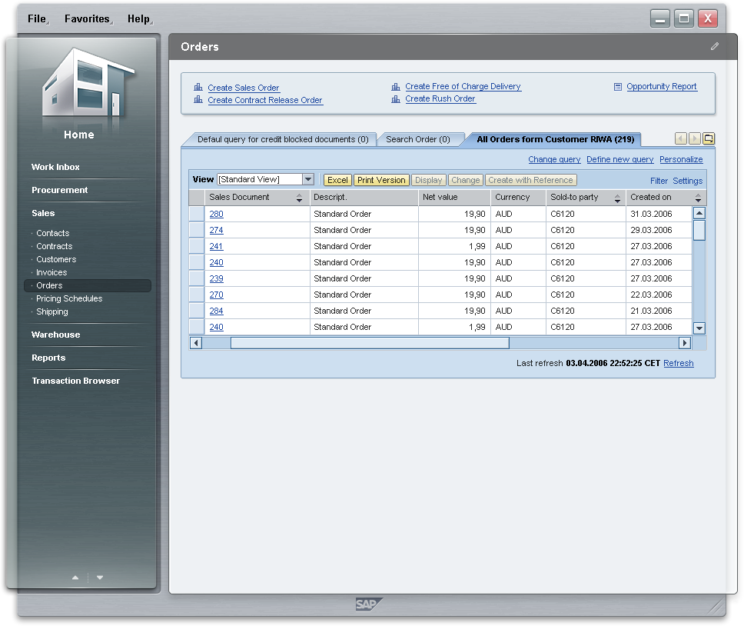
Main UI Technology Players at SAP
  Visual Composer (VC) and the underlying models are SAP’s strategic approach for composing UI applications.
  Web Dynpro (WD) is SAP’s strategic UI runtime environment for UI applications and implementation model for UI building blocks.
  The Portal Platform (PP) is the environment where application UIs are aggregate to comprehensive solutions.
  SAP’s UI modeling strategy requires to add support for different clients. Portal infrastructure incl. services is the platform facilitating all supported clients.

Slide 12
UI Modeling and UI Composition
Prime requirement: Retain power but gain speed in creation of user interfaces that are flexible and easy to change
Visual Composer
Dev Server
Web Dynpro Patterns Runtime
Pattern Kits
(Plug-in, Generator)
Web Dynpro Component
Composed
Pattern
Infrastructure
R
Generators
Models
UI Building Blocks
R
ESI Discovery Service
R
R
UI Building Blocks
Web Dynpro Foundation Runtime
Web Dynpro Component
WD Foundation Services
Web Dynpro Components
R
Rendering
Connection
Context/State
Metadata
Personalization
I18N
Eclipse
Configuration
Web Dynpro Tools
R
Generators
Code
Designtime
Runtime

Slide 13
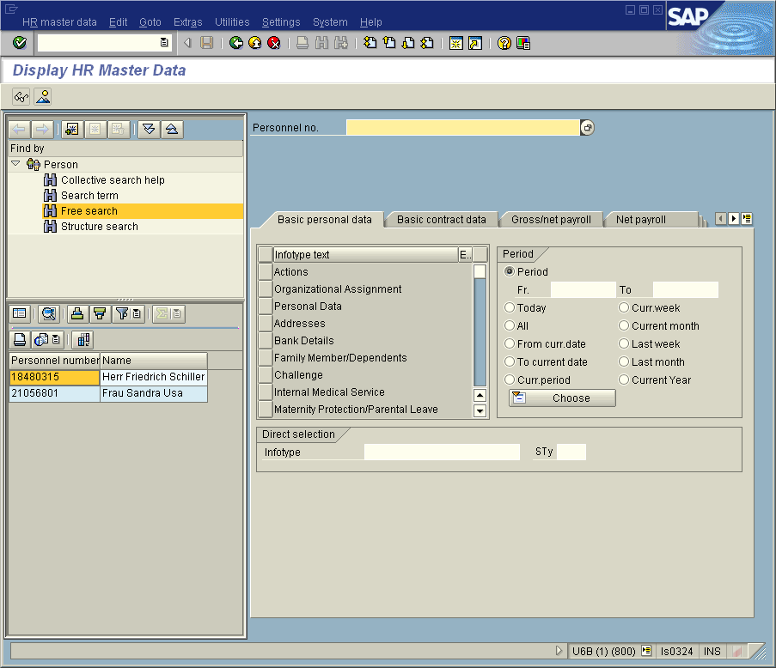


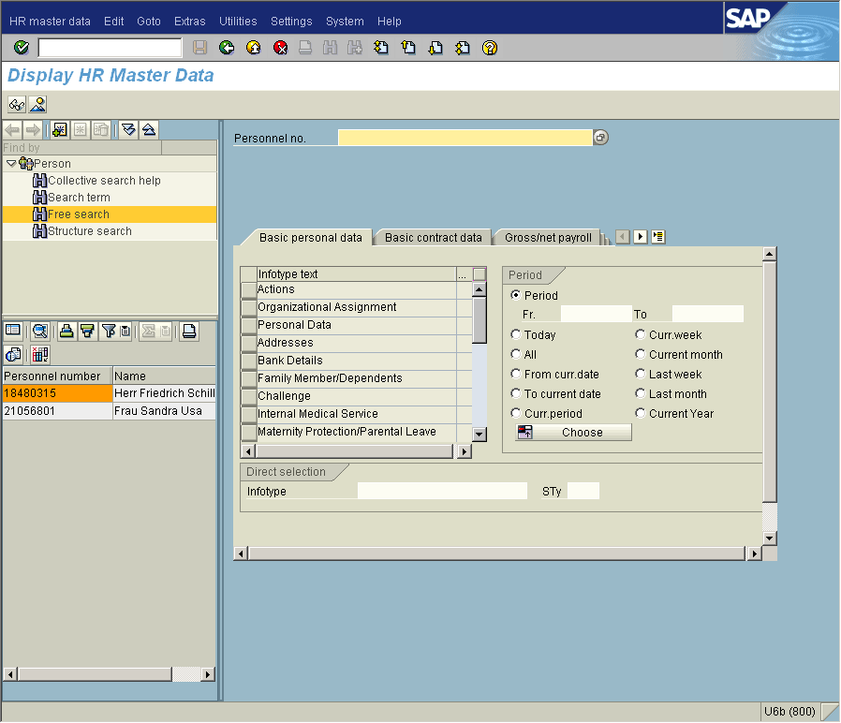
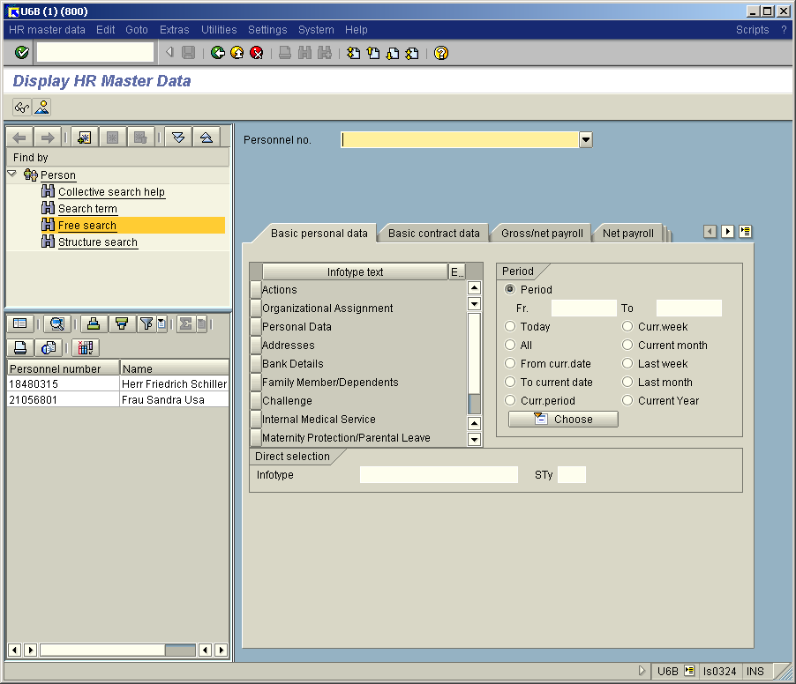

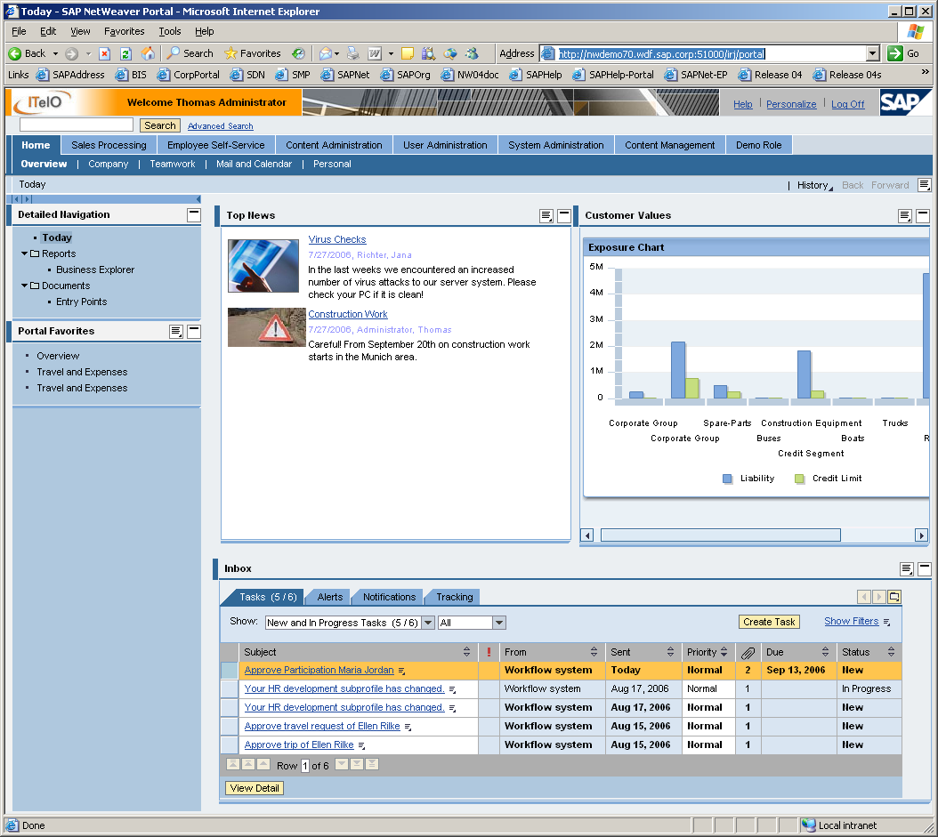
The Way to Service-enabled Infrastructure
Today
Future: service-oriented architecture
SAP GUI Family
User Clients & Access
SAP GUI for Java
SAP GUI for Win
NW BC
NW Portal
SAP GUI for HTML
SAP NetWeaver Portal
Browser
UI Services
UI Services
Roles
Navigation
App Help
Roles
Navigation
App Help
Page Builder
Work Center
Printing
Page Builder
Work Center
Printing
Rendering
Personaliz.
…
Rendering
Personaliz.
…

Slide 14
Copyright 2006 SAP AG. All Rights Reserved
No part of this publication may be reproduced or transmitted in any form or for any purpose without the express permission of SAP AG. The information contained herein may be changed without prior notice.
Some software products marketed by SAP AG and its distributors contain proprietary software components of other software vendors.
Microsoft, Windows, Outlook, and PowerPoint are registered trademarks of Microsoft Corporation.
IBM, DB2, DB2 Universal Database, OS/2, Parallel Sysplex, MVS/ESA, AIX, S/390, AS/400, OS/390, OS/400, iSeries, pSeries, xSeries, zSeries, z/OS, AFP, Intelligent Miner, WebSphere, Netfinity, Tivoli, and Informix are trademarks or registered trademarks of IBM Corporation.
Oracle is a registered trademark of Oracle Corporation.
UNIX, X/Open, OSF/1, and Motif are registered trademarks of the Open Group.
Citrix, ICA, Program Neighborhood, MetaFrame, WinFrame, VideoFrame, and MultiWin are trademarks or registered trademarks of Citrix Systems, Inc.
HTML, XML, XHTML and W3C are trademarks or registered trademarks of W3C®, World Wide Web Consortium, Massachusetts Institute of Technology.
Java is a registered trademark of Sun Microsystems, Inc.
JavaScript is a registered trademark of Sun Microsystems, Inc., used under license for technology invented and implemented by Netscape.
MaxDB is a trademark of MySQL AB, Sweden.
SAP, R/3, mySAP, mySAP.com, xApps, xApp, SAP NetWeaver, and other SAP products and services mentioned herein as well as their respective logos are trademarks or registered trademarks of SAP AG in Germany and in several other countries all over the world. All other product and service names mentioned are the trademarks of their respective companies. Data contained in this document serves informational purposes only. National product specifications may vary.
The information in this document is proprietary to SAP. No part of this document may be reproduced, copied, or transmitted in any form or for any purpose without the express prior written permission of SAP AG.
This document is a preliminary version and not subject to your license agreement or any other agreement with SAP. This document contains only intended strategies, developments, and functionalities of the SAP® product and is not intended to be binding upon SAP to any particular course of business, product strategy, and/or development. Please note that this document is subject to change and may be changed by SAP at any time without notice.
SAP assumes no responsibility for errors or omissions in this document. SAP does not warrant the accuracy or completeness of the information, text, graphics, links, or other items contained within this material. This document is provided without a warranty of any kind, either express or implied, including but not limited to the implied warranties of merchantability, fitness for a particular purpose, or non-infringement.
SAP shall have no liability for damages of any kind including without limitation direct, special, indirect, or consequential damages that may result from the use of these materials. This limitation shall not apply in cases of intent or gross negligence.
The statutory liability for personal injury and defective products is not affected. SAP has no control over the information that you may access through the use of hot links contained in these materials and does not endorse your use of third-party Web pages nor provide any warranty whatsoever relating to third-party Web pages.

Slide 15
Copyright 2006 SAP AG. Alle Rechte vorbehalten
Weitergabe und Vervielfältigung dieser Publikation oder von Teilen daraus sind, zu welchem Zweck und in welcher Form auch immer, ohne die ausdrückliche schriftliche Genehmigung durch SAP AG nicht gestattet. In dieser Publikation enthaltene Informationen können ohne vorherige Ankündigung geändert werden.
Die von SAP AG oder deren Vertriebsfirmen angebotenen Softwareprodukte können Softwarekomponenten auch anderer Softwarehersteller enthalten.
Microsoft®, WINDOWS®, NT®, EXCEL®, Word®, PowerPoint® und SQL Server® sind eingetragene Marken der Microsoft Corporation.
IBM®, DB2®, DB2 Universal Database, OS/2®, Parallel Sysplex®, MVS/ESA, AIX®, S/390®, AS/400®, OS/390®, OS/400®, iSeries, pSeries, xSeries, zSeries, z/OS, AFP, Intelligent Miner, WebSphere®, Netfinity®, Tivoli®, Informix und Informix® Dynamic ServerTM sind Marken der IBM Corporation.
ORACLE® ist eine eingetragene Marke der ORACLE Corporation.
UNIX®, X/Open®, OSF/1® und Motif® sind eingetragene Marken der Open Group.
Citrix®, das Citrix-Logo, ICA®, Program Neighborhood®, MetaFrame®, WinFrame®, VideoFrame®, MultiWin® und andere hier erwähnte Namen von Citrix-Produkten sind Marken von Citrix Systems, Inc.
HTML, DHTML, XML, XHTML sind Marken oder eingetragene Marken des W3C®, World Wide Web Consortium, Massachusetts Institute of Technology.
JAVA® ist eine eingetragene Marke der Sun Microsystems, Inc.
JAVASCRIPT® ist eine eingetragene Marke der Sun Microsystems, Inc., verwendet unter der Lizenz der von Netscape entwickelten und implementierten Technologie.
MaxDB ist eine Marke von MySQL AB, Schweden.
SAP, R/3, mySAP, mySAP.com, xApps, xApp, SAP NetWeaver, und weitere im Text erwähnte SAP-Produkte und -Dienstleistungen sowie die entsprechenden Logos sind Marken oder eingetragene Marken der SAP AG in Deutschland und anderen Ländern weltweit. Alle anderen Namen von Produkten und Dienstleistungen sind Marken der jeweiligen Firmen. Die Angaben im Text sind unverbindlich und dienen lediglich zu Informationszwecken. Produkte können länderspezifische Unterschiede aufweisen.
Die in dieser Publikation enthaltene Information ist Eigentum der SAP. Weitergabe und Vervielfältigung dieser Publikation oder von Teilen daraus sind, zu welchem Zweck und in welcher Form auch immer, nur mit ausdrücklicher schriftlicher Genehmigung durch SAP AG gestattet.
Bei dieser Publikation handelt es sich um eine vorläufige Version, die nicht Ihrem gültigen Lizenzvertrag oder anderen Vereinbarungen mit SAP unterliegt. Diese Publikation enthält nur vorgesehene Strategien, Entwicklungen und Funktionen des SAP®-Produkts. SAP entsteht aus dieser Publikation keine Verpflichtung zu einer bestimmten Geschäfts- oder Produktstrategie und/oder bestimmten Entwicklungen. Diese Publikation kann von SAP jederzeit ohne vorherige Ankündigung geändert werden.
SAP übernimmt keine Haftung für Fehler oder Auslassungen in dieser Publikation. Des Weiteren übernimmt SAP keine Garantie für die Exaktheit oder Vollständigkeit der Informationen, Texte, Grafiken, Links und sonstigen in dieser Publikation enthaltenen Elementen. Diese Publikation wird ohne jegliche Gewähr, weder ausdrücklich noch stillschweigend, bereitgestellt. Dies gilt u. a., aber nicht ausschließlich, hinsichtlich der Gewährleistung der Marktgängigkeit und der Eignung für einen bestimmten Zweck sowie für die Gewährleistung der Nichtverletzung geltenden Rechts.
SAP haftet nicht für entstandene Schäden. Dies gilt u. a. und uneingeschränkt für konkrete, besondere und mittelbare Schäden oder Folgeschäden, die aus der Nutzung dieser Materialien entstehen können. Diese Einschränkung gilt nicht bei Vorsatz oder grober Fahrlässigkeit.
Die gesetzliche Haftung bei Personenschäden oder Produkthaftung bleibt unberührt. Die Informationen, auf die Sie möglicherweise über die in diesem Material enthaltenen Hotlinks zugreifen, unterliegen nicht dem Einfluss von SAP, und SAP unterstützt nicht die Nutzung von Internetseiten Dritter durch Sie und gibt keinerlei Gewährleistungen oder Zusagen über Internetseiten Dritter ab.

