Slide 1
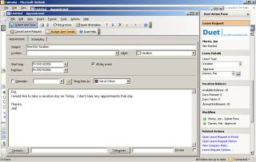
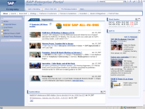
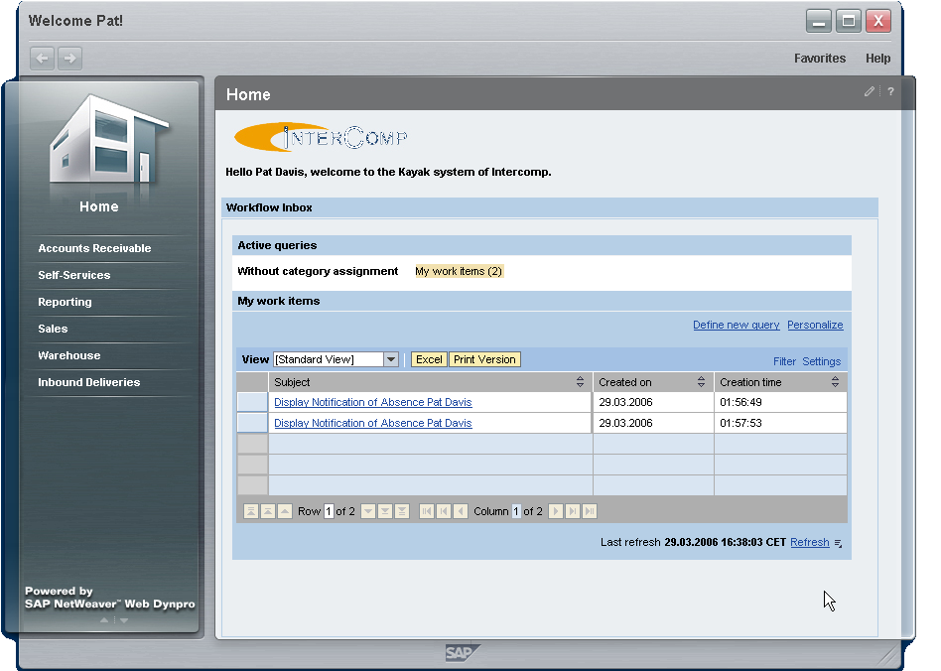

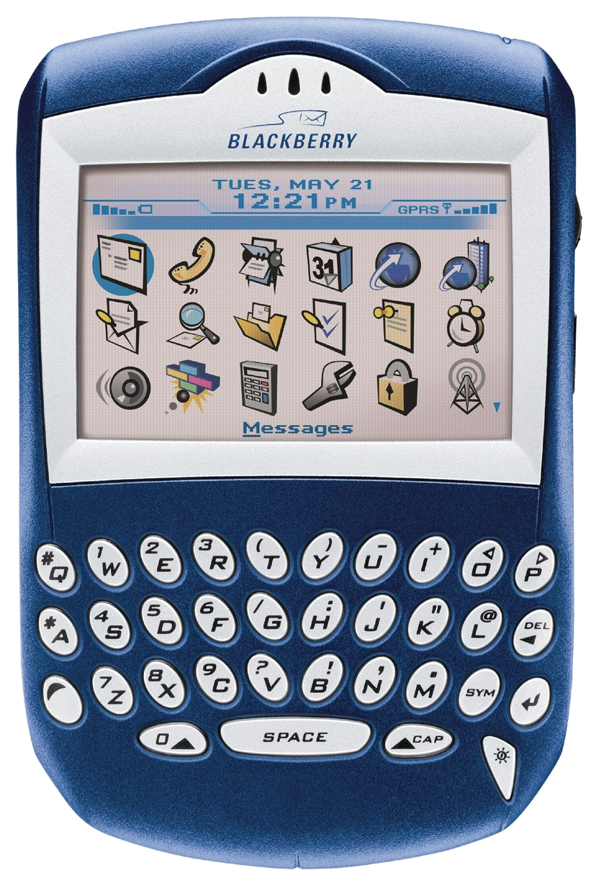
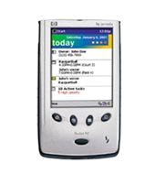
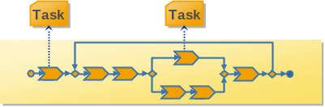
User Interface (UI)
“Big Picture” for the Next 3 Years
Clients
Office
Portal
(Ajax Client)
Business
Client
Mobile
Devices
Runtime
Authoring
Orchestration of Process Steps,
loosely integrated UIs, Tasks & Events
Support for
User Centric
Services
Core Portal
Services
Search
Messaging
Events & Tasks
Documents
Context
Collaboration
User Centric
Processes &
Collaboration
Roles
Work Centers
Control Centers
Navigation
Page Building &
Mashups
iViews
Federation
Personalization
Core
Portal
Services
Portal
Modeling
VC, WTP and SAP tools
in Eclipse
UI Modeling
mySAP Solution (ERP)
UI Building Blocks &
tightly integrated UI Composition
Web Dynpro ABAP
Dynpro
Web Dynpro Java
Local Objects &
Services
Java
Standards
Next Generation
Controller
ABAP Workbench
Services
Enterprise
Services
Business
Object
Objects
Web
Services
AP
Composite Logic

