Slide 1
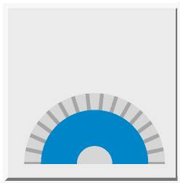
DFS60 – Programming Interface
Incremental
Encoder
SICK Inc
Encoders

Slide 2
DFS60 – Programming via Interface
Content
Start up - Timing Encoder Programming Page 3
RS485 Protocol Page 4
Explanation Response time Page 5
Command: 53h Encoder Reset Page 6
Command 56h Read Serial number, Firmware version / date Page 7
Command: 92h Read Position Page 8
Command: 96h Set Number of lines Page 9
Command: 97h Set Electrical Interface Page 10
Command: 98h Set Zero pulse width electrical Page 11
Command: 99h Zero-Set function Page 12
Command: 9Ah Read Encoder type Page 13
Command: 9Bh Set Zero pulse width mechanical Page 14
Command: 9Ch Read Zero pulse width electrical / mechanical Page 15
Command: 9Dh Read Electrical Interface Page 16

Slide 3
DFS60 – Programming via Interface
Start up - Timing Encoder Programming
Power on
Reset
53h
Initialization 20ms
Command?
yes
no
T>10ms?
Standard Encoder mode
Command?
no
Command execution
Answer

Slide 4
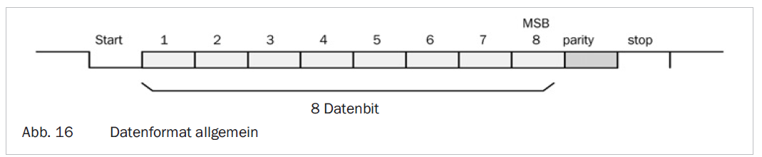
DFS60 – Programming via Interface
RS485 protocol
Asynchronous Interface with following format:
  1 start bit
  8 data bit (LSB first)
  1 Stop bit
  Parity even (if sum of data is even)
  Baud rate: 115200
8 Data bits
Data format general

Slide 5
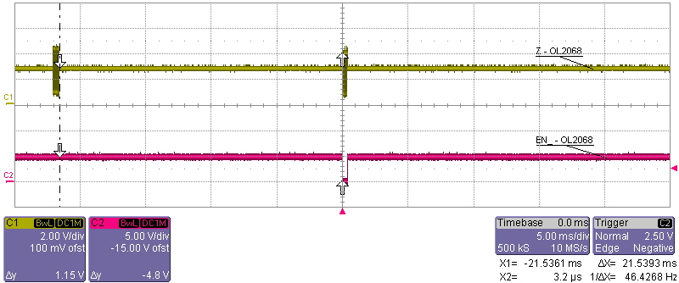
DFS60 – Programming via Interface
Explanation Response time at Command „97h – Set Electrical Interface“
Command/
Answer:
Response time = 21,5 ms
The answering time depends on the number of data during saving to the EEPROM
Details you can find at every listed command

Slide 6
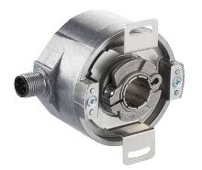
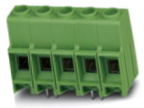
DFS60 – Programming via Interface
Command: 53h Encoder Reset
o.k.
Command 53h: “Encoder Reset“
Drive
Address
Command
Check sum
40h
53h
13h
No answer
Check sum is an EXOR – function of the transmitted bytes
Example: 40h ⊗ 99h ⊗ 69h => B0h

Slide 7
DFS60 – Programming via Interface
Command: 56h Read Serial number, Firmware version / date
o.k.
Command 56h: “Read Serial number, Firmware version / date”
Drive
Address
Command
Check sum
40h
56h
16h
Answer
Address
Command
Serial number
Firmware version
Firmware date
Check sum
40h
56h
9 Byte ASCII
10 Byte ASCII
8 Byte ASCII
xxh
Response time:
2,7 ms
Explanation:
Serial number unused?
Firmware version DFS60AV07_
Firmware date 26.11.10 (dd.mm.yy)

Slide 8
DFS60 – Programming via Interface
Command: 92h Read Position
o.k.
Command 92h: “Read Position“
Drive
Address
Command
Format
Check sum
40h
92h
21h
F3h
Answer
Address
Command
Pos_HH
Pos_HL
Pos_LH
Pos_LL
Check sum
40h
92h
xxh
xxh
xxh
xxh
xxh
Response time:
665 µs (mechanical zero pulse width)
1,46 … 2,58 ms (electrical zero pulse width)
Response time depends on the number of lines
Calculation response time:
1,46 ms + INTEGER (ln (Number of lines / ln (2)) x 0,07 ms)

Slide 9
DFS60 – Programming via Interface
Command: 96h - „Set number of lines“
o.k.
Command 96h: “Set number of lines“
Drive
Address
Command
Byte 0
Byte 1
Byte 2
Access code
Check sum
40h
96h
xxh
xxh
xxh
69h
xxh
Answer
Address
Command
Check sum
40h
96h
D6h
Response time:
129 ms
Explanation:
Number of lines: 65536 (d) = 010000 (h)
Byte 0 = 01
Byte 1 = 00
Byte 2 = 00

Slide 10
DFS60 – Programming via Interface
Command: 97h - „Set electrical Interface“
o.k.
Command 97h: “Set electrical interface“
Drive
Address
Command
Mode
Access code
Check sum
40h
97h
xxh
69h
xxh
Answer
Address
Command
Check sum
40h
97h
D7h
Response time:
21,5 ms
Explanation:
Mode xxxx xxx0 = TTL
xxxx xxx1 = HTL

Slide 11
DFS60 – Programming via Interface
Command: 98h - Set Zero pulse width electrical
o.k.
Command 98h: “Set zero pulse width electrical“
Drive
Address
Command
Mode
Access code
Check sum
40h
98h
xxh
69h
xxh
Answer
Address
Command
Check sum
40h
98h
D8h
Response time:
63,5 ms
Explanation:
Mode: xxxx xxx0 = 90° gated with channel A and B
xxxx xxx1 = 180° gated with channel B
xxxx xx10 = 180° gated with channel A
xxxx xx11 = 270° gated with channel A and B
⇒ Details see data sheet

Slide 12
DFS60 – Programming via Interface
Command: 99h - Zero - Set function
o.k.
Command 99h: “Zero – Set function“
Drive
Address
Command
Access code
Check sum
40h
99h
69h
B0h
Answer
Address
Command
Check sum
40h
99h
D9h
Response time:
776 µs

Slide 13
DFS60 – Programming via Interface
Command: 9Ah - Read Encoder type
o.k.
Command 9Ah: “Read Encoder type“
Drive
Address
Command
Check sum
40h
9Ah
DAh
Answer
Address
Command
Part number
Encoder type
Date code
Resolution
Check sum
40h
9Ah
16 Byte ASCII
7 Byte ASCII
8 Byte ASCII
xx xx xxh
xxh
Response time:
7,28 ms
Example:
Part number: 1051361
Encoder type: DFS60A-BHZA0-S01
Date code: 1011-0621 (yyww – count number)
Resolution: 01 00 00 (65536)

Slide 14
DFS60 – Programming via Interface
Command: 9Bh - „Set Zero pulse width mechanical“
o.k.
Command 9Bh: “Set Zero pulse width mechanical“
Drive
Address
Command
Byte 0
Byte 1
Access code
Check sum
40h
9Bh
xxh
xxh
69h
xxh
Answer
Address
Command
Check sum
40h
9Bh
DBh
Response time:
65,6 ms
Example: Byte 0, Byte 1
00 2D (45) ⇒ 45°
01 0E (270) ⇒ 270°

Slide 15
DFS60 – Programming via Interface
Command: 9Ch - „Read Zero pulse width electrical / mechanical“
o.k.
Command 9Ch: “Read Zero pulse width electrical / mechanical“
Drive
Address
Command
Check sum
40h
9Ch
DCh
Answer
Address
Command
Byte 0
Byte 1
Check sum
40h
9Ch
xxh
xxh
xxh
Response time:
1,2 ms
Example: Byte 0, Byte 1
00 01 (1) –
01 67 (359) ⇒ zero pulse width mechanical
02 00 (512) ⇒ 90° gated with channel A and B
02 01 (513) ⇒ 180° gated with channel B
02 02 (514) ⇒ 180° gated with channel A
02 03 (515) ⇒ 270° gated with channel A and B
------------------------------------------------
zero pulse width electrical

Slide 16
DFS60 – Programming via Interface
Command: 9Dh - „Read Electrical Interface“
o.k.
Command 9Dh: “Read Electrical Interface“
Drive
Address
Command
Check sum
40h
9Dh
DDh
Answer
Address
Command
Mode
Check sum
40h
9Dh
xxh
xxh
Response time:
1,1 ms
Explanation:
Mode
xxxx xxx0: TTL
xxxx xxx1: HTL

Slide 17

Thank you for your attention!

