Slide 1
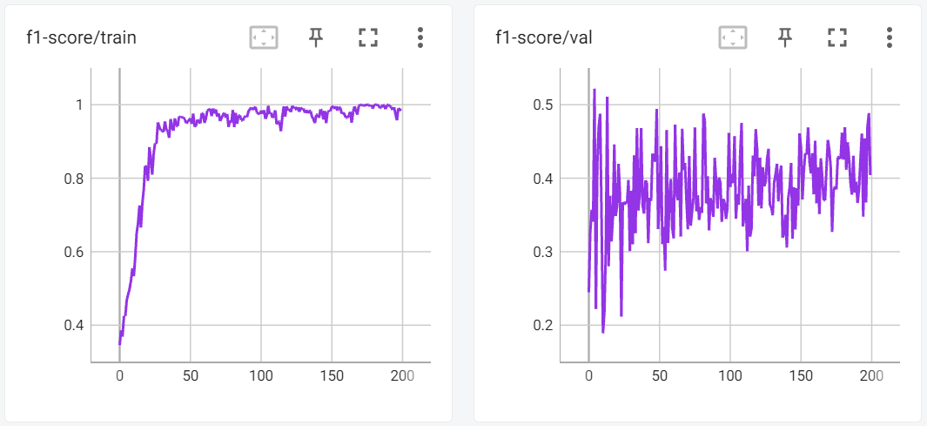
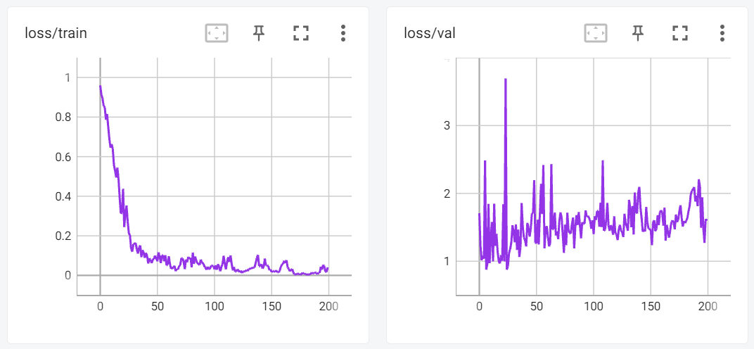
ResNet-101을 baseline model로 사용하였다.
lr : 0.00005
batch size : 16
Adam optimizer
ReLu actvation fn

Slide 2
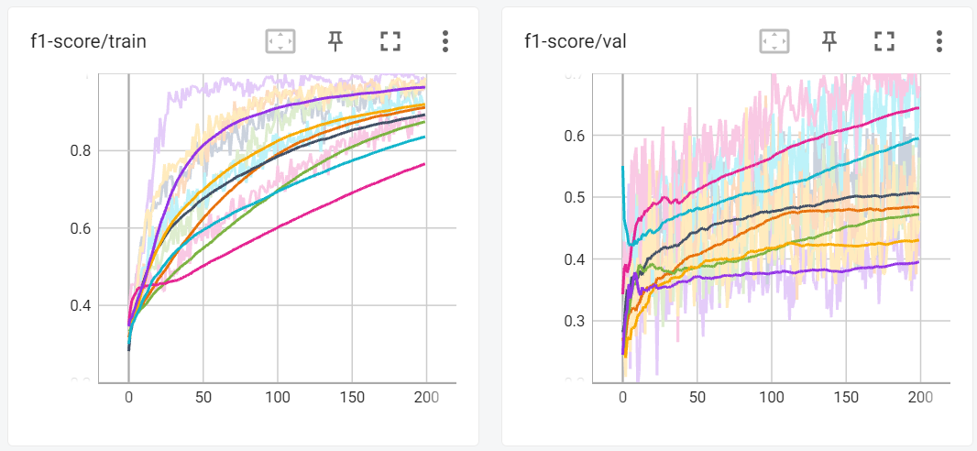
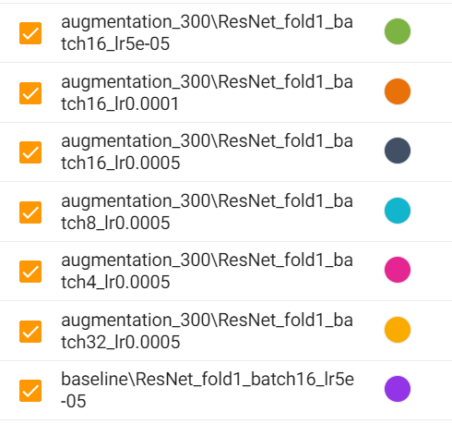
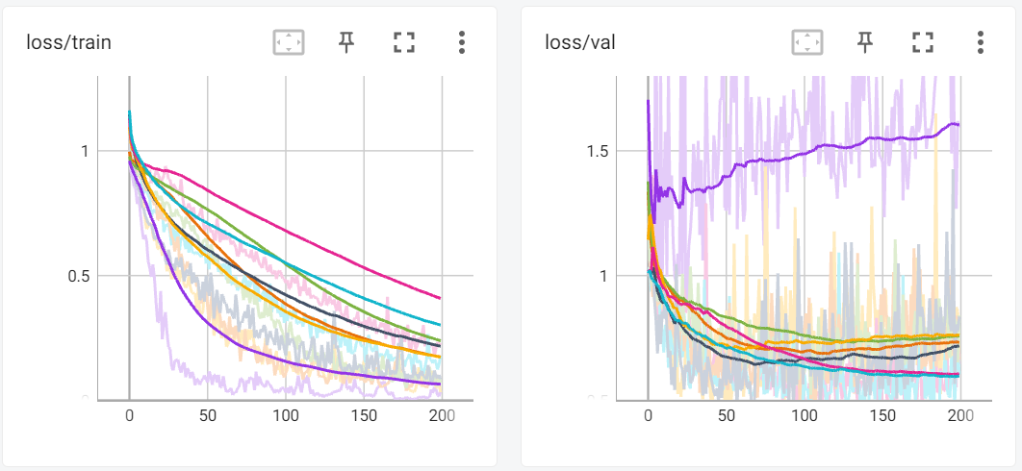
Data-augmentation

Slide 3
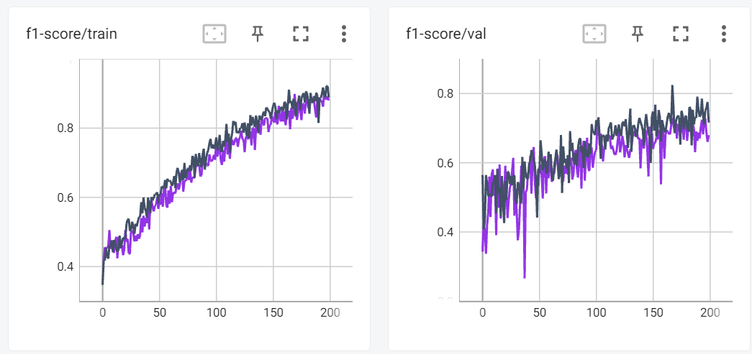
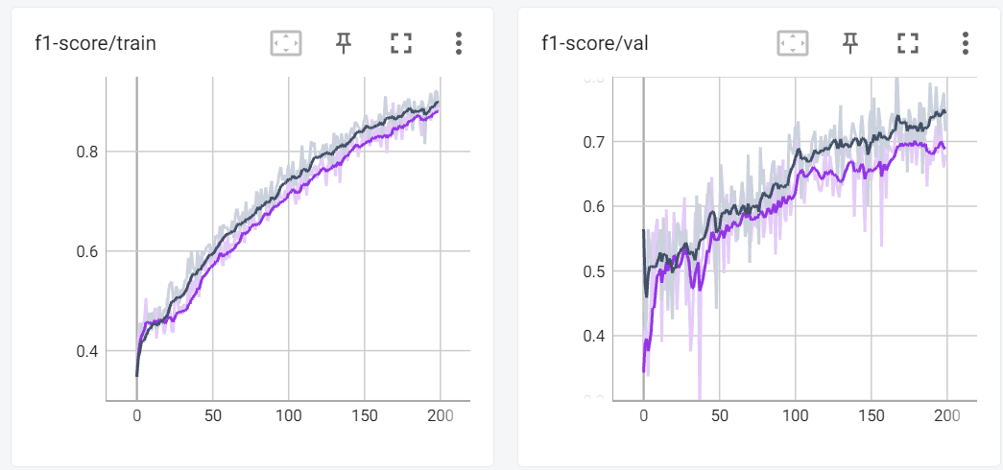
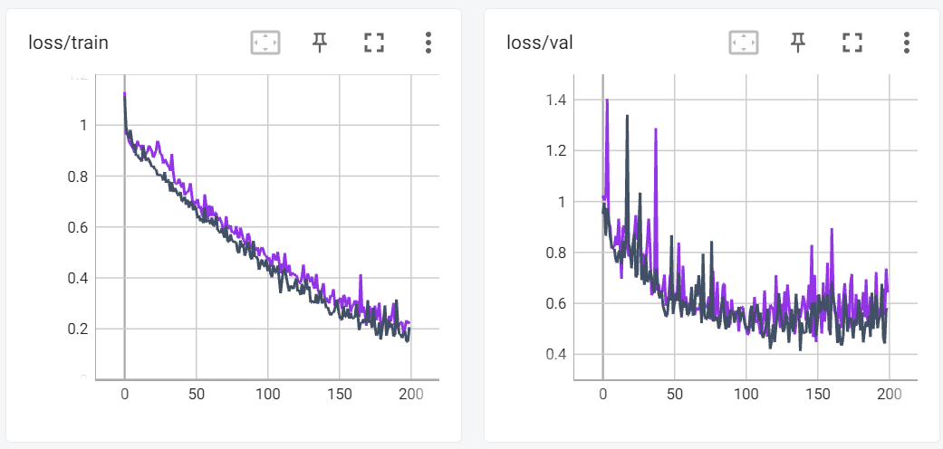
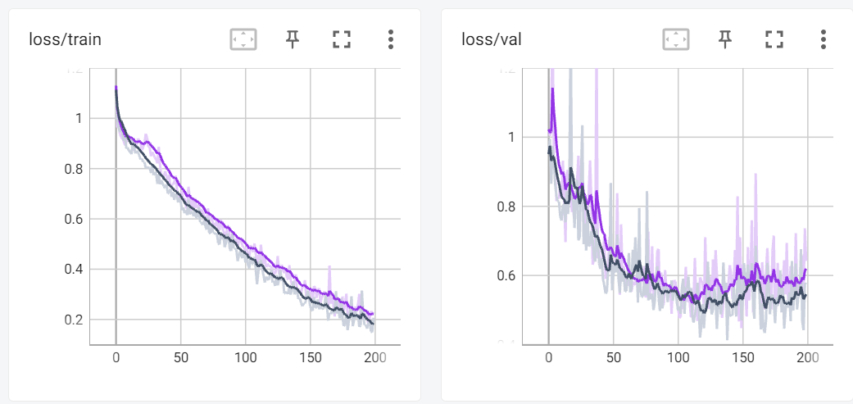
Xavier vs Kaiming

Slide 4
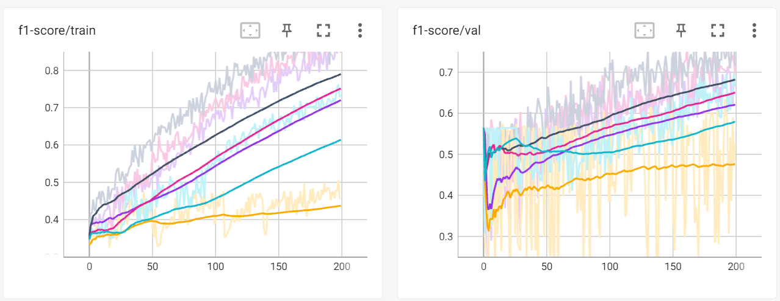
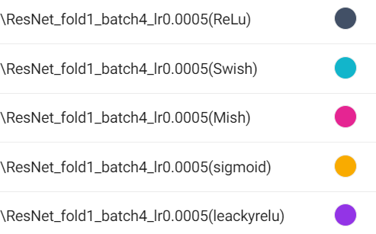
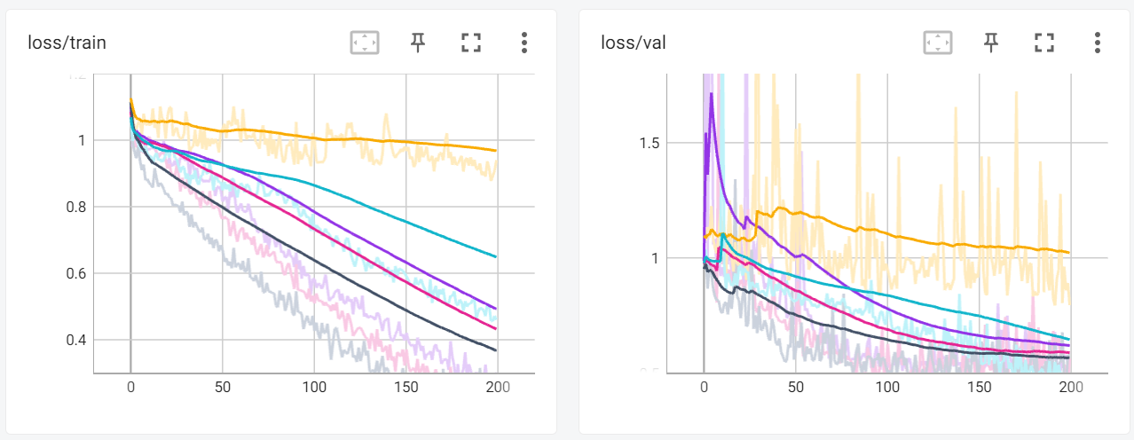
Activation Fn

Slide 5
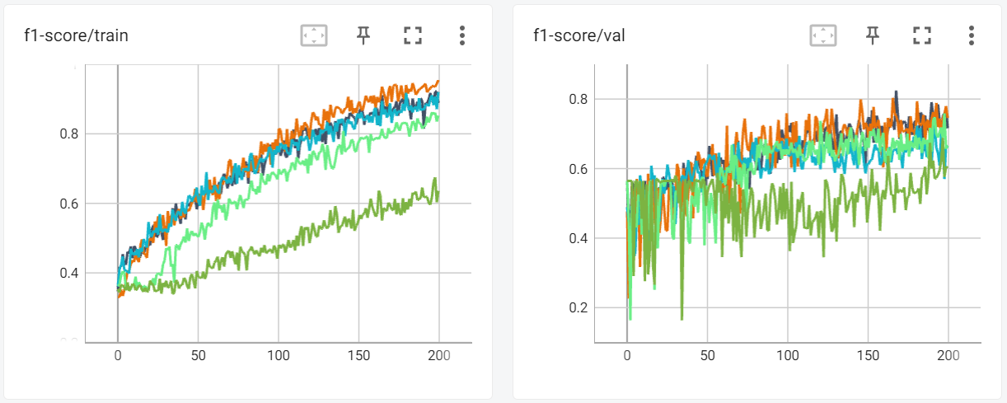
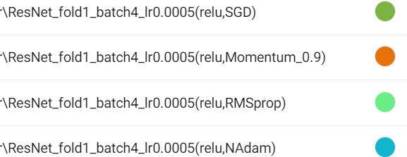
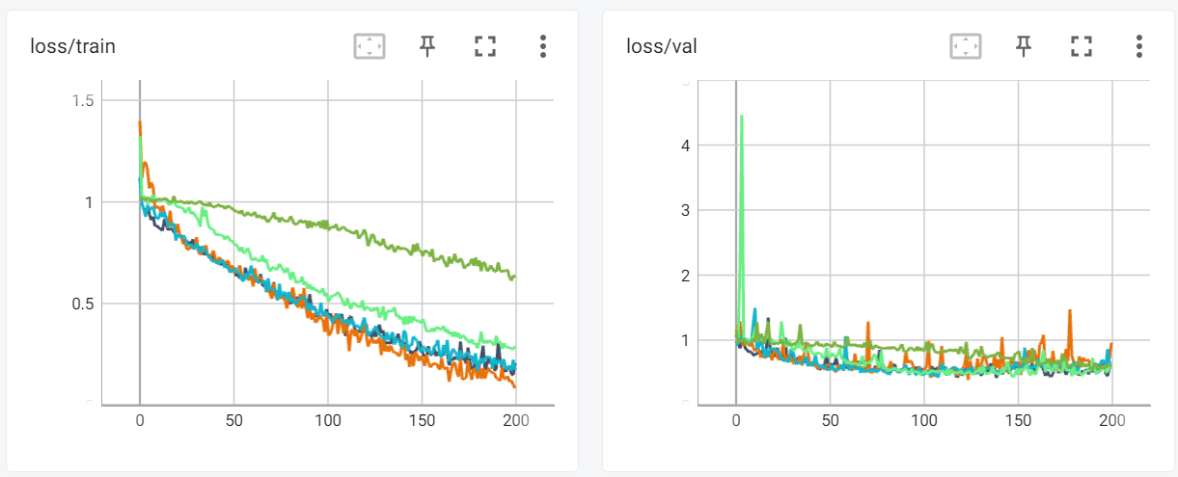
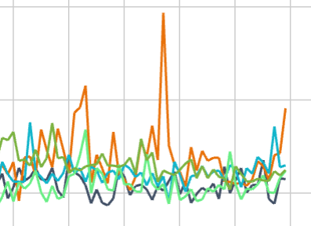
Optimizer
(Adam)

Slide 6
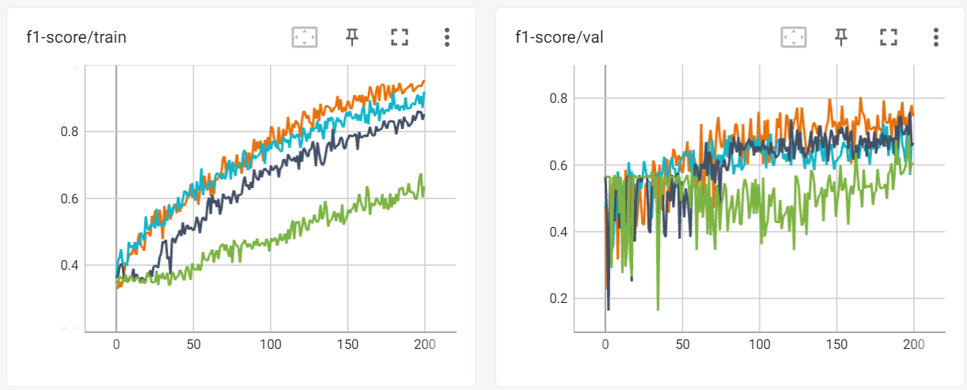
Xavier vs Kaiming

Slide 7
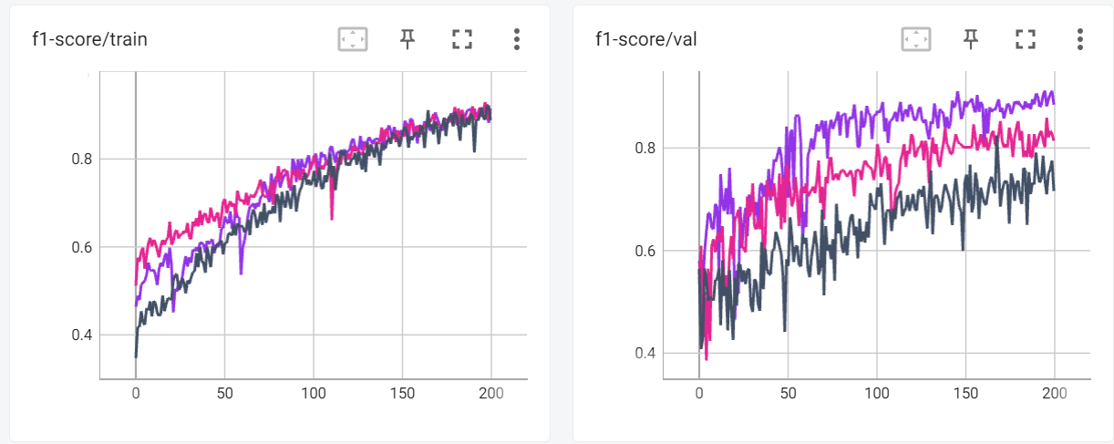



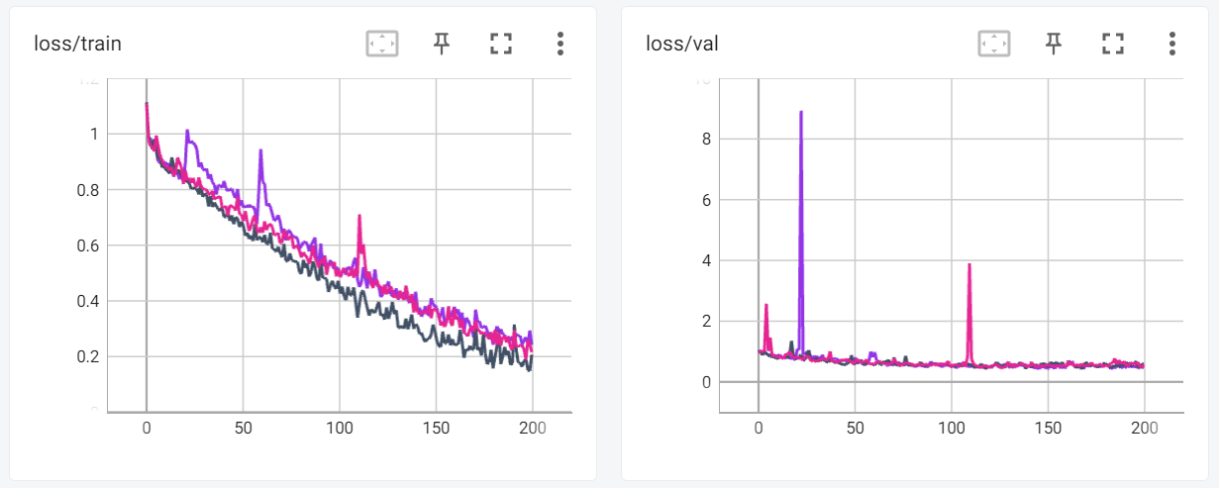
평균방법
Macro Metrics
Micro Metrics
Weighted Metrics

Slide 8
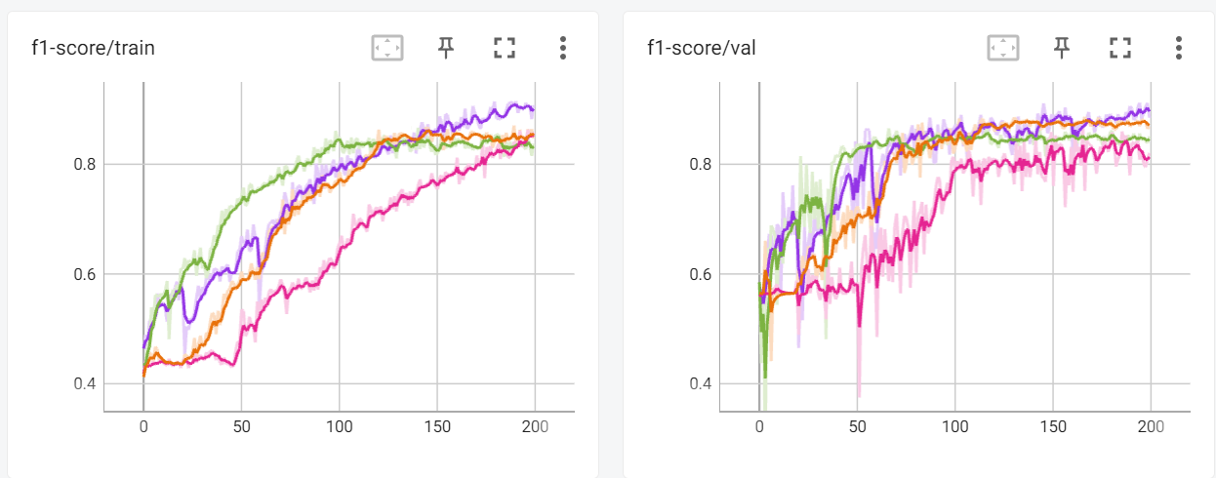
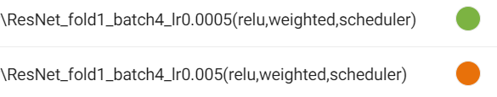
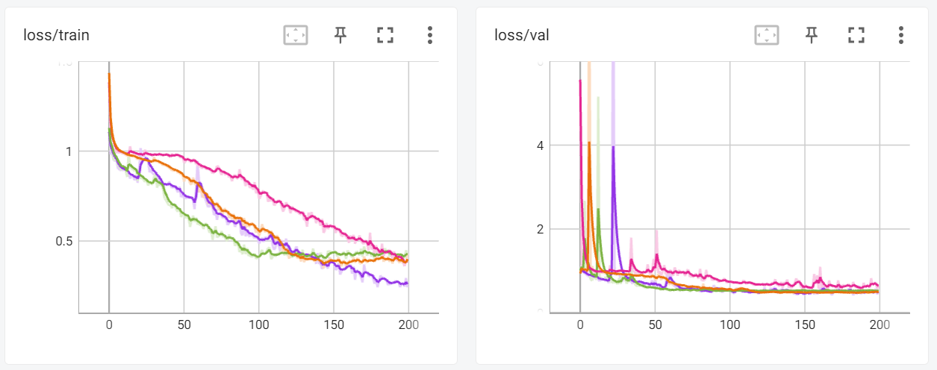
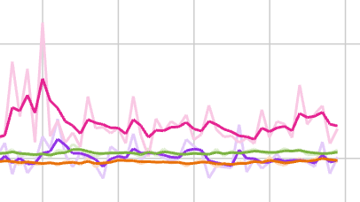
scheduler

Slide 9
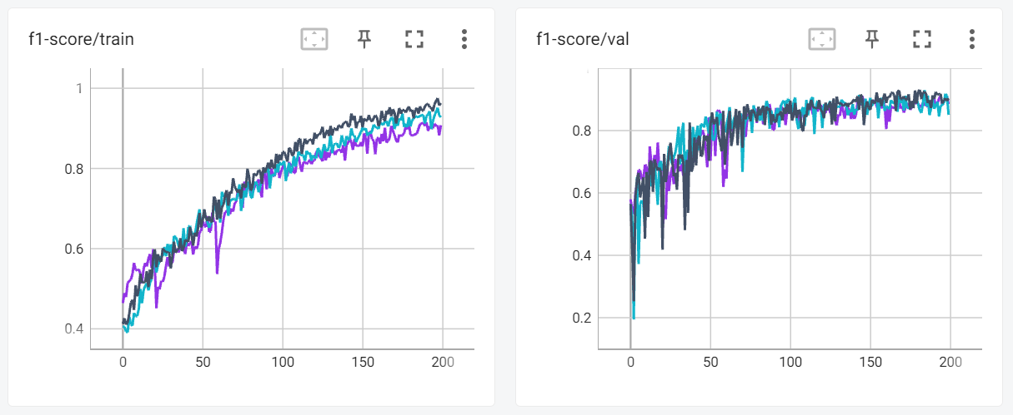


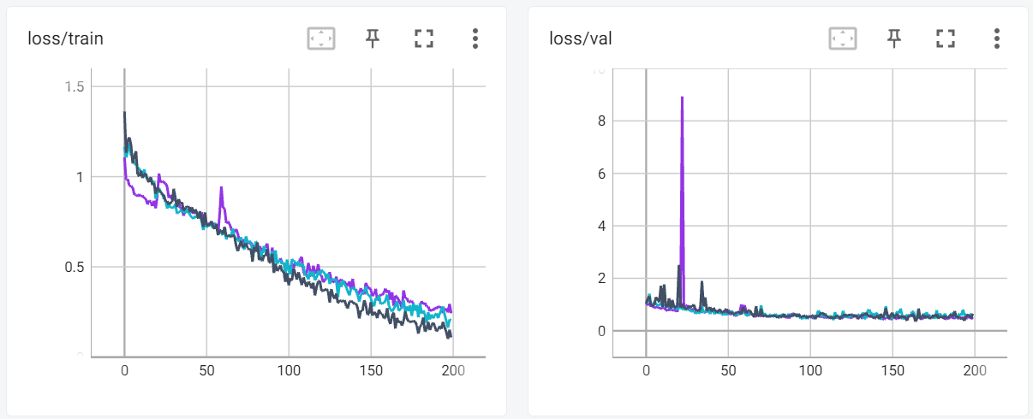
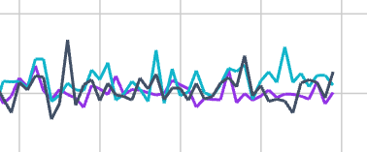
Adam vs momentum
Adam
Momentum 0.9
Momentum 0.8

Slide 10
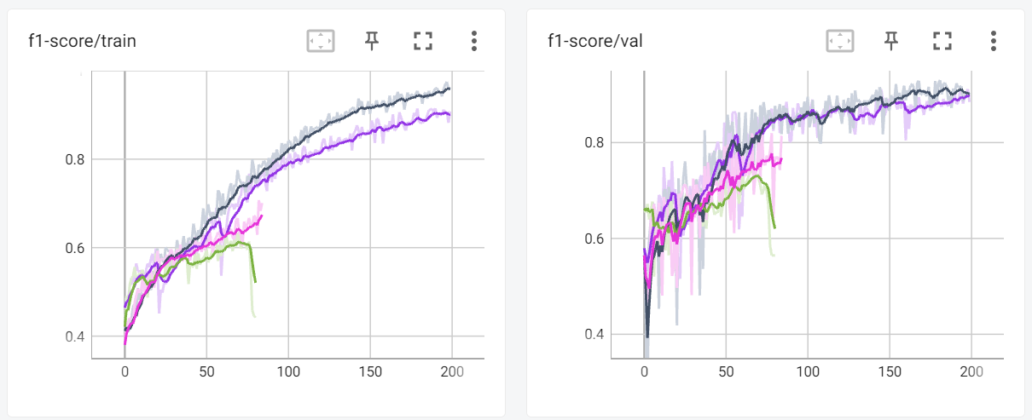


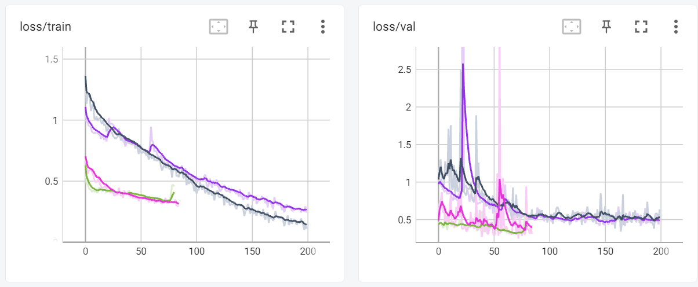
CrossEntropyLoss vs MultiMarginLoss
CrossEntropyLoss(Adam)
CrossEntropyLoss(Momentum)
MultiMarginLoss(Momentum 0.9)
MultiMarginLoss(Adam)

Slide 11
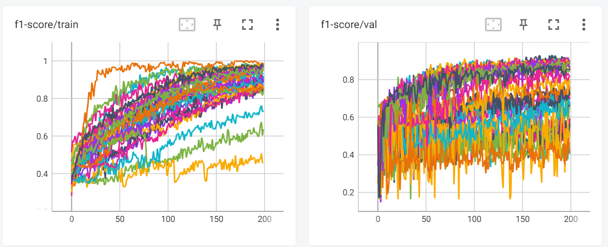
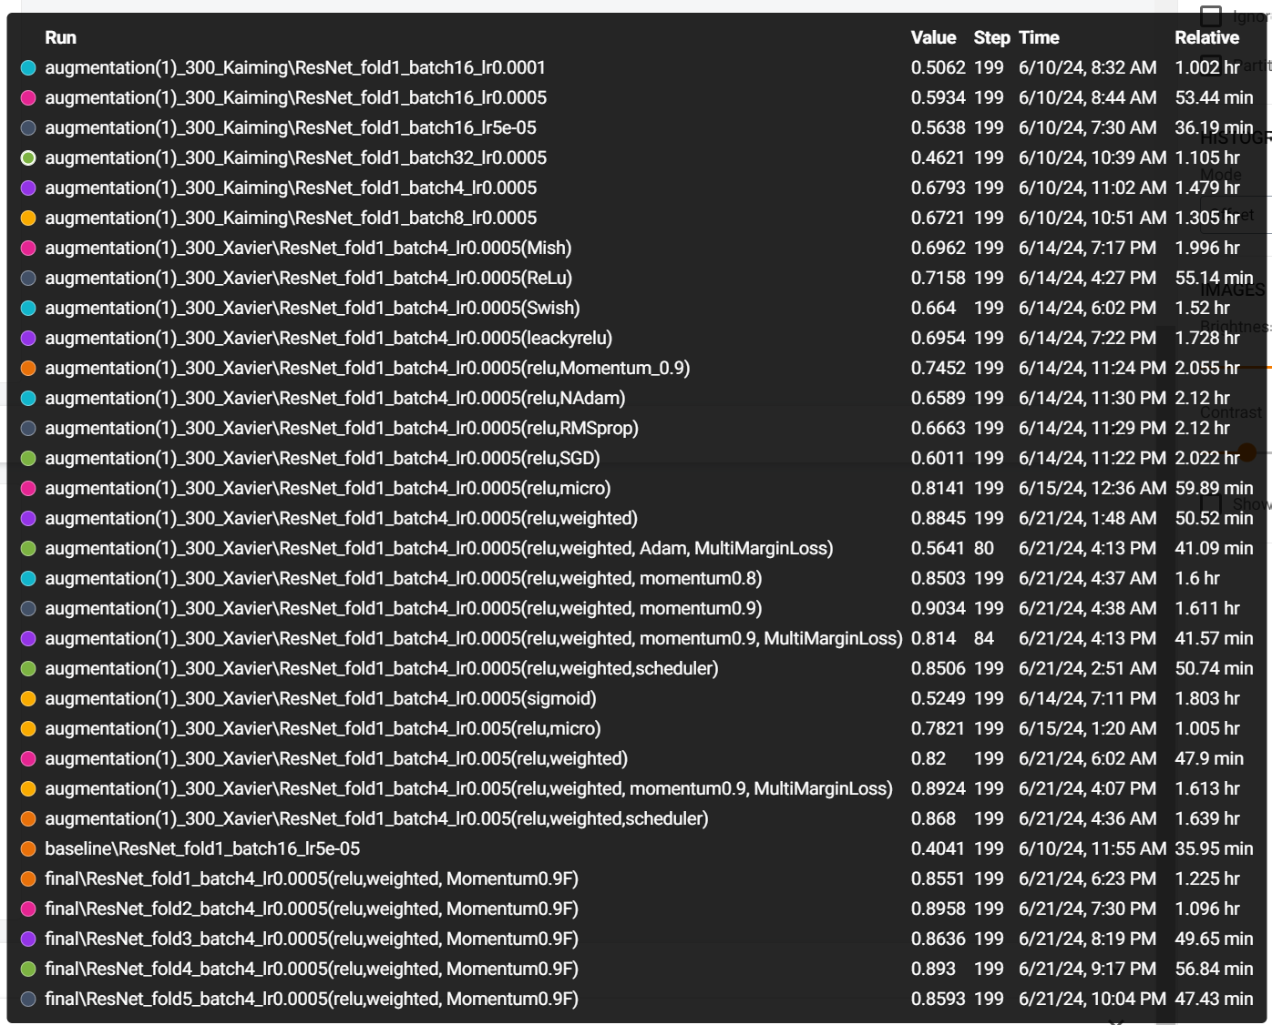
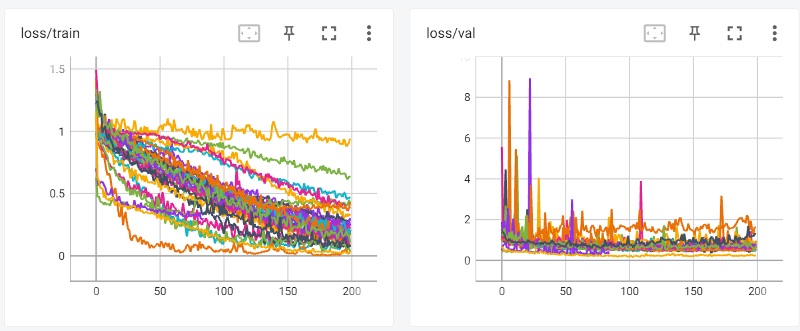
CrossEntropyLoss vs MultiMarginLoss

Slide 12
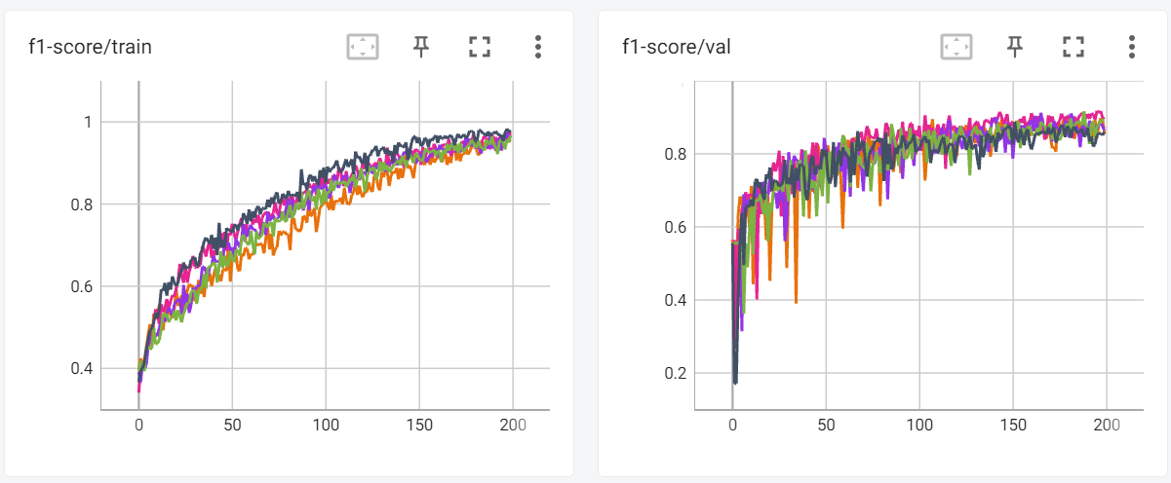
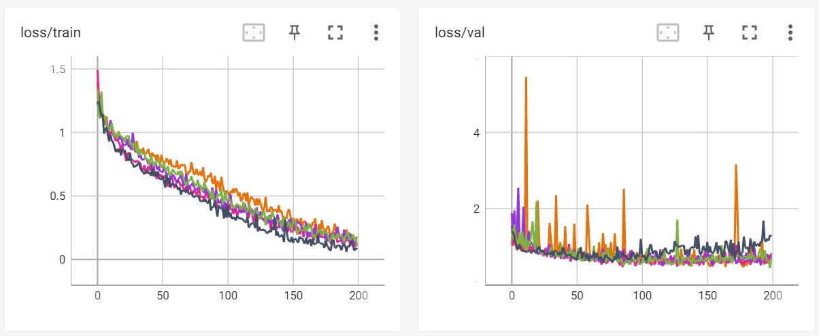
CrossEntropyLoss vs MultiMarginLoss
ResNet-101
Batch size : 4
Learning rate : 5e-4
Optimizer : Momentum
Activation function : ReLU
5-fold cross-validation
acc/val - Mean: 0.8538, Standard Deviation: 0.0188
f1-score/val - Mean: 0.9185, Standard Deviation: 0.0097
loss/val - Mean: 0.6575, Standard Deviation: 0.1200
precision/val - Mean: 0.9942, Standard Deviation: 0.0115
recall/val - Mean: 0.8538, Standard Deviation: 0.0188

Slide 13
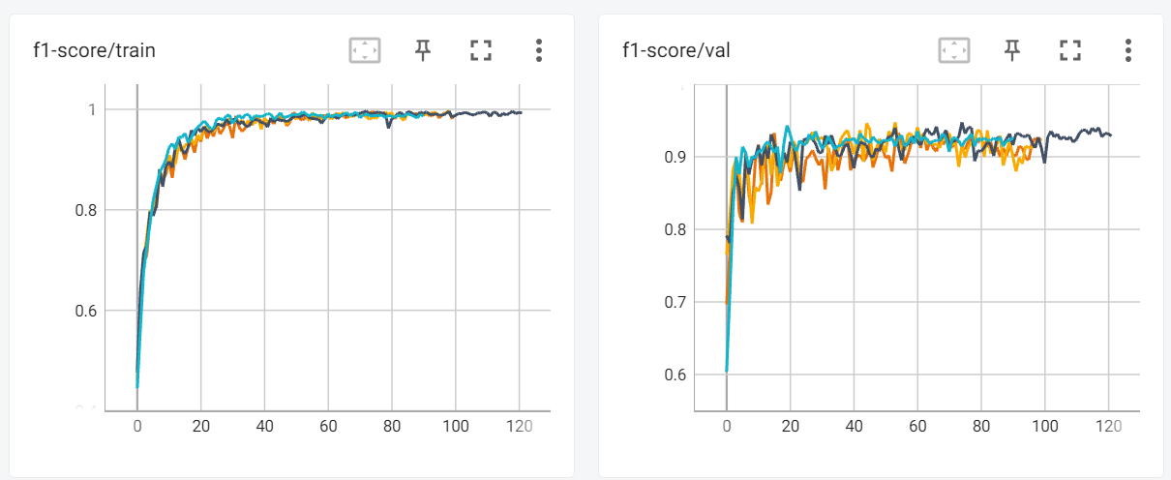
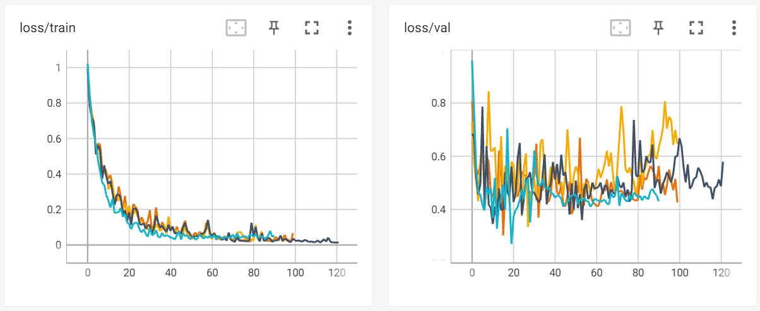
CrossEntropyLoss vs MultiMarginLoss
ResNet-101(Pretrained)
Batch size : 4
Learning rate : 5e-4
Optimizer : Momentum
Activation function : ReLU
5-fold cross-validation
acc/val - Mean: 0.9046, Standard Deviation: 0.0126
f1-score/val - Mean: 0.9498, Standard Deviation: 0.0070
loss/val - Mean: 0.4040, Standard Deviation: 0.0343
precision/val - Mean: 1.0000, Standard Deviation: 0.0000
recall/val - Mean: 0.9046, Standard Deviation: 0.0126

