Slide 1
Ontologies for Open-Ended Web Resources
Jon Corson-Rikert
Mann Library Professional Roundtable
October 9, 2003

Slide 2
Overview
Inspiration
What is an ontology?
Content organization
Vivo
Extensions to Vivo

Slide 3
Inspiration
theBrain
Concept mapping
Impetus
Prototype for Agriculture in the Changing Landscape grant proposal
ABC Ontology

Slide 4
What is an Ontology?
(painfully long version)
Paraphrasing Ontology 101:
A formal explicit description of concepts in a domain of discourse,
with properties of each concept describing various features and attributes of the concepts,
and restrictions on the type/or values of properties for individual concepts.
An ontology together with a set of individual instances of classes constitutes a knowledge base

Slide 5
What is an Ontology?
(condensed)
A set of structured information relationships

Slide 6
Classes vs. Instances
Is an ontology a framework?
  abstract “classes” and “property” relationships that serve as a defined structure for data
Or what populates a framework …
  “instances” fitting within a defined class and property relationship structure
  e.g., to serve as a controlled vocabulary
Similar to the difference between an XML Schema or DTD and an XML data file
  Elements of both schema and data
  RDF has both but confuses the issue by allowing alternative notations

Slide 7
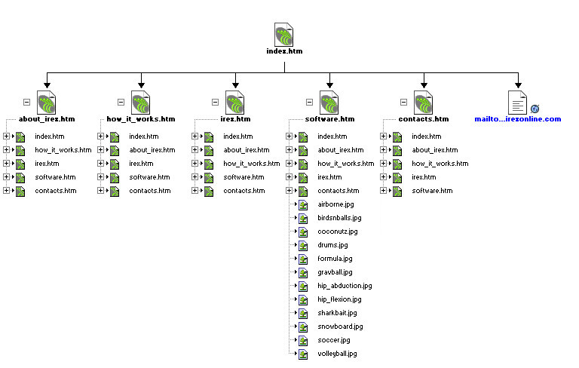
Content Organization
Dreamweaver site map

Slide 8
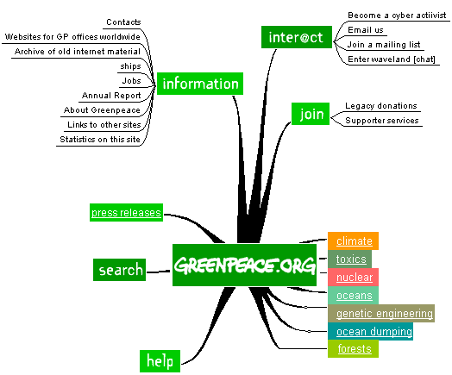
Graphical Sitemap

Slide 9
Repository Organization
(e.g., DSpace)
Communities
East Asia Papers
Physics Theses
BEE Theses
Collections
Dance in the No Theater
MS
PhD
MS
PhD
Items
Item
Item
Item
Item
Item
Item
Item
Item
Item

Slide 10
Item Organization
article
thesis
book
abstract
OCR text
title page
TOC
jacket
TOC
index
chapters
chapters
figure
image
chapters
chapters
chapters
chapters
chapters
chapters
figure
image
Item
Item
Item
figures
Item
pages
figures
pages
pages
pages
pages
pages
pages
pages
PDF
references
bibliography
pages
pages

Slide 11
Item Metadata
title
author
journal
volume
number
title
author
publisher
place
pages
article
thesis
book
title
author
department
degree

Slide 12
Database Organization: CCRP
(Collaborative Crop Research Program)
projects
organizations
people
crops
articles
genes
keywords

Slide 13
Interstitial Tables
projects
role in project
orgs2projects
people2projects
organizations
people
events
orgs2people
people2events
role in org
role in event
security level

Slide 14
Metadata About Tables
projects
organizations
people
crops
title
author
journal
volume
number
articles
genes
keywords

Slide 15
Motivation for Vivo
From the charge to the Life Sciences Working Group, November 2002
  Collate the existing library services to Life Science Initiative ‘members’, and (as quickly as possible) create a web site that identifies our services, targeted to their needs.
“Our library” for a community vs. MyLibrary for an individual

Slide 16
New Life Science Initiative Needs
Genomics curriculum
  No place now to find all courses
  No way to group or sequence courses
Keeping track of genomics technologies
  What services and equipment are available where
  What must be outsourced
  Common terminology
  Usage recommendations
Faculty and grad student recruitment
  Hard to understand the breadth and depth of Cornell
Finding research collaborators across disciplines

Slide 17
Vivo
http://vivo.library.cornell.edu

Slide 18
Design Principles
Uniformity
  Name
  Type
  URL
  Description
Context
Relationships

Slide 19
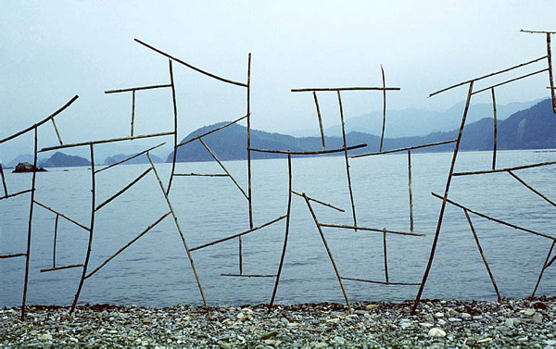
Mental Model of Vivo
Andy Goldsworthy

Slide 20
Growing Vivo
something
new?
yes
add new type
no
add new entity
new
relationship?
yes
add new relationship
no
add new instance

Slide 21
Vivo Editing
http://vivo.library.cornell.edu
(Note that editing is not publicly accessible)

Slide 22
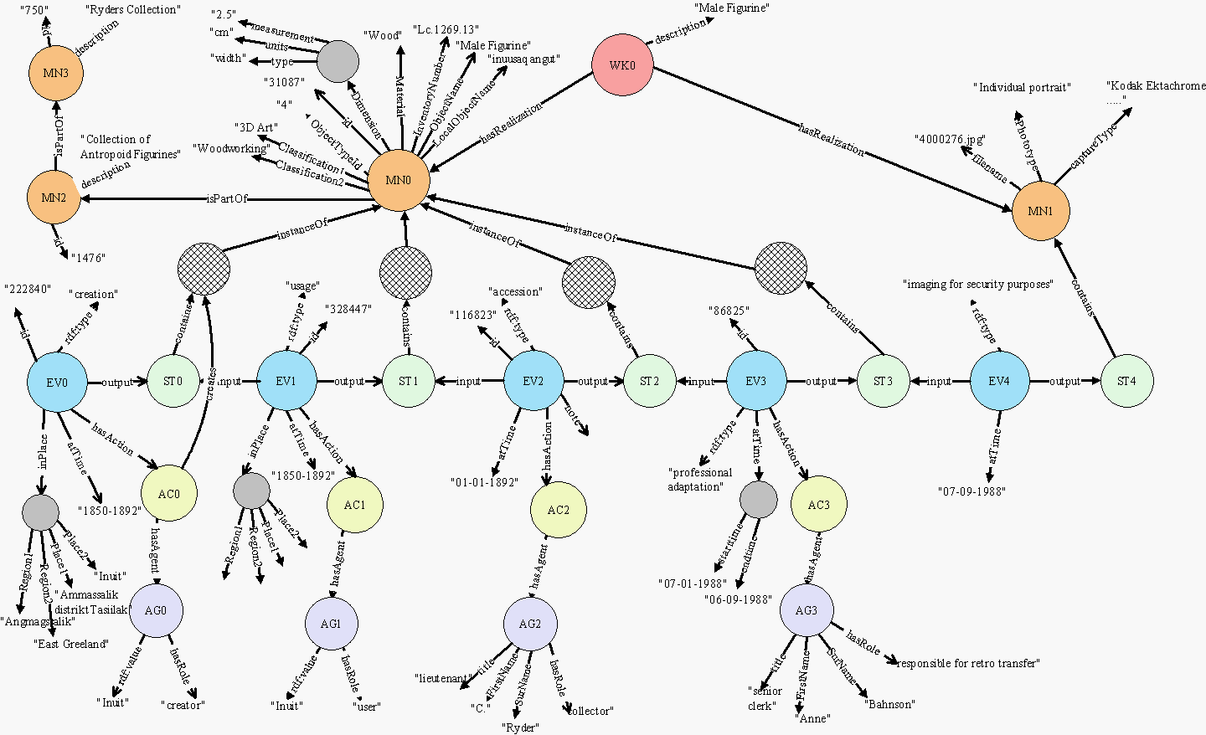
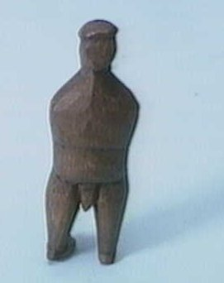
ABC Ontology

Slide 23
ABC Ontology Classes
entity
abstraction
actuality
temporality
work
agent
artifact
action
event
situation
time
place
manifestation
item

Slide 24
Vivo Classes
entity
abstraction
actuality
temporality
work
agent
artifact
action
event
situation
time
place
org
person
manifestation
item

Slide 25
What are Relationships?
Metadata:
Article
has Author
Smith, Jane Q.
RDF triplet:
Resource
propertyType
Value
ABC:
has participant
Action
Agent
is participant in

Slide 26
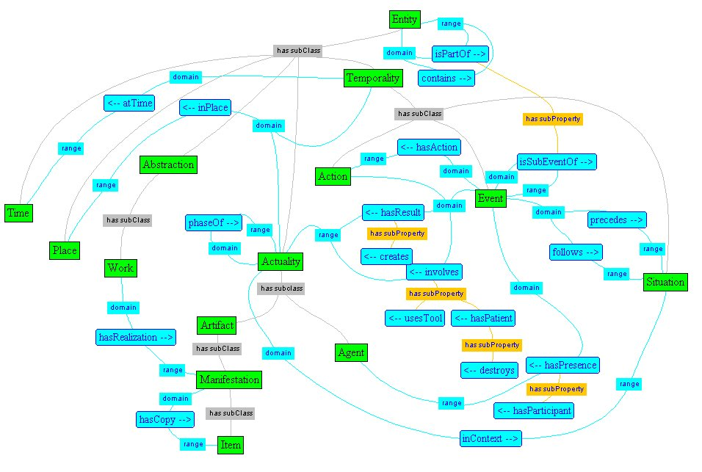
ABC Relationships

Slide 27
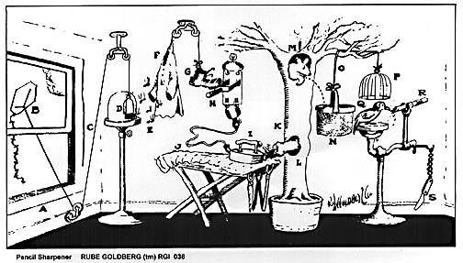
Vivo Relationships

Slide 28
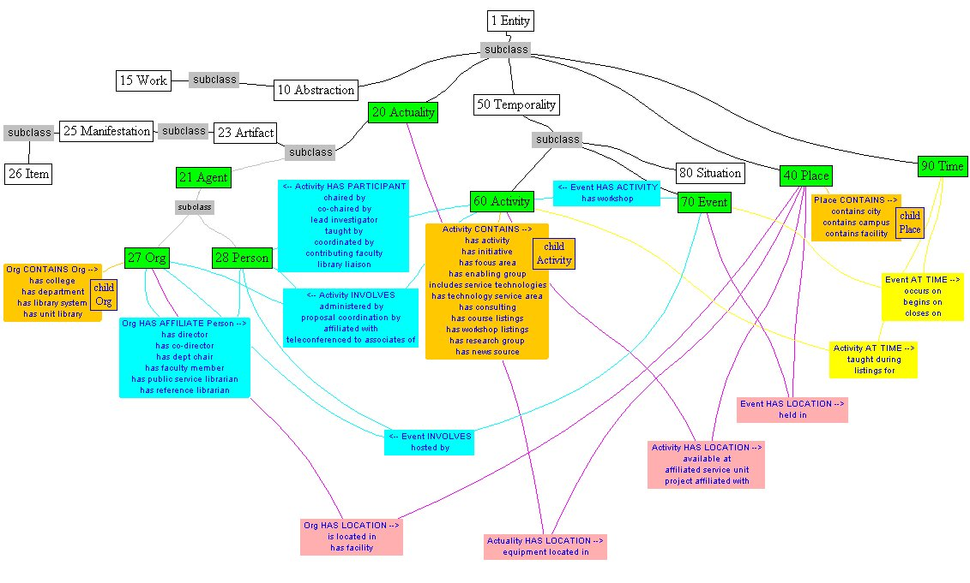
Vivo Relationships

Slide 29
Vivo Entity and its Relationships
University
Relations
department in
Cornell News
Service
has director
has department
Linda
Grace-Kobas
Cornell
Chronicle
has news
releases
Bill Steele
has staff
writers
New Yorkers’ views on biotech foods
Blaine
Friedlander
Pseudomonas syringae sequenced
Roger
Segelken
contact
person
Rapid evolution
Linda
Myers
Tracking FACT through DNA transcription

Slide 30
Class Specialization
class
type
range of monikers
Place
country
state
county
municipality
campus
building
facility
room
{ city
{
academic building
library building
{ lab facility
{
lecture hall
seminar room

Slide 31
Property Specialization
property
applied to class
expressed as
contains
[place] contains [place]
[org] contains [org]
[action] contains [action]
[time] contains [time]
state contains municipality
municipality contains campus
campus contains building
campus contains facility
building contains facility
Affiliated as:
director
co-director
associate director
faculty chair
department chair
librarian
research associate
academic staff
non-academic staff
[org] has affiliated [person]

Slide 32
Matching Types with Properties to Form Relationships
Classes are subdivided into types
Types relate to other types via expressions of Properties
Potential property relationships of one type to another may or may not be expressed
Only allowable choices show up when editing

Slide 33
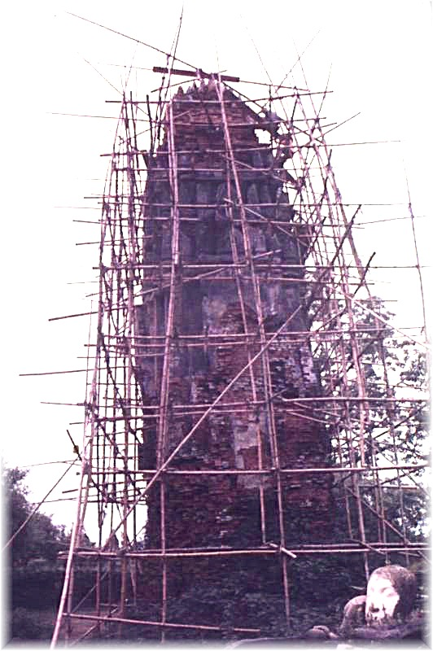
Adaptive Structure
Data are added to the site in response to interest and leads
As more data accumulate in one area, the types and relationships become more clearly differentiated
The curator can add more nuanced types and relationships, in effect adapting the scaffolding to areas of greater loading

Slide 34
Challenges in Creating and Updating Vivo
Any relational model is more complicated to add data to and edit than flat database tables
Vivo has the additional complexity that the desired relationship may not have been “expressed” yet
Adding new types or relationships may require going back to change data entered under previous assumptions
Consistent data entry and editing are essential

Slide 35
The Argument for Curation
Some entry can be streamlined
  Repeatable tasks can be automated
  Scan for missing departments, courses, faculty, labs
But
  Judgment required to set bounds
  Coding must be consistent and meaningful
  Resources referenced should be of high quality
Plus
  The curator learns a lot about Cornell
  Vivo gains real value as an index to local and external resources

Slide 36
Problems We Haven’t Solved
Pruning -- the more content you have, the more there is to go out of date
How do you set bounds gracefully?
One-size-fits-all “entity” may be too limiting
How do we include others as stakeholders?
Can we exceed the normal life expectancy of a website or at least transfer the content forward?

Slide 37
Extending Vivo
Improved searching
  Context-dependent ways to organize results
  Follow with Google search of cornell.edu domain?
  Supplement or refine user search terms via local or remote thesaurus (e.g., MeSH, GO)
Distributed editing
  Start with easy templates -- new seminars
  Work out batch input – Cornell News Service
  Streamline interactive editing

Slide 38
Distributed Knowledge Base
Models for distributed content
  RSS feeds
  uPortal
  Web services
Models for inter-related content
  Reference linking
  RDF mixed types

Slide 39
RDF Mixed Types
<pstcn:relevancy rdf:parseType=“Resource”>
<pstcn:currentStatus>Active</pstcn:currentStatus>
<dcterms:valid>2003-12-01T00:00:00-06:00</dcterms:valid>
<dc:subject>legends</dc:subject>
<dc:subject>giant squid</dc:subject>
<dc:subject>Loch Ness Monster</dc:subject>
<dc:subject>Nessie</dc:subject>
<dcterms:isReferencedBy rdf:resource=“http://www.pibburns.com/cryptozo.htm” />
<dcterms:references rdf:resource=“http://www.nrcc.utmb.edu” />
</pstcn:relevancy>
from Practical RDF, by Shelley Powers

Slide 40
Incremental Steps
Link Vivo types to more universal type definitions – e.g., DC
Link Vivo content to definitive URLs
Enable incoming links to Vivo entities by keeping ids stable
  Vivo can display its record or pass incoming queries directly through to referred resource
  Akin to the SODA bucket model used in CUGIR

Slide 41
Searching via Properties
Bi-directional metadata
  Tomato has pest _____
  _____ is pest of Tomato
Search for backlinks:
  Tomato database queried for pest information
  Tomato database has no pests but knows about pest database
  Sub-search queries pest database for anything that “is pest of tomato”
  Results returned as if from original query

Slide 42
Is Vivo a Good Approach?
Why don’t we just make more and better metadata?
  Or is Vivo just a form of enhanced metadata?
Can we develop extensions to connect with other library and external resources?
  Where we are adding real value, yes
  We have to.
Can we sustain it?
  If we keep our eyes open to best practices elsewhere
  Look for more ways to foster distributed, collaborative interoperability

Slide 43
References
“Ontology Development 101: A Guide to Creating Your First Ontology”, Natalya F. Noy and Deborah L. McGuinness, Stanford Knowledge Systems Laboratory Technical Report KSL-01-05 and Stanford Medical Informatics Technical Report SMI-2001-0880, March 2001
http://www.ksl.stanford.edu/people/dlm/papers/ontology101/ontology101-noy-mcguinness.html
“The ABC Ontology and Model”, Carl Lagoze and Janet Hunter, Journal of Digital Information, volume 2 issue 2, November, 2001.
http://jodi.ecs.soton.ac.uk/Articles/v02/i02/Lagoze/lagoze-final.pdf
“Metadata for the Web: RDF and the Dublin Core”, Andy Powell, UK Office for Library and Information Networking, University of Bath, 1998.
http://www.ukoln.ac.uk/metadata/presentations/ukolug98/paper/intro.html
“Dublin Core Abstract Model”, Andy Powell, UK Office for Library and Information Networking, University of Bath, 2003.
http://dublincore.org/documents/abstract_model/
Practical RDF, Shelley Powers, O’Reilly & Associates, Sebastopol, CA, 2003.

