Slide 1
ABSTRACT REASONING
BENJAMIN B. FERNANDEZ, Jr.

Slide 2
WHAT IS ABSTRACT REASONING ?
Abstract reasoning is the cognitive ability to analyze information, identify patterns, and solve problems using logic and critical thinking without relying on concrete examples

Slide 3
HOW TO SOLVE ABSTRACT REASONING
Inventory
Rule-Finding
Elimination

Slide 4
Next In Series Questions
Next in Series questions test your ability to identify patterns and predict the next item in a sequence. These questions often involve rotations, colour changes, and other visual patterns.

Slide 5
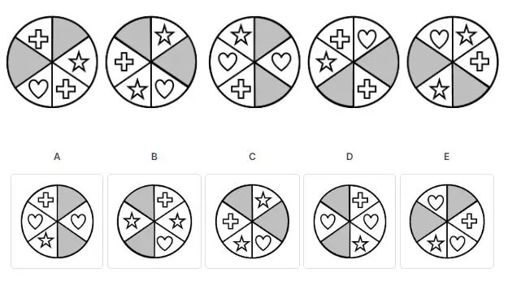
Question 1: Next In Series Questions
Choose the image that completes the pattern (From left to right)

Slide 6
1. Answer: d
Explanation
Each circle is divided into six portions; three pairs of identical shapes are located in opposite cells; the grey pieces rotate clockwise. All the inner parts rotate in a counter-clockwise direction.
Notes:
It is not easy to recognize the presence of the three pairs. However, one can reach the same conclusions using other clues. For instance, one may note that the same couple of shapes appear in the first and fourth items of the sequence, as is the second and fifth items. It is only logical that the next item of the series will include two hearts located in the right and left cells. This reasoning should lead us to narrow the possible answer to options (A) and (D). Figuring out the grey portions' movement pattern leaves us with possible options (B) and (D). Combining these two conclusions, and we're left with choice (D) as the only option to comply with this problem's reasoning.

Slide 7
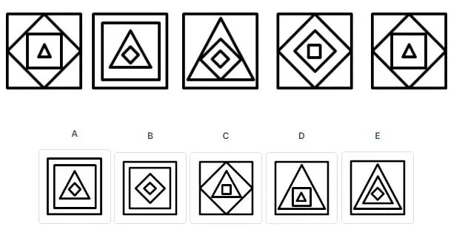
Question 2: Next In Series Questions
2. Choose the image that completes the pattern (From left to right)

Slide 8
2. Answer: a
Explanation
The logic: The inner shape in one frame becomes the middle shape in the next frame; the central form becomes the outer shape in the next frame, and the external form becomes the inner shape two frames later.
Notes:
Thus, the outer shape in the missing frame should be a square (just like the middle shape in the 5th frame), the central form should be a triangle (like the inner shape in the 5th frame), and the internal structure should be a diamond (like the outer shape in the 4th frame).

Slide 9
Matrices Questions
Matrices questions require you to identify patterns both horizontally and vertically. These questions are usually more complex than Next in Series questions because they involve multiple patterns.

Slide 10
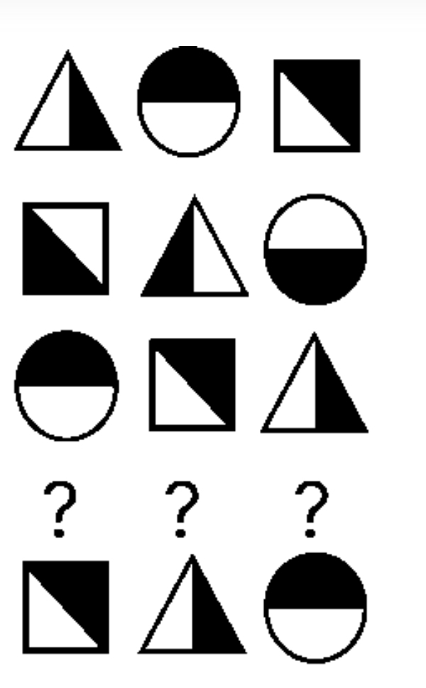
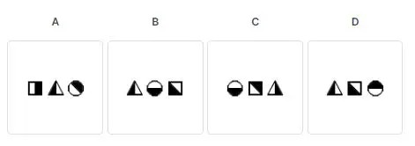
Question 3: Matrices Questions
3. Choose the correct three figures to complete the sequence:

Slide 11
3. Answer: B
Explanation
All shapes move to the right one step each row, where the rightmost shape moves to the leftmost position. Also, for each shape, the blackened half alternates every row. Following this logic, we expect the order of shapes to be, from left to right – a triangle, a circle and a square, with blackened halves similarly as they were in the second row.
Notes:
We can eliminate the answer (A) because it is missing a circle. We can further eliminate answers (B) and (D), because the star is in the wrong position, and the answer (C) because it has the circle in the wrong place.
Therefore, we are left with the answer (E) choice as the only correct solution.

Slide 12
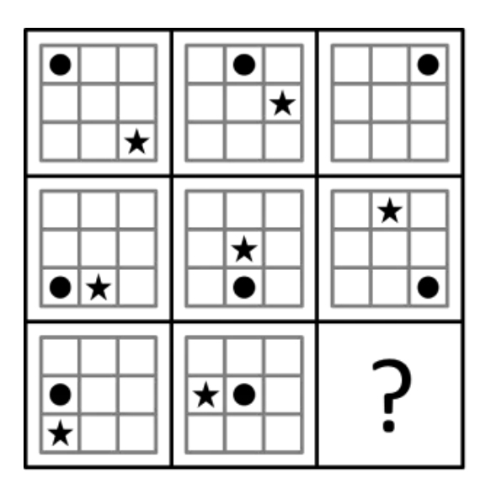
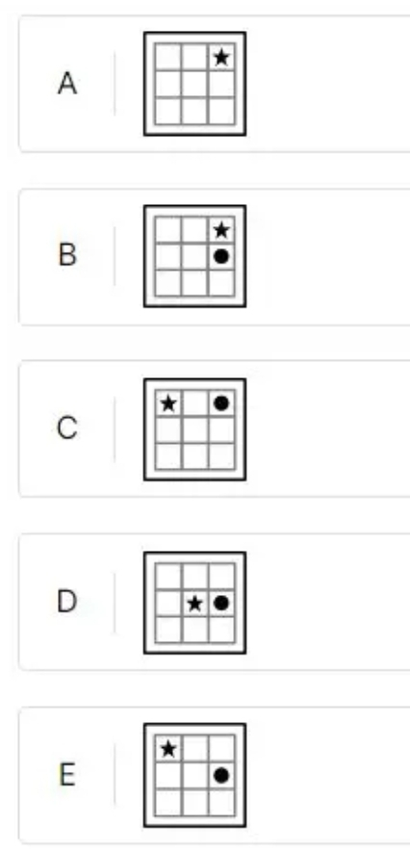
Question 4: Matrices Questions
4. Which of the following boxes should replace the question mark (?) to complete the pattern?

Slide 13
4. Answer: E
Explanation
In this matrix, there are two rules:
The circle: Across a row (from left to right) the circle always remains in the same row but moves one column to the right in each successive frame. Down a column, in each frame, the circle is still in the same row but is in different columns. The star: Across a row (from left to right) the star always remains in the same column but moves up one row in each successive frame. The star forever remains in the same row down a column but moves one column to the left in each succeeding frame. (In the upper-right frame the star and circle end up in the same position and the circle covers the star).
Notes:
We can eliminate the answer (A) because it is missing a circle. We can further eliminate answers (B) and (D), because the star is in the wrong position, and the answer (C) because it has the circle in the wrong place.
Therefore, we are left with the answer (E) choice as the only correct solution.

Slide 14
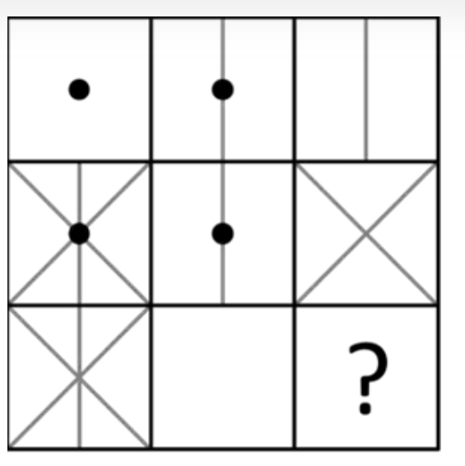
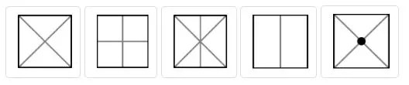
Question 5: Matrices Questions
5. Which of the following boxes should replace the question mark (?) to complete the pattern?
A B C D E

Slide 15
5. Answer: C
Explanation
In this matrix: In each row and column, one of the boxes is the combination of the other two boxes.
The two boxes are different (and do not contain a common element) down the third column. Therefore, the missing box should contain a combination of those two boxes. Notice also, that across the third row if the first box is combined with the second box, which is blank, it would produce a box identical to the first box.
Notes:
We can eliminate the answer (A) because it is missing a circle. We can further eliminate answers (B) and (D), because the star is in the wrong position, and the answer (C) because it has the circle in the wrong place.
Therefore, we are left with the answer (E) choice as the only correct solution.

Slide 16
Odd One Out Questions
Odd One Out questions ask you to identify the figure that does not belong in a set based on logical reasoning.

Slide 17
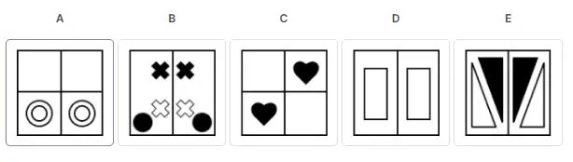
Question 6: Odd One Out Questions
6. Which of the following boxes should replace the question mark (?) to complete the pattern?

Slide 18
6. Answer: C
Explanation
The logic: In all of the options except for option three, a vertical line separates these boxes into two equal, symmetrical halves that mirror one another. If these boxes were pieces of paper that were folded vertically, the items in the boxes would be matching and perfectly identical. The right and left halves are mirror images of one another. This is not the case for option three. In option 3, there is no mirroring effect between the halves. Both hearts have to be on the top or on the box's bottom to be symmetrical.
Notes:
You have probably noticed that the amount, type and colour of items are insignificant features and simply distracters.

Slide 19
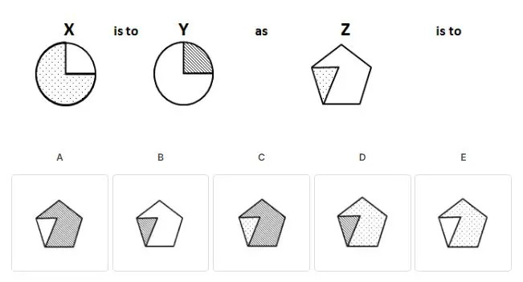
Question 7: Analogies Questions
7. Which option completes the sequence best?

Slide 20
7. Answer: A
Explanation
The relationship between figure X and figure Y is as follows:
Figure Y represents figure X with: 1) The dotted section becoming white, and 2) The white area becoming shaded.
The correct answer must have the same relationship with figure Z.
Notes:
Answer (B) can be eliminated as the blank section remains blank, and the dotted area becomes shaded instead of becoming blank. Answer (C) can be eliminated as the dotted section remains dotted. Answer (D) can be eliminated as the blank section becomes dotted instead of shaded, and the dotted area becomes shaded instead of blank. Answer (E) can be eliminated as the blank section becomes dotted instead of shaded.
We are left with answer 1, which is the correct answer, as it portrays figure Z while the blank section becomes shaded and the dotted area becomes blank.

Slide 21
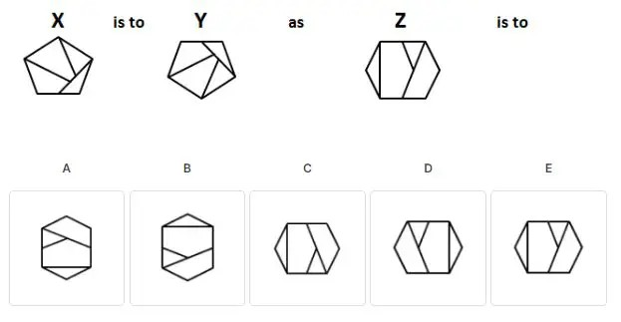
Question 8: Analogies Questions
8. Which option completes the sequence best?

Slide 22
8. Answer: C
Explanation
Figure X and figure Y are as follows: figure Y is figure X flipped vertically.
The correct answer must have the same relationship as figure Z.
You can eliminate answer A, as it represents figure Z rotated 90° counterclockwise. You can eliminate answer B, as it represents figure Z flipped vertically and rotated 90° counterclockwise. You can eliminate answer D, as it represents figure Z flipped horizontally. You can eliminate answer E, as it is identical to figure Z.
You are left with answer 3, which is the correct answer, as it is depicted in figure Z flipped vertically.
Notes:
Visualizing the entire figure flipped vertically can be challenging, breaking figure Z into smaller parts and imagining those parts flipped independently. First, notice the two triangles: the outer triangle on the left-hand side and the inner triangle. If you try to visualize the outer triangle flipped vertically, you will realize it looks the same. Based on this alone, you can already solve the problem. The only two answer choices that show the outer triangle unchanged are answers three and. As stated above, answer five can be eliminated since it is identical to figure Z. If you want to examine further, notice that the inner triangle base in figure Z is on top. In contrast, the triangle 'points down'. If it is then flipped vertically, the ground will be on the bottom while the triangle 'points up'.

Slide 23
ABSTRACT REASONING
Maria isabel r. fernandez

Slide 24
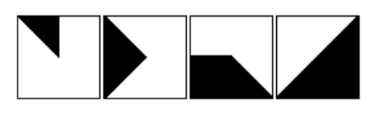
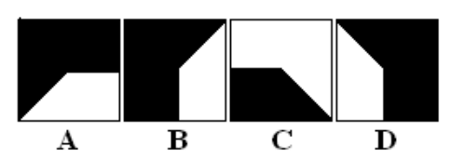
9. PATTERN COMPLETION
The black region moves clockwise around the square’s edges
Track where the dominant black mass sits:
Top-left
Right side
Bottom
Right diagonal / half-square
Next → Left side dominance
Only D places the black mass on the left side, continuing the clockwise edge progression.
Which figure completes the series?
Notes:
1. The black area is increasing in size each step
1st figure: small black triangle
2nd figure: larger arrow-like shape
3rd figure: larger block with diagonal cut
4th figure: largest so far — half the square
👉 So the next figure must be even larger, not smaller.
This immediately eliminates A, B, and C, because they reduce or break the growth pattern.

Slide 25
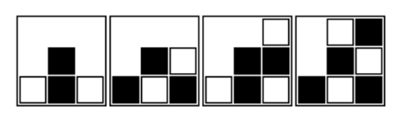
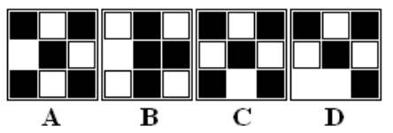
10. PATTERN COMPLETION
The black squares “climb” upward and to the right
The newly added black square follows a path:
It starts from the bottom
Then moves upward
Then continues toward the top-right
Filling available white spaces along that direction
This movement is consistent and directional, not random.
Which figure completes the series?

Slide 26
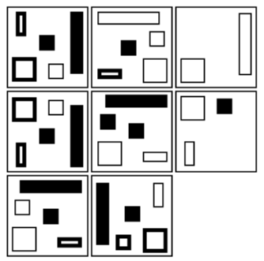
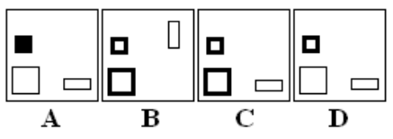
11. PATTERN COMPLETION
“Across each row, everything steps one edge clockwise; down a column, the tiny square toggles filled/outline and the two white shapes swap lanes. Only C satisfies both rules.”
Which figure com-pletes the series?
Notes:
Pwde natin tingnan yung shape na existing sa lahat ng boxes- yung SQUARE
Yung shapes hindi nagrerepeat ng position in the pattern
Why not A, B, or D?
A breaks the clockwise edge progression for at least one bar.
B satisfies part of the edge placement but fails the column toggle/swap for the small shapes.
D gets the toggle closer but misplaces a bar (violates the one‑step clockwise advance in the row).

Slide 27
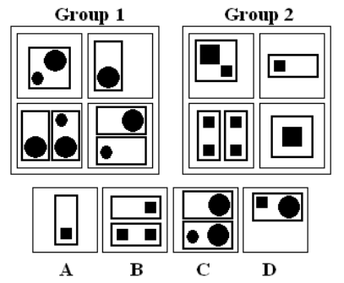
12. Which belongs to neither group?

Slide 28
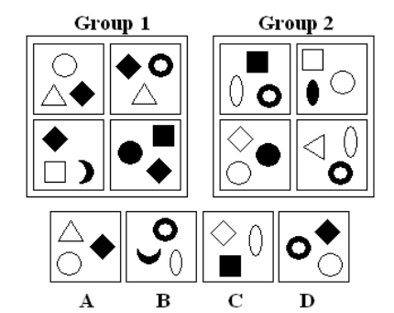
13. Which belongs to neither group?

Slide 29
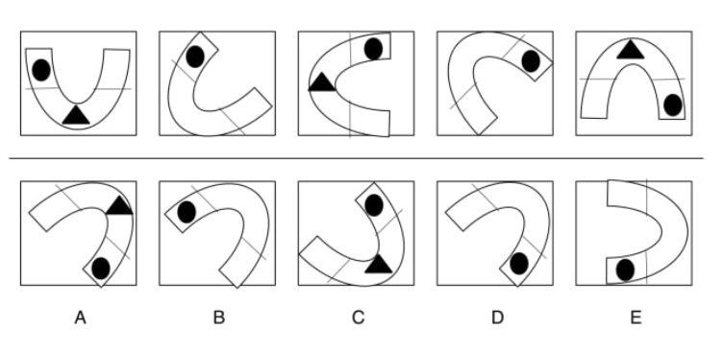
14.
Notes:
Counter clockwise movement of the magnet
Diappearance of the magnet

