Slide 1
Science Review
Physics Concepts
Momentum, Laws of Motion, Energy, Heat, and Electricity, Mirrors

Slide 2
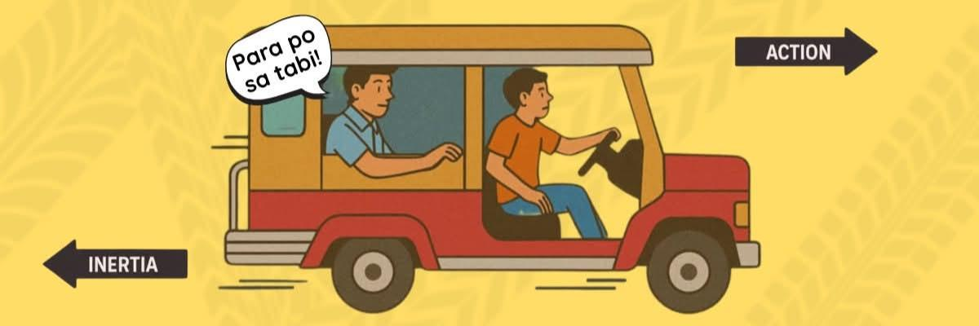
Q1. LAWS of MOTION
A jeepney traveling along Quezon Avenue suddenly stops when the traffic light turns red. Passengers tend to move forward before coming to a stop.
a. Newton’s First Law of Motion
b. Newton’s Second Law of Motion
c. Newton’s Third Law of Motion
d. Law of Conservation of Energy

Slide 3
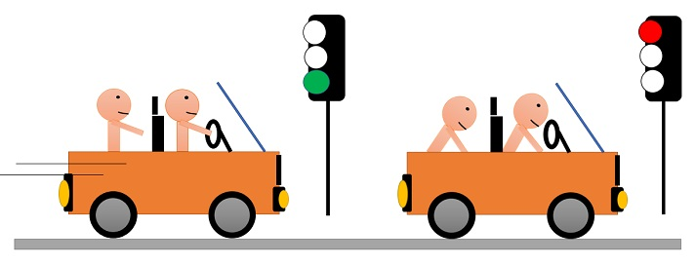
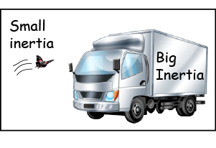
Q1 Answer & Explanation
Correct Answer: a. Newton’s First Law of Motion
Explanation:
Newton’s First Law (Law of Inertia) states that an object in motion continues moving unless acted upon by an external force. When the jeepney stops suddenly, the passengers’ bodies continue moving forward due to inertia.
Why others are incorrect:
b. Second Law – relates force, mass, and acceleration, not inertia (Law of Acceleration).
c. Third Law – deals with action-reaction pairs (Law of Interaction).
d. Conservation of Energy – not about motion behavior.
Notes:
Mass is a measure of inertia. The amount of an object's resistance to any change in its state of rest or motion depends on its mass.
Heavier objects have a higher tendency to resist this change than lighter objects.
A car, for example, has more inertia than a bicycle. You can push a bicycle and change its state of rest into motion. A car requires a lot more force to change its state of rest into motion.

Slide 4
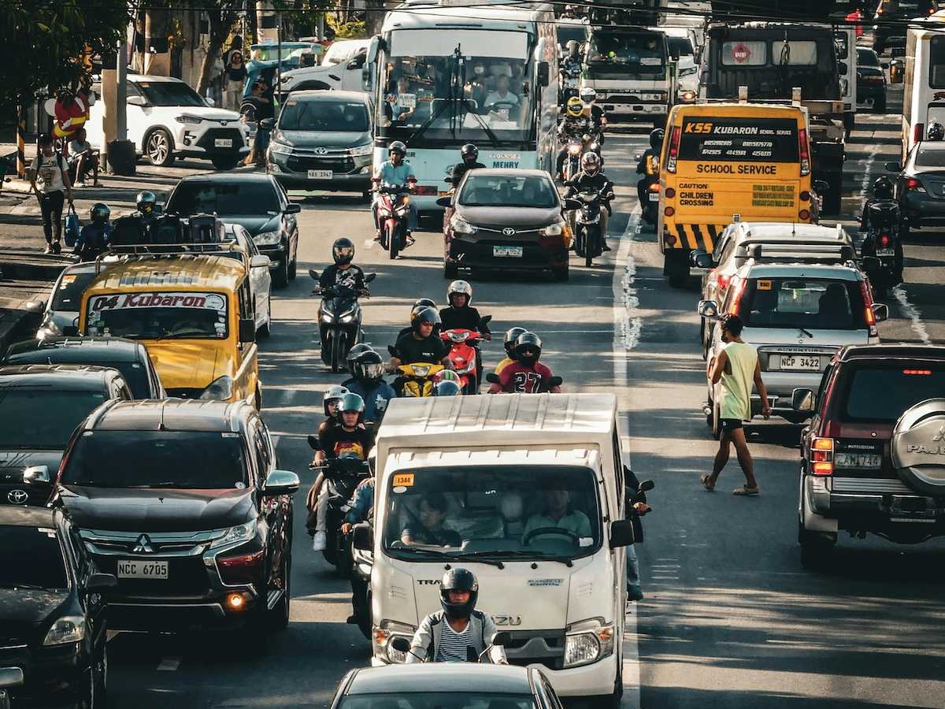
Q2. Momentum
Why do trucks traveling on Philippine highways need a longer distance to stop compared to motorcycles moving at the same speed?
a. Trucks experience less friction
b. Trucks have greater momentum
c. Motorcycles have greater mass
d. Stopping distance depends only on speed

Slide 5
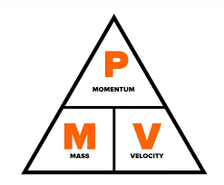
Q2 Answer & Explanation
Correct Answer: b. Trucks have greater momentum
Explanation:
Momentum depends on mass and velocity (p = mv). Trucks have much greater mass, so even at the same speed, they have greater momentum, requiring more force and distance to stop.
Why others are incorrect:
a. Trucks do not experience less friction.
c. Motorcycles have less mass, not more.
d. Mass also affects stopping distance.

Slide 6
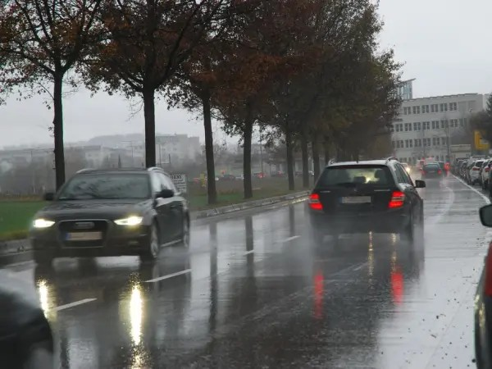
Q3. friction
During a rainy day in Baguio City, a delivery rider notices better grip when moving slowly.
a. Friction opposes the motion of objects.
b. Friction occurs only when objects are wet.
c. Friction acts in the same direction as motion.
d. Friction makes objects move faster.

Slide 7
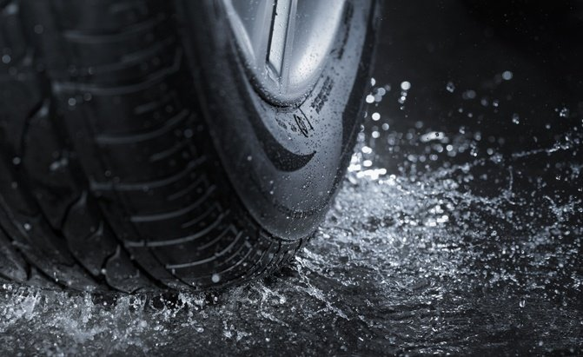
Q3 Answer & Explanation
Correct Answer: a. Friction opposes the motion of objects.
Explanation:
Friction resists motion between surfaces in contact. At lower speeds, tires maintain better frictional grip on wet roads (Tire-road interaction)
Why others are incorrect:
b. Friction exists even when surfaces are dry.
c. Friction always acts opposite motion.
d. Friction slows objects down.

Slide 8
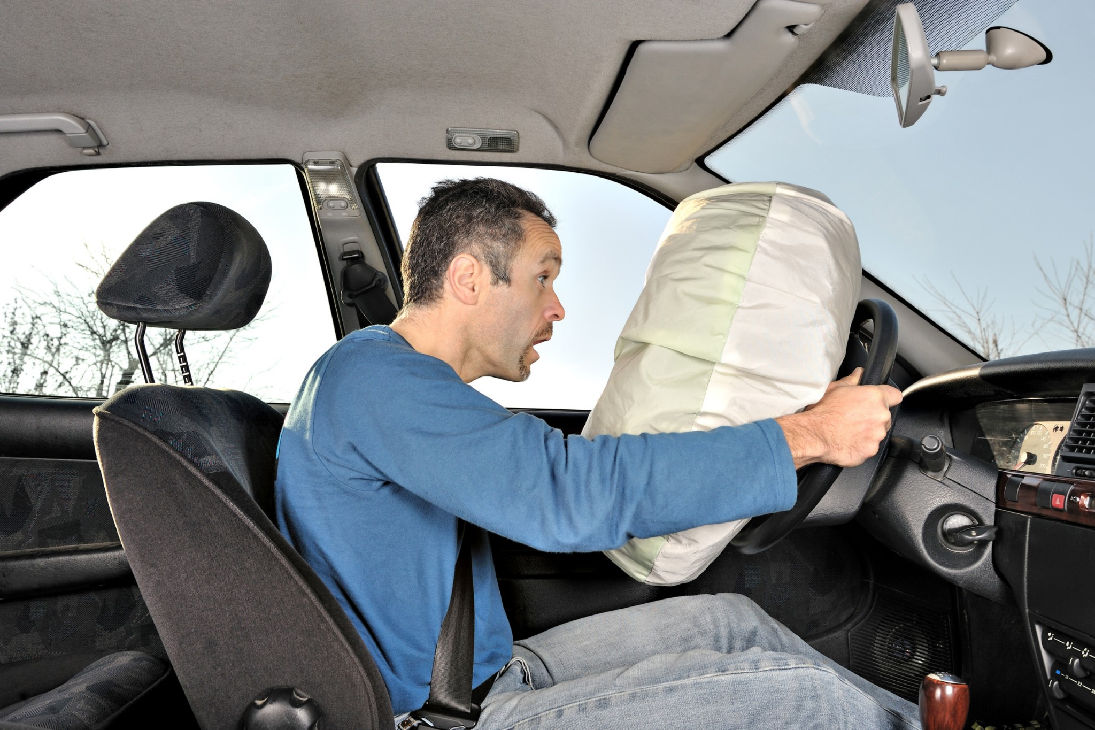
Q4. impulse and momentum
During a collision, airbags increase the time of impact. This reduces the force on passengers by:
a. increasing momentum
b. decreasing acceleration time
c. increasing stopping time
d. increasing vehicle speed

Slide 9
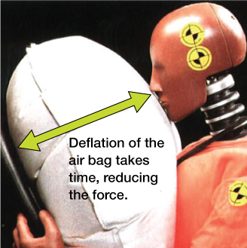
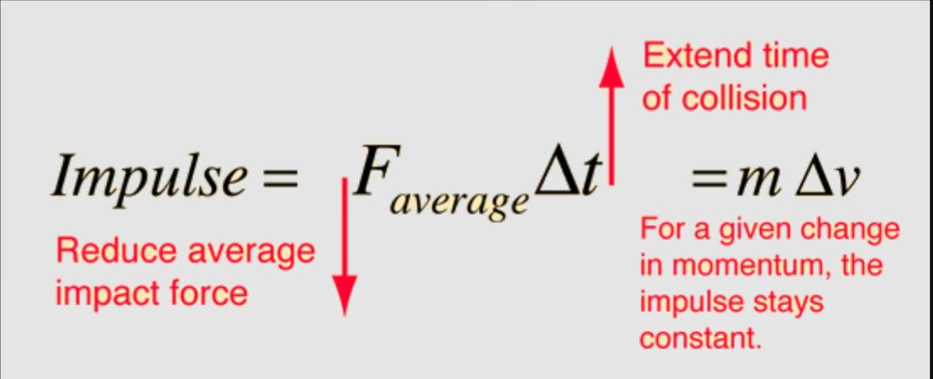
Q4 Answer & Explanation
Correct Answer: c. increasing stopping time
Explanation:
Impulse = Force × Time. Increasing the stopping time reduces the force experienced by passengers.
Why others are incorrect:
a. Momentum is not increased.
b. Time is increased, not decreased.
d. Speed is not increased.

Slide 10
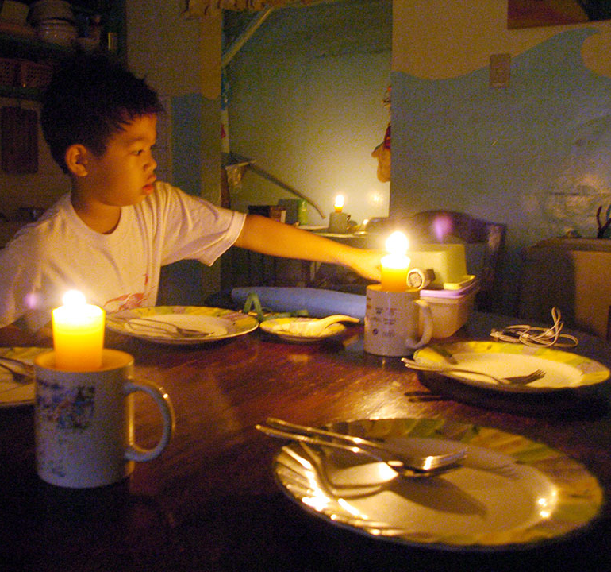
Q5. energy transformation
During a brownout, a family lights a candle. What energy transformation occurs?
a. light → chemical and heat
b. light → mechanical and heat
c. chemical → light and heat
d. chemical → electrical and heat

Slide 11
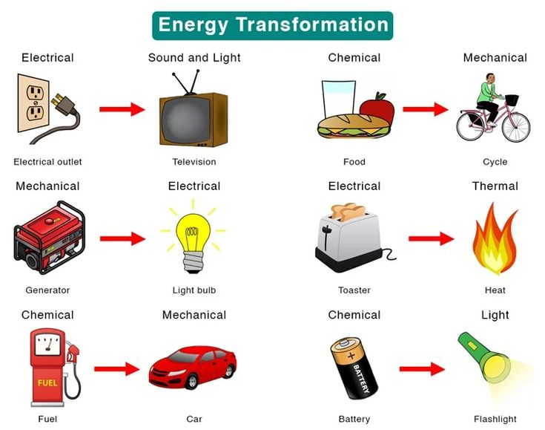
Q5 Answer & Explanation
Correct Answer: c. chemical → light and heat
Explanation:
The chemical energy stored in the candle wax is converted into light and heat when burned.
Why others are incorrect:
a. Energy does not change from light to chemical.
b. No mechanical energy involved.
d. No electrical energy produced.

Slide 12
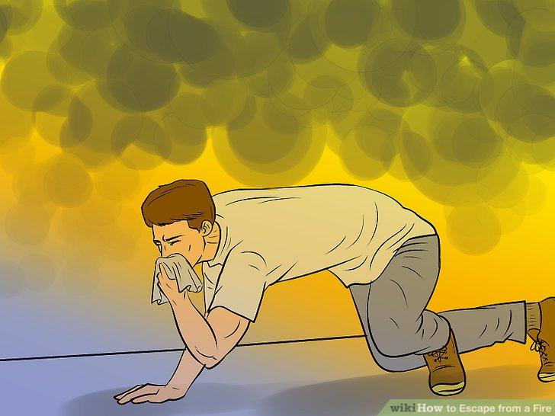
Q6. Heat transfer
During a residential fire, people are advised to stay low while evacuating.
a. Hot air and smoke rise due to convection, leaving cooler air near the floor.
b. Oxygen concentration is always higher near the floor.
c. Fire spreads faster along the floor.
d. Smoke is heavier than air.

Slide 13
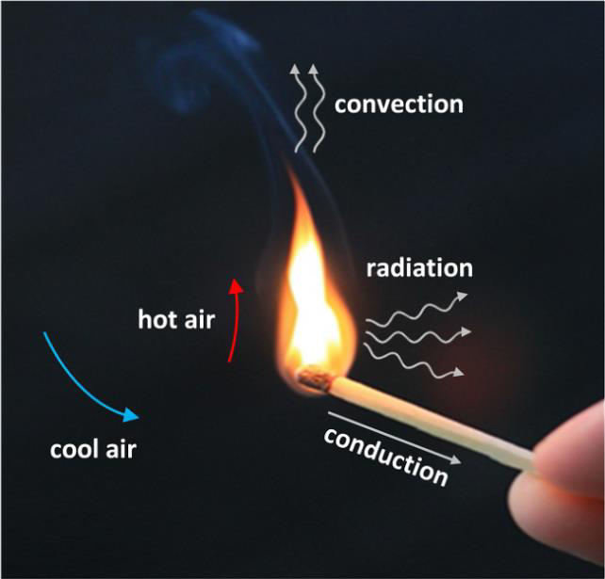
Q6 Answer & Explanation
Correct Answer: a. Hot air and smoke rise due to convection.
Explanation:
Hot air and smoke are less dense, so they rise, leaving relatively cleaner air near the floor.
Why others are incorrect:
b. Oxygen distribution depends on temperature.
c. Fire spreads upward, not mainly along the floor.
d. Smoke is lighter, not heavier, than air.

Slide 14
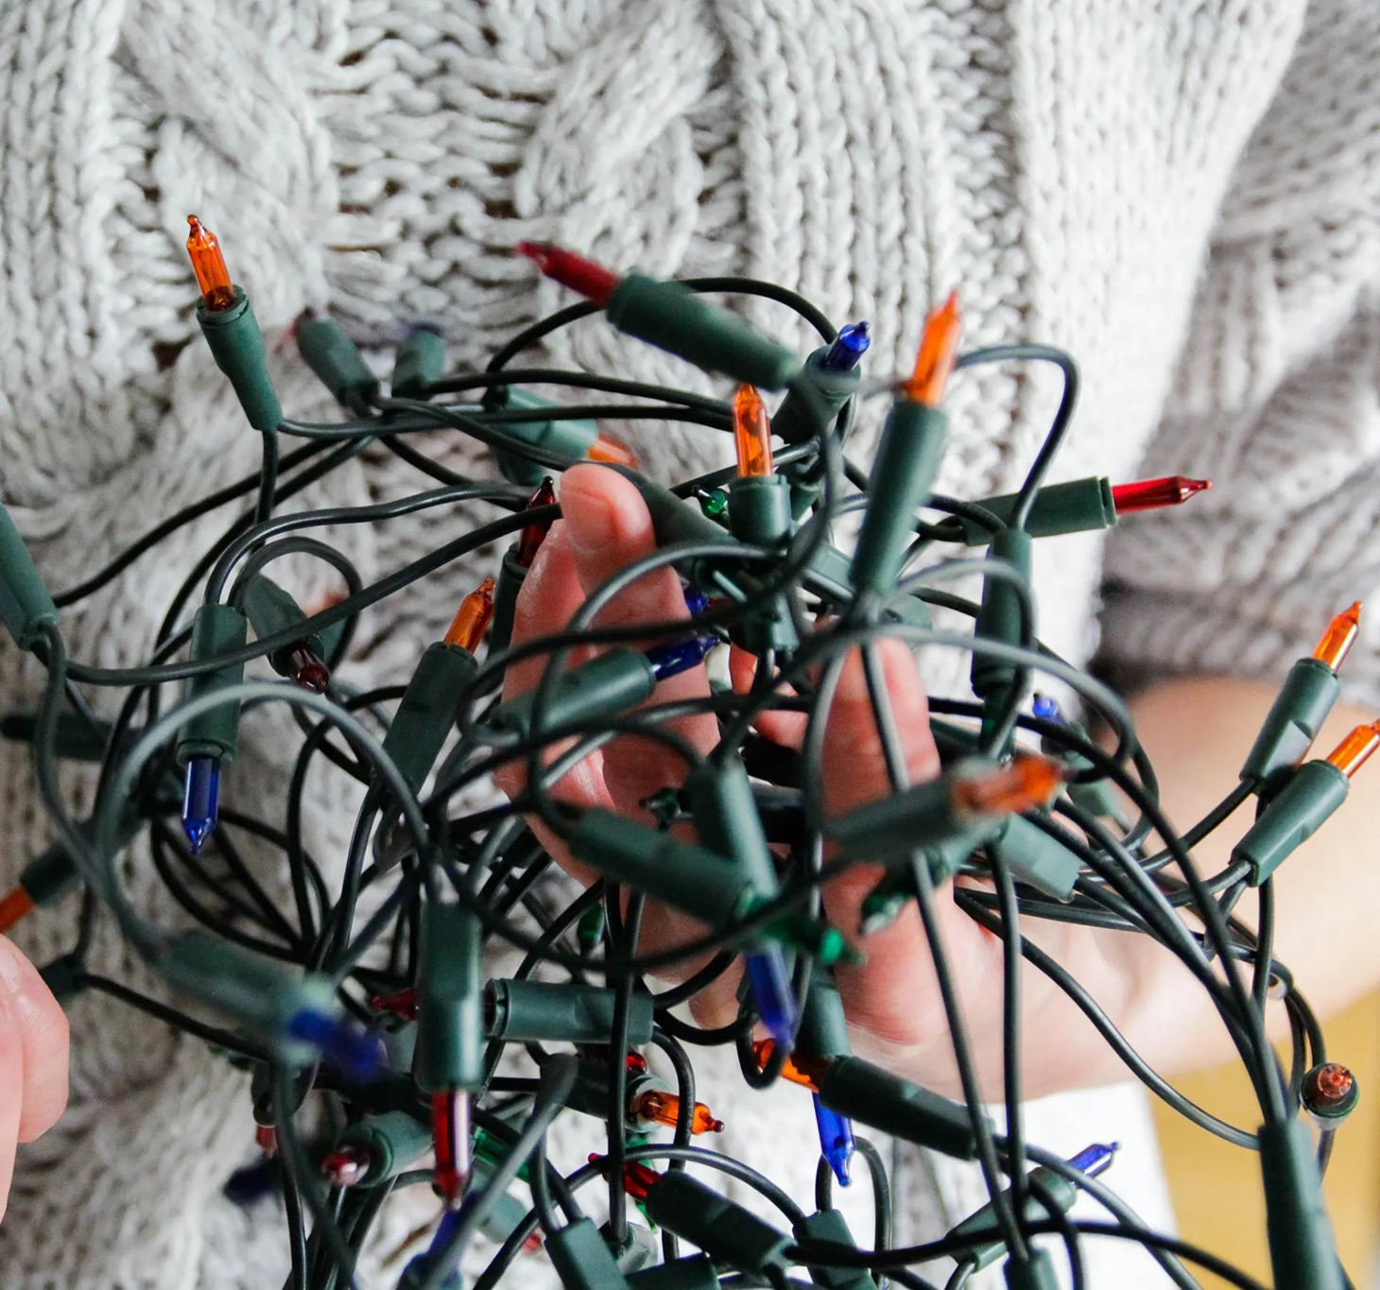
Q7. Circuit
One string goes dark when one bulb burns out; another remains lit but brighter.
A. First parallel, second series
B. First series, second parallel
C. Both series, higher voltage
D. Both parallel, blown fuse

Slide 15
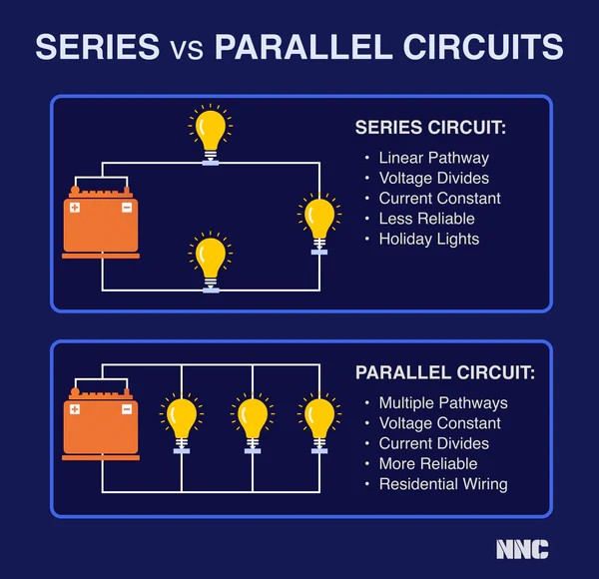
Q7 Answer & Explanation
Correct Answer: B. First series, second parallel
Explanation:
In series circuits, one broken bulb stops current flow. In parallel circuits, current continues, and fewer bulbs share the same voltage, making them brighter.
Why others are incorrect:
A. Reversed explanation.
C. Voltage is not the main factor here.
D. Fuse explanation is incorrect.

Slide 16
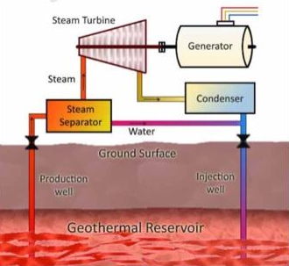
Q8. Energy Source
Heat can make a turbine rotate and turn, allowing the generator to convert energy into electricity. Which set of elements in a geothermal power plant play vital roles in the mechanical energy of the turbine?
A. Water and steam
B. Water and condenser
C. Water and generator
D. Water and geothermal energy

Slide 17
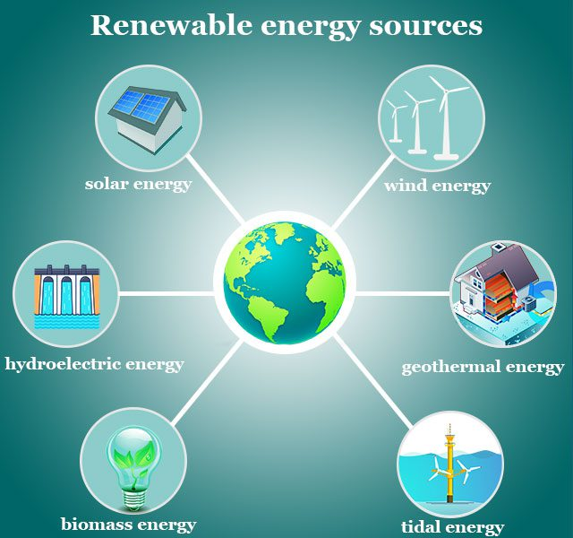
Q8 Answer & Explanation
Correct Answer: a. Water and steam
Explanation:
Mechanical energy of the turbine comes from moving fluid (steam) that pushes and spins it. Steam flows at high pressure and speed, striking the turbine blades that causes its rotation.
Why others are incorrect:
b. Condenser cools steam and turns back to water.
c. Generator does not create mechanical energy. It converts Mechanical to electrical energy.

Slide 18
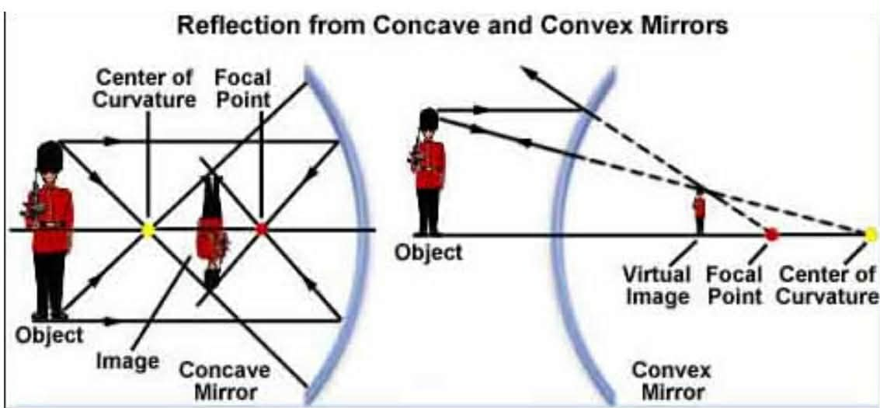
Q9. MIrrors
Which observation best demonstrates an association between the type of mirror and the characteristics of the reflected image?
A. The convex mirror produces an inverted image, while the concave mirror produces an upright image.
B. The convex mirror produces an upright and diminished image, while the concave mirror produces an inverted and diminished image.
C. Both the concave and convex mirrors produce upright images, but the convex mirror produces larger images than the concave mirror.
D. Both the concave and convex mirrors produce inverted images, but the concave mirror produces larger images than the convex mirror.

Slide 19
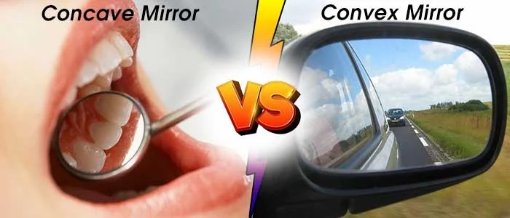
Q9 Answer & Explanation
Correct Answer: b. The convex mirror produces an upright and diminished image, while the concave mirror produces an inverted and diminished image.
Explanation:
A convex mirror always produces an upright, diminished, and virtual image, regardless of the object’s position.
A concave mirror, when the object is beyond the center of curvature (as shown in the diagram), produces an inverted and diminished image.
•Convex mirror → upright and diminished image
•Concave mirror → inverted and diminished image

Slide 20
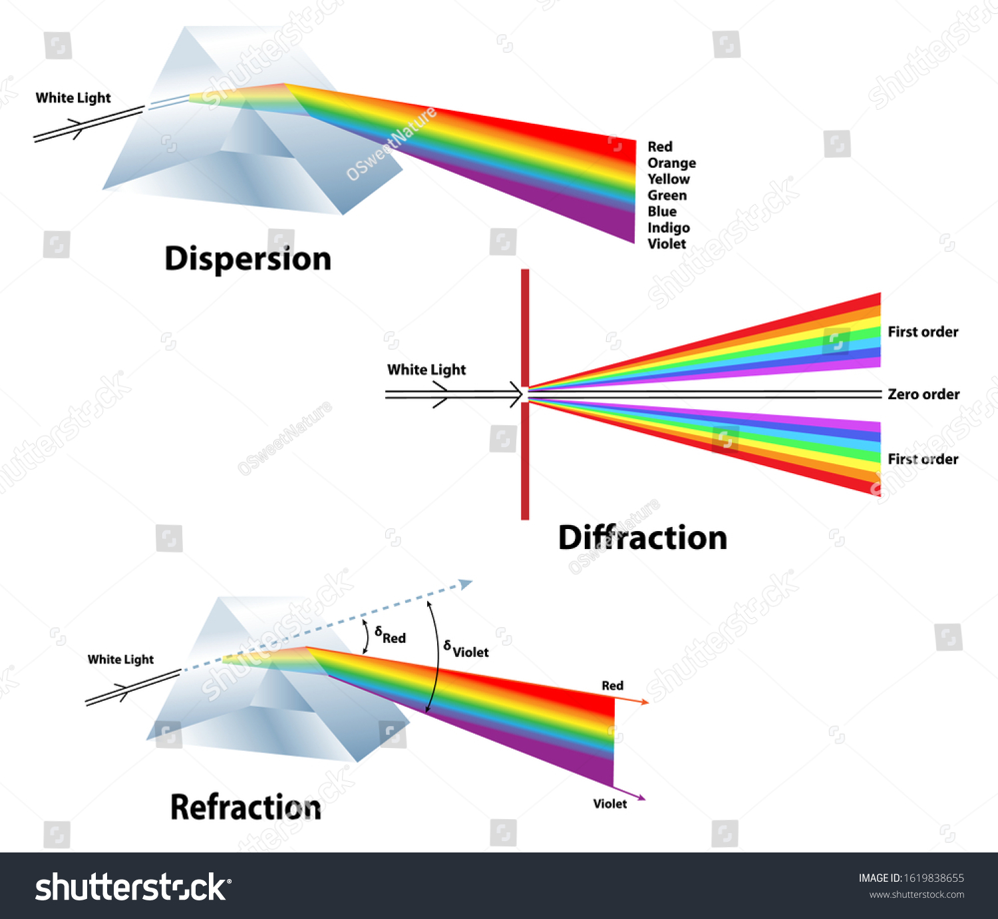
Q10. Light
What scientific evidence, based on the diagram, supports the conclusion that the different colors of light travel at different speeds in the prism?
A. All the colors of light exit the prism at the same angle.
B. The red light bends the most as it passes through the prism.
C. The violet light bends the least as it passes through the prism.
D. The white light separates into distinct bands of color as it passes through the prism.

Slide 21
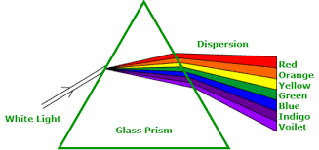
Q10 Answer & Explanation
Correct Answer: d. The white light separates into distinct bands of color as it passes through the prism.
Explanation:
When white light passes through a prism, it separates into distinct colors (red to violet). This phenomenon is called dispersion. Dispersion occurs because: - Each color of light has a different wavelength. - Different wavelengths travel at different speeds in the prism.
- Because their speeds differ, each color refracts (bends) by a different amount.
Notes:
👉 The visible separation into distinct color bands is direct evidence that different colors travel at different speeds in the prism.

