Slide 1
BIOLOGY

Slide 2
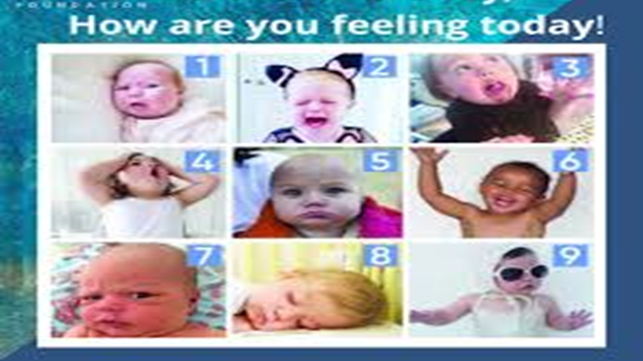

Slide 3


Slide 4

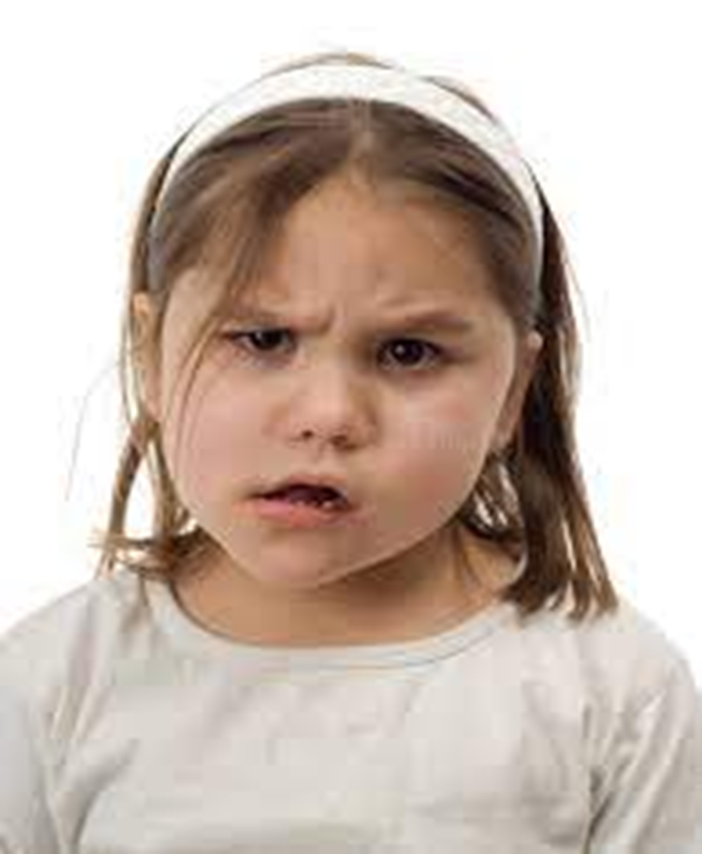

Slide 7
1. How can a biology student determine which sequence correctly shows
the hierarchy of biological organization from the simplest to the most
complex level?
A. Organelle, cells, tissues, organs, organ systems, organisms,
populations, communities, ecosystem, and biosphere
B. Macromolecule, organelle, cells, tissues, organs, organ systems,
organisms, populations, communities, ecosystem, and biosphere
C. Molecule, macromolecule, organelle, cells, tissues, organs, organ
systems, organisms, populations, communities, ecosystem, and biosphere
D. Atom, molecule, macromolecule, organelle, cells, tissues, organs, organ
systems, organisms, populations, communities, ecosystem, and biosphere

Slide 8
D
Atom, molecule, macromolecule, organelle,
cells, tissues, organs, organ systems, organisms,
populations, communities, ecosystem, and
biosphere
Explanation:
It includes the chemical foundation of all matter

Slide 9
2. Which of the following is NOT one of the three main
principles of the original Cell Theory?
A. All cells contain a nucleus and membrane-bound
organelles.
B. All living things are composed of one or more cells.
C. The cell is the basic unit of structure and function in
organisms.
D. Cells come only from the replication of pre-existing
cells.

Slide 10
A
All cells contain a nucleus and
membrane-bound organelles.
Explanation:
Prokaryotic cells lack a nucleus, making this statement incorrect as a universal rule for all life.

Slide 11
3. Which cellular process is responsible for
producing gametes with half the
chromosome number of the parent?
A. Cytokinesis C. Mitosis
B. Interphase D. Meiosis

Slide 12
D
Meiosis
Explanation:
Meiosis involves two rounds of division to reduce the chromosome count from diploid (2n) to haploid (n).

Slide 13
4. In a food chain consisting of
Grass → Grasshopper → Frog → Snake → Hawk
Which organism is the secondary consumer?
A. Snake C. Hawk
B. Frog D. Grasshopper

Slide 14
B
Frog
Explanation:
The frog eats the primary consumer (grasshopper), placing it at the third trophic level as a secondary consumer.

Slide 15
5. Compare two food chains:
Scenario 1: Grass → Cow → Human
Scenario 2: Grass → Human (eating grain directly)
In which scenario does the human receive more of the original
solar energy captured by the grass?
A. Both scenarios provide equal energy because the grass is the
same.
B. Scenario 1, because the human body digests meat more efficiently
than grain.
C. Scenario 2, because energy is lost at each additional trophic level.
D. Scenario 1, because cows concentrate the energy into meat.

Slide 16
C
Scenario 2, because energy is lost at each additional trophic level.
Explanation:
Eating lower on the food chain is more energy-efficient because it avoids the 90% loss that occurs at the herbivore-to-carnivore step.

Slide 17
6. Which of the following best defines
symbiosis in an ecosystem?
A. A competitive interaction where two species fight for
the same limited resource.
B. A close and long-term biological interaction between
two different biological species.
C. The process by which an organism evolves to blend
into its surroundings.
D. A temporary interaction between a predator and its
prey during a hunt.

Slide 18
B
A close and long-term biological interaction between two different
biological species.
Explanation:
Symbiosis literally means 'living together' and refers to various types of persistent relationships between different organisms.

Slide 19
7. Which of the following describes the
relationship between photosynthesis and
cellular respiration?
A. Photosynthesis only happens in animals and
respiration only in plants.
B. They are identical processes.
C. The products of photosynthesis are the reactants for
cellular respiration.
D. They both occur in the chloroplast

Slide 20
C
The products of photosynthesis are the reactants for cellular respiration.
Explanation:
Photosynthesis produces glucose and oxygen, which mitochondria use to produce ATP.

Slide 21
8. Which two systems work most closely
together to allow the body to move?
A. Integumentary and Immune
B. Skeletal and Muscular
C. Digestive and Excretory
D. Circulatory and Respiratory

Slide 22
B
Skeletal and Muscular
Explanation:
Muscles provide the force for movement by pulling on bones, which act as levers.

Slide 23
9. A biotechnology company is choosing an organism to produce a
specific human protein. Based on scientific and economic
efficiency, why might they choose a bacterium like E.coli over a
multicellular organism like a goat?
A. Bacteria have simpler cellular structures and reproduce
much faster, reducing the time and cost of production.
B. Bacteria are larger than animal cells, making them easier
to manipulate under a standard laboratory microscope.
C. Bacteria do not contain any DNA of their own, so there is no risk
of the added human gene being rejected.
D. Bacteria are the only organisms capable of surviving in the sterile,
artificial environments of a laboratory.

Slide 24
A
Bacteria have simpler cellular structures and reproduce much faster, reducing the time and cost of production.
Explanation:
The rapid generation time and lack of complex organelles make bacteria highly efficient biological 'factories' for mass-producing proteins.

Slide 25
10. A forensics team finds a tiny drop of
blood at a crime scene. Which
technique should they use first to
create enough DNA for a full analysis?
A. Bacterial Transformation
B. Gel Electrophoresis
C. Polymerase Chain Reaction (PCR)
D. DNA Sequencing

Slide 26
C
Polymerase Chain Reaction (PCR)
Explanation:
PCR exponentially amplifies specific DNA sequences, allowing scientists to work with very small or degraded samples.

