Slide 1
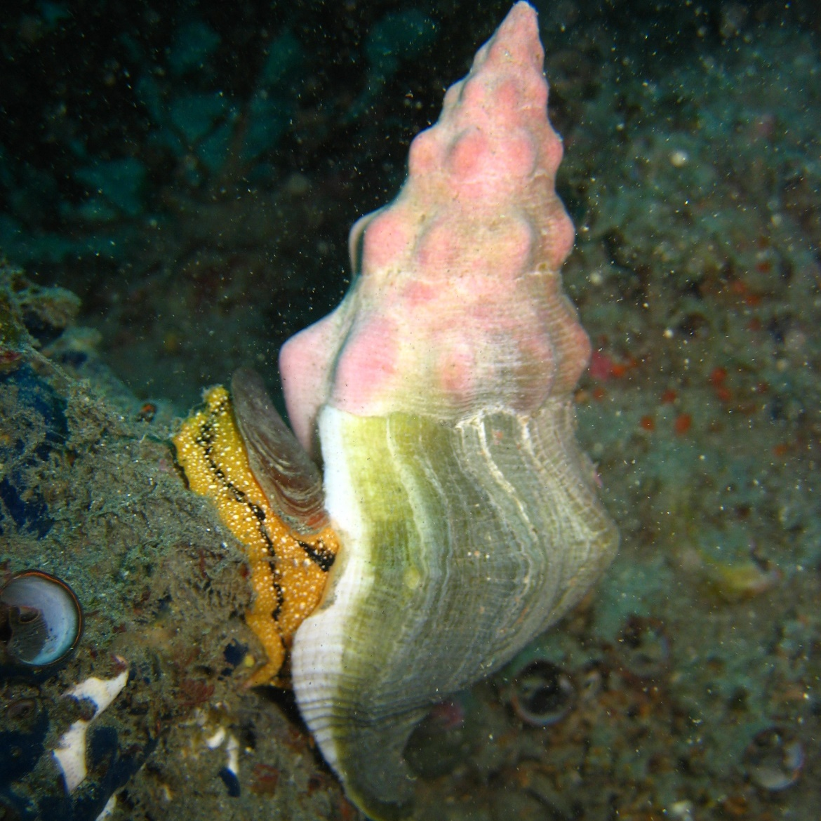
Kellet’s whelk
Kelp Forest Monitoring Program
Notes:
So a few weeks ago, Ken asked if there were any surprises, we had discovered through our machine learning approach to the KFM dataset. My initial response was the number 2 most important species, Kelletia kelletii. I was surprised by his species because it was something that I strongly associated with MPA effects. Basically when you dive at these sites all the time, you begin to associate certain species with reserves, and others with unprotected areas. These assumptions are easy to make about certain species like giant kelp, which you can see from the surface, and which has an obvious reserve effect. Kelletia was a species that I didn’t really pick up as associated with reserve effects. Today we want to talk about why this species came up in our RF analysis, and what the reserve effects are.

Slide 4
Questions?

