Slide 1

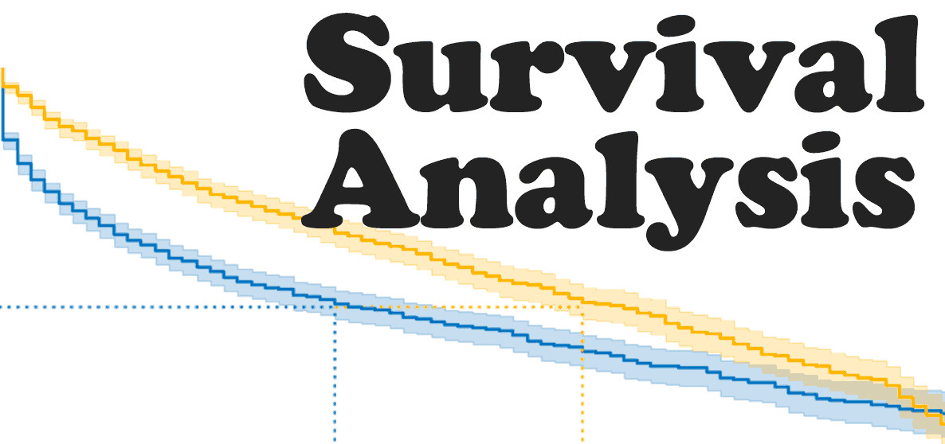
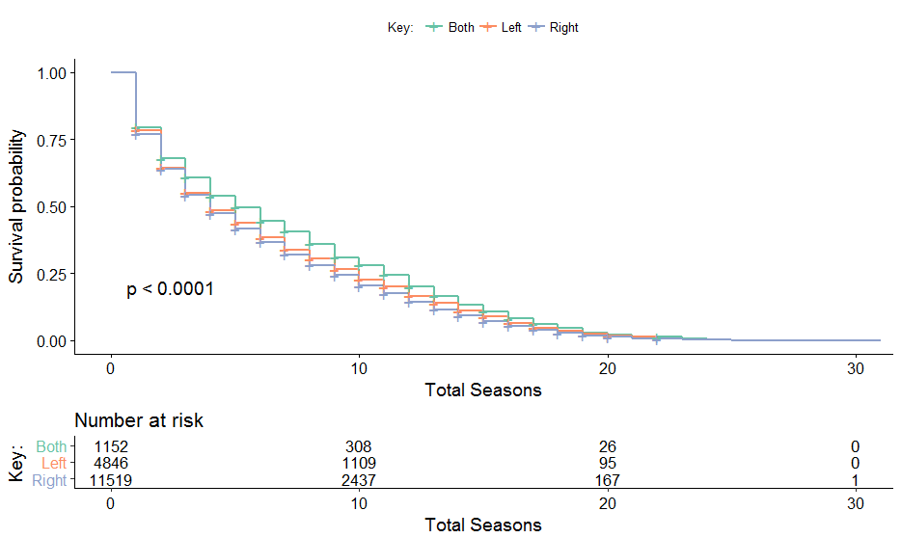
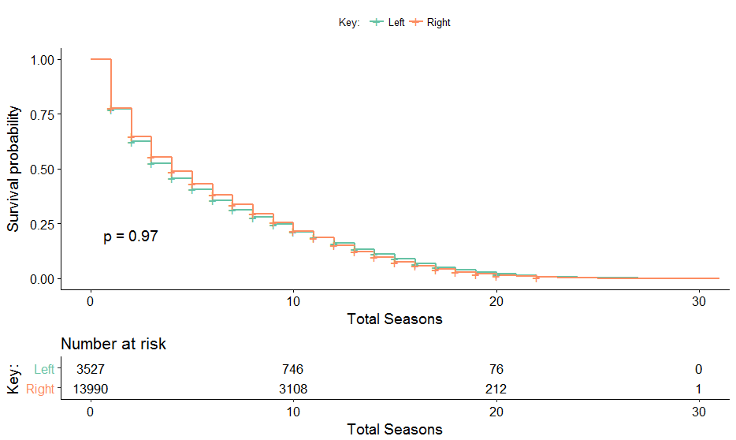
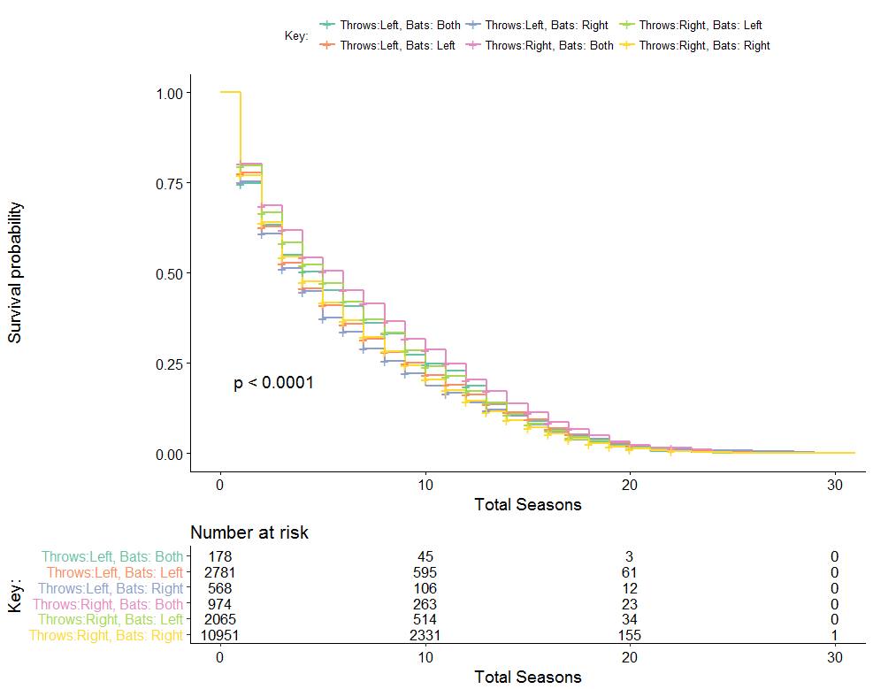

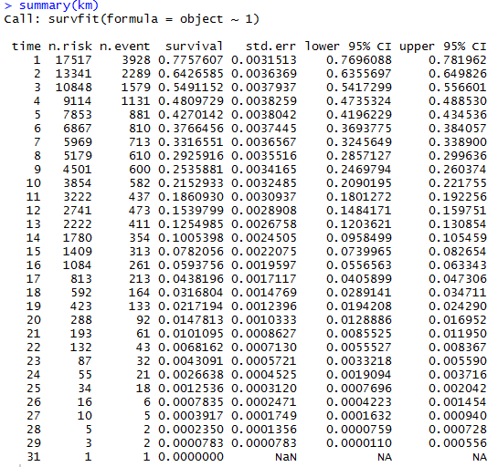
Staying Alive CDTs Ferguson and Johnson Instructor: CPT. (P) Dusty Turner
Survival Analysis
Used to investigate the time until a target event of interest
Used in a variety od disciplines such as medicine. Sociology, and education
Measured in days, weeks, years, etc ….
Survival curves for batting and throwing
Batting
Throwing
Question
Between right handed, left hand, and switch baseball players, who has the longest career span in Major League Baseball (MLB)?
Figure 2: Survival curve for batting
Figure 3: Survival curve for throwing
Model assumptions and limitations
Survival curve for both batting and throwing
Assumptions
Our model treats players, whose last year was 2016, as still currently playing.
Limitations
Our model does not take into account whether or not a player plays a whole season.
Kaplan Meier
Figure 4: Survival curve comparing different combinations of batting and throwing
Conclusion
When only batting is considered, switch hitters have the greatest survival rate
When only throwing is considered, right handed throwers have a greater survival rate
When batting and throwing are taking into account equally, players who throw right and can switch hit have the greatest survival rate
References
Despa, Simon. StattNews #78: What is Survival Analysis? New York: Cornell University: Cornell Statistical Consulting Unit. Print.
Acknowledgments
CPT. (P) Dusty Turner
Figure 1: Kaplan Meier chart generated by our data

