Slide 1
Staying Alive
By: CDTs Ferguson and Johnson

Slide 2

What is Survival Analysis
Used to investigate the time until a target event of interest
Used in a variety of disciplines such as medicine, sociology, and education
Measured in days, weeks, years, etc
Notes:
Where Beta is something that influences the hazard time. h0 is the baseline hazard, and t is time.

Slide 3
The Question
Out of right handed, left handed, and switch baseball players, who has the longest careers in the MLB ?

Slide 4
Considered data
Masters.csv
PlayerID
Name
Weight
Height
Bats
Throws
Debut
Final Game
Batters.csv
PlayerID
Number of datapoints
Last year
We created…
Censor (are they alive)
Total seasons

Slide 5
Assumptions
If 2016 was the player’s last season, they were treated as still playing

Slide 6
Limitations
Model does not take into account whether a whole season is played or not.

Slide 7
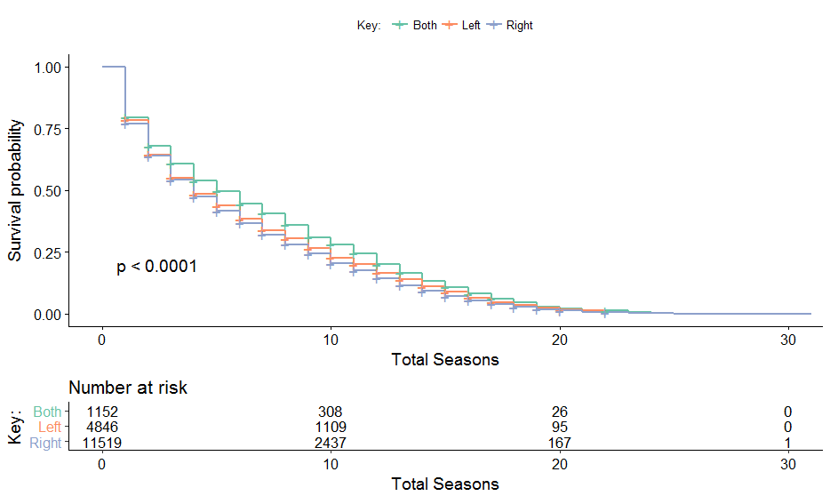
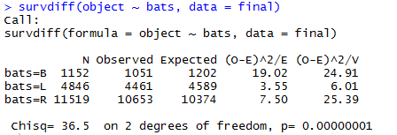
Survival Curve for batters
Figure 1: Survival curve for batters generated by accompanying survival data

Slide 8
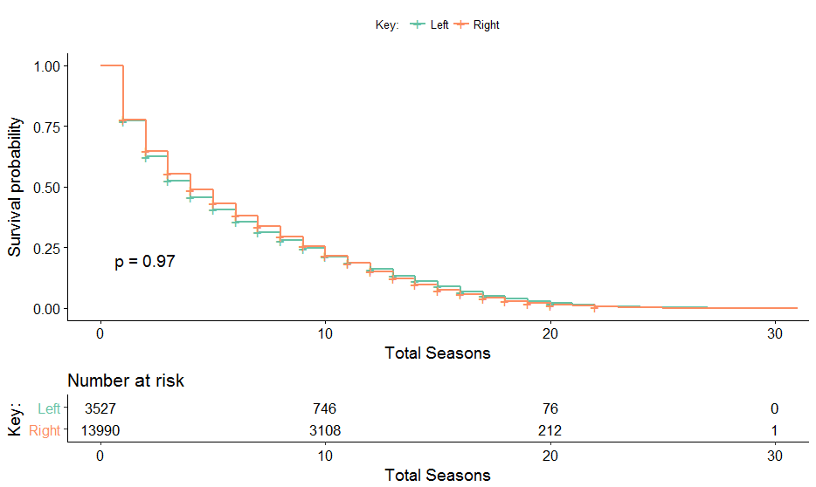
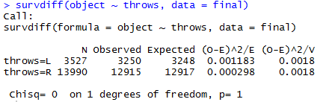
Survival Curve for throwing
Figure 2: Survival curve for throwing generated by accompanying survival data

Slide 9
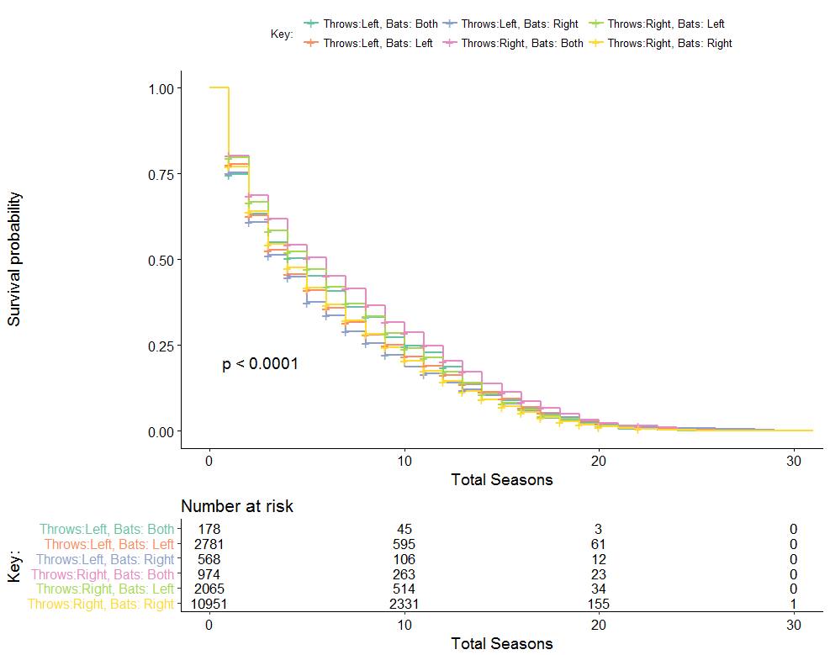
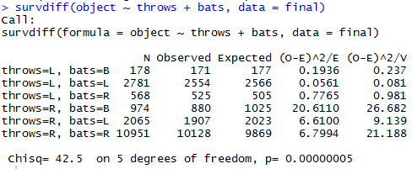
Survival Curve batting and throwing
Figure 3: Survival curve taking into account different combinations of batting and throwing, generated by accompanying survival data

Slide 10
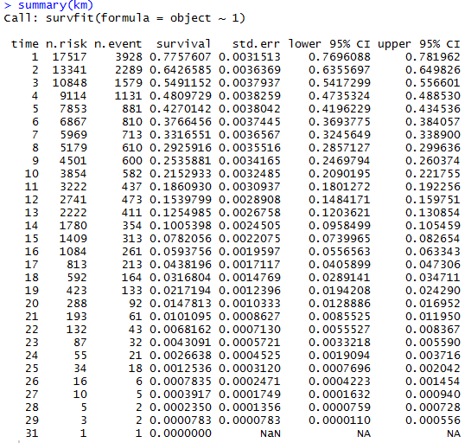
Kaplan Meier
Figure 4: Kaplan Meier chart created using model

Slide 11
Kaplan Meier
Figure 4: Kaplan Meier chart created using model
Deacon McGuire – Longest Career

Slide 12
But wait…

Slide 13
But wait…
There’s more

Slide 14
Model Building
Unconsidered data
Continuously changing statistics
Switch throwers
Players with incomplete data files

Slide 15
Model Building
Considered Data
Weight
Height
Batting
Throwing

Slide 16
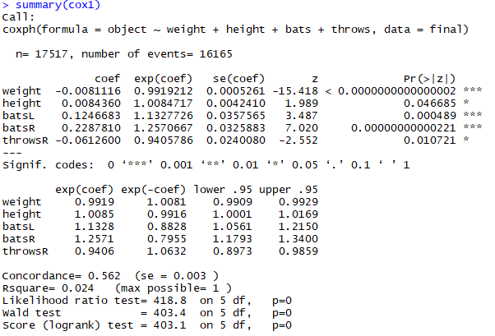
Model Building
Considered Data
Weight
Height
Batting
Throwing

Slide 17
Model Trimming
Considered Data
Weight
Height
Batting
Throwing

Slide 18
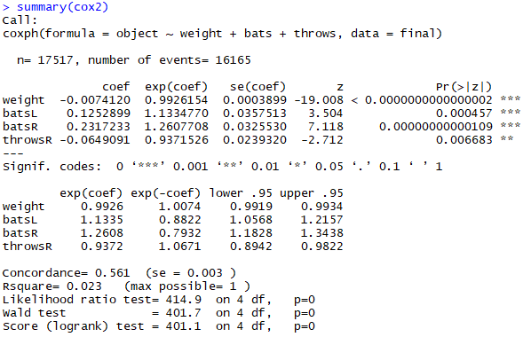
Model Trimming
Considered Data
Weight
Batting
Throwing

Slide 19
Model Trimming
Considered Data
Weight
Batting
Throwing

Slide 20
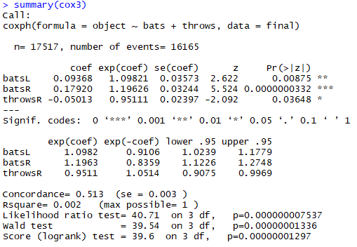
Model Trimming
Considered Data
Batting
Throwing

Slide 21
How did we do?
Use our Cox model to predict on our dataset
Based on:
Batting
Throwing
Our model got worse!

Slide 22
How did we do?
Use our Cox model to predict on our dataset
Based on:
Batting
Throwing
Our model got worse!
So we go with our original

Slide 23
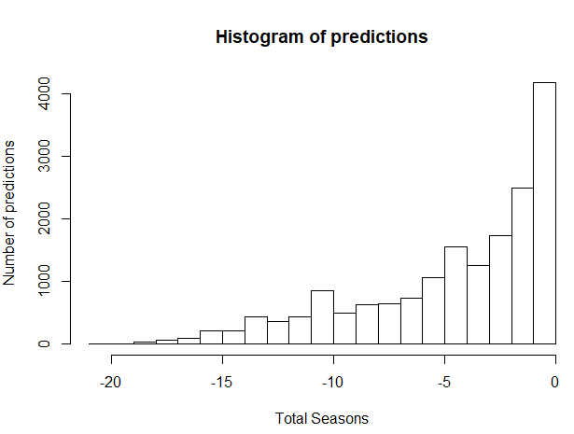
The numbers, what do they mean?

Slide 24
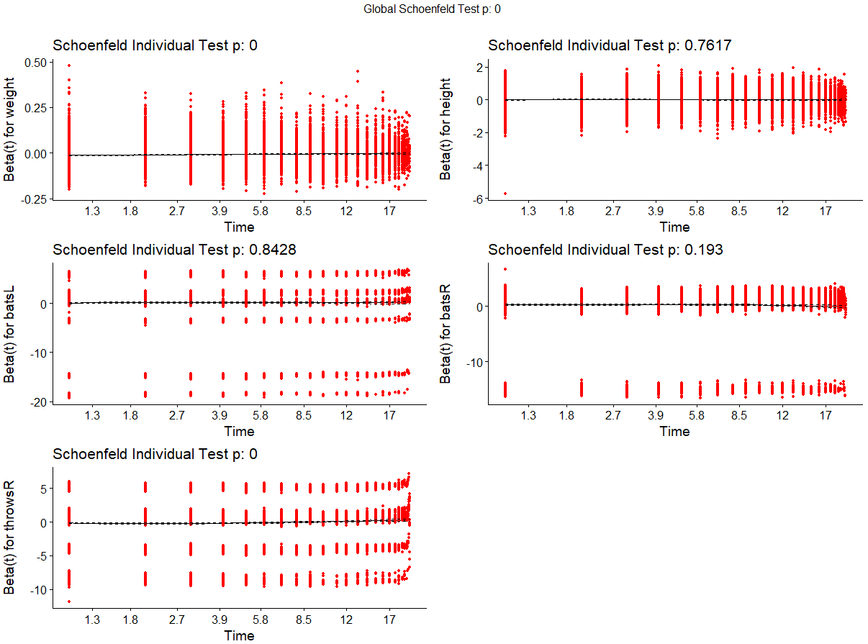
The numbers, what do they mean?

Slide 25
The numbers, what do they mean?
Systematic departure = non-proportional hazards

Slide 26
The numbers, what do they mean?
Reject the null hypothesis
Systematic departure = non-proportional hazards

Slide 27
Conclusions
When only batting is considered, switch hitters have the greatest survival rate
When only throwing is considered, right handed throwers have a greater survival rate
When batting and throwing are taking into account equally, players who throw right and can switch hit have the greatest survival rate

Slide 28
Questions?

