Slide 1
memes

Slide 2
Conservation Biology is first and foremost a multidisciplinary subject
requiring an integrative approach to problem-solving
Reserve Design
Conservation physiology
Conservation social science
Restoration
Conservation journalism
Conservation behavior
Eco-arts
Environmental business
Ecological Economics
Conservation marketing
Conservation law
Conservation ethics
Endangered Species Conservation
Ecosystem Conservation

Slide 3
memes

Slide 4
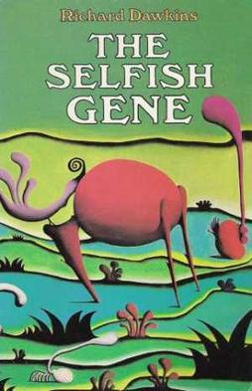
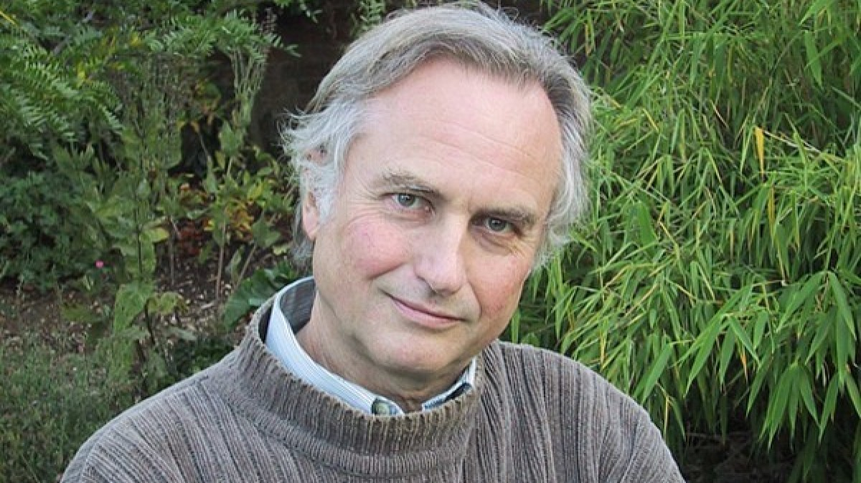
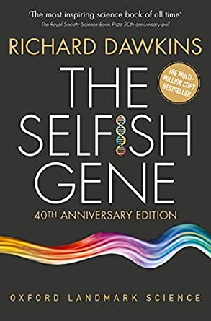
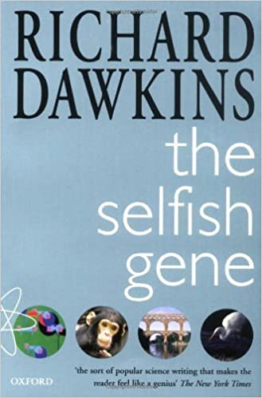
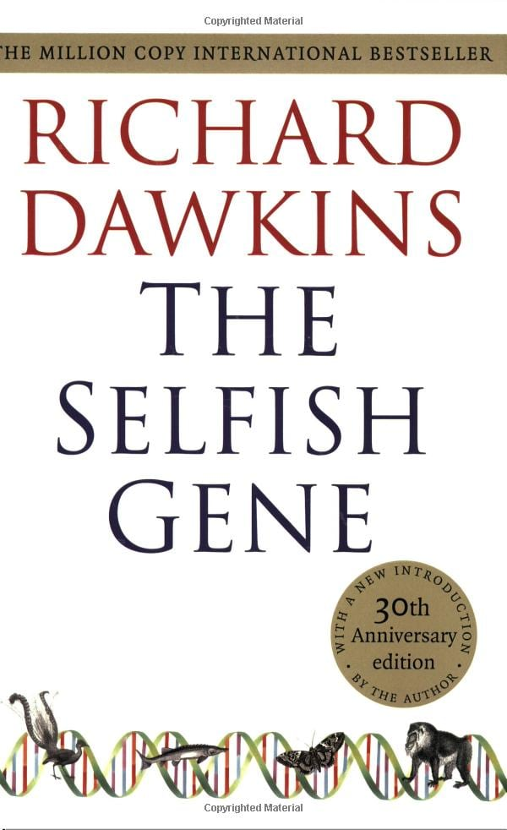
Richard Dawkins
1976
George C. Williams' Adaptation and Natural Selection (1966)
meme: a unit of human cultural evolution.
meme \MEEM\ noun. 1 : an idea, behavior, style, or usage that spreads from person to person within a culture.

Slide 5
memes = culture
genes = organism

Slide 6
Genetic diversity is the
ultimate source of biodiversity
at all levels and the material on which evolution acts upon.

Slide 7
The Evolutionary Play
evolution is the basic axiom that unites the field of biology.
The Ecological Theater
Human Presence
"Nothing in biology makes sense except in the light of evolution"
- Theodosius Dobzhansky

Slide 8
The goal of conservation biology is
not to stop evolutionary change, or conserve the status quo, but rather to ensure that populations may continue to respond to environmental change
in an adaptive manner.

Slide 9
Conservation Biology is first and foremost a multidisciplinary subject requiring an integrative
approach to problem-solving
Sociology
Communication
Policy
Biology
Philosophy
Reserve Design
Conservation physiology
Conservation social science
Ecology
Physics
Biogeography
Restoration
Conservation journalism
Conservation behavior
Engineering
Eco-arts
Chemistry
Education
Data structures
Environmental business
Epidemiology
Zoology
Conservation marketing
Statistics
Geology
Mathematics
Conservation law
Evolution
Conservation ethics
Endangered Species Conservation
Ecosystem Conservation
Ecological Economics
Genetics
Medicine
Anthropology
Computer Science

Slide 10
Systems Thinking is the opposite of linear thinking; holistic (integrative) versus analytic (dissective) thinking.
- Monat, J. P., & Gannon, T. F. (2015). What is systems thinking? A review of selected literature plus recommendations. American Journal of Systems Science, 4(1), 11-26.

Slide 11
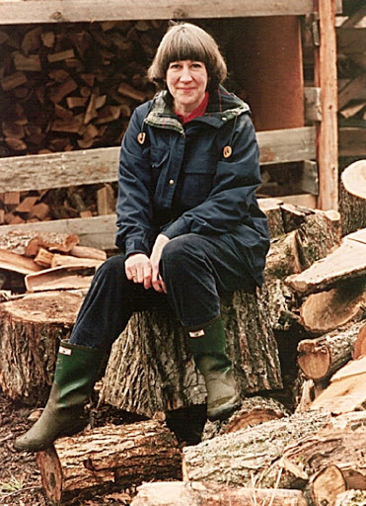
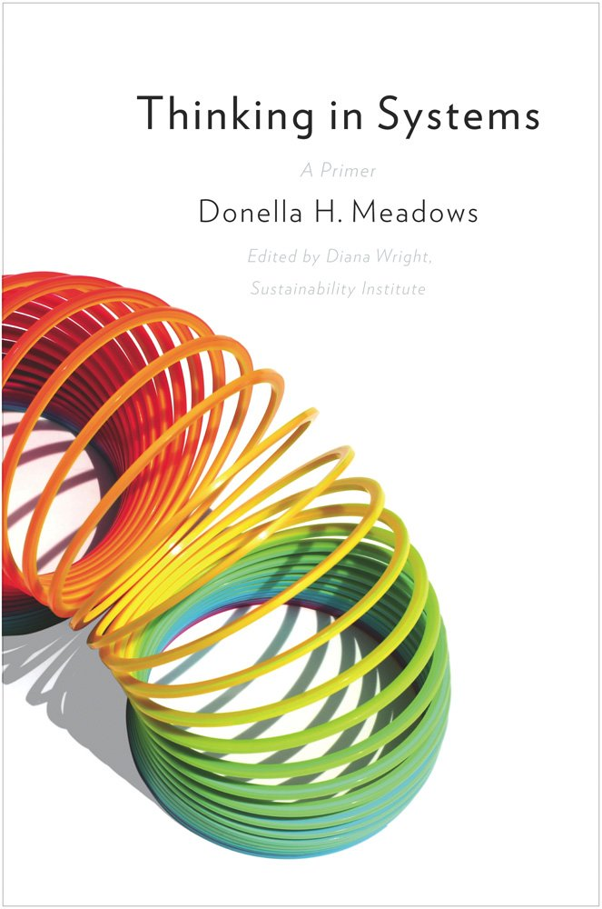
Donella Meadows
“There are no separate systems. The world is a continuum. Where to draw a boundary around a system depends on the purpose of the discussion.”

Slide 12
“The important thing is not to stop questioning
- Albert Einstein
- Wayne Gretzky”
- MICHAEL SCOTT

