Slide 1
Symmetric 3D reactions
T = 440∘C
Initial void distribution – 7.77x10²⁰ m⁻³
t = 100 nm

Slide 2
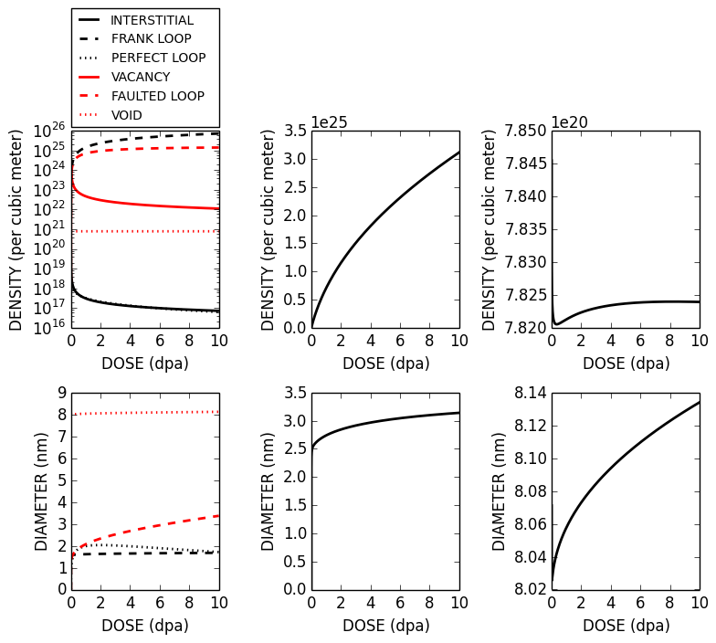
No network dislocations
5x10⁻⁴ dpa/s

Slide 3
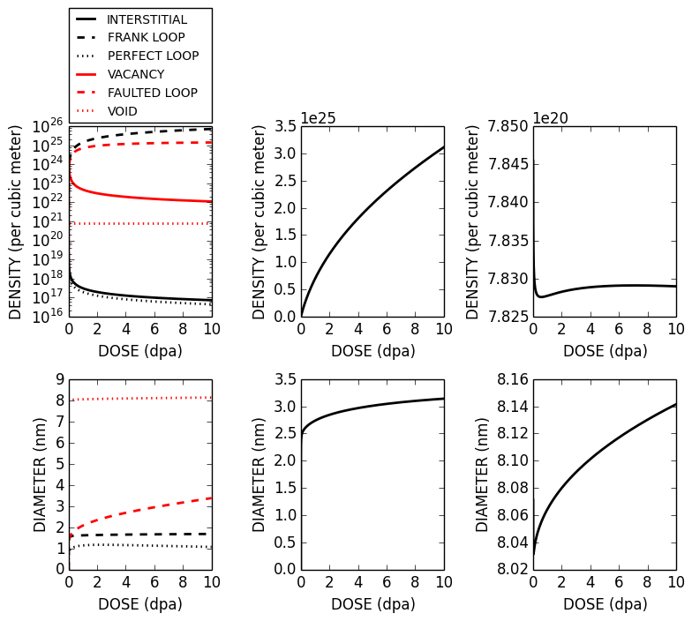
network dislocations – 10¹⁵ m⁻²
5x10⁻⁴ dpa/s

Slide 4
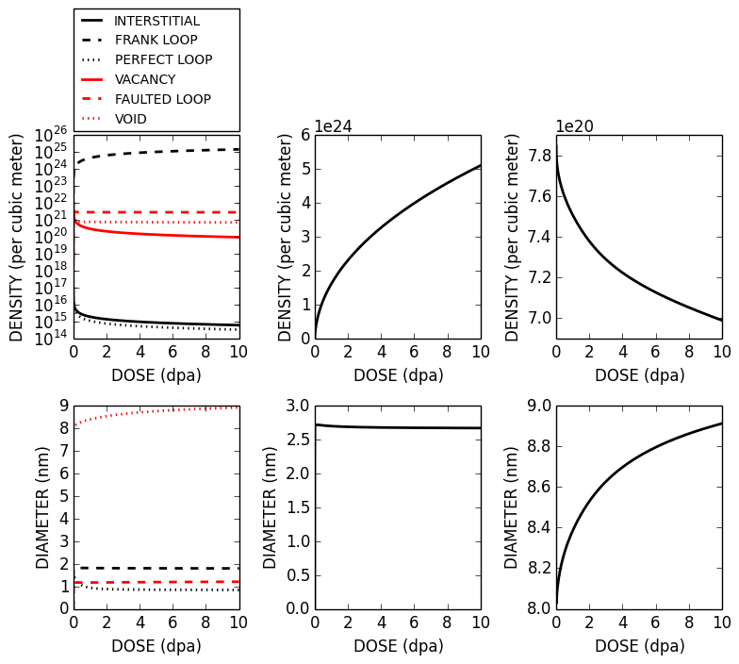
No network dislocations
5x10⁻⁷ dpa/s

Slide 5
network dislocations – 10¹⁵ m⁻²
5x10⁻⁷ dpa/s

Slide 6
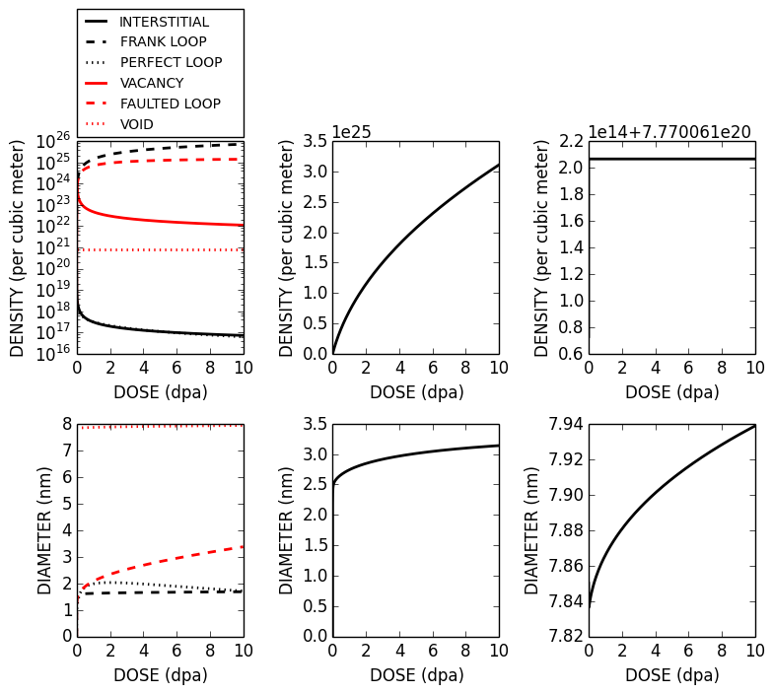
No network dislocations
5x10⁻⁴ dpa/s
All initial voids are single size at average diameter

