Slide 1
Web Services
Java Web services
- by Surendran

Slide 2
Web Services
Two Types :
SOAP implements JAX-WS specs and REST implements JAX-RS
A web service allows interaction between two application on different servers running in different languages.
Uses XML to communicate on open protocols
Are web application components
Can be published, found, and used on the Web

Slide 3
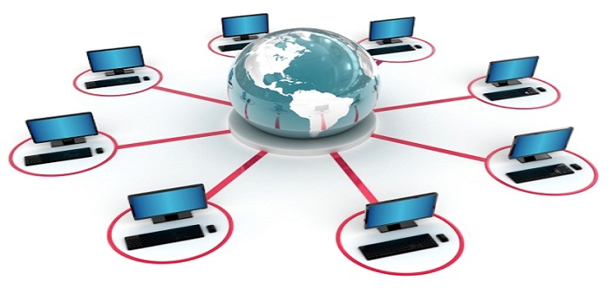
Distributed Computing
Components of a software system are shared among multiple computers
Improves efficiency and performance

Slide 4
Network Latency
Delay that happens in data communication over a network
High latency creates bottlenecks in any network communication
Decreases the communication bandwidth
Reasons :
Transmission medium issue
Errors with the router or switches
Anti-virus and similiar security processes
The propagation time of packets
Storage or disk access delays
Software malfunctions at the user level

Slide 5
State and scalability
Property of a system to handle a growing amount of work by adding resources to the system
Scalable business model implies that a company can increase sales given increased resources
Is flexible with its number of components
Adding and removing nodes should be an easy task
The entire system feels like one coherent, logical system

Slide 6
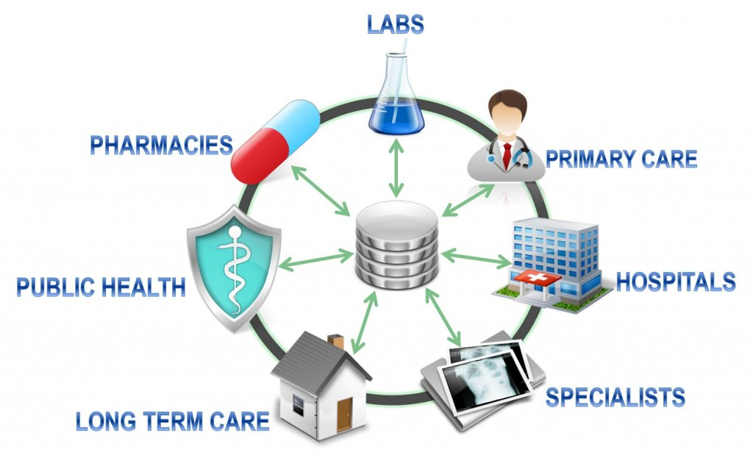
Interoperability
property that allows for the unrestricted sharing of resources between different systems
ability to share data between different components or machines
exchange of information and resources between different computers through LAN or WAN

Slide 7
Interoperability
Two types
Syntactic Interoperability: allows different software components to cooperate, even if the interface and the programming language are different
Semantic Interoperability: data exchanged between two or more systems is understandable to each system

Slide 8
Service-Oriented Architecture
Architectural style that supports a way of thinking in terms of services and service-based development and the outcomes of services
Service :
logical representation of a repeatable business activity that has a specified outcome
self-contained
May be composed of other services
a “black box” to consumers of the service

Slide 9
XML
Extensible Markup Language (XML) : a markup language that defines a set of rules for encoding documents in a format that is both human-readable and machine-readable
Emphasize simplicity, generality, and usability over the Internet

Slide 10
HTTP
Application protocol for distributed, collaborative, hypermedia information systems
Hypertext is structured text that uses logical links (hyperlinks) between nodes containing text
HTTP is the protocol to exchange or transfer hypertext

Slide 11
Simple Object Access Protocol (SOAP)
An XML based lightweight protocol for exchange of information in a decentralized, distributed environment.
Consists of three parts:
an envelope that defines a framework for describing what is in a message and how to process it,
a set of encoding rules for expressing instances of application-defined datatypes,
and a convention for representing remote procedure calls and responses
SOAP = XML + HTTP

Slide 12
SOAP Message
Ordinary XML document with :
An Envelope element that identifies the XML document as a SOAP message
A Header element that contains header information
A Body element that contains call and response information
A Fault element containing errors and status information

Slide 13
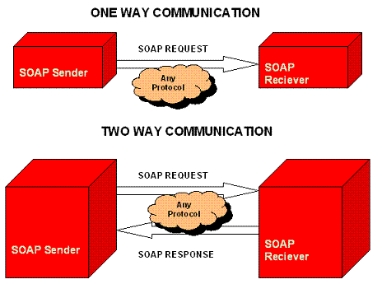
SOAP Communication

Slide 14
SOAP Component
HTTP Headers
Object Endpoint ID
SOAP method name
Method/Interface ID
SOAP Envelope
SOAP Header
Extension Headers
SOAP Body
Parameter Data

Slide 15
Development styles
contract-last : start with the Java code, and let the Web service contract (WSDL) be generated from that
contract-first: start with the WSDL contract, and use Java to implement said contract.
A WSDL file is an XML document that describes a Web service. It specifies the location of the service and the operations (or methods) the service exposes

Slide 16
Object/XML Mapper
Object/XML Mapping is the act of converting an XML document to and from an object.
Process known as XML Marshalling, or XML Serialization.
Marshaller is responsible for serializing an object (graph) to XML.
Unmarshaller deserializes the XML to an object graph
JAXB, Castor, XMLBeans, JiBX, Xstream

Slide 17
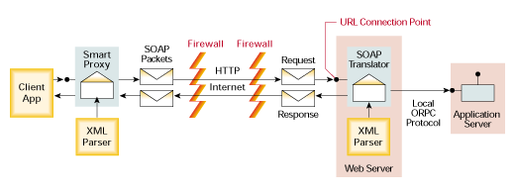
SOAP message flow

Slide 18
SOAP message
The SOAP message constructed by a SOAP Sender is sent to the SOAP Message Receiver.
The Receiver usually processes the received message and sends a response in the form of a SOAP message back to the Sender.
Universally accepted by all firewalls when HTTP is the transport layer
Slower compared to other messaging techniques - XML induces extra load on transport layer and extra processing on the receiver end

Slide 19
Basic building blocks
Envelope name space - Does not directly point to a dtd file but to a URL alias like http://www.w3.org/2003/05/soap-envelope
Envelope encoding type – Specifies the SOAP encoding rules to be followed. Does not directly point to a dtd file but to a URL alias like http://schemas.xmlsoap.org/soap/encoding/
Envelope name – Name of the SOAP message
Header – Meta information of the Envelope (optional)
Body – Application data container (required)

Slide 20
XML
<soap:Envelope xmlns:soap=http://schemas.xmlsoap.org/soap/envelope/ soap:encodingStyle=
" http://schemas.xmlsoap.org/soap/encoding/" > <soap:Header> <!-- optional block, header content here --> </soap:Header> <soap:Body> <!-- required block, request/response data comes here --> </soap:Body> </soap:Envelope>

Slide 21
Request Envelope
<soap:Envelope xmlns:soap=http://schemas.xmlsoap.org/soap/envelope/ soap:encodingStyle=
" http://schemas.xmlsoap.org/soap/encoding/" > <soap:Body> <lg:LoginRequest xmlns:lg="urn:MyServer"> <username>tom</username> <password>tom123</password> </lg:LoginRequest> </soap:Body> </soap:Envelope>

Slide 22
Response Envelope
<soap:Envelope xmlns:soap=http://schemas.xmlsoap.org/soap/envelope/ soap:encodingStyle=
" http://schemas.xmlsoap.org/soap/encoding/" > <soap:Body> <lg:LoginResponse xmlns:lg="urn:MyServer"> <Response>Congratulations !! Login Successful </Response> </lg:LoginResponse> </soap:Body> </soap:Envelope>
<Response>Login failed!! Wrong User Name Entered</Response>

Slide 23
SOAP Fault Element
<soap:Envelope xmlns:soap=http://schemas.xmlsoap.org/soap/envelope/ soap:encodingStyle=" http://schemas.xmlsoap.org/soap/encoding/" > <soap:Body> <soap:Fault> <faultcode>soap:Server</faultcode> <faultstring>Login Error</faultstring> <faultactor>Web Site User</faultactor> <detail> <lg:SiteError xmlns:lg="urn:MyServer"> <errormessage>Wrong User Name Entered</errormessage> </lg:SiteError> </detail> </soap:Body> </soap:Envelope>

Slide 24
SOAP Attachments
Send/receive binary data like images, files.
Downloaded by the receiver/sender separately
Decreases the payload to be parsed by the XML parser
<SOAP:Body> .. <productImage href="http://www.abcproducts.com/winerack.jpg"/> .. </SOAP:Body>

