Slide 1


Streamlining Bioinformatics: Adding Bioconductor Tools in Galaxy
Fabio Cumbo, Jayadev Joshi, Bryan Raubenolt, and Daniel Blankenberg

Slide 2

Outline
Let’s Install Galaxy
Brief Introduction to Galaxy
How to wrap and integrate tools
Hands on!
Basic example
R/Bioconductor tool with ArgParse
Galaxy ToolShed
Alternative ways to use R/Bioconductor in Galaxy
https://github.com/cumbof/gbcc25_training_session

Slide 3
Let’s Install Galaxy!
Open your terminal
Clone the latest version of Galaxy
$ git clone https://github.com/galaxyproject/galaxy.git
Go into the main Galaxy root directory
$ cd galaxy/
Ensure your python version >= 3.9, either system wide or with an activated environment.
$ python --version
Fire it up!
$ sh run.sh

Slide 4
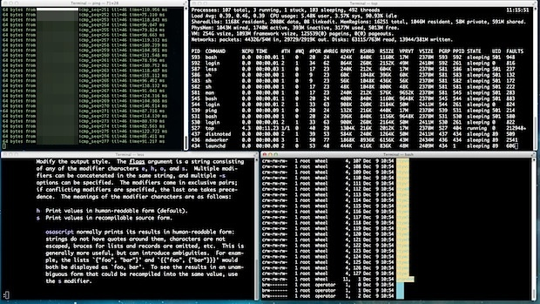
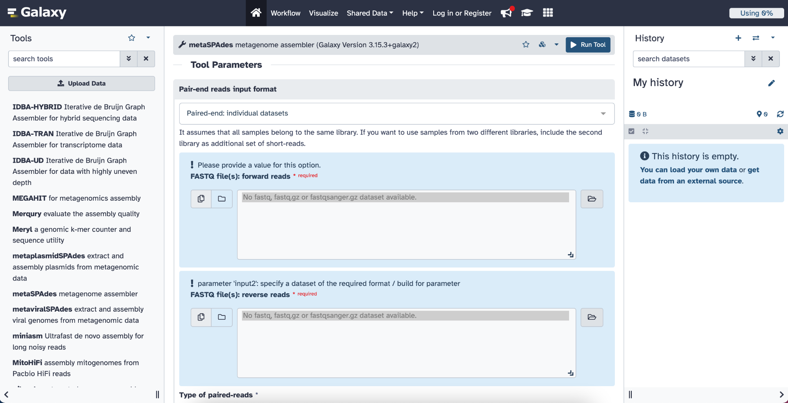
Brief Introduction to Galaxy
The Galaxy platform for accessible, reproducible and collaborative biomedical analyses: 2024 update
https://doi.org/10.1093/nar/gkae410
Worldwide community project, supporting a multitude of discipline. Open source, open access!
Workflow management system, with the aim of making computational tools accessible to researchers without a programming background. “We code so other people don’t have to”.
We write tools for bioinformatics and computational chemistry software, helping researchers bridge the gap between theory and experiments.
Reproducible, accessible, and more user friendly!
Boring and difficult!

Slide 5
Brief Introduction to Galaxy
Core values
Accessibility: users without programming experience can easily upload/retrieve data, run complex tools and workflows, and visualize data
Reproducibility: Galaxy captures information so that any user can understand and repeat a complete computational analysis
Transparency: users can share or publish their analyses (histories, workflows, visualizations)

Slide 6

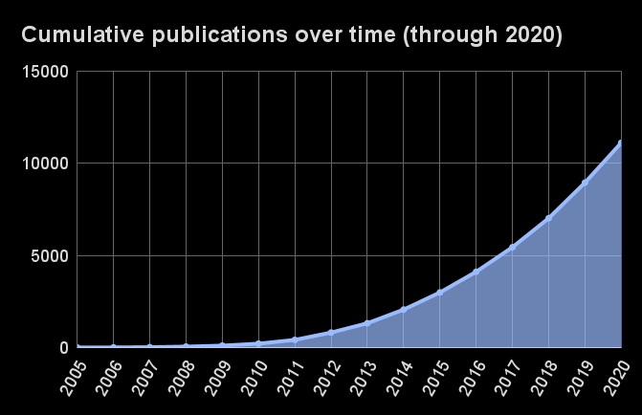
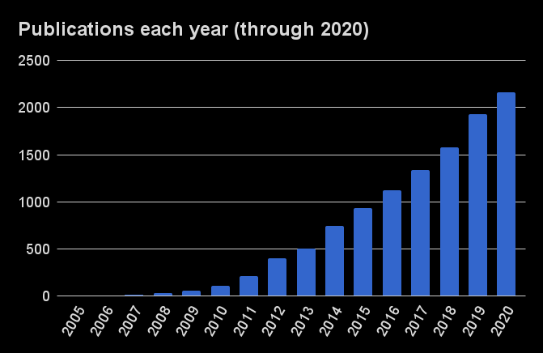

Brief Introduction to Galaxy
A few numbers

Slide 7
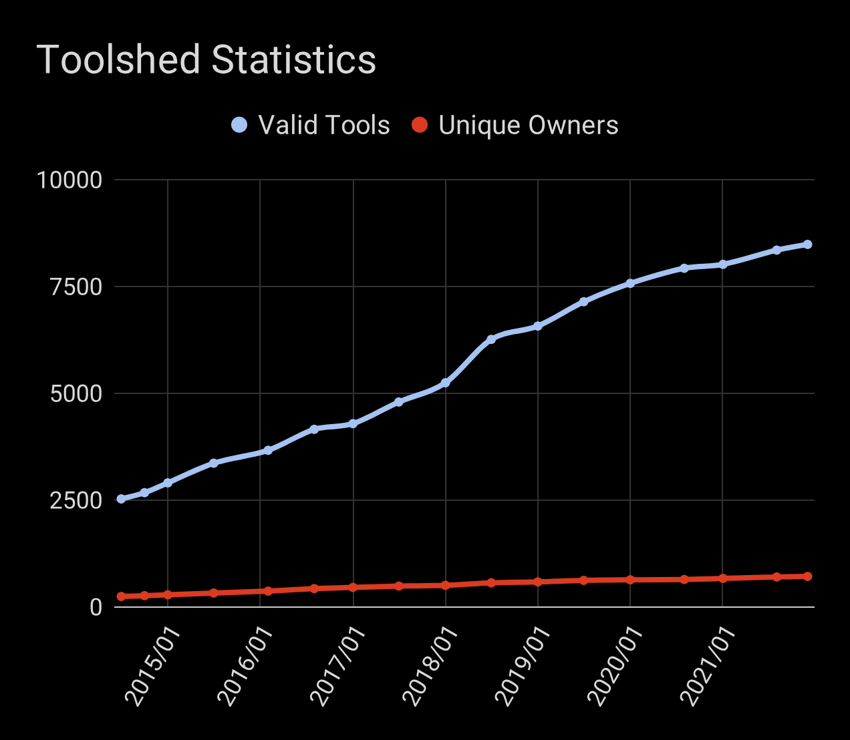
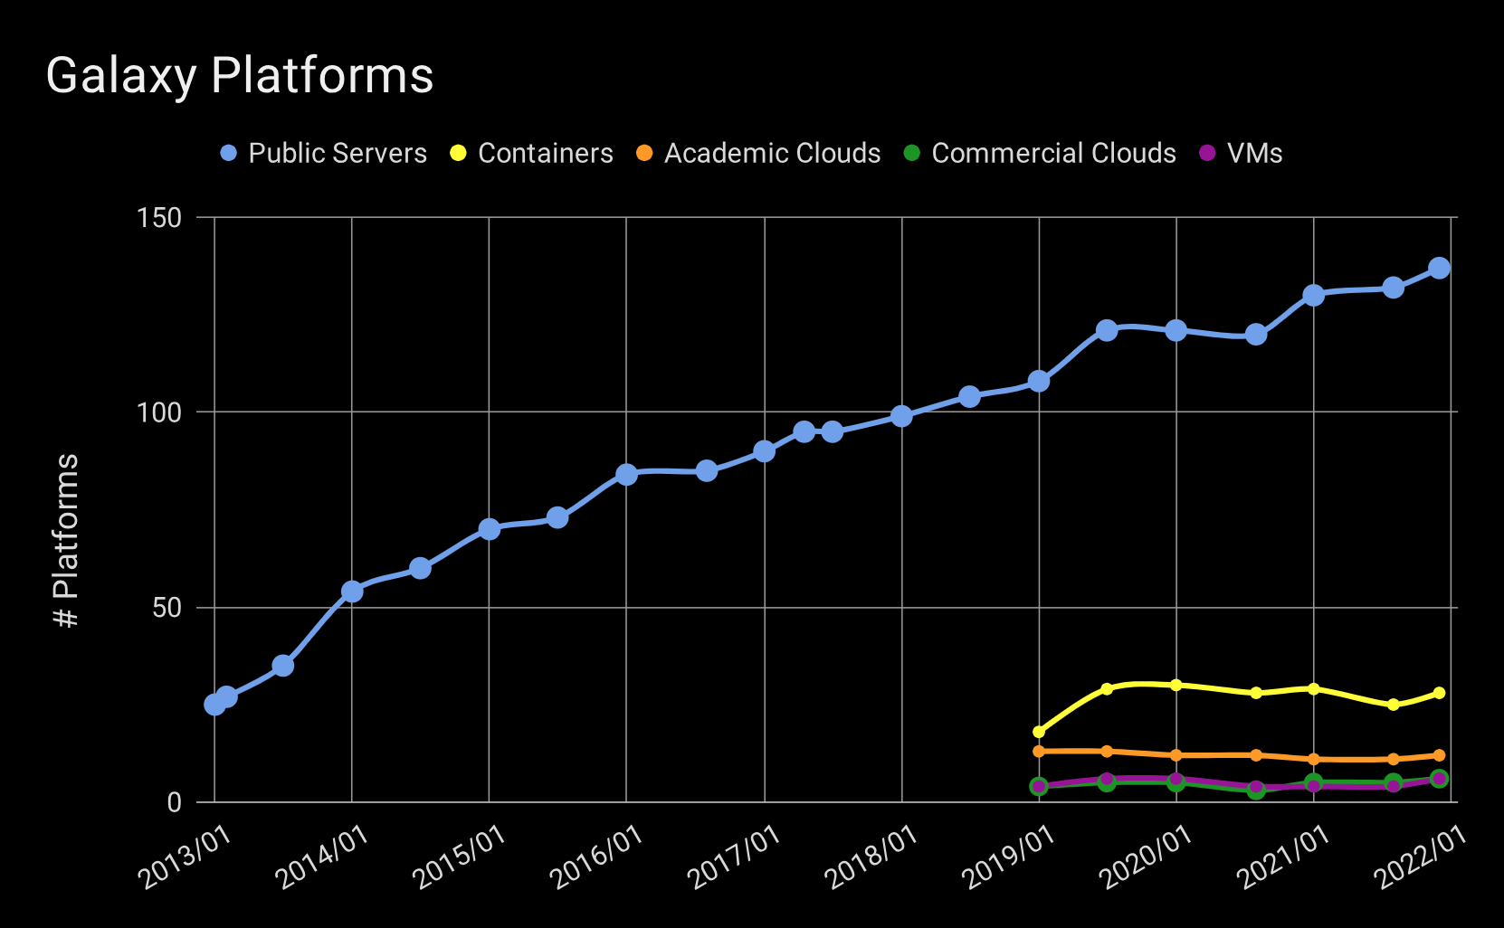
Brief Introduction to Galaxy
A few numbers

Slide 8
Wrapping and Integrating Tools
Conda/Bioconda recipes → How dependencies are made available in Galaxy
If your tool’s dependency is already in Bioconda, you’re already ahead!
Otherwise, there are a few steps needed:
1) Develop source code
2) Make a PyPI package
3) Add it to Bioconda

Slide 9
Wrapping and Integrating Tools
XML files → How your code gets a user interface (UI)
Written in Cheetah (python-based markup language)
Every tool has the same basic structure, with code blocks for:
Version control
Dependency requirements
Command line prompts
Input data
Output data
Test data
Citations

Slide 10
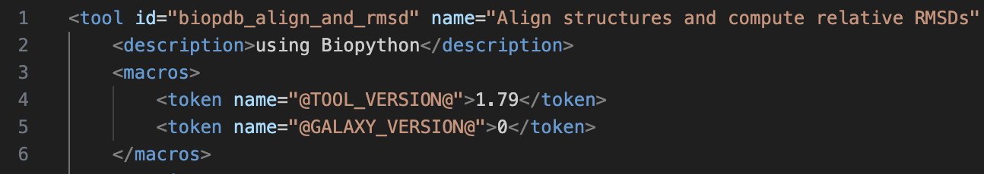
Wrapping and Integrating Tools
Version Control
Dependency version → @TOOL_VERSION@
Any changes to underlying software → bump up the version
Version of the Galaxy tool itself → @GALAXY_VERSION@
Any changes you make → bump up the version

Slide 11
Wrapping and Integrating Tools
Dependency Requirements
This specifies any software the XML tool file relies on.
Dependency must be installable via Bioconda.
Only admin can install packages (via toolshed)
When tool is launched, a virtual environment is activated with installed dependency package.

Slide 12
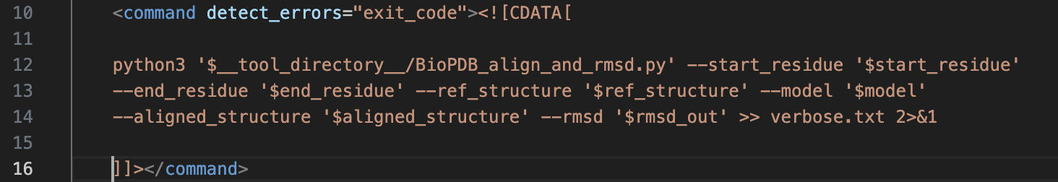
Wrapping and Integrating Tools
Command line prompts
These are the commands normally run in the terminal.
With virtual environment activated → dependency recognizes commands directly, or via auxiliary python scripts (as below).
Input parameters are passed in directly.

Slide 13
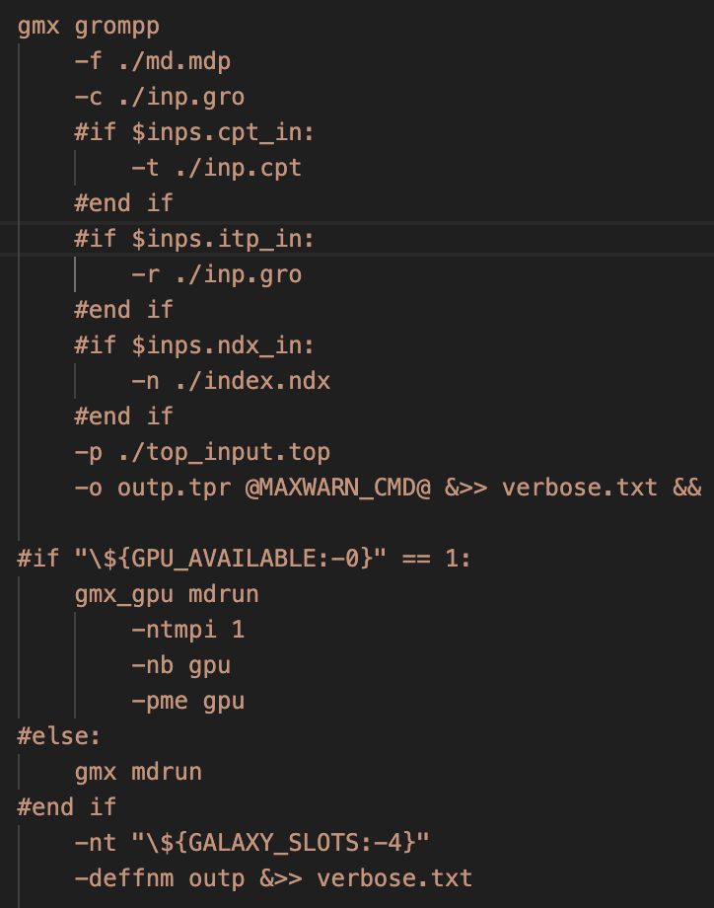
Wrapping and Integrating Tools
Command line prompts
These are the commands normally run in the terminal.
Can be conditionally set up before execution based on user input selection.

Slide 14
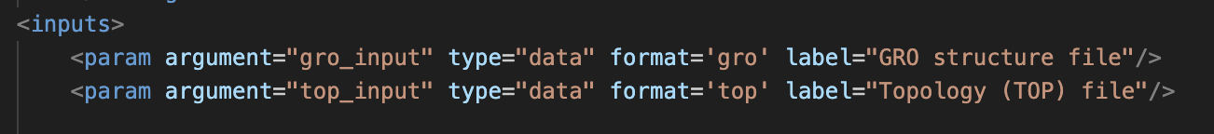
Wrapping and Integrating Tools
Input data parameters
These arguments handle all of the tool’s inputs, including data sets and other command line arguments.
Parameters can be of many types (datasets, integers, booleans, strings, etc.)

Slide 15
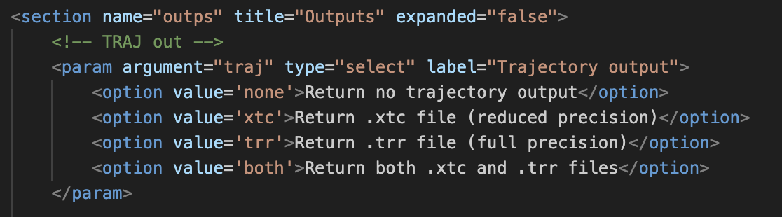
Wrapping and Integrating Tools
Input data parameters
These arguments handle all of the tool’s inputs, including data sets and other command line arguments.
Parameters can be of many types (datasets, integers, booleans, strings, etc.).
Can also be organized by sections.

Slide 16
Wrapping and Integrating Tools
Output data parameters
These arguments handle all of the tool’s outputs, mostly datasets.
Parameters can be of many formats (pdb, tabular, txt, fasta, etc.).

Slide 17
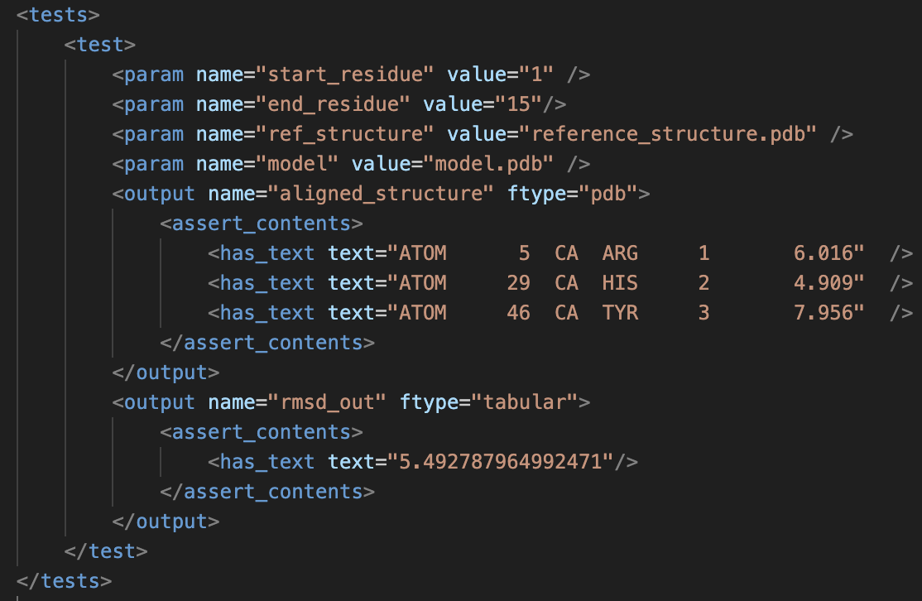
Wrapping and Integrating Tools
Testing
Helps Galaxy verify tool is working properly, ensuring reproducibility.
Tool runs with a specified set of input data sets and parameters, and assertions are made in the outputs.
Datasets must be in tool directory, in test-data/

Slide 18
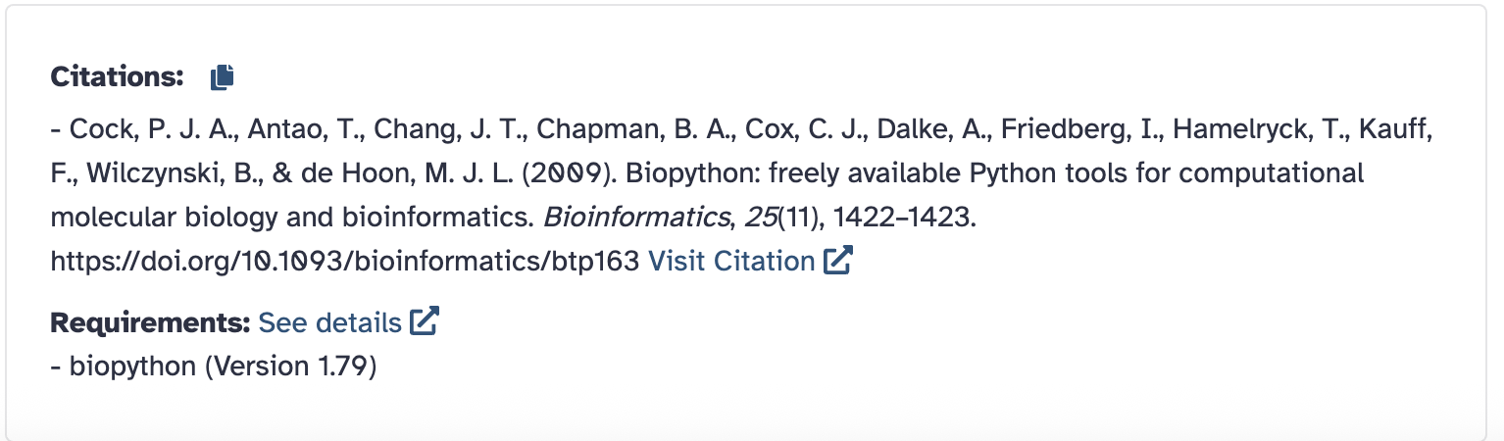
Wrapping and Integrating Tools
Tool citations
Give credit where credit is due!
Many tools use open-source dependencies.
The DOI for the associated paper is usually used.
Proper citation appears in UI.

Slide 19
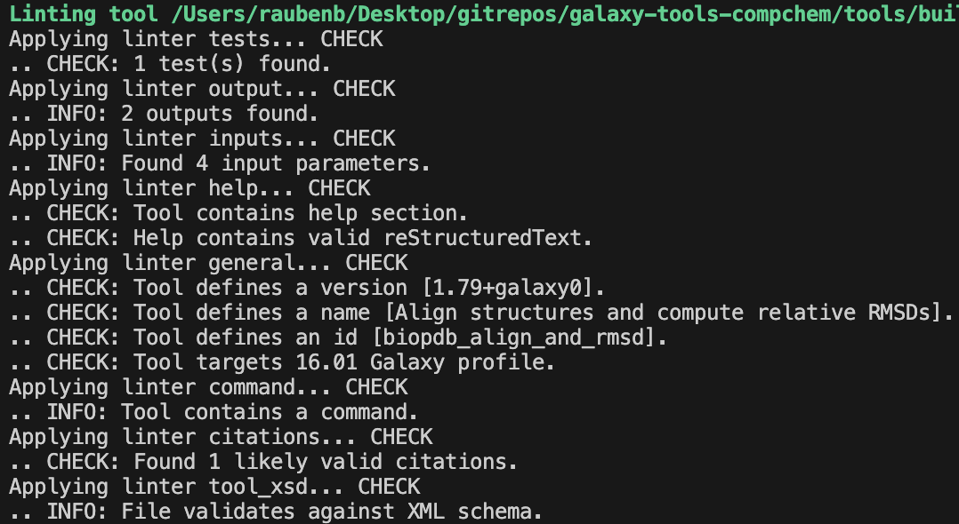
Wrapping and Integrating Tools
Planemo - helps create an XML skeleton, run tests, and lint your tool.
Install locally via Conda
$ conda install planemo
$ planemo lint tool.xml
Verifies tool has all necessary code components and formats

Slide 20
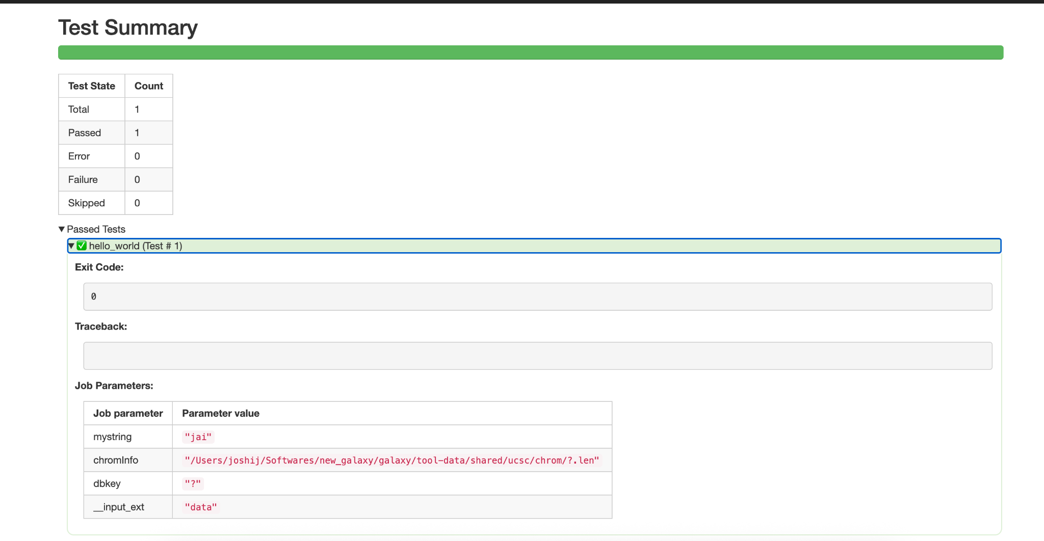
Wrapping and Integrating Tools
Planemo - helps create an XML skeleton, run tests, and lint your tool.
Install locally via Conda
$ conda install planemo
$ planemo test tool.xml
Runs the tool using the parameters in the test block.

Slide 21
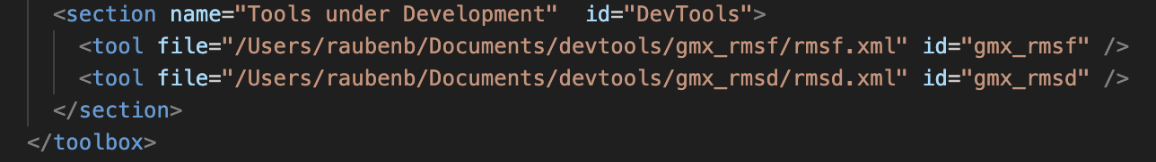
Wrapping and Integrating Tools
Manually adding tools to your Galaxy Instance
For local use, things can be simpler.
Your XML file can activate a local dependency (if not in Bioconda).
Then, simply add the tool to configs/tool_conf.xml.
It must still pass planemo lint to appear in your instance.

Slide 22
Hands on #1
Now, let’s make some tools!

Slide 23
Hands on #1
Hello World Example

Slide 24
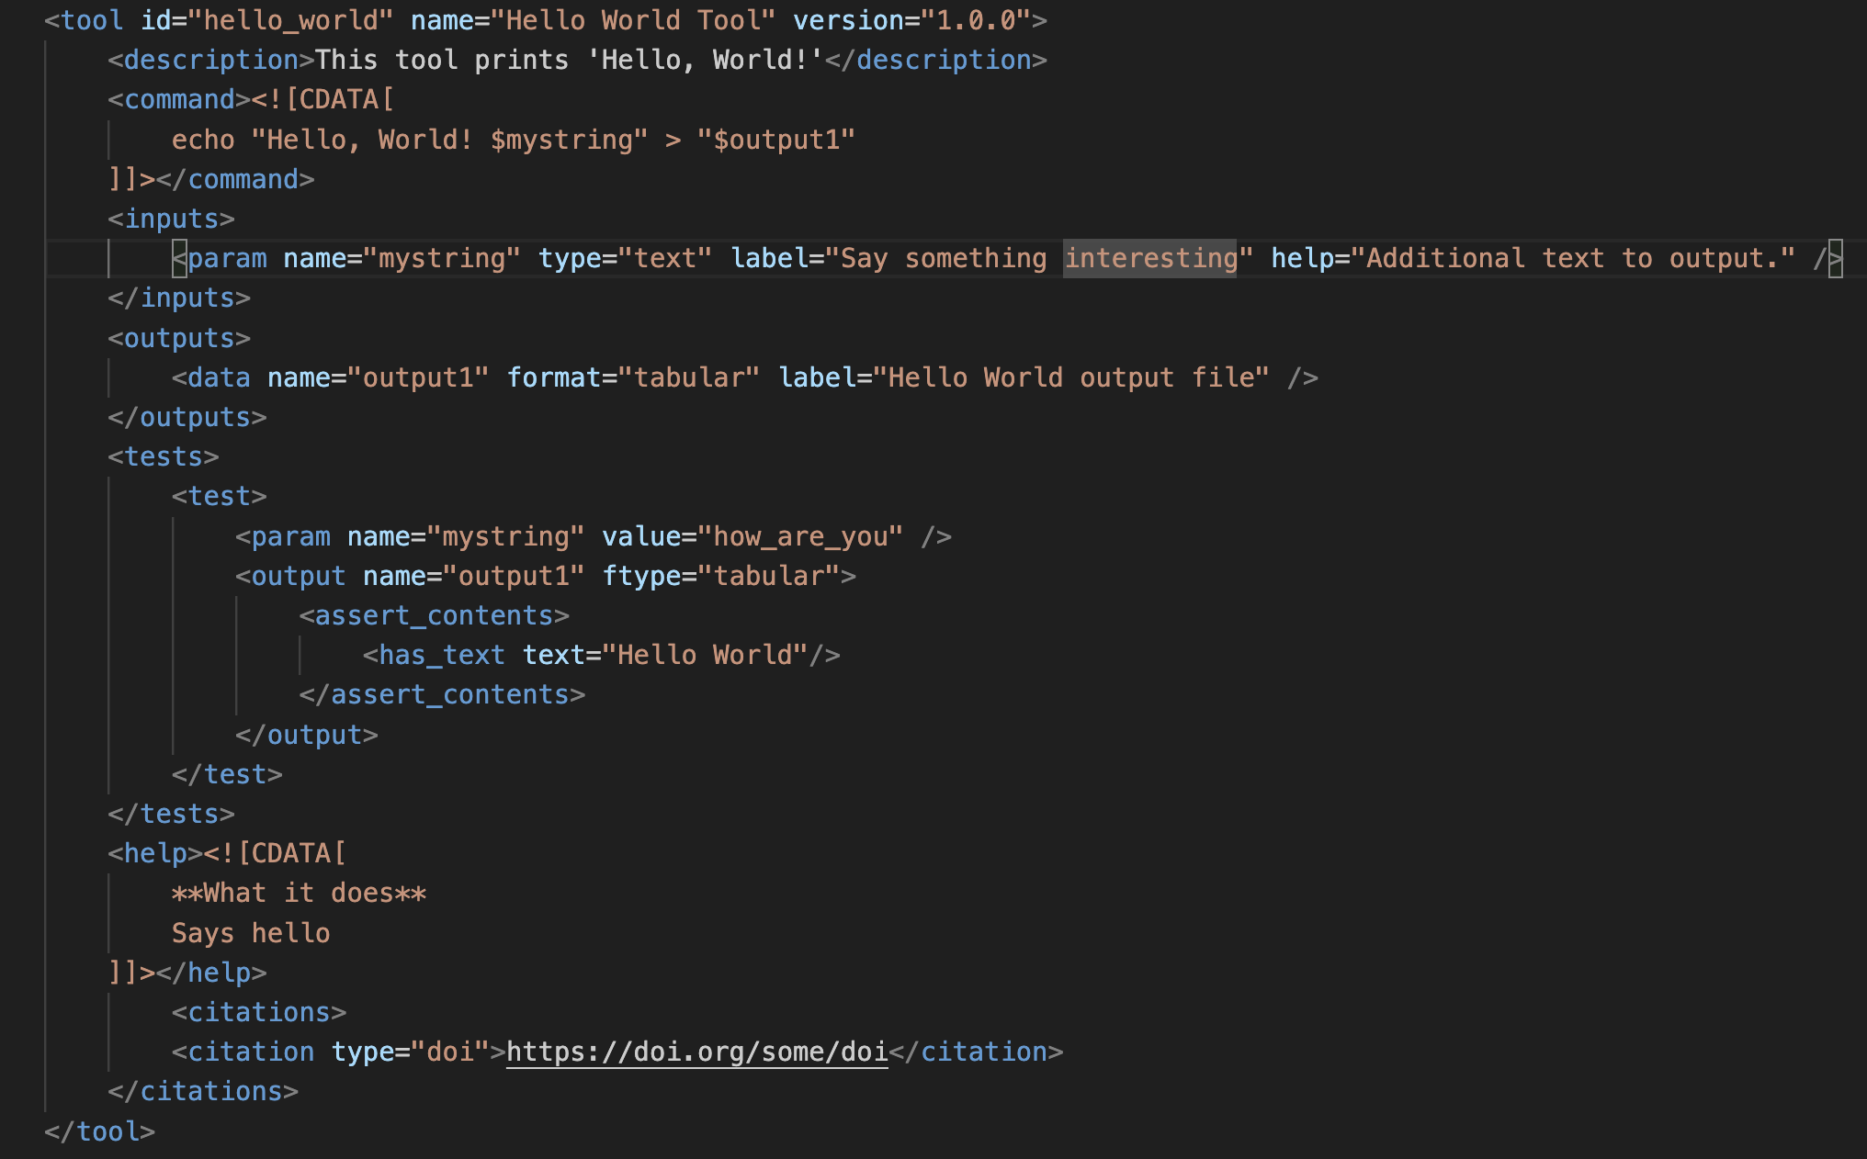
Hands on #1
Write this file in a directory of your choice.

Slide 25
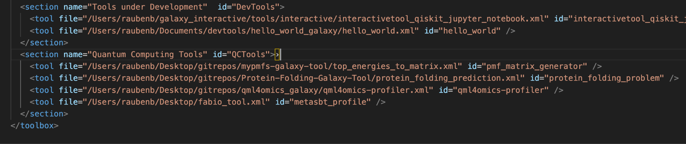
Hands on #1
Add full path to xml file and tool id, in your /galaxy/config/tool_conf.xml file

Slide 26
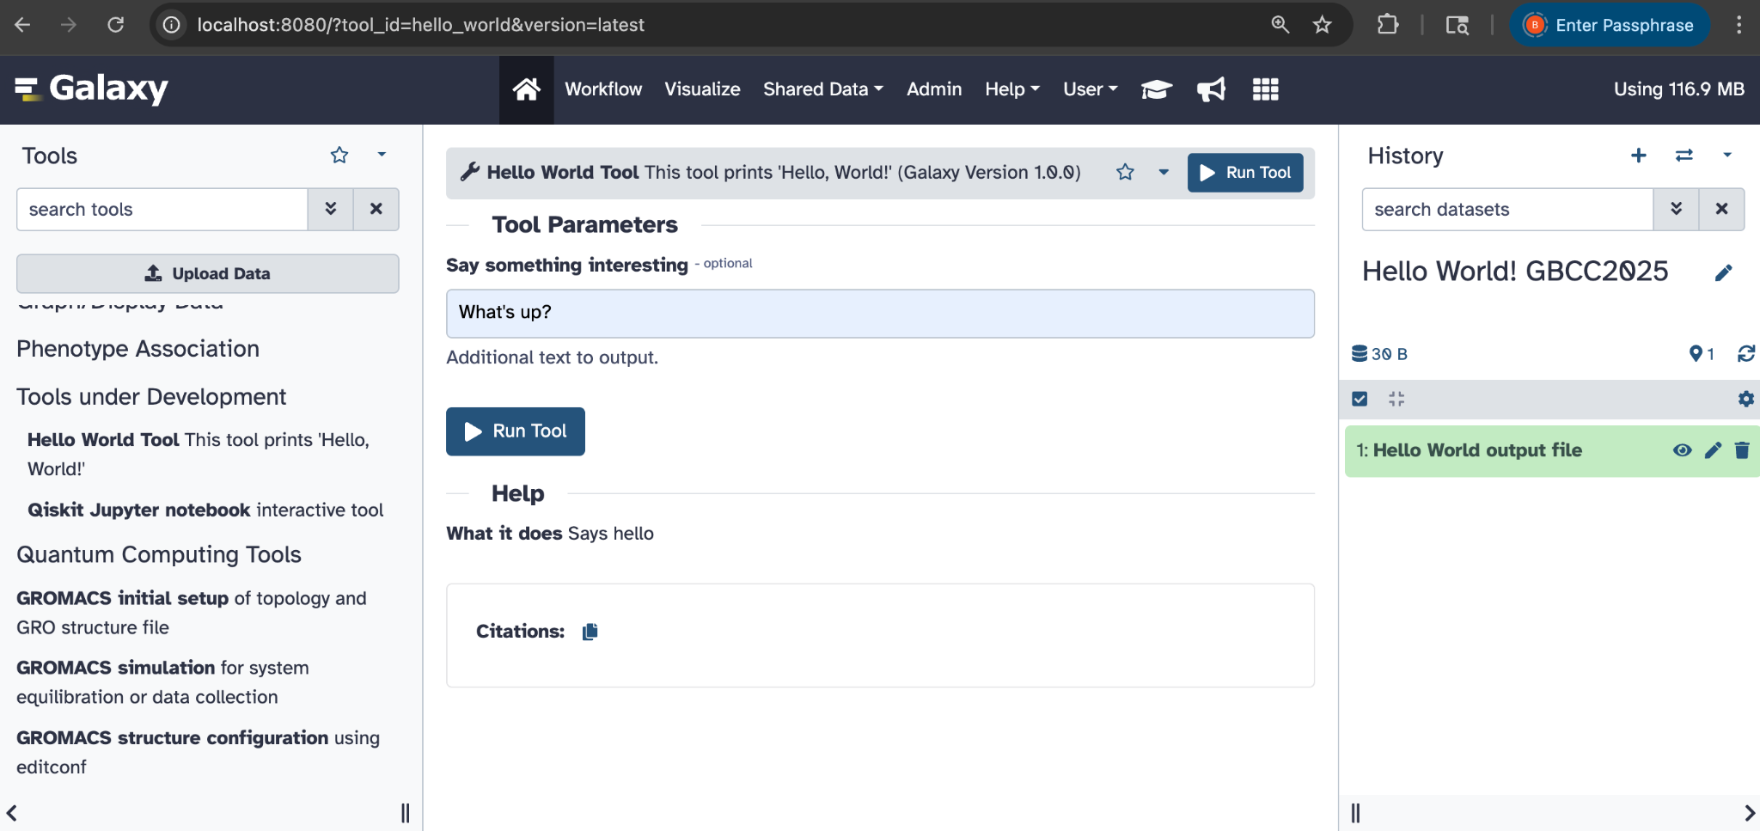
Hands on #1
Refresh your Galaxy instance (or restart if needed), and your tool should be there! Write your string of choice and hit Run Tool!

Slide 27
Hands on #2
Jay

Slide 28
Galaxy ToolShed
http://toolshed.g2.bx.psu.edu/
Tool Shed is a free tool store, with thousands of tools already available (9,310 and counting!)
For Galaxy administrators (only admin can install tools), facilitates:
installing/updating tools
For tool developers, facilitates:
sharing of Galaxy utilities
versioning: multiple installable revisions of any repository can be present in Galaxy
https://training.galaxyproject.org/training-material/topics/dev/tutorials/toolshed/slides.html

Slide 29
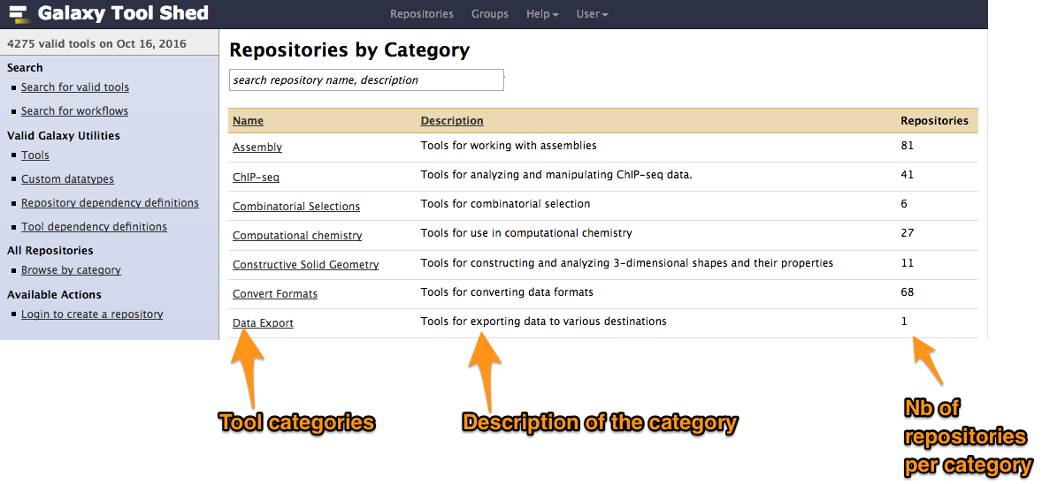
Galaxy ToolShed
http://toolshed.g2.bx.psu.edu/
https://training.galaxyproject.org/training-material/topics/dev/tutorials/toolshed/slides.html

Slide 30
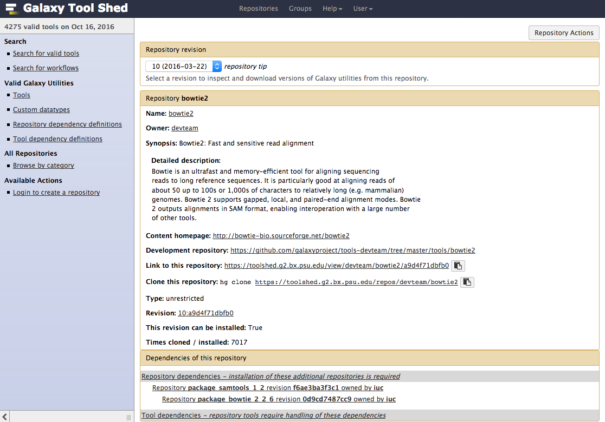
Galaxy ToolShed
http://toolshed.g2.bx.psu.edu/
https://training.galaxyproject.org/training-material/topics/dev/tutorials/toolshed/slides.html

Slide 31
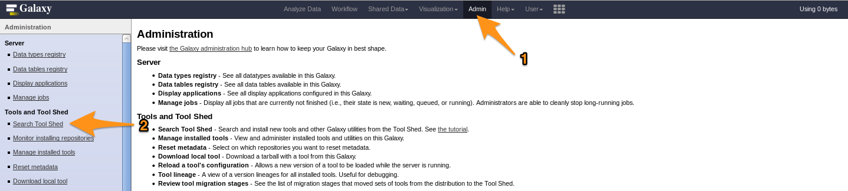
Galaxy ToolShed
http://toolshed.g2.bx.psu.edu/
https://training.galaxyproject.org/training-material/topics/dev/tutorials/toolshed/slides.html

Slide 32
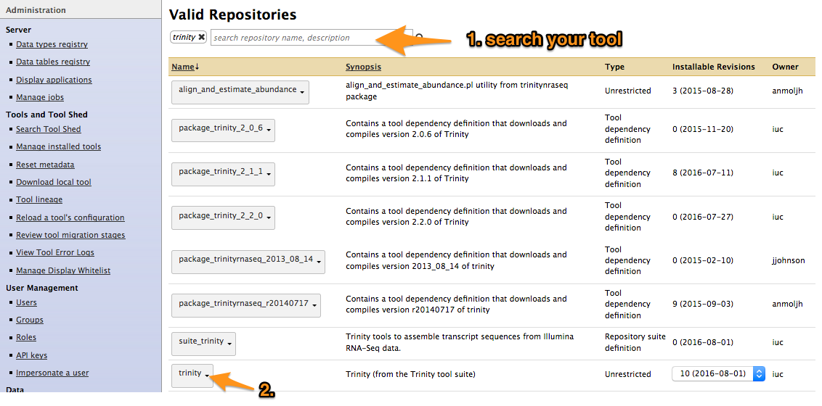
Galaxy ToolShed
http://toolshed.g2.bx.psu.edu/
https://training.galaxyproject.org/training-material/topics/dev/tutorials/toolshed/slides.html

Slide 33
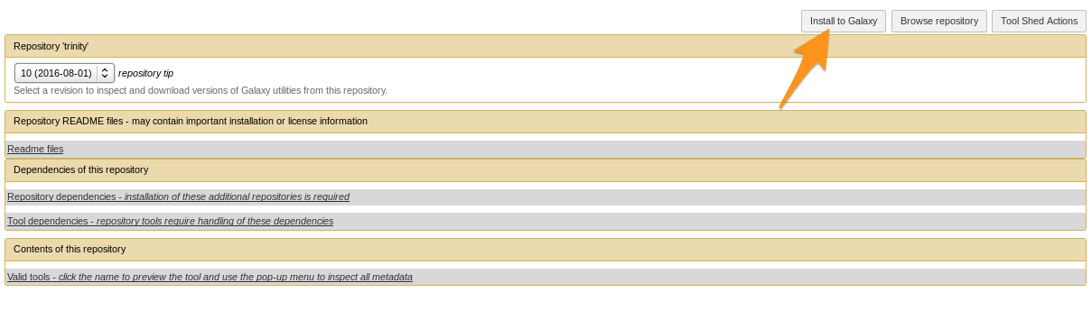
Galaxy ToolShed
http://toolshed.g2.bx.psu.edu/
https://training.galaxyproject.org/training-material/topics/dev/tutorials/toolshed/slides.html

Slide 34
Galaxy ToolShed
http://toolshed.g2.bx.psu.edu/
Initialize a .shed.yml file
$ planemo shed_init --name=<name>
--owner=<shed_username>
--description=<short description>
[--remote_repository_url=<URL to .shed.yml on github>]
[--homepage_url=<Homepage for tool.>]
[--long_description=<long description>]
[--category=<category name>]*
Lint your .shed.yml file
$ planemo shed_lint --tools
Create the tool repository on the ToolShed
$ planemo shed_create --shed_target testtoolshed
https://planemo.readthedocs.io/en/master/publishing.html

Slide 35
argparse: Provides command-line argument parsing functionality for R scripts, similar to Python’s argparse. Useful for creating flexible, user-configurable command-line tools in R.
clusterProfiler: A Bioconductor package for functional enrichment analysis (GO, KEGG, etc.) of gene clusters. It supports visualization and comparison of biological themes among gene clusters.
org.Hs.eg.db: An annotation package containing mappings between human gene identifiers and biological metadata. Often used with Bioconductor workflows for converting gene symbols, Entrez IDs, and other identifiers.
ggplot2: A popular and powerful data visualization library for R based on the Grammar of Graphics. Enables creating complex, multi-layered, publication-quality plots with concise syntax.
enrichplot: A Bioconductor package providing visualization tools specifically for enrichment analysis results. Integrates seamlessly with clusterProfiler to plot dotplots, enrichment maps, and other diagrams.

Slide 36
Alternative ways to use R/Bioconductor in Galaxy

Slide 37
Alternative ways to use
R/Bioconductor in Galaxy

Slide 38
Thanks for joining this Training Session!

