Slide 1

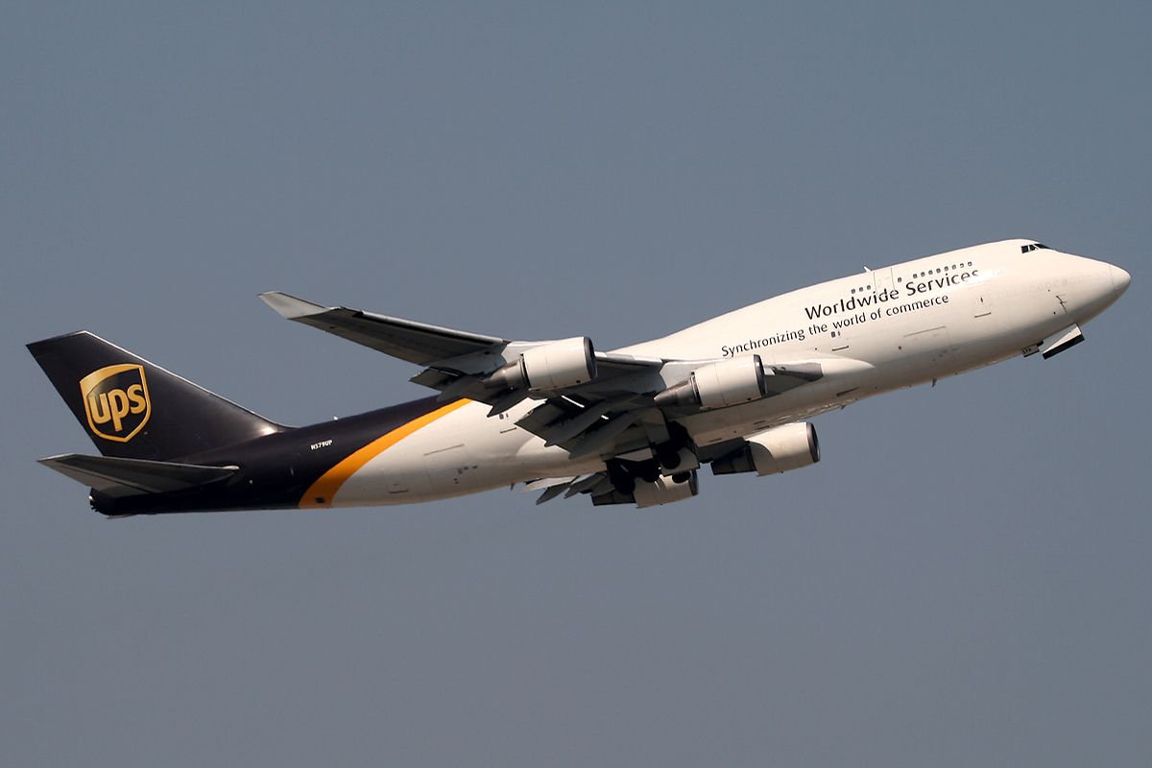
2019 Stock Portfolio Recommendation: UPS
By
Chima “Francis” Umeakunne

Slide 2
So, you are a savvy investor in search of your next venture.

Slide 3
You found a candidate UPS, United Parcel Service Inc. and you heard some good things.

Slide 4
BUT…you need more quality data to make a smart decision.

Slide 5




Your Decision Metrics
 | BUY | HOLD | SELL
Valuation Metrics
Historic Performance
Current Value
Exit Price (+5% to +25%)
Current Industry
Emerging Markets
Innovation
Source: Motley Fool, TDAmeritrade, CFA Institute
= GREAT
= OKAY
= POOR
= NA

Slide 6

BUY, HOLD, OR SELL?
BUY Company = Overall GREAT short term and long-term value
HOLD Company = Overall GREAT long- term value
SELL Company = Overall OKAY or POOR long-term value

Slide 7
Well you've come to the right place. Our team of top-notch analysts have formulated a quality valuation for your company.

Slide 8
Now let’s walk through why our team gives your company, UPS, a HOLD rating and recommend that you take a moderate long-term position.

Slide 9


Who is UPS?
Industry: Courier Services
Size: LARGE with about 481,000 employees (2016)
Presence: United States, Canada and Latin America, Europe, the Asia Pacific, the Indian sub-continent, the Middle East, Africa, and Australia
Market by Application
Business-To-Business (B2B)
Business-To-Consumer (B2C)
Consumer-To-Consumer (C2C)
Market by Medium
Air Transport (Airplane/Drone*)
Land Transport (Truck/Rail)
Sea Transport (Ocean Liner)
Source: Mergent, Yahoo Finance, MarketWatch
Company Overview
Risk Analysis
Ratio Analysis
Financial Analysis
Recommendation: HOLD
Market Performance

Slide 10
Does UPS have an Origin Story?
Founded in 1907 in Seattle, Washington
Focused on leading mainland deliveries in the United States
‘Went Public’ 92 years later in 1999 (Share Price $50.00)
Expanded Globally
Two decades later in November 2019 (Share Price $118.62)
Total Gains: +$68.62 per Share |+137% Overall | +6.86% Average Annual
Company Overview
Risk Analysis
Ratio Analysis
Financial Analysis
Recommendation: HOLD
Market Performance

Slide 11
Where is UPS going?
To answer that, we need to explore the competition and changes to industry.
And then see what UPS is doing to stay competitive.
Company Overview
Risk Analysis
Ratio Analysis
Financial Analysis
Recommendation: HOLD
Market Performance

Slide 12
How does it compare with the competition?
* After UPS, TOP 3 Global Couriers Circled
Source: Mergent
Company Overview
Risk Analysis
Ratio Analysis
Financial Analysis
Recommendation: HOLD
Market Performance

Slide 13



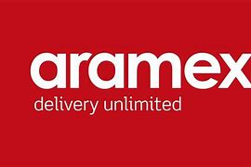








The Competition
International (Global)
Domestic
International (Regional)
*2 – 30 Billion in Revenue each *Government Owned
*Foreign Nation Limited
Source: Glassdoor
Company Overview
Risk Analysis
Ratio Analysis
Financial Analysis
Recommendation: HOLD
Market Performance

Slide 14
Where is the money coming from?
*8%
*18%
*6%
*Profit Margin
Company Overview
Risk Analysis
Ratio Analysis
Financial Analysis
Recommendation: HOLD
Market Performance

Slide 15
How does the margin look over time?
Company Overview
Risk Analysis
Ratio Analysis
Financial Analysis
Recommendation: HOLD
Market Performance

Slide 16
Where does UPS stand in the market?
12/11/2017: acquired Sandler & Travis Trade Advisory Services Inc., a global trade compliance management firm
10/08/2014: bought i-parcel LLC
Amazon initiated its trial run of “shipping With Amazon” in February, amongst other things.
Company Overview
Risk Analysis
Raito Analysis
Financial Analysis
Recommendation: HOLD
Market Performance

Slide 17
What are the risks to UPS’s Growth?
Company Overview
Risk Analysis
Ratio Analysis
Financial Analysis
Recommendation: HOLD
Market Performance

Slide 18
Economic Threats?
Shift from traditional B2B to B2C world
“One of the most prominent shifts occurring in the world of commerce today is the expansion of B2C capabilities within traditional B2B companies.” - Infoverity
Collective top client loss
“No single customer accounts for 10% or more of consolidated revenue…however, collectively, some…large customers might account for a relatively significant portion of the growth in revenue…” - UPS 2018 10K
Union-heavy…Good or Bad?
“Significant number of employees…employed under national master agreement…Strikes, work stoppages and slowdowns by our employees could adversely affect…meeting customers’ needs,…We may face permanent loss of customers if…unable to provide uninterrupted service, and this could materially adversely effect our business, financial position and results of operations.” - UPS 2018 10K
Company Overview
Risk Analysis
Ratio Analysis
Financial Analysis
Recommendation: HOLD
Market Performance

Slide 19
Geopolitical Threats?
Political Upheaval
“In 2017 the U.K. government initiated a process to leave the E.U., and the U.K. and the E.U. continue to negotiate the future relationship between the U.K. and the E.U., which could take several years to finalize. The results of these negotiations could result in, among other things, fewer goods being transported globally, volatility in currency exchange rates and further regulations relating to, among other things, trade and aviation. Any of the foregoing could materially adversely affect our business, financial position and results of operations” - UPS 2018 10K
Global Warming Regulations
“Concern over climate change, including the impact of global warming, has led to significant legislative and regulatory efforts, particularly internationally but also in the United States, to limit greenhouse gas (“GHG”) emissions…exposes our transportation and logistics businesses to significant new taxes, fees and other costs.” - UPS 2018 10K
Company Overview
Risk Analysis
Ratio Analysis
Financial Analysis
Recommendation: HOLD
Market Performance

Slide 20

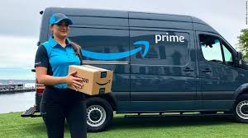
Future Competition?
“We face significant competition on a local, regional, national and international basis. “- UPS 2018 10K
“….including start ups and other companies that combine technologies with crowdsourcing to focus on local market needs.” - UPS 2018 10K
“…other sources in the future, including as a result of the development of new technologies. Some of our competitors may have cost and organizational structures that differ from ours and may offer services and pricing terms that we may not be willing or able to offer.“ - UPS 2018 10K
Company Overview
Risk Analysis
Ratio Analysis
Financial Analysis
Recommendation: HOLD
Market Performance

Slide 21
We get the risks, and we see how UPS sales compares with the competition. BUT what is its value in terms of the financials. What is UPS worth to me today?
Company Overview
Risk Analysis
Ratio Analysis
Financial Analysis
Recommendation: HOLD
Market Performance

Slide 22
What are the ratios?
Source: Forbes, Mergent
Company Overview
Risk Analysis
Ratio Analysis
Financial Analysis
Recommendation: HOLD
Market Performance

Slide 23
What is the Company Valuation?
Model 1: Discounted Cash Flow (DCF)
Weight: 50% | Value: $151.06 (+27%)
Current Price: $118.62
Model 2: Relative Valuation
Weight: 30% | Value: $92.56 (-22%)
Estimated Value: $123.73 (+4%)
Model 3: Monte Carlo Simulation
Weight: 20% | Value: $102.17 (-14%)
Why the Weight?
DCF model best considers the company’s historical cash flows
Relative Valuation limited by representative competitors, regional or limited sector couriers
Monte Carlo ignores all relevant factors outside of historic prices
Company Overview
Risk Analysis
Ratio Analysis
Financial Analysis
Recommendation: HOLD
Market Performance

Slide 24
Decision Breakdown: HOLD
 | Rating | HOLD
Valuation Metric |  | $123.73 today is just shy of 5% upside
Historic Performance |  | Consistently beat S&P 500, but not over 20% margin
Current Value |  | Underpriced by about 4%
Exit Price (+5 to +25%) |  | +5 % worst case estimate +25% best case estimate Dependencies: Market Disruptors, Trade Policies
Current Industry |  | E-commerce boom is gas for the courier industry fire
Emerging Markets |  | E-Commerce and International Markets have few global courier leaders
Innovation |  | SMART HUB, Drone deliveries, Electric Vehicles, Enhanced Tracking, Modern UI
Source: Motley Fool, TDAmeritrade, CFA Institute
*Statements regard only the past decade
= GREAT
= OKAY
= POOR

Slide 25
Breaking the 4th Wall
You would be $410,400 richer today; minus commission and other fees

Slide 26

Questions
This Photo by Unknown Author is licensed under CC BY-NC

Slide 27
Resources
TDAmeritrade
The Motley Fool
Glassdoor
MarketWatch
Yahoo Finance
Mergent
Forbes
UPS 2018 10K

Slide 28
Appendix

Slide 29
The Three Methods used for Company Valuation
Relative Valuation
FedEx | DHL| EXPD| XPO | ALK | NEX.F
P/E - $93.69
EBITDA Multiplier - $114.08
Sales Multiplier - $69.91
Target Stock Price - $92.56
Stock Price Monte Carlo
Current Price: $118.62
Average UPS Return: 0.022%(0.20%)
Target Stock Price - $102.17
Max: $116.17 (No BUY)
Percentile:
85%: $106.31 HOLD
85%: $106.31 SELL
DCF Model
EV/share - $175.35 - Risk Free Rate: 2.0%
Terminal Value - $162,723.46 - Market Risk Premium: 6.40%
Target Stock Price - $151.06 - Annual Sales growth: 5.0%
Company Overview
Ratio Analysis
Risk Analysis
Financial Analysis
Recommendation: HOLD
Market Performance

