Slide 1
IO tuning tool Most APK
2016/1/14
Yang Jun

Slide 2
Agenda
Root your device
Relationship with most tool
APK usage and function
IO bench present

Slide 3
Root your device
App project location:
ssh://junyan1x@git-ger-6.devtools.intel.com:29418/most_io_tunign_tool-most_android_app
1. Clone this project
2. cd mostbin folder under project. Unzip device_root.zip
3. execute root_script.sh
Because app need root right, so we use SuperSU to achive this.

Slide 4
Relationship with most tool
This apk target is execute most tools cmd through android application and display the result with GUI.
Most tools bin include: blktrace & blkparse & most
(Most tools can record all IO operations on the DUT)
There is another script filter.sh which used for filter IO log for target launched app. This script will also execute by most apk.

Slide 5
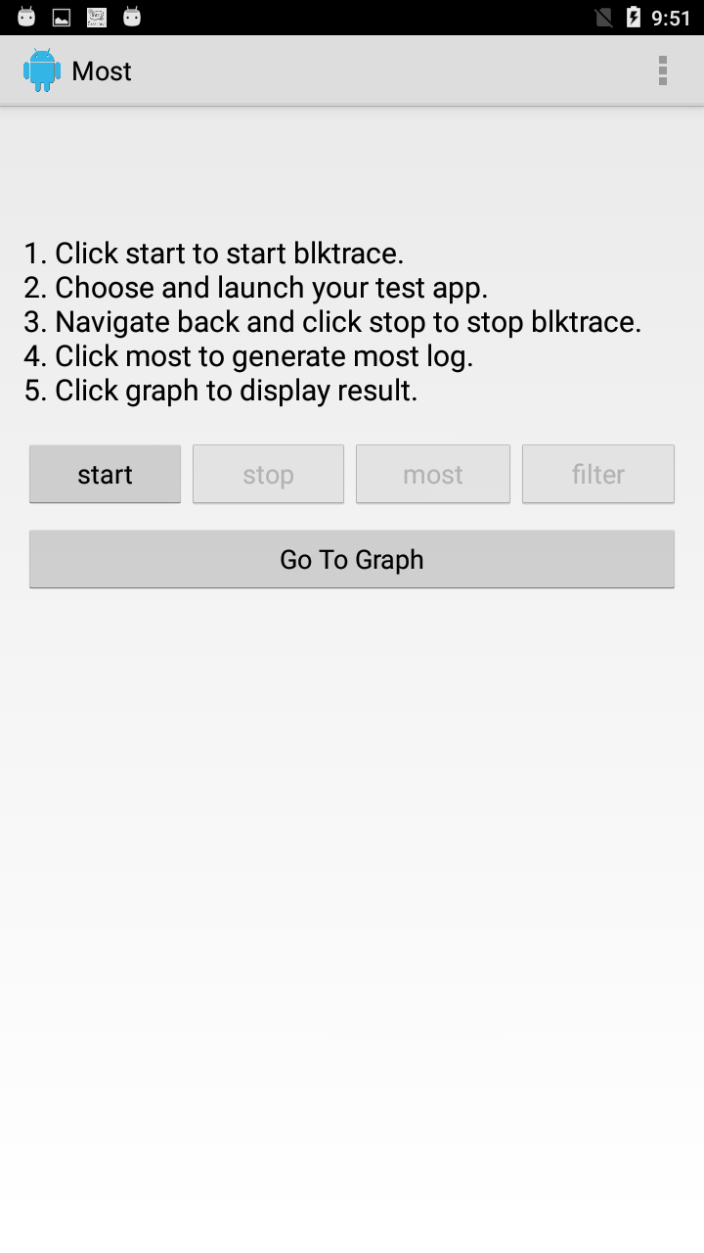
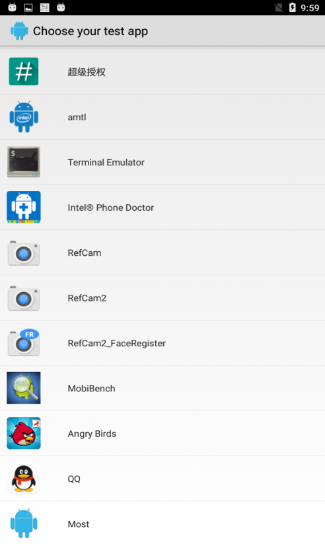
APK usage and function
1. Click start button, then blktrace will start, and an app list show up. Choose your test app.
Click start will execute: “/data/blktrace -d /dev/block/mmcblk0 -o /sdcard/result” background

Slide 6

2. Launch your test app, such as QQ. After app launched nav back. And click stop to stop blktrace.
Click stop will execute: "pgrep /data/blktrace | xargs kill"

Slide 7
3. Click most and then click filter
Click most will execute:
1) "/data/blkparse -q -i /sdcard/result> /sdcard/result.p"
2) "/data/most EXT4 /dev/block/mmcblk0p6 /sdcard/result.p /sdcard/cache_result.txt"
3) "/data/most EXT4 /dev/block/mmcblk0p11 /sdcard/result.p /sdcard/data_result.txt"
4) "/data/most EXT4 /dev/block/mmcblk0p5 /sdcard/result.p /sdcard/system_result.txt“
Click filter will execute:
1) "/data/filter.sh /sdcard/cache_result.txt"
2) "/data/filter.sh /sdcard/data_result.txt"
3) "/data/filter.sh /sdcard/system_result.txt"

Slide 8
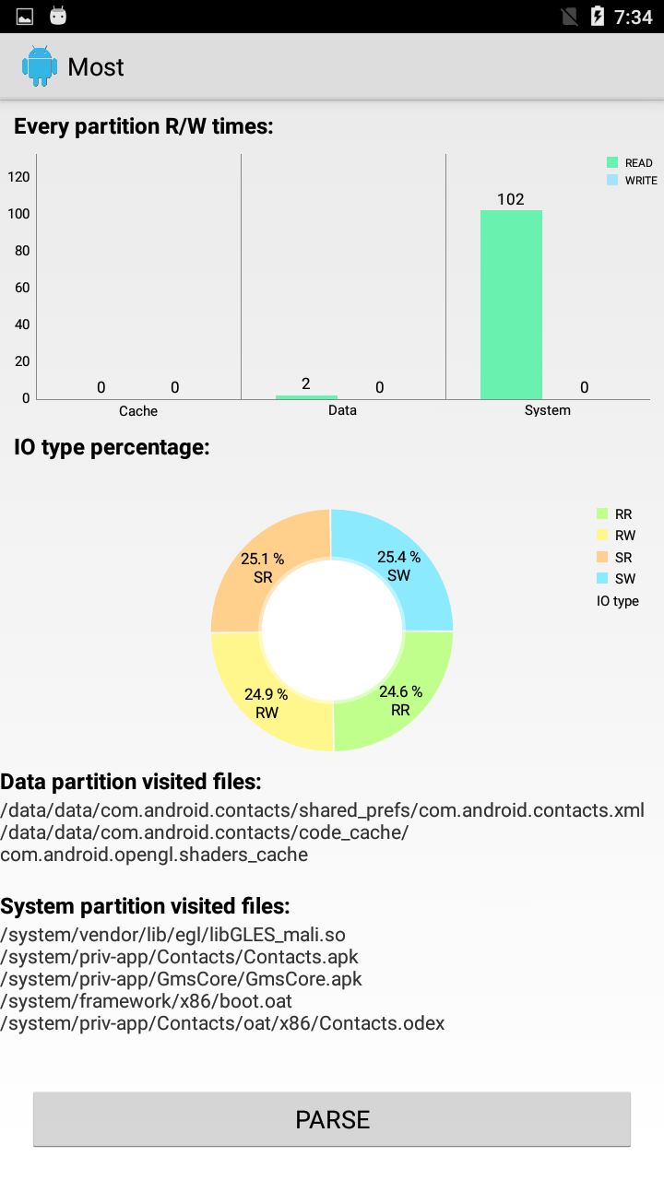
3. Click go to graph to display UI
Here is a demo. You can 3 types info:
R/W times on every partition
IO type percentage of each one
Which files does the apk visited

Slide 9
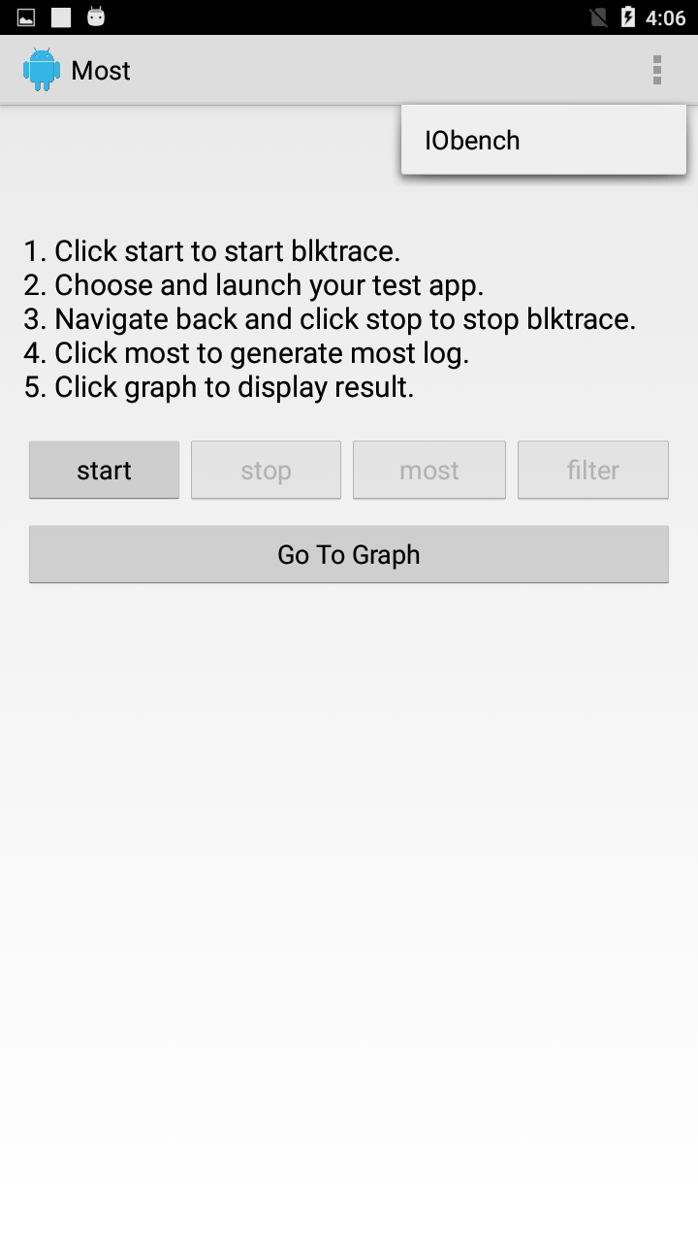
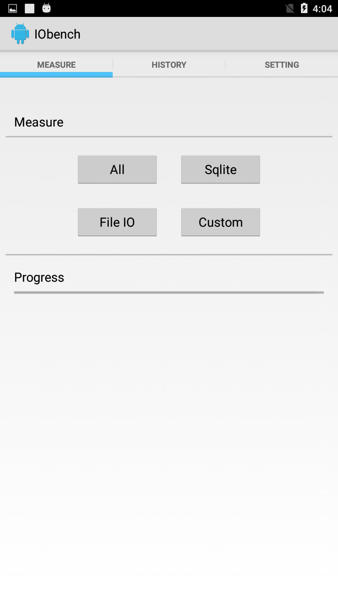
IO bench present
1. Enter IOBench

Slide 10
Function of the four buttons :
File IO: Test file system IOBench result
Sqlite: Test sqlite database IO Bench
All: Test file system and sqlite both
Custom: Run user’s config

Slide 11
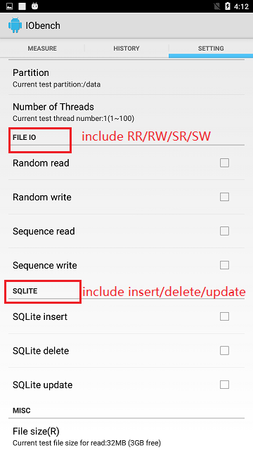
Custom can config which parts need to run. File system include RR/RW/SR/SW test. Sqlite include inset/delete/update test.
You can also set other config options from this page. Such as partition or
test file size.

Slide 12
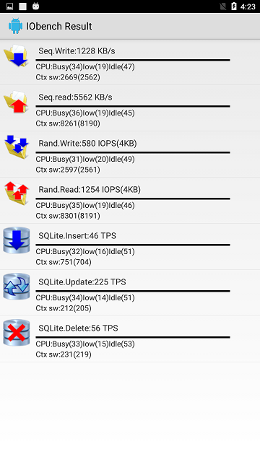
Here is the example result of full test:
The result will be record in database, you can open from history tab.

