Slide 1
Build a CNI plugin from scratch

Slide 2
Reference
https://github.com/eranyanay/cni-from-scratch
https://ronaknathani.com/blog/2020/08/how-a-kubernetes-pod-gets-an-ip-address/
https://github.com/cumulus-joeyyang/demoCNI

Slide 3
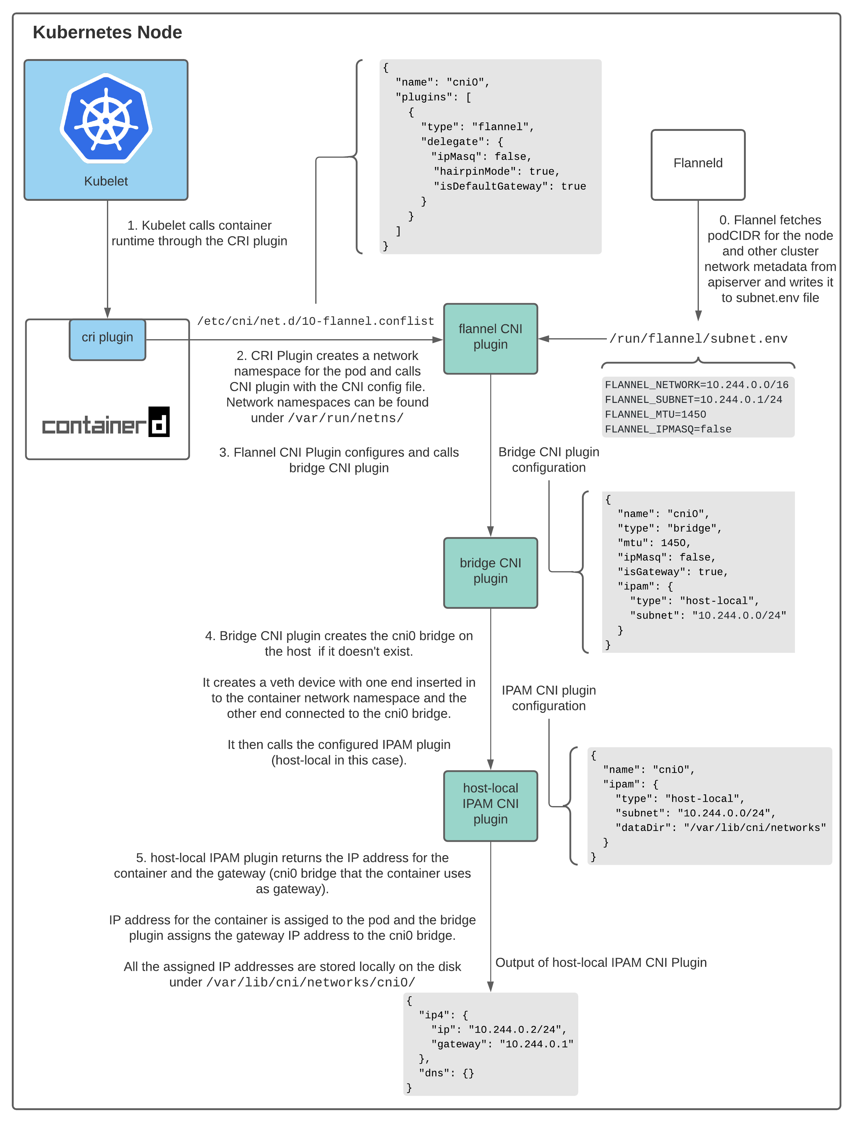
When CNI plug is called?

Slide 4
How does a CNI plugin work in K8S?
Config file(in /etc/cni/net.d/)
Provides configuration to kubelet/cri and plugin itself
A daemon
Handles reachability - manages routings across the cluster
A CNI binary(in /opt/cni/bin/)
Handles connectivity - configures the network interface of the pod

Slide 5
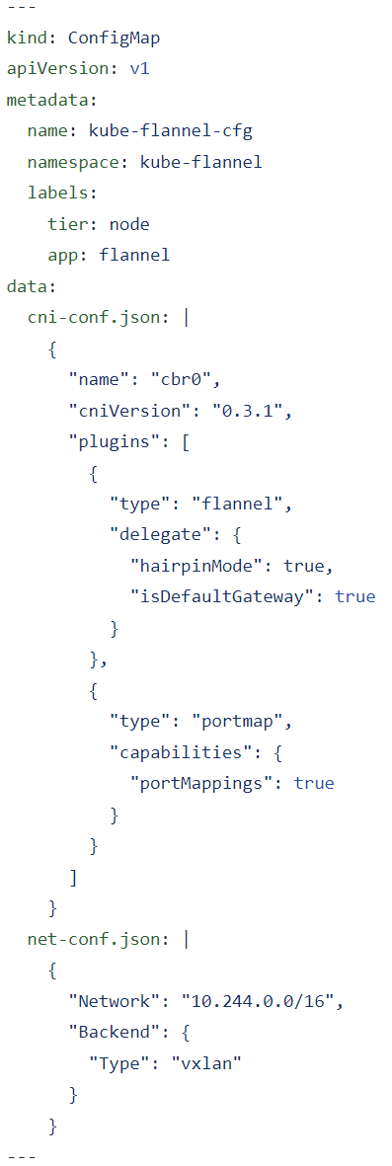
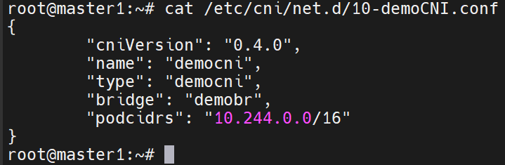
Config file

Slide 6
A daemon or init script
Run a daemonset pod on each node, set up network on the node to make pods on different nodes to communicate with each other; And monitoring resources on api-server and perform actions of network on the node accordingly.
Use a shell script to finish the local network initialization and provision config for BIRD to set up the inter-node communication.
Make sure BIRD/kubectl/kubeconfig/jq are installed on each node

Slide 7
A CNI binary
Under /opt/cni/bin/ for kubelet/cri call
Kubelet/cri must provide container info and CNI config when it calls the CNI binary:
# cat /etc/cni/net.d/10-demoCNI.conf | CNI_COMMAND=ADD CNI_CONTAINERID=b784313dfe CNI_NETNS=/proc/12345/ns/net CNI_IFNAME=eth0 /opt/cni/bin/democni

Slide 8
Demo
Install config file
Execute init script
Install binary file
Test

Slide 9
vnet/host-only
192.168.100.0/24
enp0s8
192.168.100.11/24
enp0s8
192.168.100.21/24
enp0s8
192.168.100.22/24
enp0s8
192.168.100.23/24
master1
worker1
worker2
worker3
Rack 1
Rack 2
enp0s3
10.0.0.11/24
enp0s3
10.0.0.21/24
enp0s3
10.0.0.22/24
enp0s3
30.0.0.23/24
vnet#2/host-only
10.0.0.0/24
vnet#3/host-only
30.0.0.0/24
swp1/vlan10
10.0.0.254/24
mgmt/eth0
192.168.100.101/24
Leaf01
AS65100
swp1/vlan30
30.0.0.254/24
swp2
Leaf02
AS65200
mgmt/eth0
192.168.100.102/24
vnet#5/host-only
vnet#4/host-only
swp2
swp2
Spine
mgmt/eth0
192.168.100.200/24
swp1
swp3
192.168.8.100/24
k8sNAT
192.168.8.0/24
Internet
192.168.8.1/24
Laptop
192.168.100.1/24
Notes:
链接：https://pan.baidu.com/s/1G0Lf68x60nBI0sf4PsHn8g
提取码：btxe

Slide 10
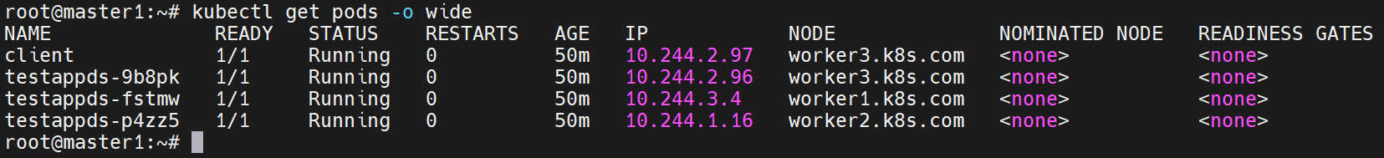
root@worker3:~# cat /var/log/democni.log
#### Start the initialization..... ###
Default config directory is: /etc/cni/net.d
Default config file is: /etc/cni/net.d/10-demoCNI.conf
PodCIDRs is: 10.244.0.0/16
Bridge name is: demobr
Local PodCIDR is: 10.244.2.0/24
Local NodeIP is: 30.0.0.23
Local bridge name and its IP is: demobr: 10.244.2.254/24
Local ToR AS is: 65200
Local ToR IP is: 30.0.0.254
Local Node AS is: 65223
#### Finish the initialization..... ###
#### Start of the democni binary logging..... ###
COMMAND: ADD
{ "cniVersion": "0.4.0", "interfaces": [ { "name": "eth0", "mac": "5e:53:69:75:88:9d", "sandbox": "/var/run/netns/cni-04a33415-05ef-41b3-d483-81c7fb94fb37" } ], "ips": [ { "version": "4", "address": "10.244.2.96/24", "gateway": "10.244.2.254", "interface": 0 } ] }
#### Start of the democni binary logging..... ###
COMMAND: ADD
{ "cniVersion": "0.4.0", "interfaces": [ { "name": "eth0", "mac": "ae:c9:99:7e:53:15", "sandbox": "/var/run/netns/cni-aaf407f9-e8ca-37e4-fb5f-99e8d3d75815" } ], "ips": [ { "version": "4", "address": "10.244.2.97/24", "gateway": "10.244.2.254", "interface": 0 } ] }
root@worker3:~#

