Slide 1
Command Line Interface: mastering the terminal and its tools

Slide 2
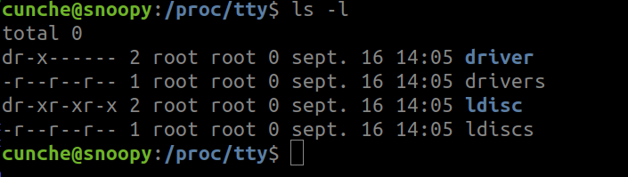
The Command Line Interface
An Interface
  Enables interaction between the computer and the user
    User give orders to the computer
    Computer displays results to the user
Command Line
  All interactions are done through text
    User write commands (orders) through the keyboard
    Computer display results in text format
  No button, no menu, … the mouse is not used

Slide 3
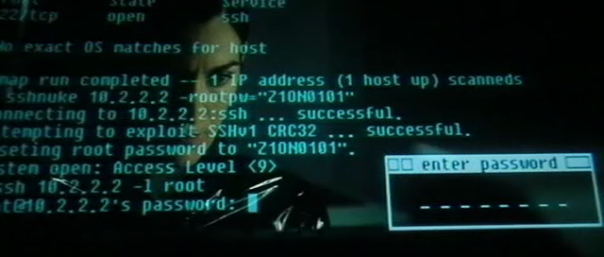
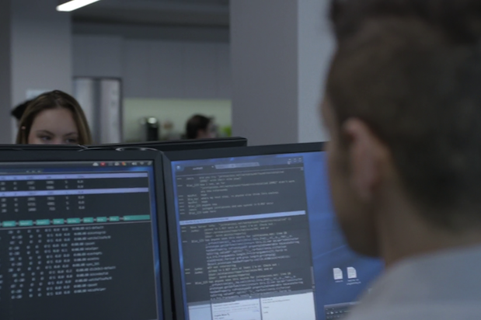
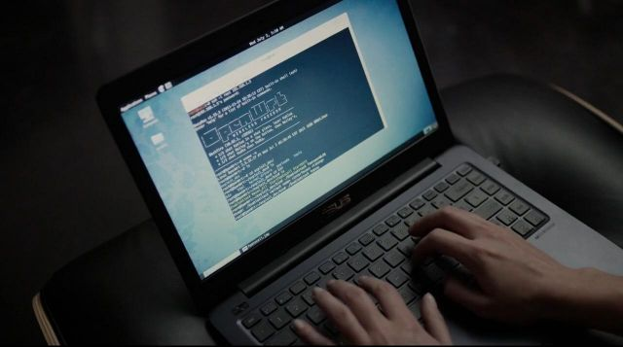
The Command Line Interface
As seen in Hacker movies / TV shows

Slide 4
The Command Line Interface
What is a command ? Ex: ls -l document.txt
  The name of the command : ls
  Followed by (optional)
    -l : enable long print option
    document.txt : name of a file
Writing and executing a command
  Type the command using the keyboard
  Press <enter> to execute the command
Commands for everything
  Create a directory, rename/copy a file, compress/extract archives, read/edit text file
See Command Line Reference document for basic commands and examples

Slide 5
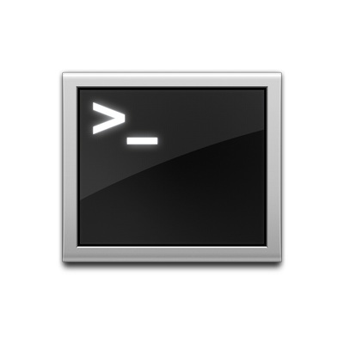
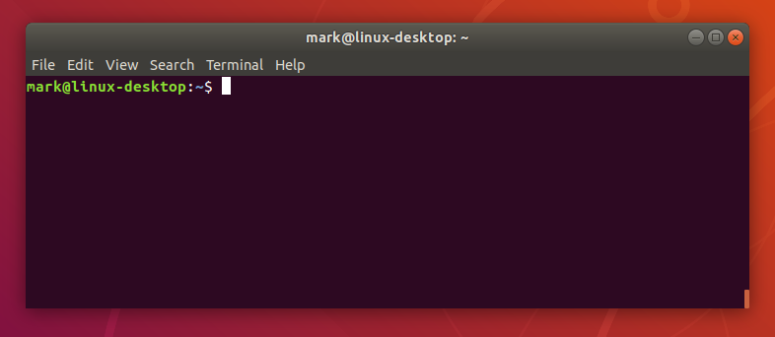
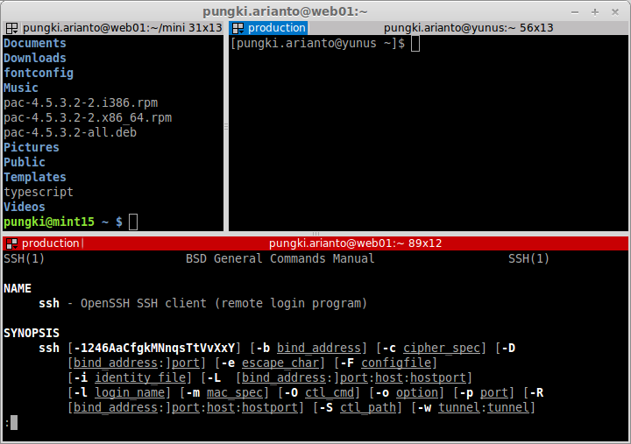
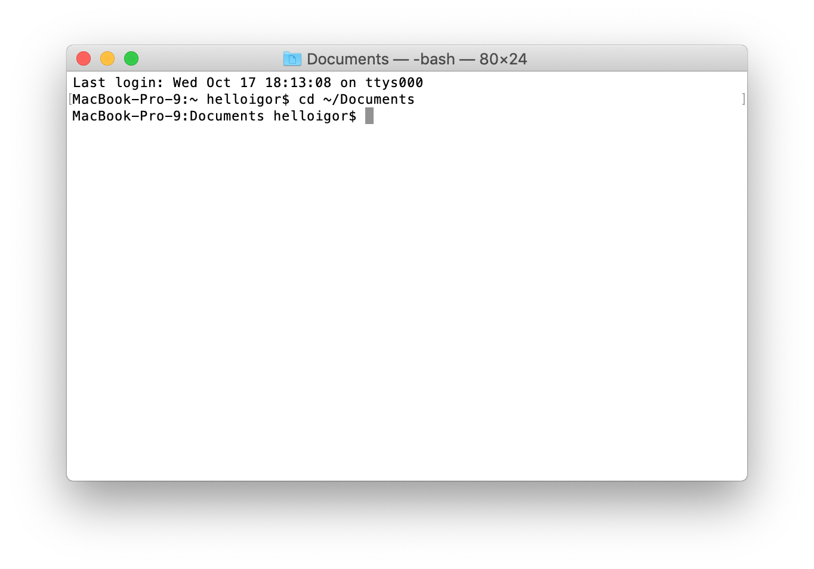
The terminal
Terminal: a program implementing the CLI (command line interface)
  Available on all system (GNU/Linux, MacOS, Windows ...)
  xterm, terminator, qterminal ….

