Slide 1



SOUTH EASTERN REGIONAL COLLEGE (SERC)
KENT STAINLESS LIMITED
Cuneguines Nixon
Notes:
1

Slide 2
Innovation Boost Programme
Project Management Group
Progress Meeting No. 5
Kent Stainless
16/05/2023
Cuneguines Nixon

Slide 3
IB6051
Venue
ONLINE
Tuesday 16TH May 2023
12.30pm

Slide 4
Project Objective.
To have a hybrid quality system (Learning Log) that can be accessed by all staff in the company. The system will give all staff access to readily available information on an easy to use interface. A visual dashboard will also be included to display metrics and KPI’s.
The system will be built around products and product types. A user can use the embedded filters on the system or a search function to find the information required on any company product or process.

Slide 5
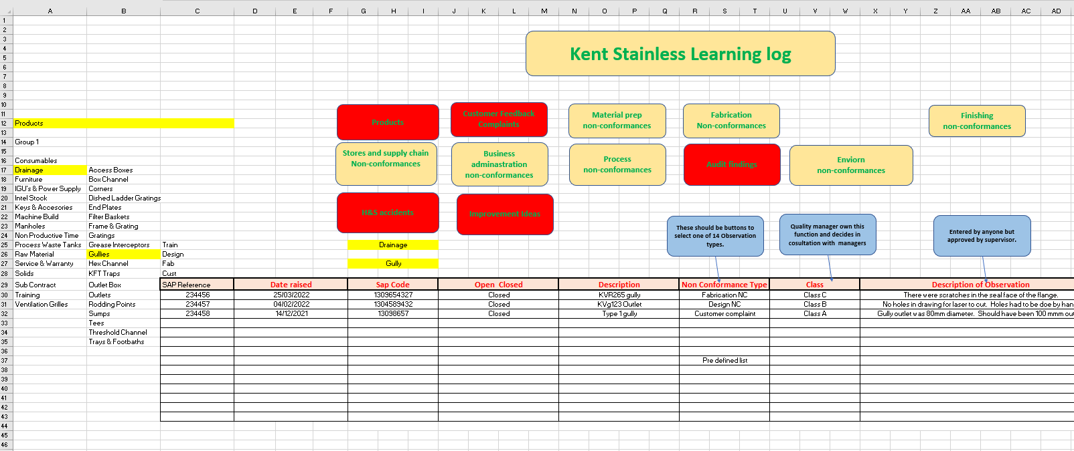
USER Specs/Vision

Slide 6
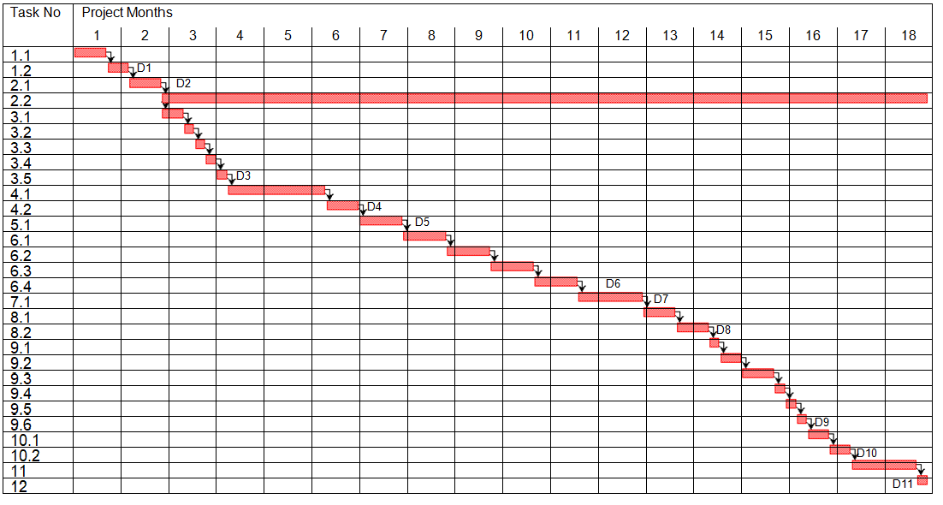


ACTIVITY SINCE LAST MEETING
Gant Chart Details.docx

Slide 7
Create Functionality into Solution/System(7.1)
Created code for Data retrieval and manipulation. Created code for retrieval and manipulation of data for strategic planning. Customized user interface for the target audience. Email notifications. File manipulation and uploading interface for quality-related purposes.

Slide 8
Functional testing/non functional testing(6.1-6.4)
Regular investigation to make sure it does what it is supposed to do.
Tested with several inputs to make sure it produces the desired results.
Periodic testing to guarantee scalability and reliability.

Slide 9
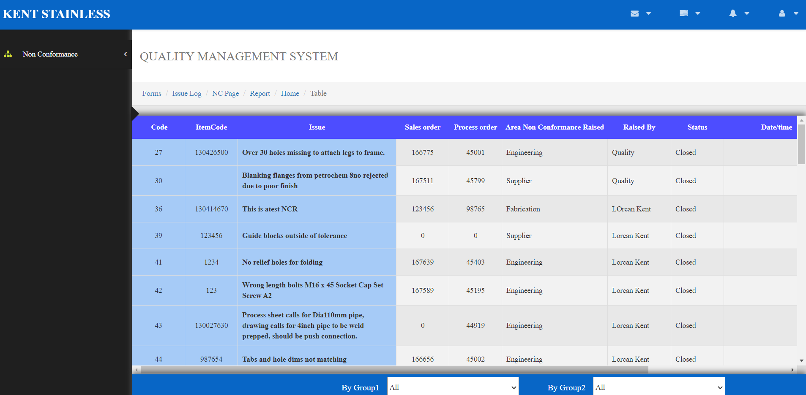
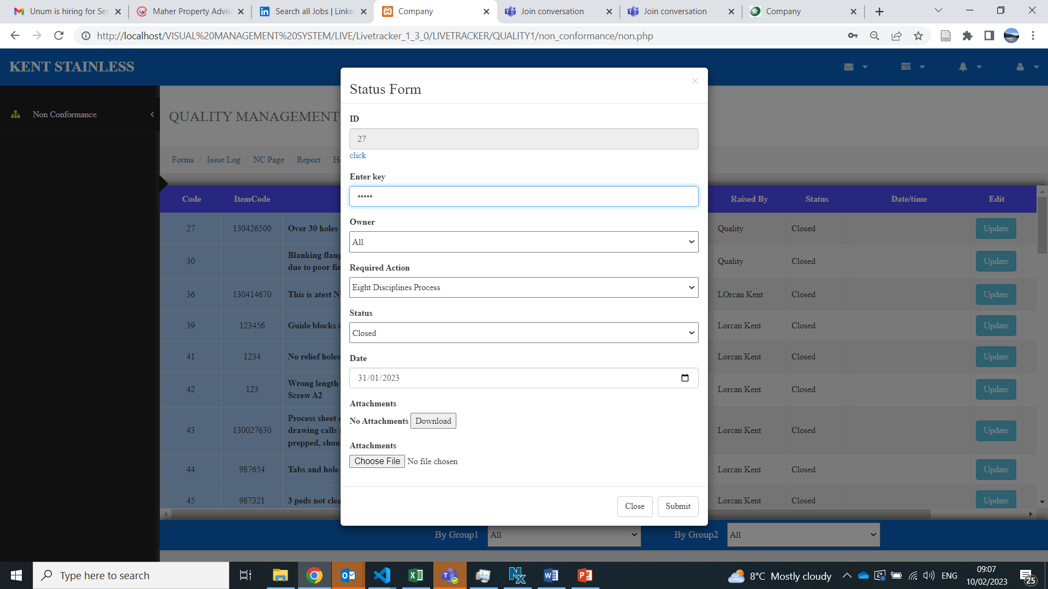
Output screen for manipulating and sddressing non confirmities

Slide 10
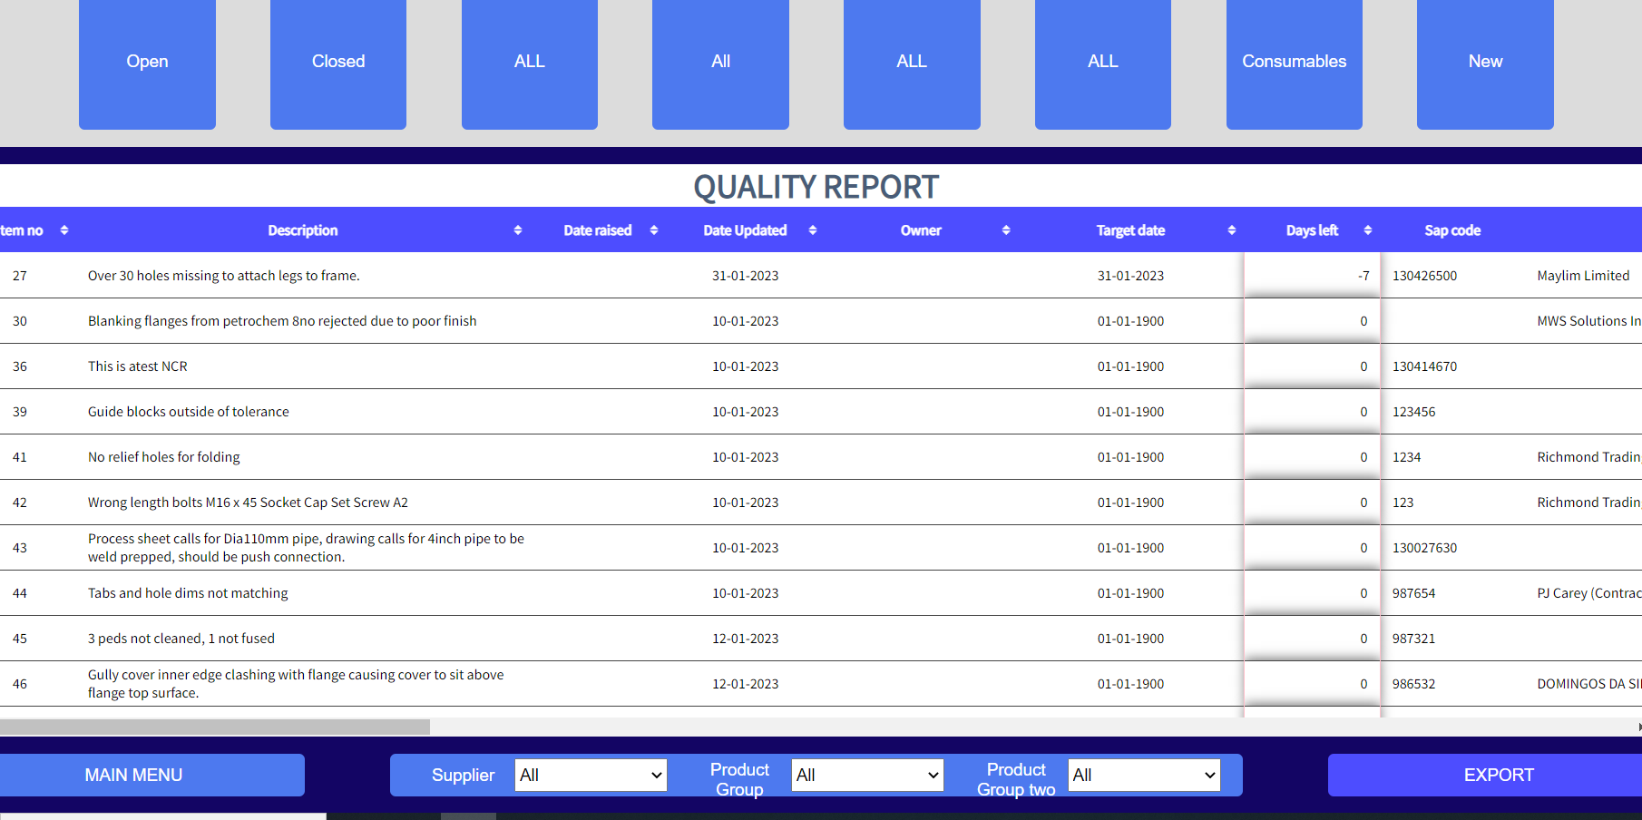
Created Reports by retrieving data from the main database for manipulating and analysing

Slide 11
Additional features
Security measures guarantee secure data management.
Report tool for the team .
System warning to how much time is left to resolve the problem.

Slide 12
Future works
Reporting.(Started)
Develop KPIs and Performance indicators screen(may-july).
Pilot and Functional testing (Apr-may).
Release , training and documentation.(Aug-sept)
Customer complaints interface .(July)

Slide 13
Skills development plan
Strengthening my coding abilities.
Gain more self-assurance when designing System functionality without using notes or resources from outside sources.
Boost my knowledge in APIs.
Enhance my knowledge of the production environment where the system is used.
Gaining experience with all phases of the development cycle in project management.
Increasing familiarity with version control systems.
Gain more experience with analysis using Tableau and Python libraries, as well as some forecasting .

Slide 14
Thank you

