Slide 1
Improving Let’s Hash: Development of a website helping developers with security-related programming tasks
UNIVERSITY OF BONN
MASTER THESIS
Cüneyt Erem
First Examiner
Prof. Dr. Matthew Smith
Second Examiner
Prof. Dr. Michael Meier
Supervisors
Lisa Geierhaas, M.Sc
Dr. Christian Tiefenau

Slide 2
Outline
Introduction
Related work
Methodology
Results
Discussion
Conclusion / Future work

Slide 3
Introduction
Password Security is an important area that hackers’ attacks continue to do great harm like RockYou2021 incident (100GB TXT file that contains 8.4 billion entries of passwords).
The problem is programmers do not securely store the password while writing code

Slide 4
Related Work
Password Storage:
Acar et all.
Software developers use plain storage (14.0%)
not use salting (23.3%)
use static salt (8.7%)
Naiakshina et al.
Programmers always think functionality first
no one think security without asking
Password Policy:
Ur et al. 56.5% of users could type a password from their memory
Tan et al. give some password policy recommendations balance between security and usability
Two-Factor Authentication:
Colnago et al. found two-factor authentication tedious but easy to use and safe
Reynolds et al. demonstrated users found it helpful
-> OWASP and NIST recommend specifications

Slide 5
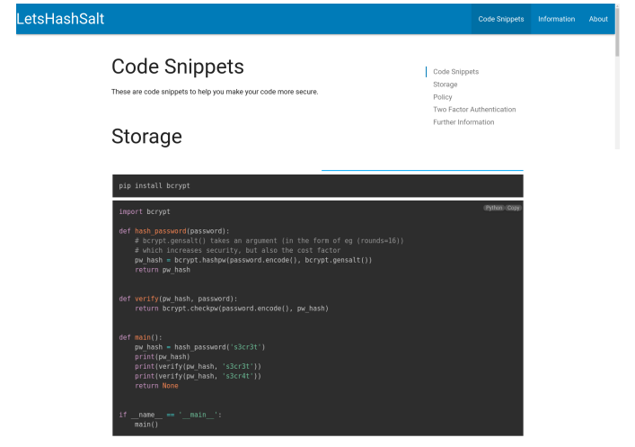
Related Work
LetsHashSalt Website:
Acar et al. showed developers use websites (Stackoverflow)
They are usually using the copy-paste method
Acar et al. showed software developers have problems writing secure code
Website has 3 different parts
Password Storage (Python)
Password Policy (JavaScript)
Two-factor Authentication (Python)

Slide 6
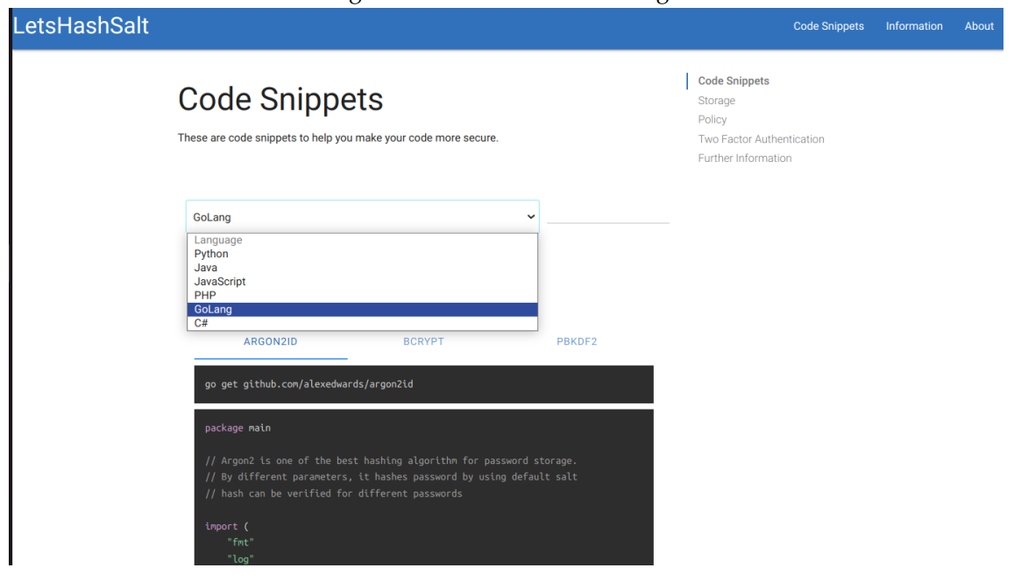
Methodology
New Website Design
three parts remain such as code snippets, information, and about
The wizard does not increase website usability, it is discarded
Different languages are added to serve more developers

Slide 7
Methodology
Programming languages Selection
Each language has emerged for a specific purpose, no superior everywhere
Stackoverflow Survey 2022 (53,421 professional developers)
JavaScript, HTML/CSS, SQL, Python, TypeScript, Java, C#, Bash/Shell, PHP, C++, C, PowerShell and Golang
Search ’password storage’ on the Github website
Python, Java, javascript, C#, C++, PHP and GoLang
Regex can be used many languages
Search ’two-factor authentication’ on the Github website
PHP, Javascript, Python, Java, C#, Ruby, HTML, and GoLang
-> Python, Java, JavaScript, PHP, GoLang, and C#

Slide 8
Methodology
Password Storage Library Selection
Some algorithms are fast but do not hash securely enough (MD5 or SHA)
OWASP recommendations:
Argon2: winner of the 2015 Password Hashing Competition
Argon2id: balanced defense against side-channel and GPU-based attacks
Bcrypt: second choice by OWASP
Scrypt: it uses high memory against largescale custom hardware attacks
NIST recommendation:
Pbkdf2
It should be used when FIPS-140 is needed
It allows the use of internal algorithms such as HMAC-SHA-256

Slide 9
Methodology
Password Policy Library Selection
Apply the minimum criteria determined to increase user account security
NIST recommendations;
Password must not contain consecutive characters.
It should not be changed too often.
It must be at least eight characters long (subscriber-chosen at least 64 char)
ASCII, space, and Unicode must be accepted.
advise the user with the password-strength meter to create a strong password
OWASP recommendations;
passwords must not contain consecutive characters.
Password must be at least eight characters long.
ASCII, space, and Unicode must be accepted.
Frequently used words should not be used.
It should not contain complex requirements but should be long enough
-> Regex and zxcvbn

Slide 10
Methodology
Two-Factor Authentication Library Selection
OWASP and NIST recommendations: verification can only be something
the user knows (password or PIN),
something they have (token or phone),
something that exists (biometric data such as a fingerprint)
Many OTP libraries have two methods:
counter-based one-time passwords (HOTP)
time-based one-time passwords (TOTP)

Slide 11
Methodology
Adapting Code Snippets for Different Languages
library should be
Official (or trustful)
Secure (and up-to-date)
Has high Github usage
High readability

Slide 12
Methodology
ython | argon2-cffi | bcrypt | pbkdf2
Java | argon2-jvm | jbcrypt | javax.crypto (default)
JavaScript | argon2 | bcrypt | crypto-js
PHP | PASSWORD_ARGON2ID (default) | PASSWORD_BCRYPT (default) | hash_pbkdf2 (default)
GoLang | github.com/alexedwards/argon2id | golang.org/x/crypto/bcrypt | golang.org/x/crypto/pbkdf2
C# | Konscious.Security.Cryptography.Argon2 | BCrypt.Net-Next | X
ython | re | zxcvbn
Java | regex (default) | com.nulabinc.zxcvbn
JavaScript | regex (default) | zxcvbn
PHP | regex (default) | bjeavons/zxcvbn-php
GoLang | regexp (default) | github.com/nbutton23/zxcvbn-go
C# | System.Text.RegularExpressions (default) | zxcvbn-core
ython | pyotp
Java | com.j256.two-factor-auth
JavaScript | totp-generator / otpauth
PHP | poles/php
GoLang | github.com/xlzd/gotp
C# | GoogleAuthenticator

Slide 13
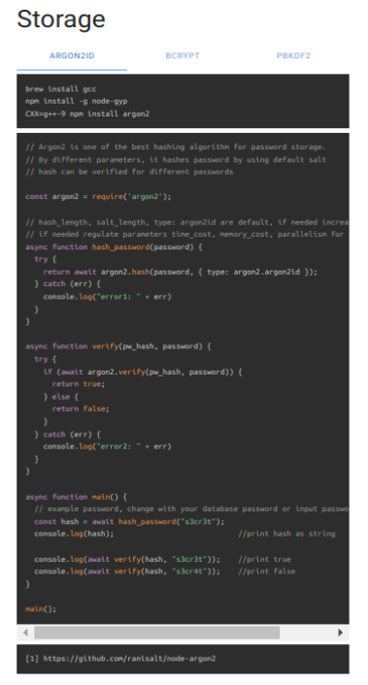
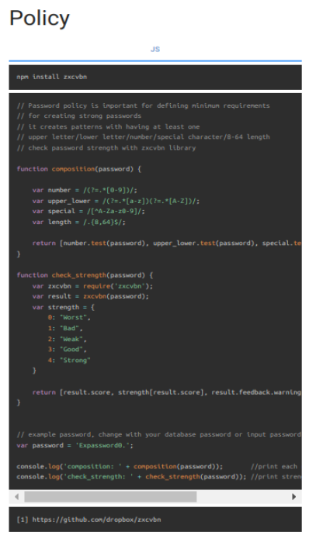
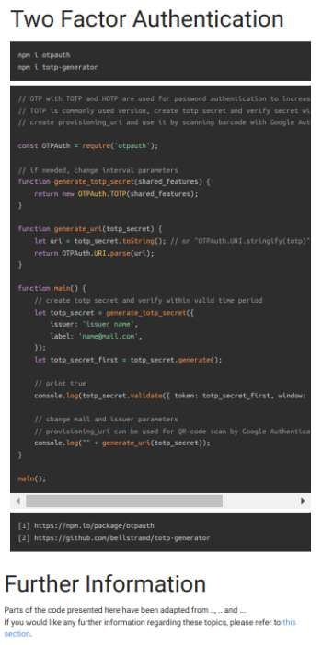

Slide 14
Methodology
STUDY DESIGN
The think-aloud method (Covid-19)
Survey is short, understandable, and straightforward
(not get bored such that 15-20 min)
Questions generally ask;
is this code safe?
if not, how can it be strengthened?

Slide 15
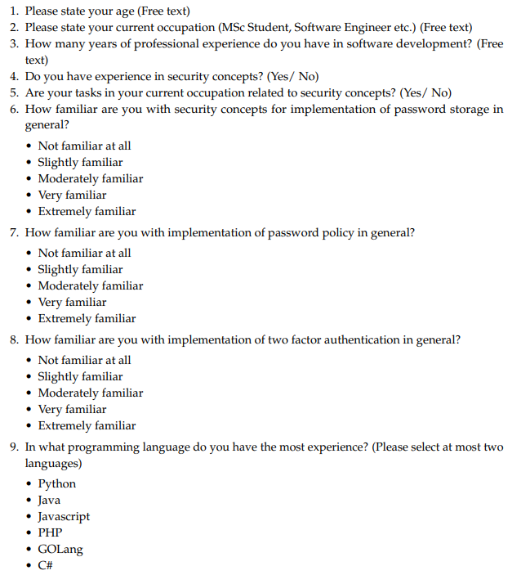
Methodology
Survey Questions

Slide 16
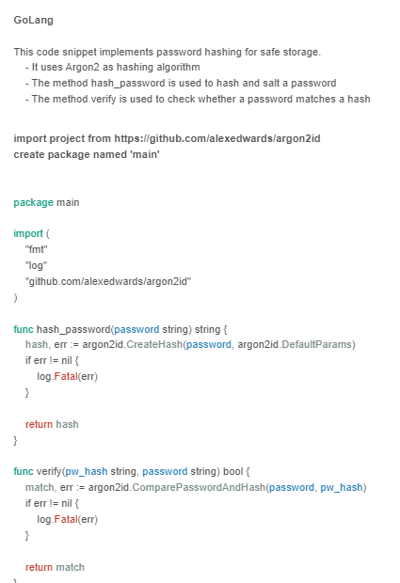
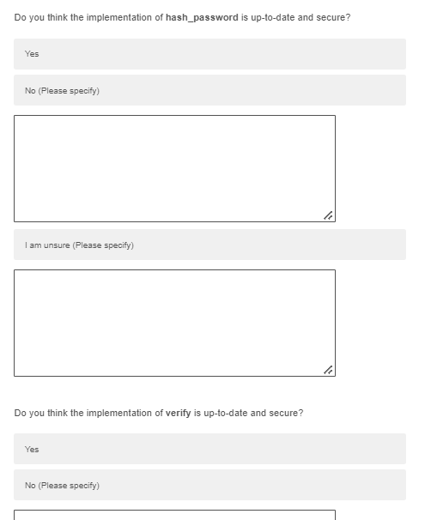
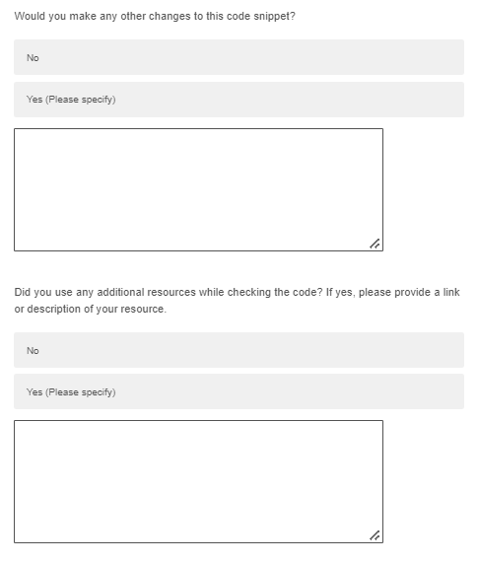
Methodology

Slide 17
Methodology
Participants
LinkedIn website:
Professional software engineers
Cyber security title
Working in Germany, England, Netherlands and America
Nationalities are German, British, Dutch, American, Indian, and Turkish
Messages;
172 sent by inMail and Connect message
76 read the message (in LinkedIn)
45 started the survey (in Qualtrics)
5 completed the survey, received money (50 euros per language)

Slide 18
Methodology
Evaluation Criteria:
ISO usability: effectiveness, efficiency, and satisfaction for survey
The purpose is to increase code security rather than functionality
Examine professional software developers’ suggestions
Applied OWASP and NIST standards

Slide 19
Methodology
Evaluation Criteria:
Password storage:
Suggesting the use of hash/salt instead of encryption
Recommending the use of Argon2, Bcrypt, Scrypt, and Pbkdf2 libraries
parameter configurations of the libraries (Random salt, 32-bit salt length, etc.)
Password policy:
Application of minimum criteria while creating a password (one upper/lower case, one special case, etc.)
The way Regex and zxcvbn libraries are used
Two-factor authentication:
Using TOTP or HOTP libraries
extra changes in code content

Slide 20
Methodology
Limitations
Covid-19 restrictions
No Lab facilities
Persuading software engineers for survey
Ethics
German privacy regulations and EU General Data Protection Regulations

Slide 21
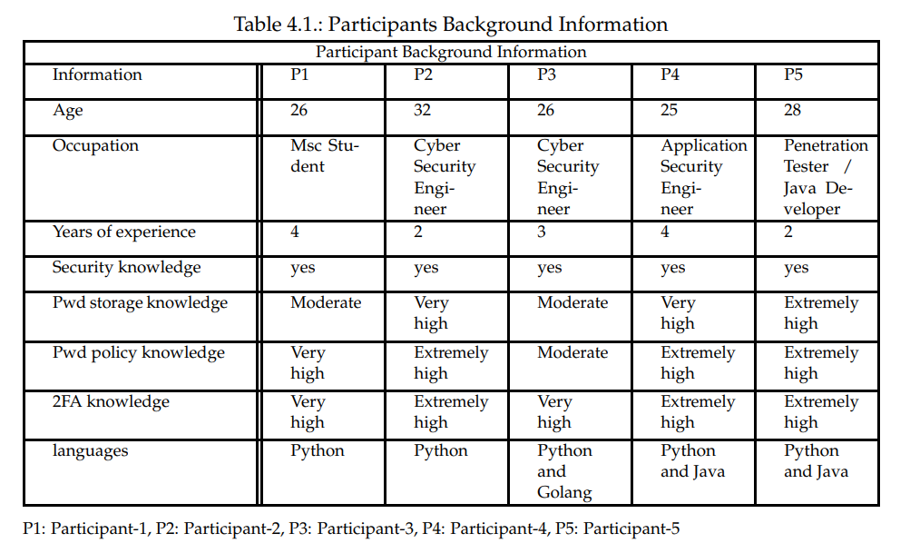
Results

Slide 22
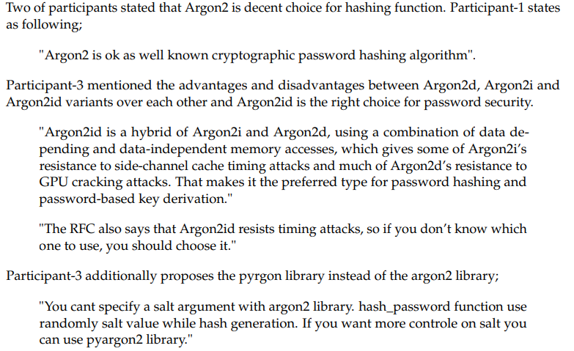
Results

Slide 23
Results
Password Storage
Participant-1 evaluation
No change: Argon2 and Bcrypt are correct
Did not add: functional rate.limiting mechanism
Participant-2 evaluation
Wrong suggestion: use encryption (OWASP)
No change: library use PyCryptodome, Criptography, PyNaCl instead bcrypt (it is official)
Participant-3 evaluation
No change: use pyargon2 instead of argon2 if needed to parameter changes
Selection: use crypto/argon2, but we used alexedwards Argon2id
Did not add: functional Code linter tools
Participant-4 evaluation
No change: Argon2 and Bcrypt are correct
Checked: mvnrepository and Snyk websites for libraries version
Did not add: functional secret management tool
Participant-5 evaluation
No change: Argon2 is correct, bcrpyt not sure (it is also safe enough)
Added: Pbkdf2 by NIST recommended

Slide 24
Results
Password Policy Evaluation
Did not change:
at least one lowercase character
one uppercase character
one number
one special character
8-64 password length
Regulated Regex by Participant-3 and Participant-5;
Changed "(?=.* \d)“ to "[0-9]“
Changed .*[^\\d\\w] to .*[^A-Za-z0-9]
No objection: Regex and zxcvbn
Participant-4 says do not use zxcvbn-python (it is official)
No functional changes

Slide 25
Results
Two-Factor Authentication
Many did not comment on OTP and TOTP selection, Participant-3 says TOTP is decent choice
Everybody says it is secure enough
No functional change added like Vault tool

Slide 26
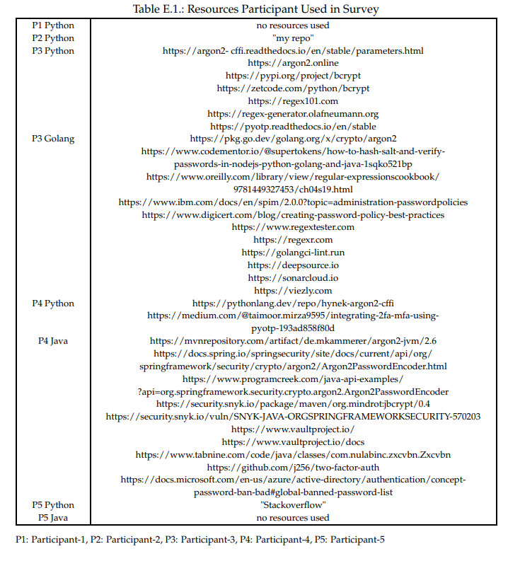
Discussion
Resources:
Official websites
Tutorial websites
Library vulnerability check websites
Languages:
Python, Java, GoLang
Adapt Javascript, PHP, C#
Password Storage parameters
Password policy Library Selections
Regex
zxcvbn
Two-Factor Authentication, content really secure?

Slide 27
Conclusion Future work
Conclusion
Libraries remain with content changes
Argon2id, Bcrypt, Pbkdf2
Regex, zxcvbn
TOTP
Secure and up-to-date (for now)
Future work
Examine at least 2 senior developer for each programming language
Get feedback with more details (parameter config, library selection, company documents)
Participants in Linkedin with more money

Slide 28
Questions and Answers

Slide 29
Thank you…
References

