Slide 1
Cs411/ Final Presentaition
Group-16
Ahmet Ay
Anıl Göllü
Cüneyt Erem
Muratcan Katırcı

Slide 2
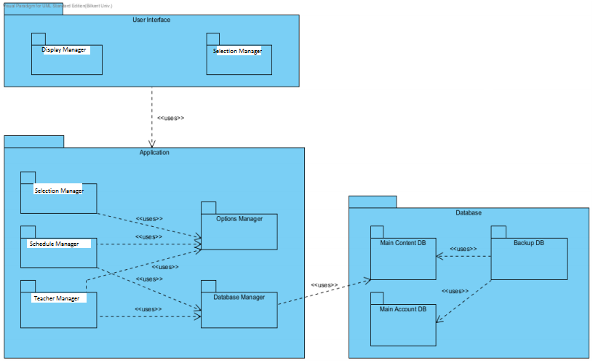
9. Module Views
Generally, Application Module is used by User Interface Module and uses Database Module. User Interface Module includes Display Manager and Selection Manager Packages. In Application Module, Selection Manager uses Options Manager package, while Schedule and Teacher Manager Packages use both Options Manager and Database Manager Packages.

Slide 3
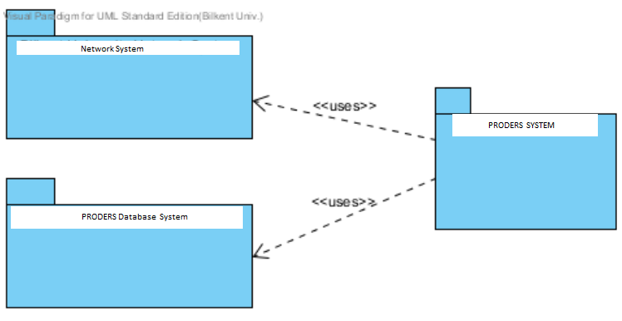
Context Diagram of Uses View

Slide 4
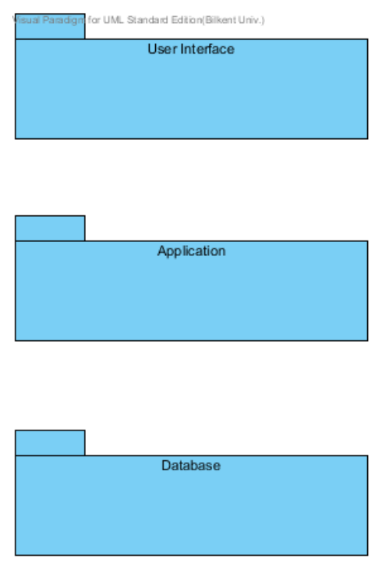
DECOMPOSITION VIEW
Decomposition view of the PRODERS consists of three main modules which are called User Interface, Application and Database, and the modules in each of them. User Interface Module consists of Display Module, where buttons, checkboxes, images and multimedia related user content are provided to be visualized and Selection Module, where users log in the system as user or admin and decides to what to change or add suchs as creating a new schedule, class, teacher or editting an existing one of them

Slide 5
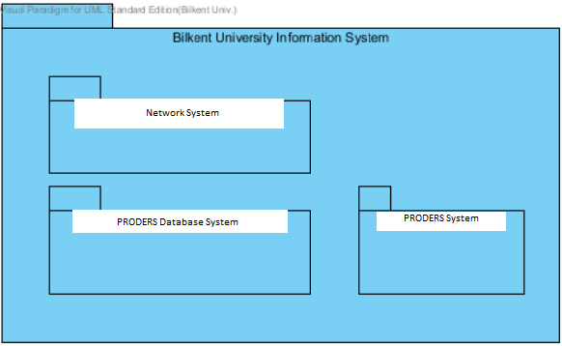
Context Diagram of Decomposition View

Slide 6
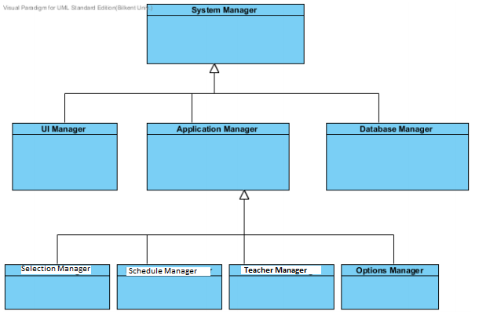
GENERALIZATION VIEW
The generalization view of PRODERS is illustrated at Figure below this paragraph. The system has Selection Manager, Schedule Manager, Teacher Manager and Options Manager which are the extension of Application Manager

Slide 7
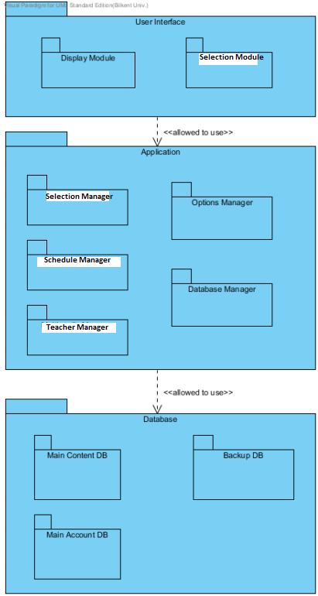
LAYERS VIEW
Layered view is benefitted to separate the modules of PRODERS and define their permission to use relationships for each other. Layered view shows the PRODERS's permission to use different module together and within them

Slide 8
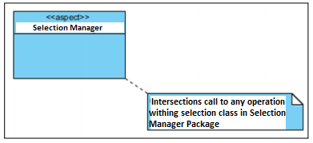
ASPECTS VIEW
PRODERS use aspect view to design a model for implementation of intersection troubles. In order to promote the modifiability by increasing modularity by avoiding the tangling of intersection functionality and business domain functionality we have used such view

Slide 9
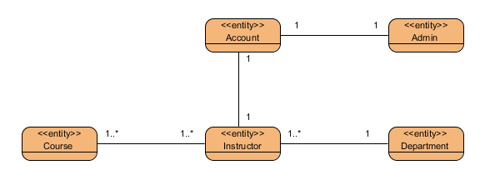
DATA MODEL VIEW
The Data Model Style is chosen to describe the static information structure of Proders project in terms of data entities and their relationships. The data model is represented graphically in entity relationship diagrams.

Slide 10
COMPONENT AND CONNECTOR VIEWS

Slide 11
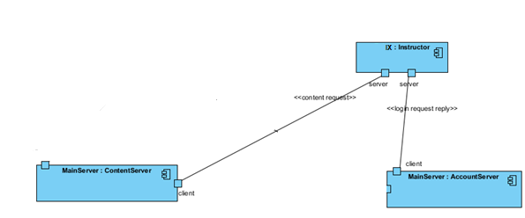
Client-Server Style
Client-server Style is used in Proders in order to show computational flow of the system. In case Client-Server Style provides a synchronous service invocation, this style is convenient for our project. In Client Server Style the requester of a service waits, until a requested service completes its actions, possibly providing a return result.

Slide 12
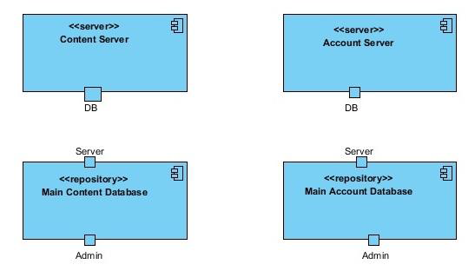
Repository Style
Repository Style is used in Proders in order to show which data accessors are connected to which data repositories. Components of this view are data accessors and repositories. In repository style, components are Content Server, Account Server, Main Content Database and Main Account Database

Slide 13
ALLOCATION VIEWS

Slide 14
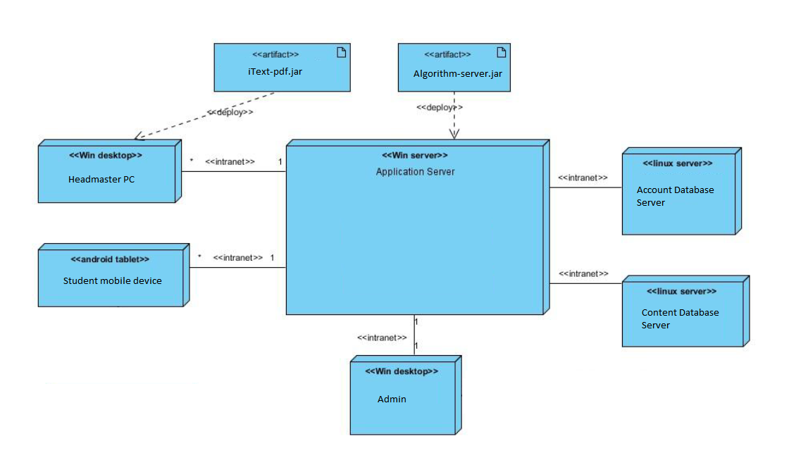
Deployment View
It shows the allocation relations of the software elements of ProDers system to their environment. Environmental elements shows software elements are used to deploy in deployment diagram. This deployment diagram serves to model the physical deployment of software artefacts on deployment targets

Slide 15
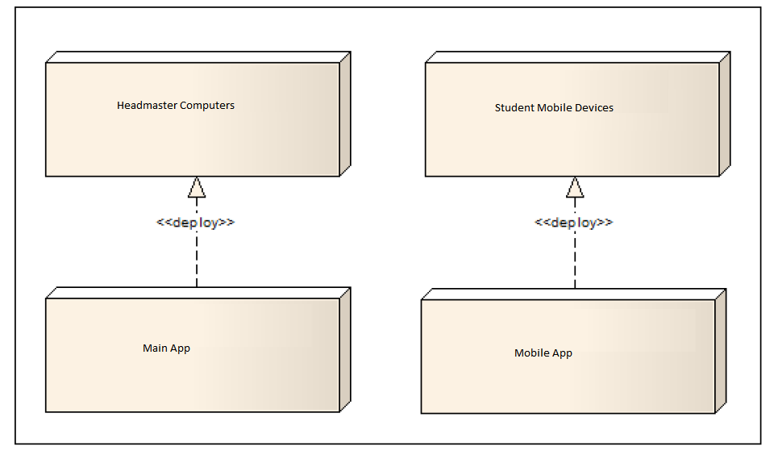
Context diagram

Slide 16
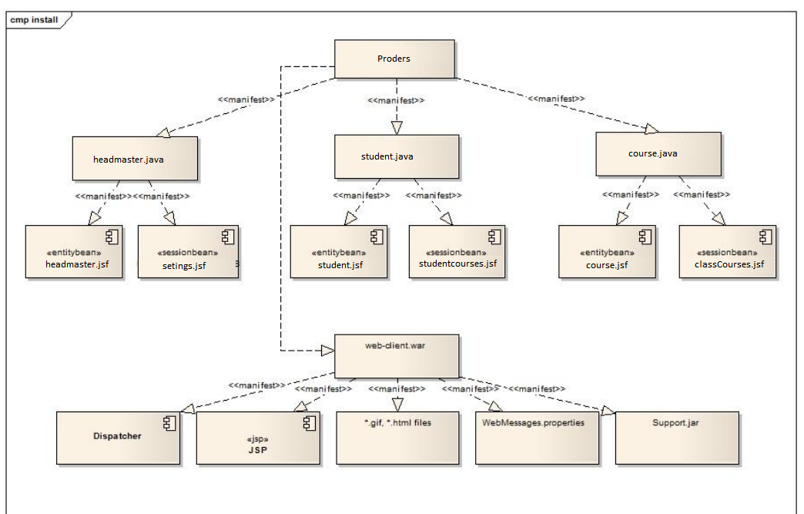
Install View
. Install view is system to show how the installed system is organized as a structure of files and folders and describes how software elements map to that structure.

Slide 17
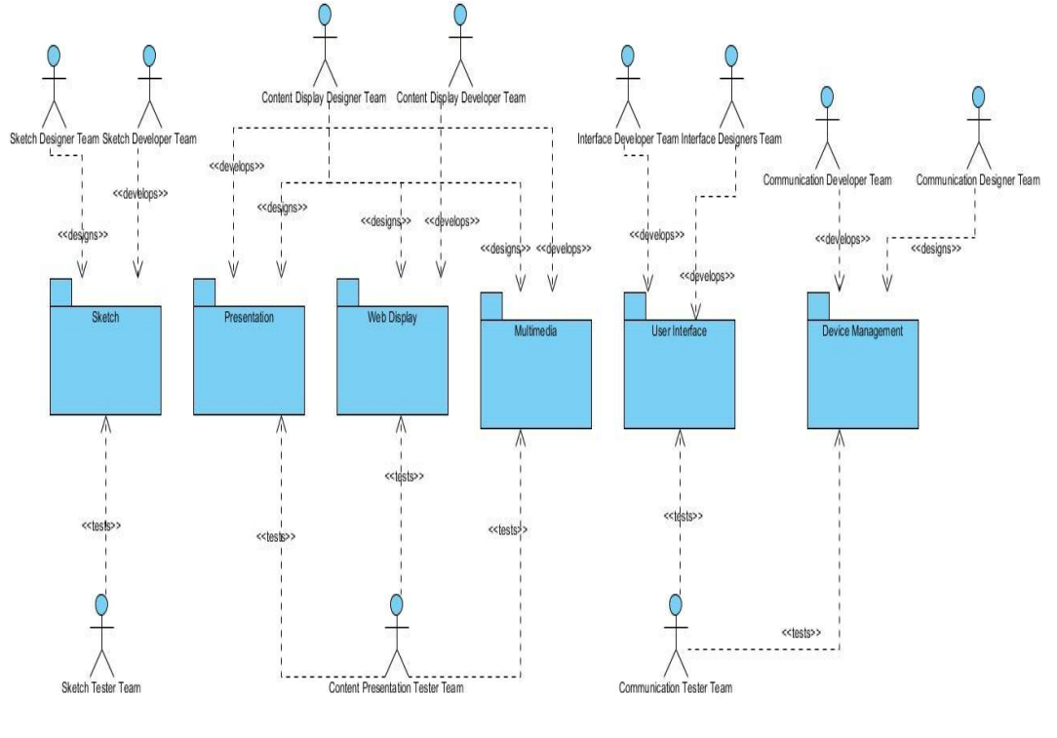
Work Allocation View
It is used in the app to describe the allocation of a module to a configuration item. Items are teams which are for developing, design and testing the system. Work Allocation view is to show the major units of the system that must be present to form a working system and who will produce them. Developing teams are for sketching, content display, interface, communication.

Slide 18
EVALUATION OF THE SOFTWARE ARCHITECTURE
. The evaluation of the software architecture is necessary to analyze the system quality at the beginning of the life cycle and to predict the quality of the system before it is installed. The assessment provides a mechanism to identify the potential risks and how the system will evolve. To do this, we evaluated the producers with scenario-based architectural analysis (SAAM) and ATAM.

Slide 19
* Headmaster:
- Login to system
- Add/delete course
- Change course
- Change identity information
- Change access permission to the system
* Student:
- Access schedule content
- Change identity information
* Software Engineer:
- Add a new feature to the system.
- Port to another operating system

Slide 20
. CONCLUSION
We gained a lot of experience and we had the chance to practice our knowledge while performing this project. As a result, this project has met some obstacles, but we have taken care of everything and have increased our knowledge of software architecture design steps. In the future, according to the information we receive from the software architecture evaluation process, we will monitor our architecture; We need to add new modules to our system and improve accordingly. In general, we fulfill high-quality architectural requirements and have implemented a successful architecture for the Proders project.

