Slide 1
ROS-Based UAV Flight Control and Collision Avoidance
David Jones

Slide 2
This Presentation
Covers:
What is ROS?
ROS Concepts
Our current ROS implementation
Doesn’t cover:
ROS Install (Google it!)
Specific ROS syntax (Google it!)

Slide 3
What is ROS?
Robot Operating System (ROS), more like a framework than an OS
Library of component intended for robot applications
Many standard components for devices on robots
Simplified methods of:
Multi-process applications
Communication standards
Primarily runs C++ and Python on Ubuntu, Mac OS X functionality is mostly there also
Webpage: http://www.ros.org/wiki/
Example of Kinect mounted on Roomba: http://www.ros.org/wiki/Robots/TurtleBot

Slide 4
The Node – ROS Concepts
Thought of as a process
Performs a specific task
Must register with the master process (roscore)
Many Nodes form a single application

Slide 5
Topics – ROS Concepts
Much like a bulletin board, many-to-many
Messages are posted to it
Publishers
Post TO the topic
May have many or none
Subscribers
Reads FROM the topic
Typically has a callback for when a message is received
May have many or none
Once declared a publisher or subscriber, ROS handles all communication channels

Slide 6
Services – ROS Concepts
One-to-one communication
Request/response communication
Also has a callback to some function
Generally used for one-time functions or things requiring a response
Nodes advertise services for other nodes to use

Slide 7
Useful ROS Commands
rosmake – like “make” only it performs additional tasks such as creating the headers for messages and services
roscore – necessary to be running in order to use other ROS components
rosrun – used to run a specific component
roslaunch – will launch multiple components along with roscore
rxgraph – displays a graphical menu much like…

Slide 8
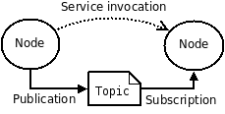
Example From ROS

Slide 9
AU_UAV_ROS
The ROS package we created
Major Components:
X-Bee IO
Simulator
Coordinator
Components for you:
Collision Avoidance
Visualization

Slide 10

In the beginning…
X-Bee IO

Slide 11
X-Bee IO – Component
Original JAVA code from last summer
Ported into ROS framework
Responsible for:
X-Bee communication
Translation from internal data to a message understood by the ArduPilot and vice versa

Slide 12
Post it
X-Bee IO
Telemetry Updates

Slide 13
Telemetry Updates – Topic
Topic consisting of information sent FROM a UAV
Types of information:
Plane ID
Position (Latitude, Longitude, Altitude)
Destination (Lat., Long., Alt.)
Speed
Bearing

Slide 14
Read it
X-Bee IO
Telemetry Updates
Coordinator

Slide 15
Coordinator – Component
Primarily in charge of monitoring the planes and communicating the next destination of a plane
Responsibilities:
Detect when a plane has reached a destination
Sending next destination (whether it’s a true destination or avoidance destination)
Alerting planes to collision avoidance maneuvers

Slide 16
Where do we go now?
X-Bee IO
Commands
Telemetry Updates
Coordinator

Slide 17
Commands – Topic
Topic for sending new commands to a UAV
ONLY the coordinator updates this topic, I would prefer to keep it this way if possible
Types of information:
Plane ID of recipient
Waypoint index
New Destination (Lat., Long., Alt.)

Slide 18
If you can dodge a wrench…
X-Bee IO
Commands
Telemetry Updates
Coordinator
Collision Avoidance

Slide 19
Collision Avoidance – Component
In charge of monitoring UAV position to avoid collisions
Responsibilities:
UAV monitoring
Report avoidance maneuvers to Coordinator
How it works is up to you!
If you need special information or a way to report a maneuver for a particular algorithm/system, let me know and we’ll see what we can do

Slide 20
Real fake
X-Bee IO
Simulator
Commands
Telemetry Updates
Coordinator
Collision Avoidance

Slide 21
Simulator – Component
Responsible for simulating a UAV
Very basic simulation this summer
Potential room for extra work here
Responsibilities
Sending simulated updates
Receiving commands and changing “trajectory” accordingly
Detecting a “crash”

Slide 22
Nothing like HD
X-Bee IO
Simulator
Commands
Telemetry Updates
Coordinator
Collision Avoidance
Visualization

Slide 23
Visualization – Component
This component visualizes the UAV positions on a map or something similar
Responsibilities:
Receiving new telemetry
Displaying the position/path of the UAV
Looking awesome

Slide 24
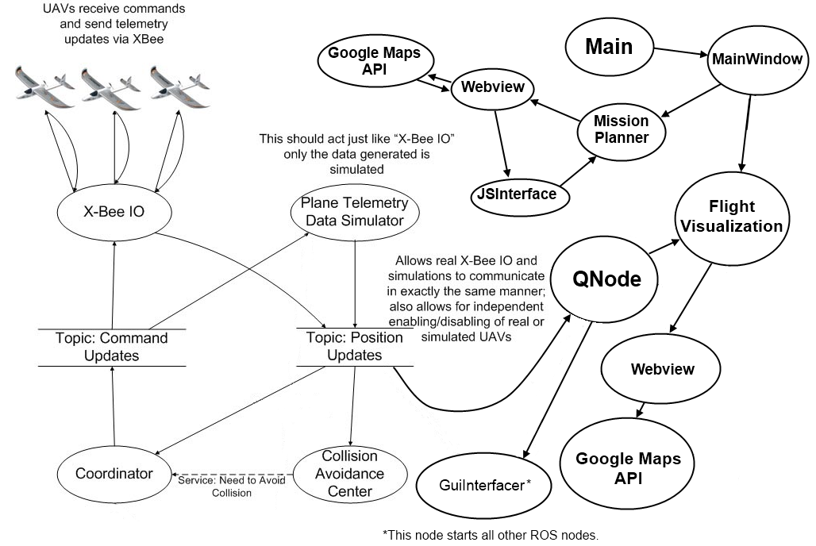
Final Product – Questions?

