Slide 1
Small Business Opportunity
In Atlanta, Georgia

Slide 2
Business Problem
A venture capitalist has seen the recent housing boom in Atlanta, Georgia and is looking to start a small business in whichever areas have seen pronounced value increase. One assumption this venture capitalist is making, wherever he starts his business will see an increase in public spending as long as it is in a heavily gentrified area. This person is looking to do some initial research to identify those areas in Atlanta that have the highest percentage increase in home value. The capitalist is hoping to start a business while business zoned property is still relatively cheap, In order that in 10 years, a large profit can be made when selling. However, this person does not want to compete in a saturated market. Ideally, this initial data would lead into possible ideas and identify what types of business would add the most value to the local neighborhood.

Slide 3
Data Information
For this assignment I will be using two data sources. One will be Foursquare venue data pulled from Folium geolocation points, after identifying those zip codes which have been most affected by the housing boom. The second data set will be pulled from Zillow housing research for average home prices. This data will be filtered to include all of Atlanta. It will need to be historical data, starting after the 2009 housing market crash. Ideally, we would have month by month value for each zip code.

Slide 4
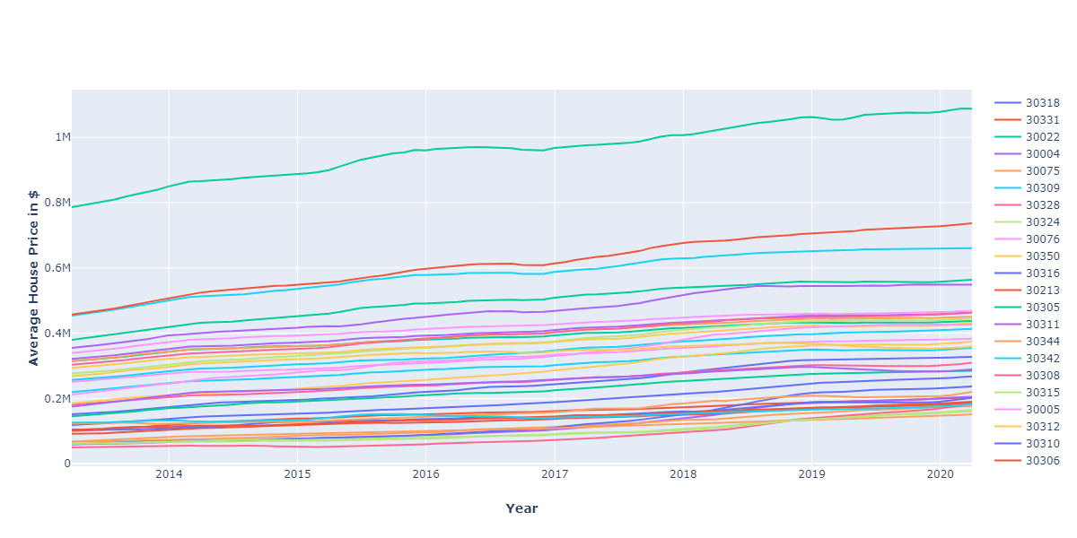
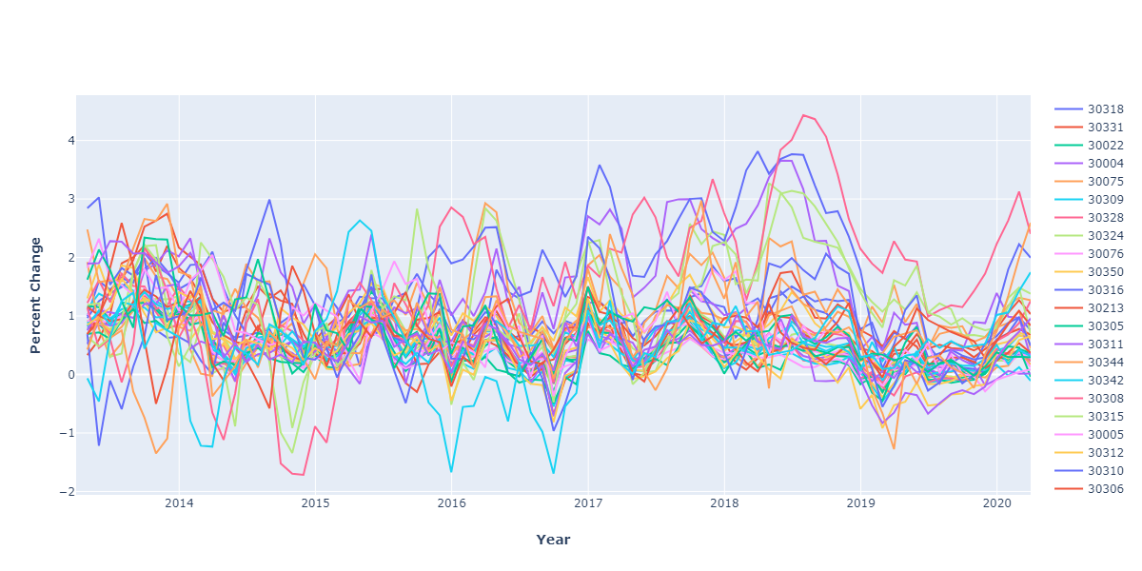
Housing Prices in Atlanta (2013 – 2020)
First I pulled research data from Zillow and plotted out line graphs for all zip codes in Atlanta. But this venture capitalist is looking for the highest, percentage gain, in home value. These are the areas that have gentrified the quickest.
Using the ‘pct_change’ function and ‘sort_values’, we can remake the line graph in the next slide.
Using Zillow research data

Slide 5
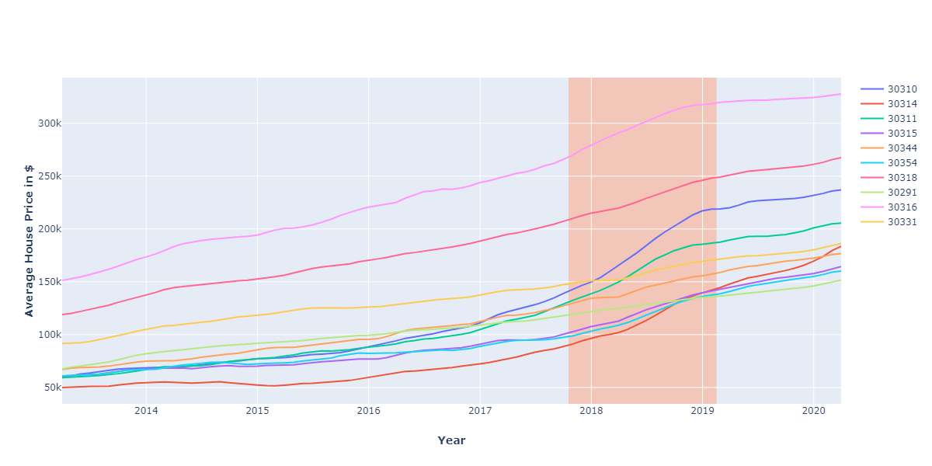
Top ten, by percentage, zip codes with increasing home value
The steep increases are clear in this graph

Slide 6
Next I used Folium to look at the Geolocation of these Zip codes to do further exploratory analysis

Slide 7
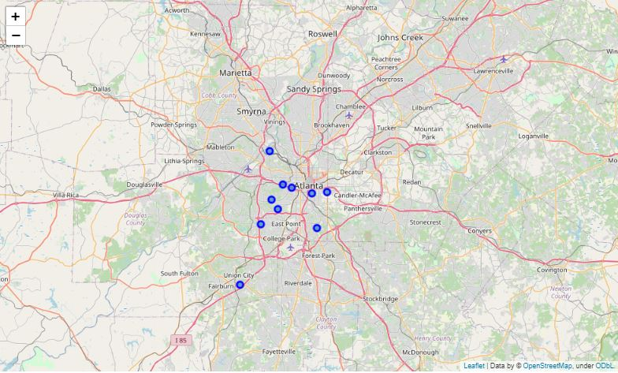
It is interesting to note that all of these zip codes seems to be located in southwest Atlanta

Slide 8
Using Foursquare API, pulling all venues within 2 miles of the Geolocation coordinates (previous slide), we are able to generate some ideas for new businesses. More importantly we are able to see ideas to stay away from in order to stay away from saturated markets.

Slide 9
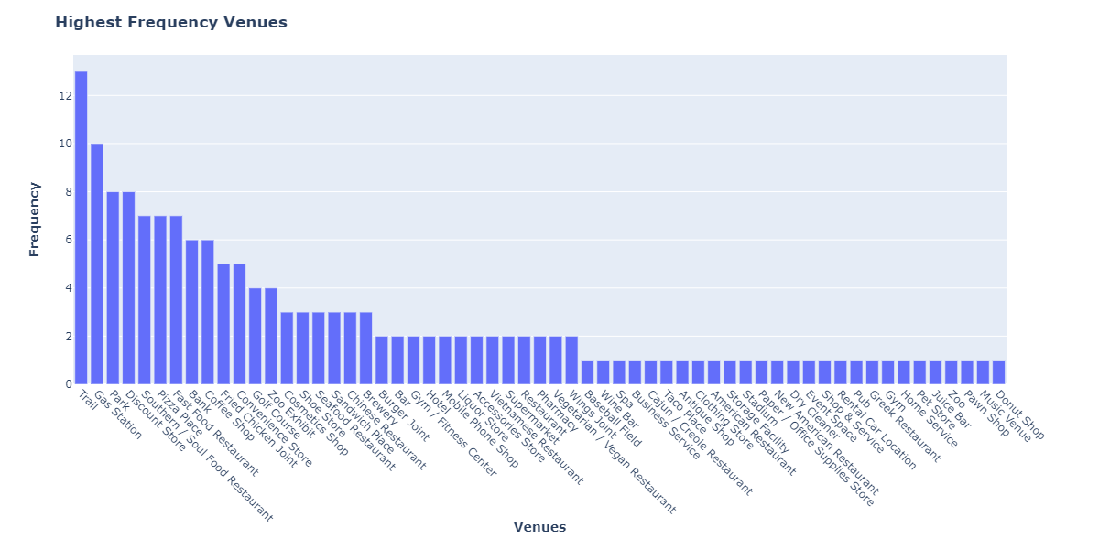
It appears that trails and gas stations seem to be very popular…
Lets dig deeper using Foursquare venue data location coordinates to see where all of these trails are located.

Slide 10
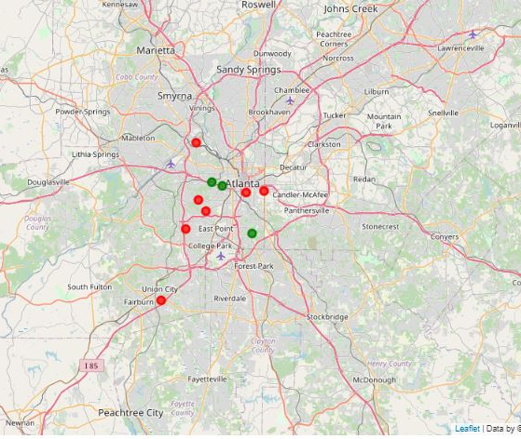
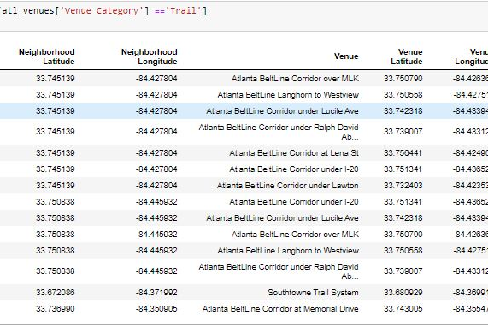
So actually only three zipcodes contain trails and all of the trail markers seem to be the Atlanta Beltline

Slide 11
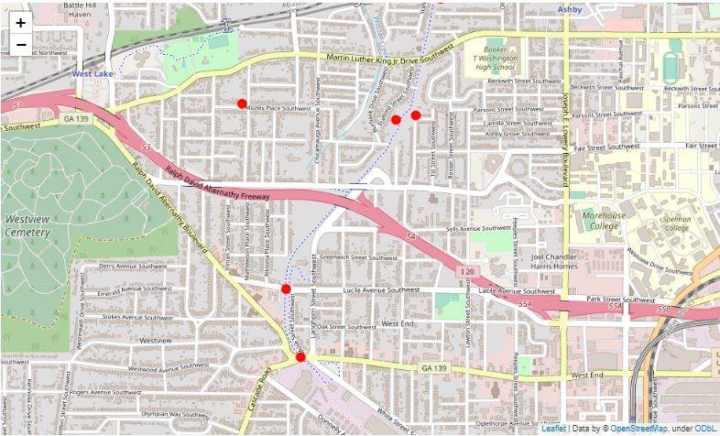
Yes, most of these coordinates are pulling from the Atlanta beltline, westside, which is one continuous trail. This trail is becoming more popular and is causing increased property values

Slide 12
This seems like a good lead on a small business idea. Let’s see if the Westside Atlanta Beltline is underserved compared to other large metropolitan areas. Three large trail systems are located in Chicago, Dallas, and New York

Slide 13
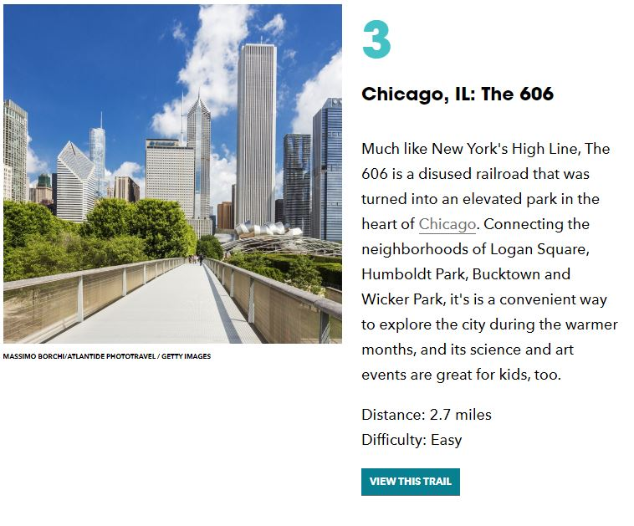
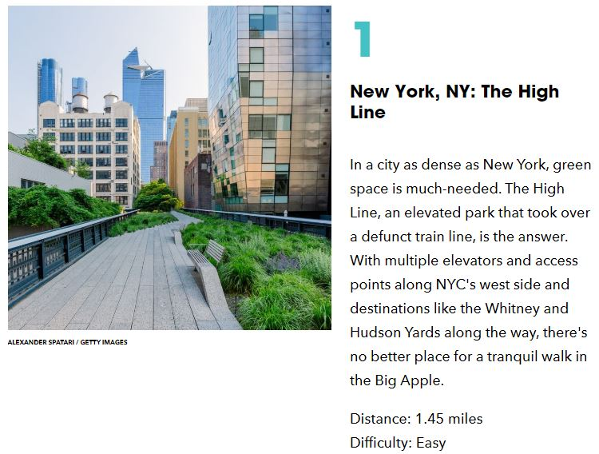
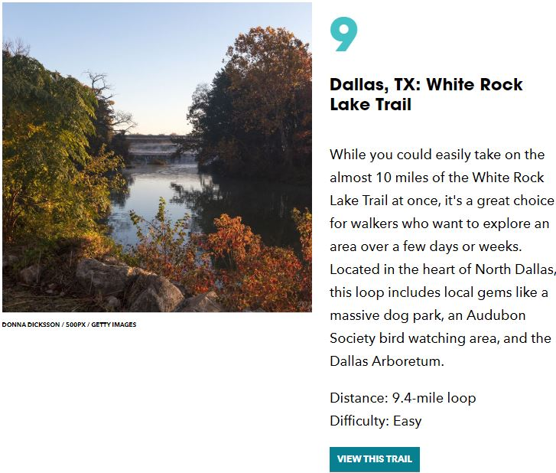


Slide 14
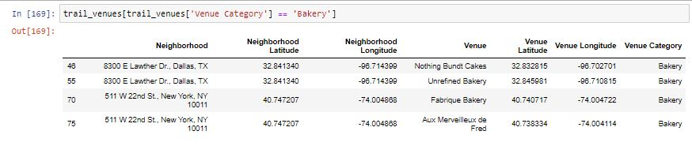
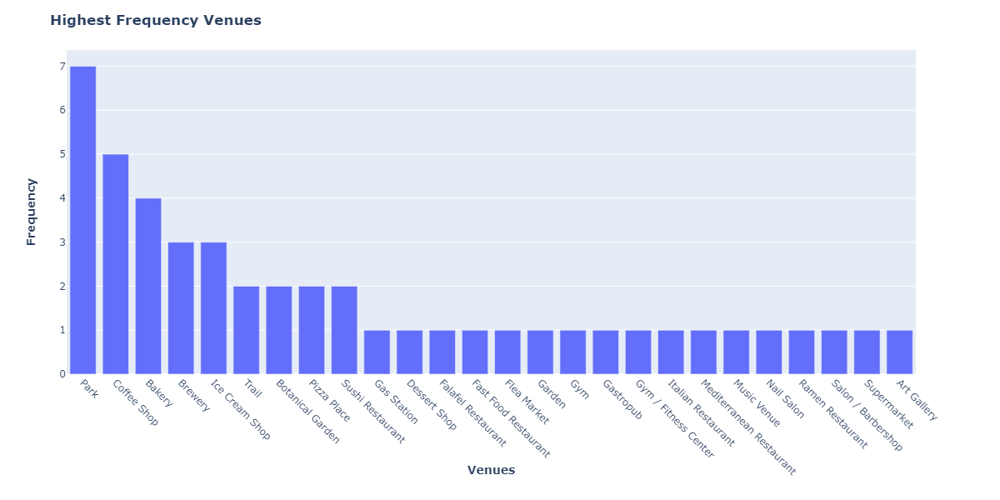
In a one mile radius around these developed trail systems, the top 4 venues according to Foursquare are: Ice Cream Shops, Coffee Shops, Bakeries, and Breweries
In order to estimate if Atlanta is underserved on the west side trail compared to other metro cities we would need to see some sort of comparison

Slide 15
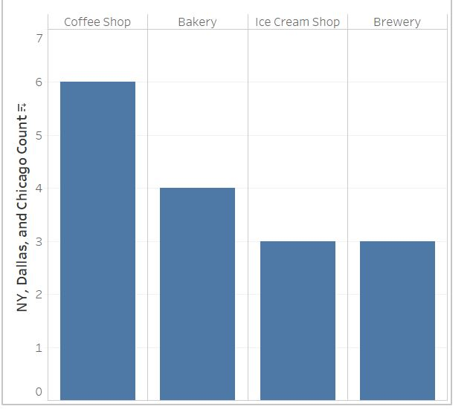
These are the top 4 venue categories near Chicago, New York, and Dallas trail systems.
Comparison was not possible because there are none of these venue types located in these areas!

Slide 16
Conclusion
Looking at the venue area data from the top most gentrifying zip codes in Atlanta, it is clear that there is an opportunity in the vast Westside Atlanta Beltline area for small business. Right now is an opportunity for a savvy investor to purchase property close to or on the Westside Atlanta Beltline, open a brewery, coffee shop, ice cream shop, or bakery because people love to eat before, during, or after walks, as the data shows!

