Slide 1

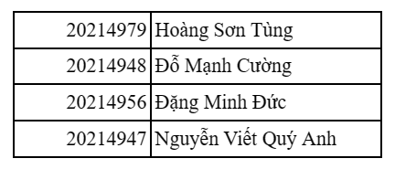
Topic: Finger Vein Recognition

Slide 2
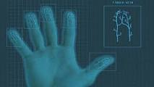
Introduction
Finger vein recognition is a biometric authentication method that identifies individuals based on the patterns of veins in their fingers.

Slide 3
General ideas
Data collection: find datasets in Kaggle
Data preprocessing: Image process (reduce, eliminate noise, enhance image quality, normalize image sizes, ..)
Edge detection: use detection methods to extract region of finger vein in the images.
Feature detection: use some feature detection models to transform vein image to feature vector.
A matching models: use machine learning algorithm to construct vein recognition models based on extracted feature vector.
Evaluate models: assess the vein recognition models using precision, recall.
Fine- tune and enhance models: by using different datasets, adjusting different parameters (Threshold), combine different techniques (filter) to improve vein recognition models based on evaluation.

Slide 4
Data collection
Datasets be collected in Kaggle

Slide 5
Matching model
As classification task based on extracted datasets using unsupervised learning approach
For each input finger vein or stored in a database, we have each finger vein as a vector of features
For each vector, we calculate its similarity(L1 or L2 norm)
The finger vein in a database with a max score will represent the matching to the input fingerprint.

Slide 6
THANK YOU !

