Slide 1
Introduction to PFC
Languages and C Compilers
First Program in C
Notes:
Prepared by Thân Văn Sử

Slide 2
Objectives
This chapter supplies basic concepts in computer programming. After studying this chapter, you should be able to:
Understand steps to develop a software
Explain ways for representing data
Understand a C program structure

Slide 3
2- How to make a good software?
Issues for a program/software:
Usability: Users can use the program to solve the problem
robust and user-friendly interfaces
Correctness: Solution must be correct
comprehensive testing
Maintainability: The program can be modified easily
Understandability
structured programming
internal documentation
Modifiability
standards compliance
Portability: The program can run in different platforms
standards compliance → Needed modifications are minimum
(platform: CPU + operating system running on it)

Slide 4
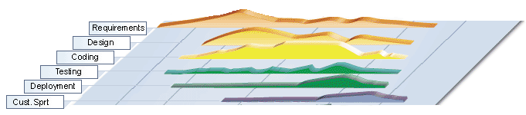
3- Steps to develop a software
Requirements → The problem is understood
Analysis → Data and tasks are identified
Design → folders, files are organized
Coding → Implementation
Testing → Checking whether requirements are satisfied or not
Deploying → Program is installed to user computers
Maintenance → Needed modifications, if any, are carried out

Slide 5
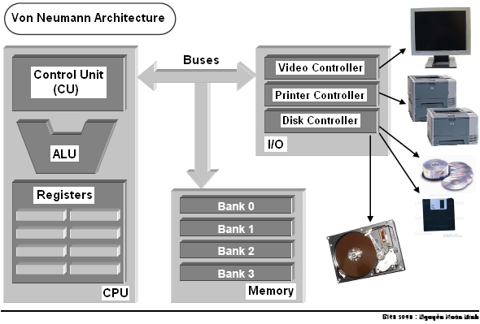
4- Computer Hardware - Review
3 steps to read a memory cell:
CPU puts the memory address to address bus
CPU puts the read-signal to control bus.
Data in memory cell is transferred to a register in CPU
ALU: Arithmetic and Logic Unit
Bus | Used to
Address bus | Determine the IO peripherals, position of accessed memory.
Data bus | Transmit data
Control bus | Determine operation on peripherals, read peripheral ‘s states

Slide 6
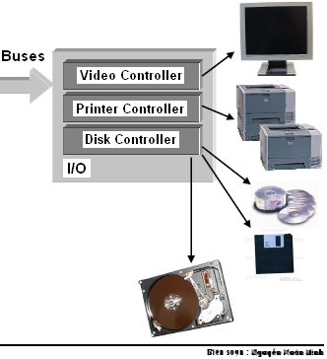
Computer Hardware…
Devices
Include basic I/O devices such as a keyboard, a monitor and a mouse…
Storage devices such as a floppy drive, a hard drive and a CD-ROM drive (secondary storage).
All device interfaces connect to the system buses through a central controller.

Slide 7
5- Data Units
Transistor is the basic physical unit for storing data → Binary format
John von Neumann selected binary (base 2) digits as the EDVAC's fundamental unit.
The vast majority of modern computers process and store information in binary digits.
We call a binary digit as a bit.
Nibble = 4 consecutive bits.
Byte = 8 consecutive bits
= 2 nibbles
Unit of memory is BYTE
Byte
Nibble |  |  |  | Nibble
Bit | Bit | Bit | Bit | Bit | Bit | Bit | Bit
00000000 <- possibility 0 00000001 <- possibility 1 00000010 <- possibility 2 00000011 <- possibility 3 00000100 <- possibility 4 ... 00111000 <- possibility 104 ... 11111111 <- possibility 255

Slide 8
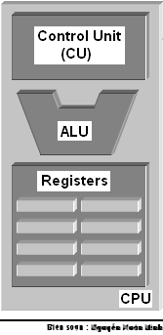
Data Units …
The natural unit of the CPU is a word.
The word length is number of bits of a general register within CPU(CPU memory).
Word length can be 8, 16 (old CPUs), 32, 64 (current CPUs)

Slide 9
6- Data Representations
Data in computer are binary values → They can be treated as numbers.
3 common number systems:
Decimal Representation
Hexadecimal Representation
Base 16: 0, 1, …, 9, A, B, C, D, E, F
Each hexadecimal digit represents 4 bits of information.
The 0x prefix identifies the number as a hexadecimal number: 0x5C
Octal Representation
Base 8: 0, 1, 2, .., 7
Set of 3 consecutive bits forms an octal digit
The prefix 0 identifies the number as an octal number: 031
We can convert a number in one system to another ( introduced in the subject Introduction to Computing) → Next 12 slides will be read by yourself. Use your notebook for doing exercises.

Slide 10
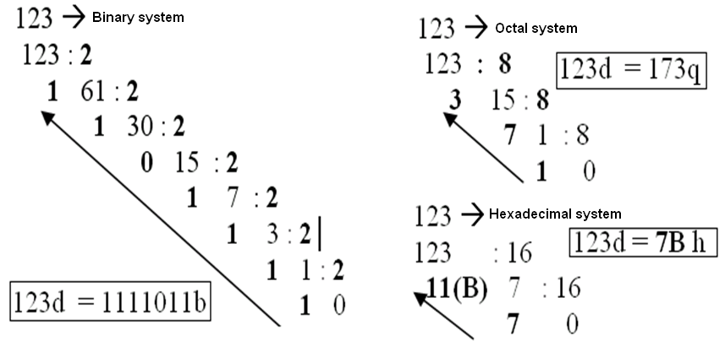
Data Representations: Conversion- A review
Read by yourself

Slide 11
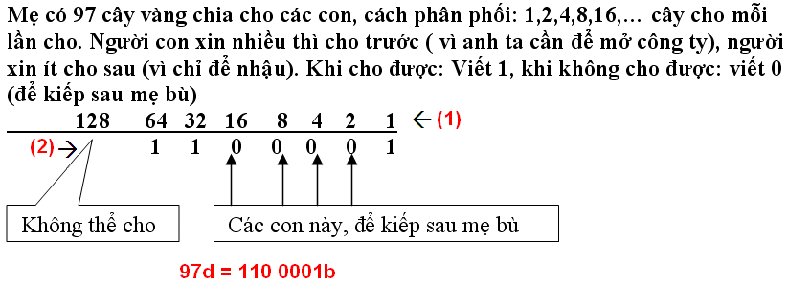
Data Representations: Conversion: A review
Read by yourself
97 → Binary system

Slide 12
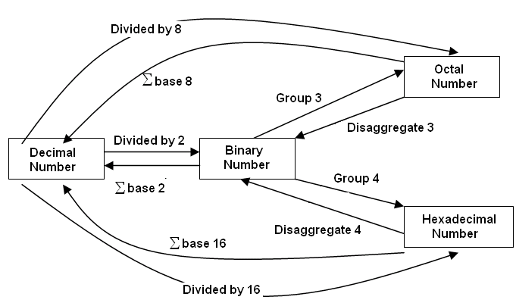
Data Representations: Conversion: A review
Read by yourself
Summary

Slide 13
Data Representations: Conversion…
Read by yourself
Computer is a binary device → All data are stored in binary format
Decoding (restore) to the normal description
3
Number:
3
Encode
(Another format is chosen)
00110011
Normal description (human being)
3

Slide 14
Data Representations: Conversion…
Fill the corresponding binary expansions of the following decimal number:
Decimal | 4-bit Binary | Decimal | 8-bit Binary | Decimal | 16-bit Binary
9 | 1001 | 7 | 0000 0111 | 255 | 0000 0000 1111 1111
7 |  | 34 |  | 192
2 |  | 125 |  | 188
15 |  | 157 |  | 312
12 |  | 162 |  | 517
11 |  | 37 |  | 264
6 |  | 66 |  | 543
5 |  | 77 |  | 819
8 |  | 88 |  | 1027
13 |  | 99 |  | 2055
14 |  | 109 |  | 63
Do by yourself

Slide 15
Data Representations: Conversion…
Do by yourself
Fill the blank cells
Decimal | Binary | Hexa. | Decimal | 16-bit Binary | Hexadecimal
9 | 1001 | 9 | 255 | 0000 0000 1111 1111 | 00FF
127 | 0111 1111 | 9F | 192
125 |  |  | 188
157 |  |  | 312
162 |  |  | 517
37 |  |  | 264
66 |  |  | 543
77 |  |  | 819
88 |  |  | 1027
99 |  |  | 2055
109 |  |  | 63

Slide 16
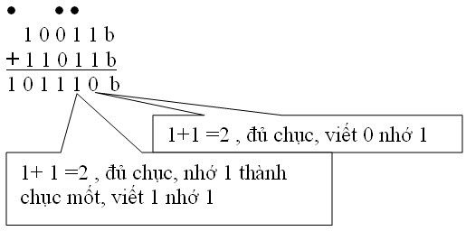
Data Representations: Operations
Read by yourself
Do yourself:
3245q + 247q
1A7Bh + 26FE7h
101101111 b
100111011 b
110110001 b
110001101b
+

Slide 17
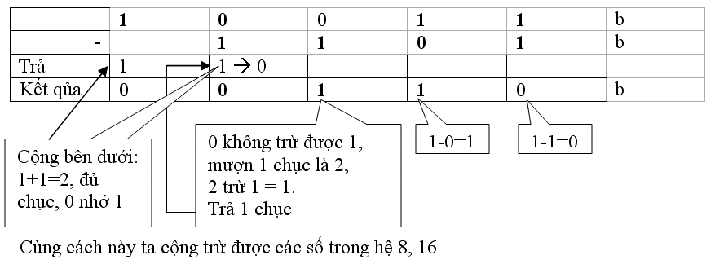
Data Representations: Operations …
Read by yourself
Do yourself
1101101101b - 10110111b 3654q – 337q 3AB7h – 1FAh
36Ah – 576q = ? h 64AEh – 1001101b= ? q

Slide 18
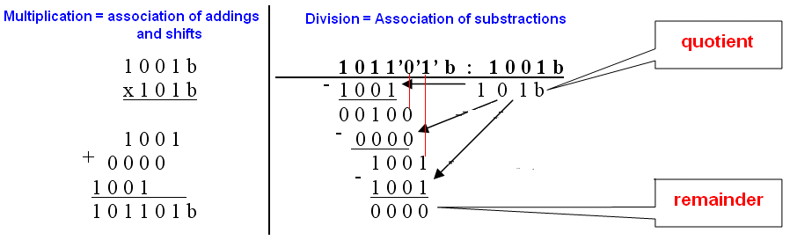
Data Representations: Operations …
Read by yourself
Exercises :
1011010 b* 1011b
1101000b + 2AB h + 345 q = ? h = ? q
3AFh / 1Ch =? b = ?d
3ACh – 562q = ?b = ? d
3FFA h / 327q = ?b = ? d

Slide 19
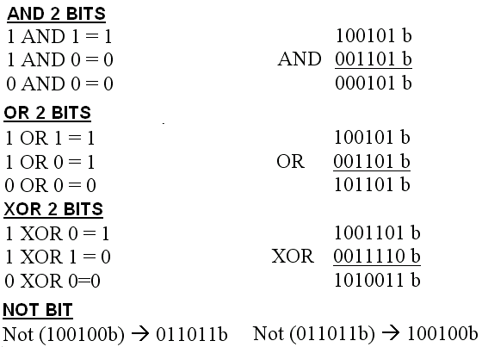
Data Representations: Operations …
Read by yourself

Slide 20
7- Addressing Information
Each byte of primary memory has a unique address (order number), starting from zero
Kilobyte = 1024 bytes
Kilo K= 1024 ( 2¹⁰)
Mega or M (=1024k)
Giga or G (=1024M)
Tera or T (=1024G)
Peta or P (=1024T)
Exa or E (=1024P)
Addressible Memory
The maximum size of addressable primary memory depends upon the size of the address registers
 | MEMORY
… | …….
5 | 1010 1010
4 | 0011 1100
3 | 0101 0100
2 | 1001 0000
1 | 1100 1011
0 | 0100 0001
B: byte
b: bit
Address
value

Slide 21
8- Program Instructions
01001011 | 100110110110 | 011011010111
Opcode | Operand 1 | Operand 2
Each program instruction consists of an operation and operands
The CPU performs the operation on the values stored as operands or on the values stored in the operand addresses.
Operands: Constants, registers, primary memory addresses

Slide 22
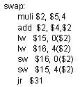

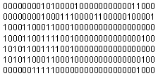
Program Instructions…
High-level language code
Assembly
(low-level)
code
Machine (binary)
code
compiler
assembler

Slide 23
Programming Languages…
5 Generations of Programming Languages:
(1) Machine languages.
(2) Assembly languages.
(3) Third-generation languages. These are languages with instructions that describe how a result is to be obtained (C, Pascal, C++, Java…).
(4) Fourth-generation languages. These are languages with instructions that describe what is to be done without specifying how it is to be done (SQL).
(5) Fifth-generation languages are the closest to human languages. They are used for artificial intelligence, fuzzy sets, and neural networks (Prolog, Matlab)

Slide 24
Programming Languages…
The higher the level, the closer to the human languages and the further from native machine languages
Each third generation language statement ~ 5-10 machine language statements.
Each fourth generation language ~ 30-40 machine language statements.

Slide 25
10- Translating and Executing a Program
Program code in a high level language can not run, It must be translated to binary code (machine code) before running.
2 ways of translations:
Interpreting: one-by-one statement is translated then run → Interpreter
Compiling: All statements of program are translated then executed as a whole → Compiler
C translator is a compiler

Slide 26
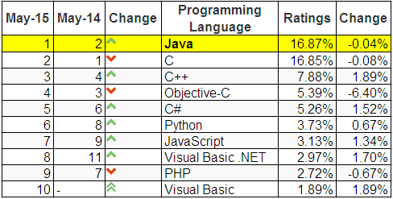
11- Why C is the 1st Language?
Top ten common programming languages:
From http://www.tiobe.com/index.php/content/paperinfo/tpci/index.html

Slide 27
Why C is the 1st Language?
C is one of the most popular languages in use globally
Some reasons for learning programming using the C language include:
Language | Time to Run
Assembly | 0.18 seconds
C | 2.7 seconds
Basic | 10 seconds
Comparative times for a Sieve of Eratosthenes test
C is English-like,
C is quite compact - has a small number of keywords,
A large number of C programs need to be maintained,
C is the lowest of high-level languages,
C is faster and more powerful than other high-level languages,
The UNIX, Linux and Windows operating systems are written in C and C++.
The most common languages, such as Java, C#, are similar to C.
C supports basic ways which help us understanding memory of a program. These can be hidden in higher languages.

Slide 28
12- Some Notable C Features
Comments
/* */
We use comments to document our programs and to enhance their readability. C compilers ignore all comments.
Whitespace
We use whitespace to improve program readability and to display the structure of our program's logic. C compilers ignore all whitespace
Case Sensitivity
C language is case sensitive.
C compilers treat the character 'A' as different from the character 'a' .

Slide 29

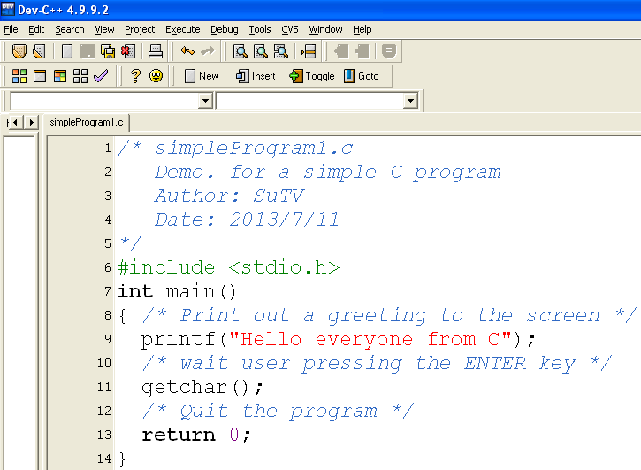

13- Structure of a Simple C Program
Comment for program description
Declaration for library using
Entry point of C-program
Statements + comments
Exit point of C-program

Slide 30
Structure…: C program Entry Points
Entry point: the point where a program begins.
Entry points of C-programs:
[int] main( [void] )
{ <statements>
[ return number; ]
}
Common form
[int] main( int argCount, char* args[])
{ <statements>
[ return number; ]
}
Demo.
In the module H (Files)

Slide 31
Basic Computations
Variables
Basic Memory Operations
Expressions
Notes:
Prepared by Thân Văn Sử

Slide 32
Objectives
A problem needs to be represented by data. After studying this chapter, you should be able to:
Understand what is a data type
Declare constants and variables of a program
Express operations on data

Slide 33
Contents
Variables and Data types
Data Types
Integral Types
Floating-Point Types
Declarations
Basic Memory Operations
Literals
Constants
Assignment Operator
Output
Input
Expressions
Arithmetic
In-Class Problem
Statistics: Which operators should be used?
Relational
Logical
Bit operators
Shorthand Assignment Operators
Mixing Data Types
Casting
Precedence

Slide 34
Introduction
Instruction: A task that hardware must perform on data.
Data can be: constants, variables.
Constants: Fixed values that can not be changed when the program executes.
Variables: Values can be changed when the program execute.
Data must be stored in the main memory (RAM).
2 basic operations on data are READ and WRITE.
Numerical data can participate in expressions.

Slide 35
Variables and Data Types…
Data Types:
Typed languages, such as C, subdivide the universe of data values into sets of distinct type.
A data type defines:
How the values are stored and
How the operations on those values are performed.
Typed languages defined some primitive data types.

Slide 36
Variables and Data Types…
C has 4 primitive data types:
Type | Length | Range
int | Word (length of CPU register) | -32,768 to 32,767 (16 bit) -2,147,483,648 to 2,147,483,647 (32 bit)
char | byte | -128 to 127
float | 4 bytes | 3,4 * 10⁻³⁸ to 3,4 * 10³⁸
double | 8 bytes | 1,7 * 10⁻³⁰⁸ to 1,7 * 10³⁰⁸

Slide 37
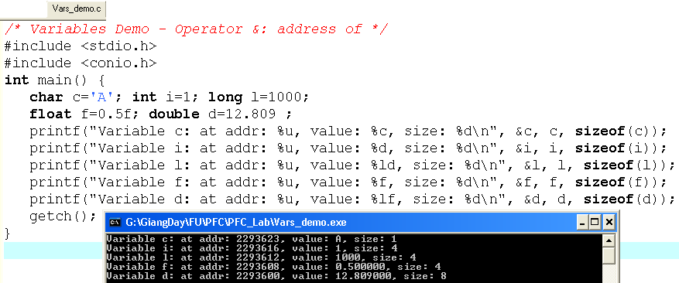
Variables and Data Types…
c:2293623
‘A’
Where are variables stored and how many bytes do they occupy?
1
i:2293616
1000
l:2293612
0.5
f:2293608
12.809
d:2293600
The operator & will get the address of a variable or code.
The operator sizeof(var/type) return the size (number of byte) occupied by a variable/type

Slide 38
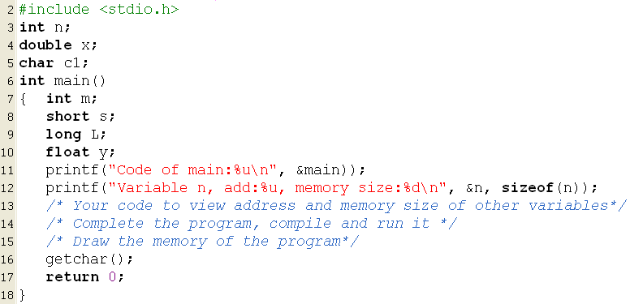
Extra Exercise

Slide 39
Variables and Data Types…
Qualifiers:
We can qualify the int data type so that it contains a minimum number of bits.
Qualifiers:
short :at least 16 bits
long: at least 32 bits
long long: at least 64 bits
Standard C does not specify that a long double must occupy a minimum number of bits, only that it occupies no less bits than a double.

Slide 40
Variables and Data Types…
Exercises:
Convert the following decimal integers to binary:
63 __________________________________
219 _________________________________
Convert the following binary notation to decimal:
0111 0101 ___________________________
0011 1011 ___________________________
01011011 ___________________________

Slide 41
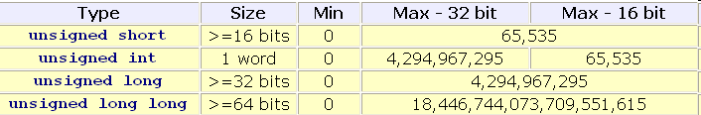
Variables and Data Types…
Unsigned Integers:
We can use all of the bits available to store the value of a variable.
With unsigned variables, there is no need for a negative-value encoding scheme.

Slide 42
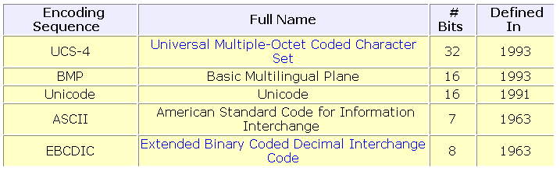
Variables and Data Types…
Cultural Symbols (characters):
We store cultural symbols using an integral data type.
We store a symbol by storing the integer associated with the symbol.
Over 60 encoding sequences have already been defined.
We use the ASCII encoding sequence throughout this course

Slide 43
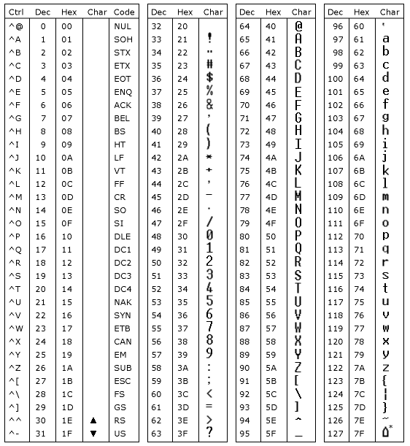
Variables and Data Types…
The ASCII table for characters

Slide 44
Variables and Data Types…
Exercises:
What is the ASCII encoding for
'0' ___________________________________________
'a' ___________________________________________
'A' ___________________________________________
What is the EBCDIC encoding for
'0' ___________________________________________
'a' ___________________________________________
'A' ___________________________________________
Convert the following binary notation to an ASCII character:
0110 1101 _____________________________________
0100 1101 _____________________________________
Convert the following decimal notation to an EBCDIC character:
199 ______________________
35 __________________________

Slide 45
Variables and Data Types…
Representation of Floating-Point Data :
Computers store floating-point data using two separate components:
an exponent and
a mantissa (phần định trị)
1.2345 = 1.2345 *10⁰
123.45 = 1.2345 *10²
1234.5 = 1.2345 *10³
0.0012345 = 1.2345 *10⁻³
Give your comment about position of the point mark and it’s mantissa

Slide 46
Variables and Data Types…
Variable Declarations in C:
data_type identifier [= initial value];
For example:
char section;
int numberOfClasses;
double cashFare = 2.25;
Naming Conventions: Name is one word only
must not be a C reserved word
Some compilers allow more than 31 characters, while others do not. To be safe, we avoid using more than 31 characters.
Letter or ‘_’
Letters/digits/ ‘_’

Slide 47
Variables and Data Types…
Exercises:
Which of the following is an invalid identifier?
whale giraffe's camel_back 4me2
_how_do_you_do senecac.on.ca digt3 register

Slide 48
Questions as Summary
What is a variable?
What is a data type?
Characteristics of a data type are …… and …
The size of the int data type is …. Bytes.
Choose the wrong declarations:
int n=10;
char c1, c2=‘A’;
int m=19; k=2;
char c3; int t;
float f1; f2=5.1;
Explain little-endian ordering and big-endian ordering.

Slide 49
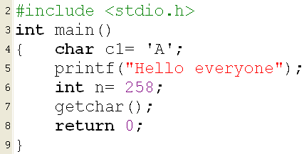
2- Literals
Constant values are specified directly in the source code.
They can be
Character literals (constant characters)
String literals(constant strings)
Number literals (constant numbers)

Slide 50
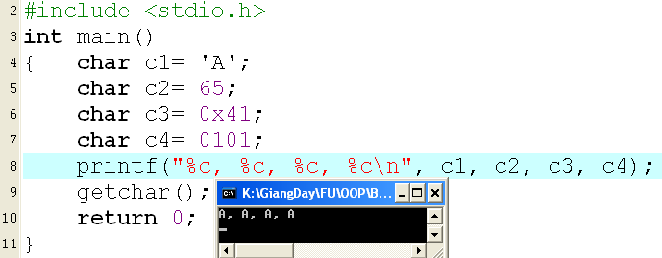
Literals: Characters, Strings
4 ways for representing a character literal:
04 ways:
Enclose the character single quotes - for example 'A',
Decimal ASCII code of the character : 65 for 'A‘
Octal ASCII code of the character: 0101 for 'A',
Hexadecimal ASCII code of the character: 0x41 for 'A',
Assign value to a variable:
The operator =

Slide 51
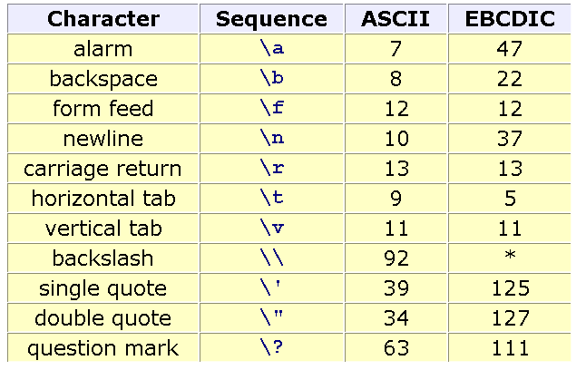
Literals: Escape Sequences
Pre-defined literals for special actions:

Slide 52
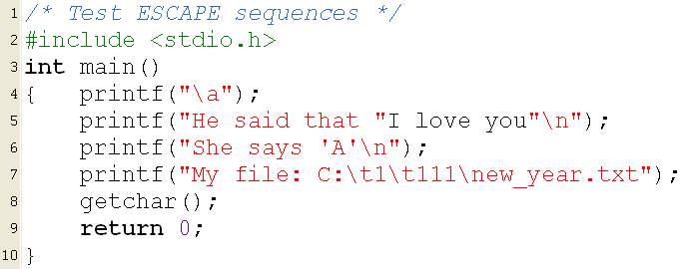
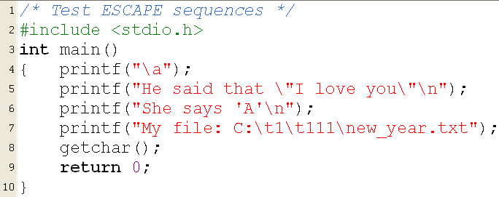
Literals: Escape Sequences…
Error! Why?
Modify then run it
Change \ to \\ then run it

Slide 53
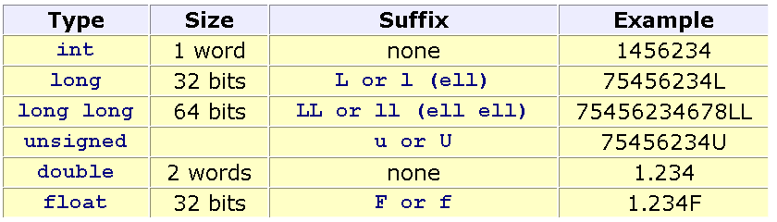
Literals: Numbers
The compiler will convert directly numeric literals (constants) to binary numbers and put them in the executable file. → How long of binary constants? → They depend on their data types specified by programmers.
Default: Integral value → int, real number → double
Specifying data type of constants: Suffixes after numbers.

Slide 54
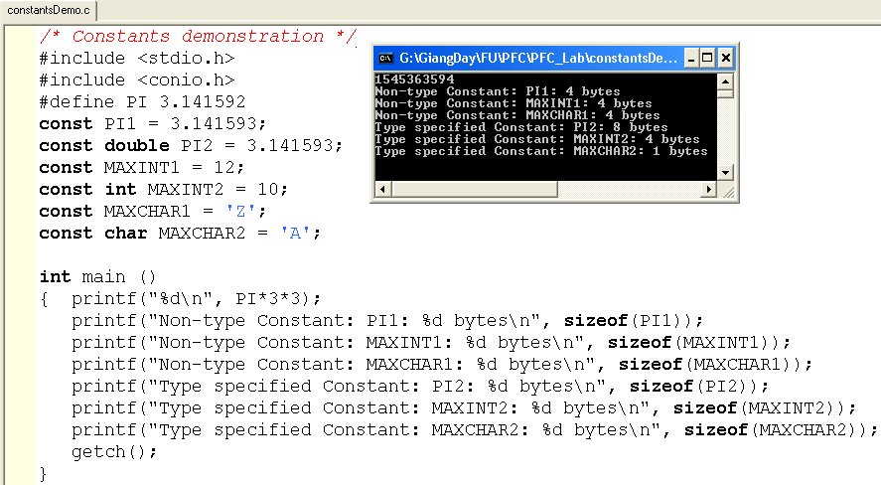
3- Named Constants
Use the pre-processor (pre-compiled directive) #define or the keyword const
Compiler will allocate memory location for constants that are declared using the keyword const

Slide 55
Fill the blank
3 ways to specify a constant in a source program: use a literal, use the keyword…., and specify a macro using the directive …..

Slide 56
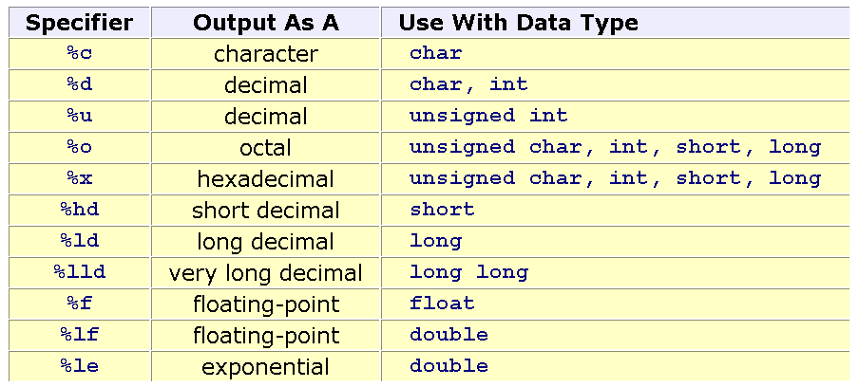
Input/Output Variables…
Conversion Specifiers

Slide 57
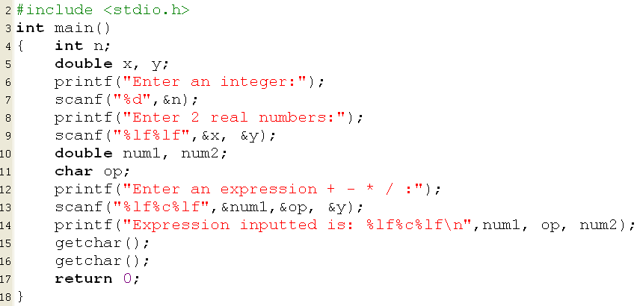


Input/Output Variables…
The function scanf receive the BLANK or ENTER KEYSzas separators.
Format string
Data holders

Slide 58
Questions
Explain means of parameters of the scanf(…) and the printf(…) functions.
Use words “left” and “right”. The assignment x=y; will copy the value in the ….. side to the ….. Side.

Slide 59
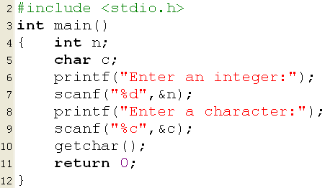
Exercises
1- Develop a C program in which 2 integers, 2 float numbers and 2 double numbers are declared. Ask user for values of them then print out values and addresses of them. Write down the memory map of the program.
2- Run the following program:
Why user do not have a chance to stroke the ENTER key before the program terminate?
Modify and re-run:
getchar();
getchar();

Slide 61
5- Expressions
Expression is a valid association of constants, variables, operators and functions and returns an only result.
Examples:
32-x+y/6 16.5 + 4/sqrt(15) * 17 – 8
45 > 5*x y = 17 + 6*5/9 –z*z
Hardware for calculating expressions: ALU
Operations that can be supported by ALU: Arithmetic, relational and logic operations.

Slide 62
Expressions: Arithmetic Operators
Op. | Syntax | Description | Example
+ | +x | leaves the variable, constant or expression unchanged | y = +x ; ←→ y = x;
- | -x | reverses the sign of the variable | y= -x;
+ - | x+y x-y | Add/substract values of two operands | z= x+y; t = x-y;
* / | x*y x/y | Multiplies values of two operands Get the quotient of a division | z= x-y; z = 10/3; → 3 z = 10.0/3; → 3.3333333
% | x%y | Get remainder of a integral division | 17%3 → 2 15.0 % 3 → ERROR
++ -- | ++x --x x++ x-- | Increase/decrease the value of a variable (prefix/postfix operators) | Demo in the next slide.

Slide 63
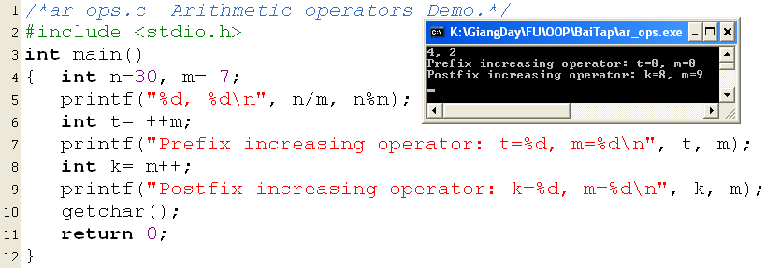
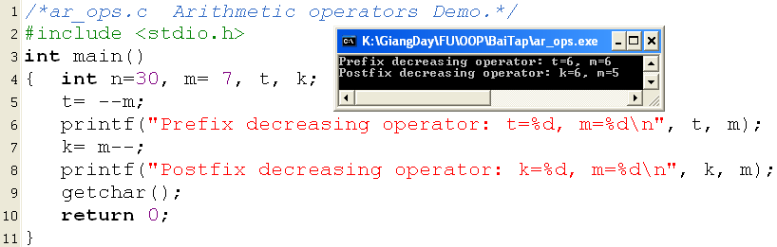
Expressions: Arith. Operators…
Explain yourself the output

Slide 64
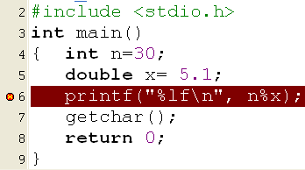

Expressions: Arith. Operators…
?
Explain yourself the output

Slide 65
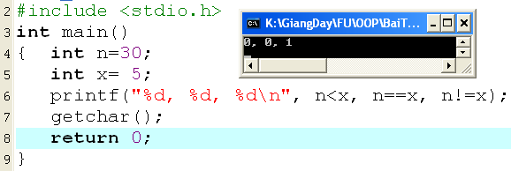
Expressions: Relational Operators
For comparisional operators.
< <= == >= > !=
Return 1: true/ 0: false

Slide 66
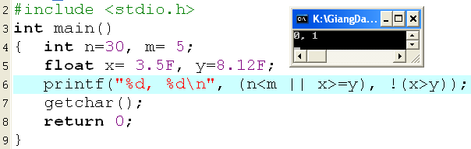
Expressions: Logical Operators
Operator for association of conditions
&& (and), || (or) , ! (not)
Return 1: true, 0: false

Slide 67
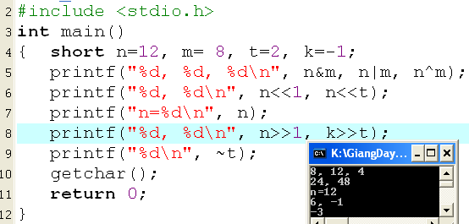
Expressions: Bitwise Operators
& (and), | (or) , ^ (xor): Will act on a pair of bits at the same position in 2 operands.
<< Left shift bits of the operand (operands unchanged)
>> Right shift bits of the operand (operands unchanged, the sign is preserved.)
~ : Inverse bits of the operand.
n&m
0000 0000 0000 1100
0000 0000 0000 1000
0000 0000 0000 1000 → 8
n=12: 0000 0000 0000 1100
m= 8: 0000 0000 0000 1000
n|m
0000 0000 0000 1100
0000 0000 0000 1000
0000 0000 0000 1100 → 12
n^m
0000 0000 0000 1100
0000 0000 0000 1000
0000 0000 0000 0100 → 4

Slide 68
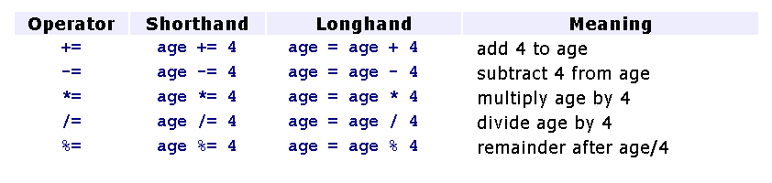
Expressions: Assignments Operators
Variable = expression
Shorthand assignments:

Slide 69
Expressions: Mixing Data Types
Although the ALU does not perform operations on operands of differing data type directly, C compilers can interpret expressions that contain operands of differing data type.
If a binary expression contains operands of differing type, a C compiler changes the data type of one of the operands to match the other.
Data type hierarchy: double, float, long, int , char .

Slide 70
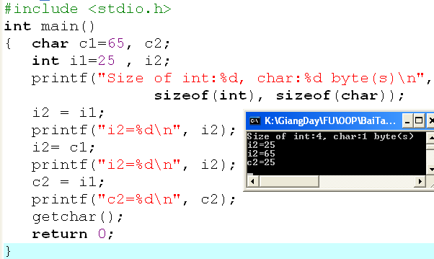
Expressions: Mixing Data Types
Casting Data Type: x = y;
00000000
00000000
00000000
00000000
00000000
00000000
00011001
00011001
00000000
00000000
00000000
01000001
01000001
00000000
00000000
00000000
01000001
00011001
Direction for copying: From the lowest byte to higher bytes

Slide 71
Expressions: Mixing Data Types
Implicit Casting for the assignment
If the data type of the variable on the left side of an assignment operator differs from the data type of the right side operand, the compiler
promotes the right operand to the data type of the left operand if the left operand is of a higher data type than the right operand,
truncates the right operand to the data type of the left operand if the left operand is of a lower data type than the right operand.
0000 0000
0000 0000
0000 0000
0100 0001
0100 0001
0000 0000
0000 0000
0000 0000
0001 1001
0001 1001

Slide 72
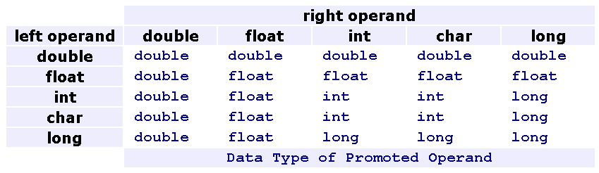
Expressions: Mixing Data Types
Implicit Casting for arithmetic and relational expressions
If the operands in an arithmetic or relational expression differ in data type, the compiler promotes the value of lower data type to a value of higher data type before implementing the operation.
int n=3; long t=123; double x=5.3;
3*n + 620*t – 3*x
(int*int) + (int*long) - (int*double)
int + long - double
long - double
double

Slide 73
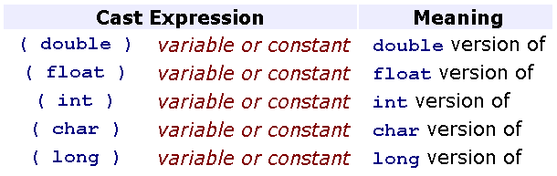
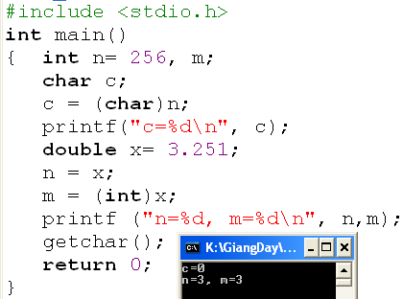
Expressions: Mixing Data Types
Explicit Casting
We may temporarily change the data type of any operand in any expression to obtain a result of a certain data type.
00000000
00000000
00000001
00000000
00000000
c
n

Slide 74
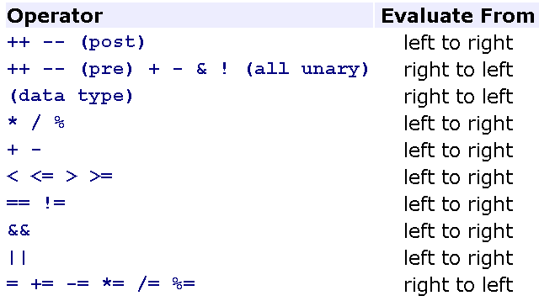
Expressions: Operator Precedence
In a expression containing some more than one operator. Which operator will perform first? → Pre-defined Precedence.
We can use ( ) to instruct the compiler to evaluate the expression within the parentheses first
int m=3, k=2, n=4;
What is the results?
m<n
k<m<n
k>m>n
m<n>k
m&& k<n

Slide 75
Summary
Variable is ……
Basic memory operations are…..
Expression is ……….
Which of the following operators will change value of a variable? + - * / % ++
Which of the following operators can accept only one operand? + - * / % --
13 & 7 = ?
62 | 53 = ?
17 ^ 21 = ?
12 >> 2 = ?
65 << 3 = ?

Slide 76
Summary
Expressions
Arithmetic operators
Relational operators
Logical operators
Bit operators
Shorthand Assignment Operators
Casting
Precedence

