Slide 1
Basic Logics
Module-C-Logic
Logic Constructs
Programming Style
Walkthroughs
Notes:
Prepared by Thân Văn Sử

Slide 2
Evaluate Workshop1
  Nxet Workshop1
  Tkhao 14-17
  Nhắc btap Long

Slide 3
Review
  A variable is a name referencing to a memory location.
A data type defines: How the values are stored and how the operations on those values are performed.
4 primitive data types in C: int, char, float, double
Data stored are in binary format
Declare a variable in C: type var [=initialValue];
An identifier begin with a letter or ‘_’, the later symbols can be letters, digits and ‘_’
An user-defined identifier must not a C keyword.
Expression is a valid association of constants, variables, operators and functions.

Slide 4
Content
1- Logic constructs
2- Programming Styles
3- Walkthroughs
4- Bonus – Redirect a Program ( a technique is used in the ACM Contest)

Slide 5
1- Logic Constructs
  Logic constructs: Expressions enable us to write programs that perform calculations and execute statements in a sequential order.
  Structured Programming
  Logic constructs:
    Sequence constructs
    Selection constructs (1/2, 1/n)
    Iteration constructs

Slide 6
1.1- Structured Programming
Structure of a program code should be organize in a manner so that it is understandable, testable and readily modifiable.
➔It consists of simple logical constructs, each of which has one entry point and one exit point.
The beginning step for developing a program is DESIGN using
  pseudo-coding or
  flow charting

Slide 7
Structured Programming: Pseudo-code
Example: Calculating the absolute value of an integer inputted from the keyboard.
Prompt the user for an integer value
Accept an integer value from the user and store it in x
If x is negative then x = -x
Display x

Slide 8
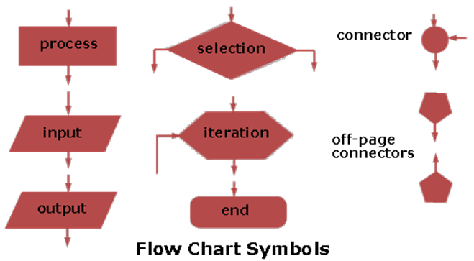
Structured Programming: Flowcharting
Describe the flow of a program unit symbolically

Slide 9
1.2- Sequence Constructs
A sequence is either a simple statement or a code block.
Simple Statements
  expression ;
Code Blocks
  A code block is a set of statements enclosed in curly braces.
  {
  statement
  ...
  statement
  }

Slide 10
1.3- Selection Constructs
Select 1/2 | Select 1/n
if if … else If … else if …. else ? : (operator) | switch
Integral
expression
Condition ?
c1
c2
c3
default
TRUE
FALSE
Op1
Op2
Op3
Op4
Operation 1
Operation 2

Slide 11
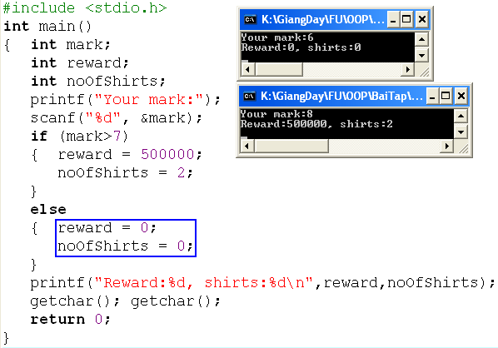
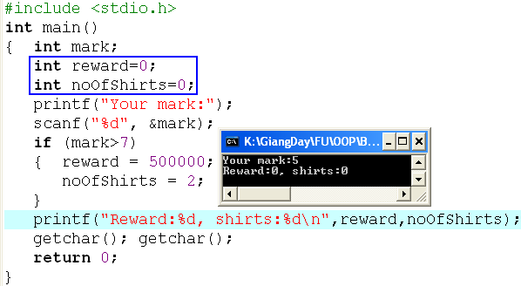
Selection Constructs: if … else
if (condition)
{ statements
}
if (condition)
{ statements
}
else
{ statements
}

Slide 12
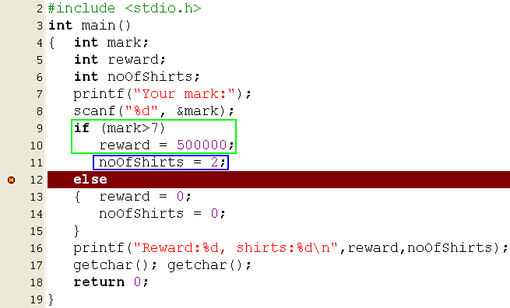

Selection Constructs: if … else
if (condition)
{ statements
}
else
{ statements
}
The compiler can not determine the if statement before the else statement.

Slide 13
Selection Constructs: if … else
Begin
N,t → int
Accept N
Compute t
Print out t
End
if (condition 1)
{ statements
}
else if (condition2)
{ statements
}
else
{ statements
}
Buying N T-shirts with promotion:
N<=3: 120000$/item
From 4th to 6th: 90000$/item
From 7th to 10th: 85000$/item
From 11th : 70000$/item
Describe the expression that will compute the paid value.
Nested if
Let N: number of T-shirts bought, t: money must be paid.
if (N <=3) t = N*120000 ;
else if (N<=6) t= 3*120000 + (N-3) * 90000;
else if (N<=10)
t= 3*120000 + 3*90000 + (N-6)*85000;
else
t= 3*120000 + 3*90000 + 4*85000 + (N-10)*70000;

Slide 14
Selection Constructs: if … else
if (condition 1)
{ statements
}
else if (condition2)
{ statements
}
else
{ statements
}
Similarly, describe the expression that will compute the paid value when we use electric power.
Implement it to a program.
Begin
N,t → int
Accept N
Compute t
Print out t
End
100
150
200
Number of kwhs
950
1250
1350
1550
prices

Slide 15
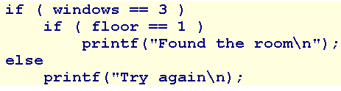
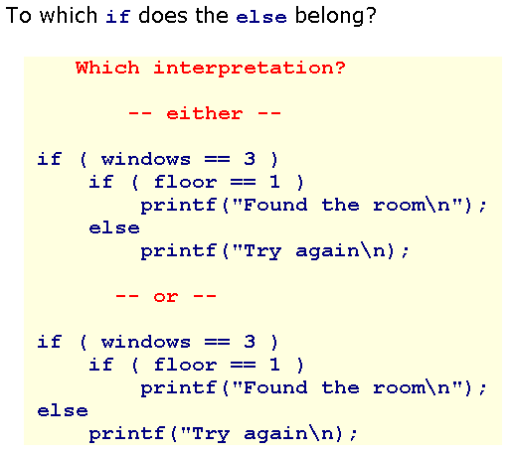
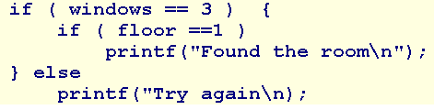
Selection Constructs: Dangling Else
Ambiguity may arise in the case of nested if else constructs.
?
The rule in C is that an else always belongs to the innermost if available. Use { } to explicitly determine statements
?

Slide 16
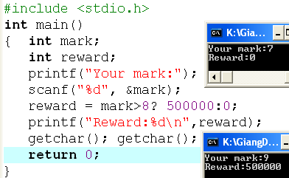
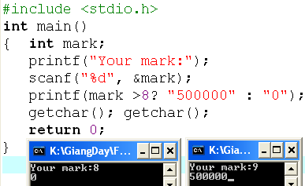
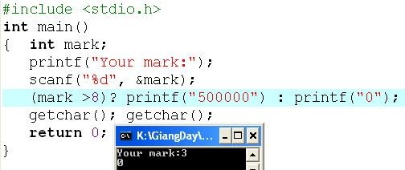
Selection Constructs: Operator ? :
(condition) ? True_Value : False_Value

Slide 17
Selection Constructs:
The switch statement
switch (variable or expression)
{
  case constant :
    statement(s);
    break;
  case constant :
    statement (s);
    break;
  default:
    statement (s);
}
Integral
expression
char / int
c1
c2
c3
default
Op1
Op2
Op3
Op4
If the break statement is missed, the next statements
are executed until a break is detected
or all statements in the body of the switch are executed.
Each case is an entry of a selection

Slide 18
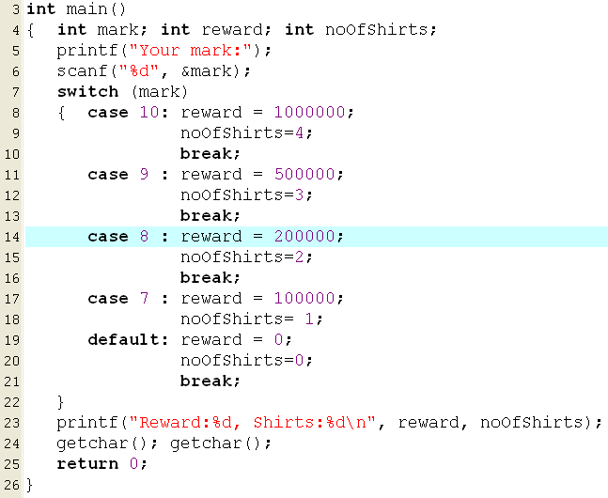
Selection Constructs:
The switch statement
If input is 8, what are outputs?
200000 , 2
300000, 3
0, 0
1000000, 4
1500000, 10
None of the others
If input is 7, what are outputs?

Slide 19
Selection Constructs: switch…
Analysis
Nouns: expression num1 op num2
➔ double num1, num2; char op
result → double result
Verbs: Begin
Accept num1, op, num2 → “%lf%c%lf”
switch (op)
{ case ‘+’ : result = num1 + num2;
print out result;
break;
case ‘-’ : result = num1 - num2;
print out result;
break;
case ‘*’ : result = num1 * num2;
print out result;
break;
case ‘/’ : if ( num2==0)
print out “Divide by 0 “
else
{ result = num1 / num2;
print out result;
}
break;
default: print out “Op is not supported”
}
End
Write a program that allows user inputting a simple expression containing one of four operators +, -, *, / then the result is printed out to the monitor. Input format:
num1 operator num2,
Example: 4*5
Implement it.

