Slide 1
Basic Logics
Module-C-Logic Logic Constructs Programming Style Walkthroughs
Notes:
Prepared by Thân Văn Sử

Slide 2
1.4- Iteration (loop) Constructs
Loop/Iteration: some statements are executed repetitively
Structure of a loop:
Initial block.
Condition.
Task in each execution.
Types of iteration: fixed loops, variable loops
The iteration constructs are:
while
do while
for

Slide 3
Iteration…
Identify a loop:
Calculate S= 1+2+3+4+5+6+7+ … + 100
Some addition are performed ➔ Loop
Sum of some numbers they are inputted until user enters 0.
Accept and add numbers ➔ Loop

Slide 4
Iteration…
Identify a loop for an expression:
Left side → Initial block
Right side → Condition
An operation and preparations for the next iteration: Tasks in each iteration.
S=1+2+3+4+… + 100
→ S=0+1+2+3+4+… + 100
S=1*2*3*4*… * 100
→S=1*1*2*3*4*… * 100
S=0
(1) S=S+i;
(2) i=i+1;
i<=100
S=1
(1) S=S*i;
(2) i=i+1;
i<=100
i=1
i=1
S=1
i=2

Slide 5
Iteration…
S= 0 , n<=0
1 + 3 + 5 +… + n, n is odd
2 + 4 + 6 + … + n, n is even
S= 0 , n<=0
n + (n-2) + (n-4) + … + 0
Initial value:
S = 0;
i = n;
Condition i>0
Tasks: S += i;
i -=2;
Initial value:
S = 0
i = (n%2==1)? 1: 2;
Condition i <=n
Tasks: S += i;
i+=2;
S= 1 + 1/1⁰ + 1/ 2¹ + 1/3² + … + 1 /n^{n-1}
Initial value:
S = 1.0;
i = 1;
Condition i <=n
Tasks: S += 1.0/ pow ( i, i-1 );
i = i +1;
math.h

Slide 6
Iteration: for statement
for ( InitBlock; Condition; Task2) Task1;
for ( Init1, Init2; Condition ; Task1, Task2);
InitBlock;
for ( ; Condition ; Task2) Task1;
InitBlock;
for ( ; Condition ;)
{ Task1;
Task2;
}
InitBlock
no
Condition?
yes
Task1
Task2
The condition will be tested before tasks are performed.

Slide 7
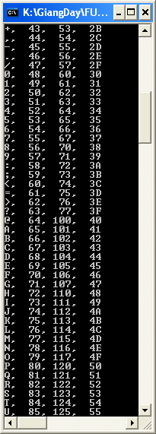
Iteration…
Write a program that will print out the ASCII table.
ASCII code : 0 → 255
Initialize: int code =0
Condition: code <256
Task:
Print the code using 4 format: %c, %d, %o, %X
code = code +1

Slide 8
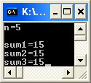
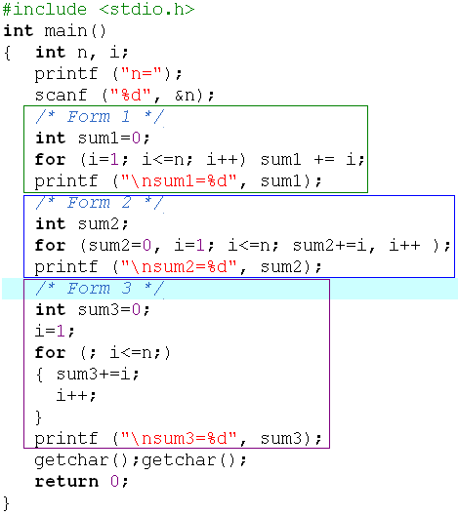
Iteration…
Write a program that will calculate 1+2+3+…+n.
Accepted variable: int n
Sum 1 .. N → int sum
Algorithm
Accept n
Loop:
Initialize i=1, sum=0
Condition i<=n
Tasks: sum += i; i++;
Print out sum

Slide 9
Iteration: while/do…while statements
InitBlock
InitBlock
no
Condition?
Task1
yes
Task2
Task1
yes
no
Task2
Condition?
/* Initializations */
while (condition)
{ statements;
}
/* Initializations */
do
{ statements;
}
while (condition) ;
The condition will be tested before tasks are performed.
The condition will be tested after tasks are performed.

Slide 10
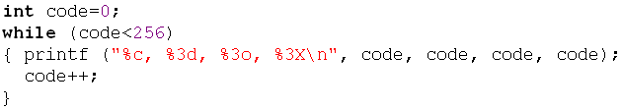
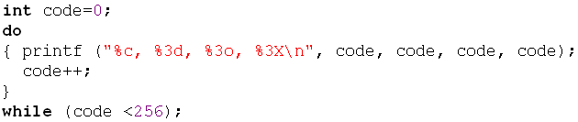
Iteration: while/do…while statements
Write a program that will print out the ASCII table.
ASCII code : 0 → 255
Initialize: code =0
Condition: code <256
Task:
Print the code using 4 formats: %c, %d, %o, %X
code = code +1

Slide 11
Iteration…
Write a program that will print out the sum of integers inputted by user. The input will terminate if user enters the value 0.
Nouns: inputted integer → int x,
sum of integers → int sum
Tasks (algorithm)
Begin
sum =0
do
{ accept x;
sum += x;
}
while (x!=0);
Print out sum
End
Implement it by yourself.

Slide 12
Iteration…
Write a program that permits user entering some characters until the ENTER key (code 10) is pressed. The program will print out the number of digits, number of letters, number of other keys were pressed. Accept a character: c=getchar();
Nouns:
character inputted → char c, Number of digits → int noDigits
Number of letters → noLetters, Number of other keys → noOthers
#define ENTER 10
Algorithm
Begin
noDigits = noLetters = noOthers = c= 0
printf(“Enter a string:”);
While (c!=ENTER)
{ accept c;
if ( c>=‘0’ && c <=‘9’) noDigits++;
else if ( (c>=‘a’ && c <=‘z’) || (c>=‘A’ && c <=‘Z’) ) noLetters++;
else noOthers++;
}
Print out noDigits, noLetters, noOthers
End
The while statement is intentionally used. So, c=0 is assigned and the condition c!=ENTER is evaluated to TRUE
Implement it by yourself.
Input form:
abc1234fGH+-*/?(ENTER)

Slide 13
Iteration…
When a loop is needed, what loop statement should be used?
➔ All of them can be used to satisfy your requirement.

Slide 14
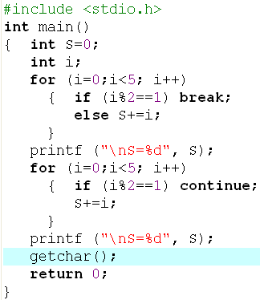
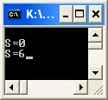
Iteration: Break/ Bypass a loop
0 1 2 3 4 5
0 1 2 3 4 5

Slide 15
Iteration Constructs: Flags
The one entry, one exit principle is fundamental to structured programming.
C includes three keywords that allow jumps across statements: goto, continue, and break. Using any of these keywords, except for break in a switch construct, violates the one entry, one exit principle of structured programming.

Slide 16
Iteration Constructs: Flags…
To improve readability, programmers advocated:
the use of whitespace to identify the logical structure of the code
the abolition of all goto statements
the abolition of all continue statements
the abolition of all break statements, except with switch
A technique for avoiding jumps is called flagging. A flag is a variable that keeps track of a true or false state.

Slide 17
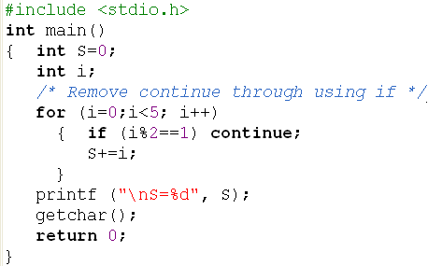
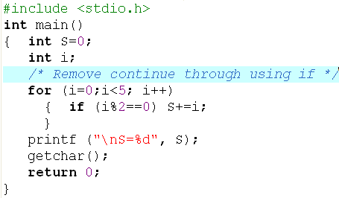

Iteration Constructs: Flags…
Use if instead of continue

Slide 18
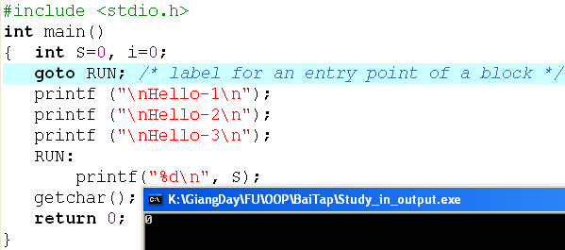
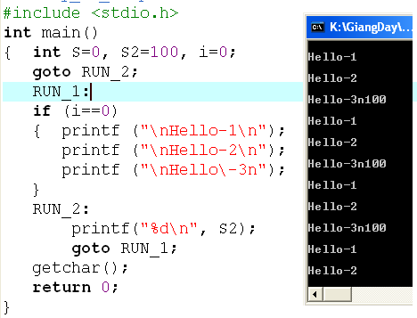
Iteration Constructs: Flags…
Loop infinitively

Slide 19
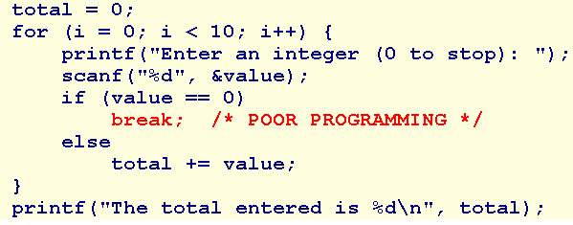
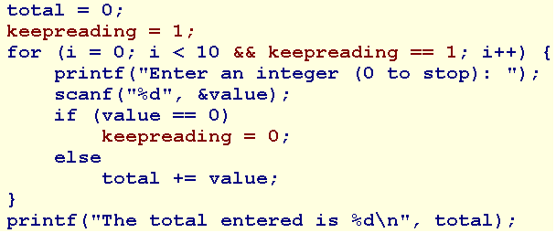
Iteration Constructs: Flags…
No flag is used.
A flag is used.

Slide 20
2- Programming Styles
Habits in programming
A well-written program is a pleasure to read. Other programmers can understand it without significant effort. The coding style is consistent and clear throughout.
Develop your own style guide or adopt the style outlined here or elsewhere, but adopt some style.
Recommendations on
Naming
Indentation
Comments
Magic Values
General Guidelines

Slide 21
Programming Styles: Naming
Adopt names that are self-descriptive so that comments clarifying their meaning are unnecessary
Use names that describe identifiers completely, avoiding cryptic names
Prefer nouns for variable names
Keep variable names short - studentName rather than theNameOfAStudent
Keep the names of indices very short - treat them as mathematical notation

Slide 22
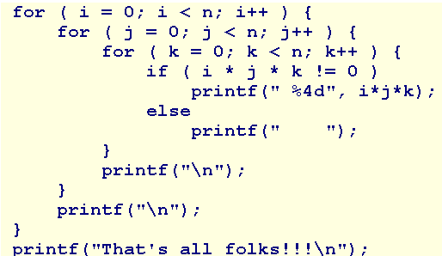
Programming Styles: Indentation
Indent the body of any construct that is embedded within another construct. For example,
Use in-line opening braces or start opening braces on a newline but don't mix the two styles.

Slide 23
Programming Styles: Comment
Use comments to declare what is done, rather than describe how it is done.
Comments introduce what follows.
Keep them brief and avoid decoration.

Slide 24
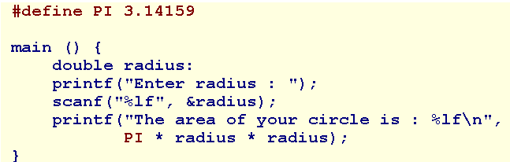
Programming Styles: Magic Values
These may be mathematical constants, tax rates, default values or names.
To improve readability, assign symbolic names to these magic values and refer to the symbolic names throughout the code.
Use the directive
#define SYMBOLIC_NAME value

Slide 25
Programming Styles: Magic Values…
Compiler Idiosyncracies
Use #define to manage idiosyncracies (đặc điểm) across platforms.
For example, the Borland 5.5 compiler does not recognize the long long data type. Instead, it recognizes an _int64 data type. To improve portability, #define the data type using a symbolic name such as LONG_LONG and embed that name throughout our code.

Slide 26
Programming Styles: Guidelines
Limit line length to 80 characters - both comments and code
Avoid global variables
Select data types for variables wisely and carefully
Initialize a variable when declaring it only if the initial value is part of the semantic of the variable.
If the initial value is part of an algorithm, use a separate assignment statement.
Avoid goto, continue, break except in switch.
Avoid using the character encodings for a particular machine.
Use a single space or no spaces either side of an operator.

Slide 27
Programming Styles: Guidelines
Use in-line opening braces or start opening braces on a newline but don't mix the two styles.
Initialize iteration variables in the context of the iteration
Avoid assignments nested inside logical expressions
Avoid iterations with empty bodies - reserve the body for the algorithm
Limit the initialization and iteration clauses of a for statement to the iteration variables
Distribute and nest complexity

Slide 28
Programming Styles: Guidelines
Avoid fancy algorithms that may be efficient but are difficult to read
Add additional comments where code has been fine tuned for efficient execution
Add an extra pair of parentheses where an assignment is also used as a condition
Remove unreferenced variables
Remove all commented code and debugging statements from release and production code

Slide 29
3- Walkthroughs
Understand code is a skill of programmer.
To understand code, we should know how the code execute.
To know how the code execute, we should perform each instruction.
A walkthrough is
a record of the changes that occur in the values of program variables as a program executes and
a listing of the output, if any, produced by the program.
Ways to perform a walkthrough
Memory Map → You knew that
Walkthrough Tables → A simpler way

Slide 30
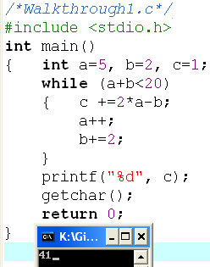
Walkthroughs: Demo.
a | b | a+b | c
5 | 2 | 7 | 1
6 | 4 | 10 | 9
7 | 6 | 13 | 17
8 | 8 | 18 | 25
9 | 10 | 19 | 33
10 | 12 | 22 | 41
Output
41

Slide 31
Walkthroughs: Demo.
int n, i, S=0;
scanf(“%d”, &n);
for (i=1; i<=n; i+=3)
if (i%2!=0 && i%3!=0) S+=i;
printf(“%d”, S);
What is the output if the input is 15?
n | 15
i | 1 | 4 | 7 | 10 | 13 | 16
S | 0+1 → 1 |  | 1+7 → 8 |  | 8+13→21
S=21

Slide 32
Walkthroughs: Demo.
int m,n, i, S=0;
scanf(“%d%d”, &n, &m);
for (i=m; i<=n; i++) S+=i;
printf(“%d”, S);
What is the output if the input are 8 12?
Modify | Input
“%d %d” | 12 8
“%d%d” | 12 8
“%d%d” | 12 8
“%d-%d” | 12-8
Test the program:
int m,n, i, S=0;
scanf(“%da%d”, &n, &m);
for (i=m; i<=n; i++) S+=i;
printf(“%d”, S);
What is the output if the input are 8a12?

Slide 33
Walkthroughs: Demo.
Study the following code:
int n=15;
int S=0;
i=1;
while (i<2*n)
{ S+= i;
i*=4;
}
Give your opinion.
S=21
S= 85
A syntax error

Slide 34
Extra Demo: Print star characters
i= 1
2
3
4
5
6
N=6
*
**
***
****
*****
******
Print out 1*, “\n”
Print out 2*, “\n”
Print out 3*, “\n”
Print out 4*, “\n”
Print out 5*, “\n”
Print out 6*, “\n”
i
Accept N;
for ( i=1; i<=N; i++)
{ for (j=1; j<=i; j++) printf(“*”);
printf (“\n”);
}

Slide 35
Extra Demo: Multiplication Table
N=5
5x 1= 5
5x 2=10
5x 3=15
5x 4=20
5x 5=25
5x 6=30
5x 7=37
5x 8=40
5x 9=45
5x10=50
Accept n;
for ( i=1; i<=10; i++)
Print out “%dx%2d=%2d\n”, n, i, n*i

Slide 36
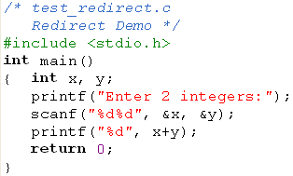





4- Redirect a Program
A characteristic is supported by the operating system and it is used in the ACM International contest.
➔ So, pay attention to input/output formats.

Slide 37
Summary
Logic constructs = Statements can be used in a program.
3 Basic constructs: Sequence, selection constructs (if, if…else, ?:, switch), Iteration constructs (for/ while/ do … while)
Walkthrough: Code are executed by yourself, Tasks in a walkthrough: a record of the changes that occur in the values of program variables and listing of the output, if any, produced by the program.

