Slide 1
Pointers
Notes:
Prepared by Thân Văn Sử

Slide 2
Objectives
After studying this chapter, you should be able to:
Explain what are pointers
Declare pointers in a program
How pointers can be used
Understand operators on pointers
Implement functions in which pointers are parameters
Use build-in functions to allocate data dynamically

Slide 3
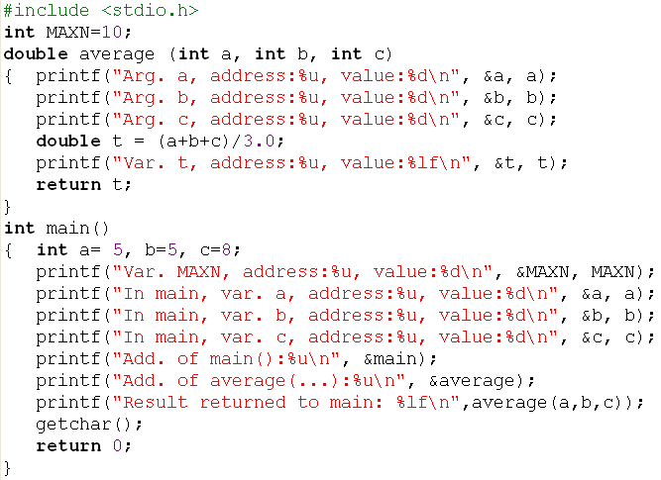
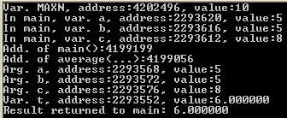
Memory Map of a program
Data segment
4202496
MAXN=10
Code segment
Code of main()
4199199
Code of average()
4199056
HEAP
STACK
segment
2293620
a = 5
2293616
b = 5
2293612
c = 8
2293576
c = 8
2293572
b = 5
2293568
a = 5
2293552
t = 6.0000

Slide 4
Questions
Address of a variable is a number. Can we assign this number to another variable then access data through the new variable?
Data segment
4202496
MAXN=10
Code segment
Code of main()
4199199
Code of average()
4199056
Address of a function is a number. Can we assign this number to another variable then call this function through the new variable?
HEAP
Yes. We can access a data through it’s address and call a function through it’s address also. POINTER is a way to satisfy these requirement.
In this chapter, pointers of variables are concerned only.
STACK
segment
2293620
a = 5
2293616
b = 5
2293612
c = 8
2293576
c = 8
2293572
b = 5
2293568
a = 5
2293552
t = 6.0000

Slide 5
3- What is a Pointer?
address
value
A pointer is a variable, which contains the address of a memory location of another variable
80000
32
p2: 80000
If one variable contains the address of another variable, the first variable is said to point to the second variable
400
7
p1: 400
A pointer provides an indirect method of accessing the value of a data item
Pointers can point to variables of other fundamental data types like int, char, or double or data aggregates like arrays or structures

Slide 6
2- Where can we put program’s data?
Data
Segment
Common Variables
All functions can access them
Global
Code
Segment
Dynamic
Heap
Dynamic allocated data through
explicitly statements for memory
allocation
Data
Local
Stack
Segment
Variables are defined in functions.
They will exist only when the
function is executed and they will
be removed when the function
Completed execution

Slide 8
4- Pointer Variables
A pointer declaration consists of a base type and a variable name preceded by an *
Syntax: dataType *name;
The variable name will contain the address of a data belonging to the type dataType
Examples:
int *pI;
double* pD;
char *pC;

Slide 9
5- Where are pointers used?
Some situations where pointers can be used are:
To modify outside arguments of a function
To return more than one value from a function (It will be introduced in slots 18→24)
To pass array and strings more conveniently from one function to another (It will be introduced in slots 18→24)
To manipulate arrays easily by moving pointers to them instead of moving the arrays itself (It will be introduced in slots 18→24)
To allocated memory and access it (Direct memory allocation) (It will be introduced at the bottom of this lesson)

Slide 10
6- Pointer Operators
How to | Operator | Example
Get address of a variable and assign it to a pointer | & | int n= 7; int* pn = &n;
Access indirectly value of a data through it’s pointer | * | *pn =100;
10000
n = 7
10000
n = 7 → 100
9996
pn
9996
pn = 10000
int n= 7;
int* pn = &n;
*pn = 100;
*pn = 100; → Value at [10000] =100
pn = &n; → pn=10000

Slide 11
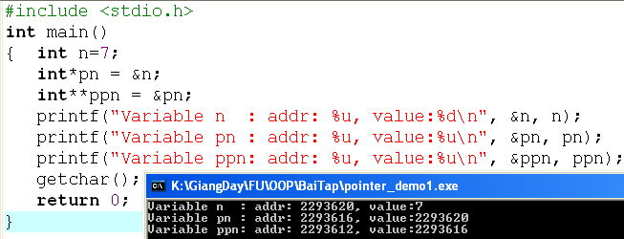
Pointer Operators…
2293620
n=7
2293616
pn= 2293620
2293612
ppn= 2293616
n → int → pn stores address of n
→ pn: int*
pn → int* → ppn stores address of pn
→ ppn: (int*)* → ppn: int**

Slide 12
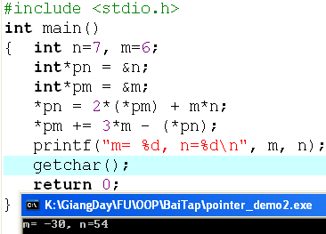
Pointer Operators… Walkthrough
100
n=7 → 54
*pn = 2*(*pm) + m*n;
Value at 100 = 2*(value at 96) + m *n
Value at 100 = 2*6 + 6 *7
Value at 100 = 12 + 42 = 54
96
m=6 → -30
92
pn=100
88
pm= 96
*pm += 3*m - (*pn);
Value at 96 += 3*6 – value at 100
Value at 96 += 3*6 – 54
Value at 96 += 18 – 54
Value at 96 += (-36)
Value at 96 = 6+ (-36) = -30

Slide 13
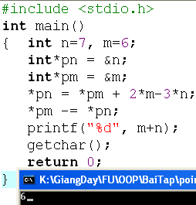
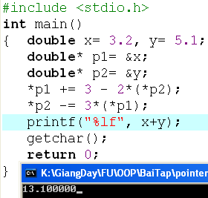
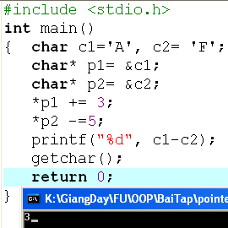
Walkthroughs: Do yourself
int n=7,m=8;
int* p1= &n, *p2=&m;
*p1 +=12-m+ (*p2);
*p2 = m + n- 2*(*p1);
printf(“%d”, m+n);
What is the output?
int n=7, m=8;
int* p1= &n, *p2=&m;
*p1 +=5 + 3*(*p2) –n ;
*p2 = 5*(*p1) – 4*m + 2*n;
What are values of m and n?

Slide 15
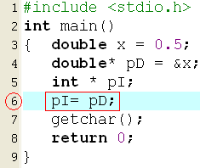

Attention about Accessing Pointers
Accessing data through pointers will manipulate on basic-data size.
Access int* → 4 bytes are affected.
Access char* → only 1 byte is affected.
Access double* → 8 bytes are affected.
Assign pointers which belong to different types are not allowed. → If needed, you must explicitly casting.

Slide 16
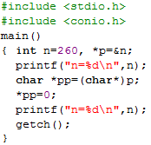

Attention…Pointers: Explicit Casting
Review: When a casting is performed, lowest byte is copied first then the higher bytes.
0000 0001
0000 0100
500
0000 0001
0000 0100
500
0000 0100
0000 0001
0000 0000
500
p
500
500
pp
Manipulate on 4 bytes
Manipulate on 1 byte only

Slide 18
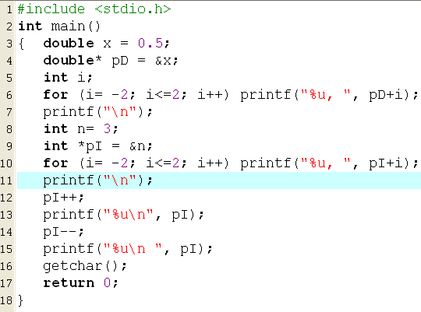

Pointer Arithmetic Operators : +, -, ++, --
Pointer +i → Pointer + (i*sizeof(baseType))
2293632
2293624
x
2293616
If access data using pD (bytes) can cause a harm on the variable n
2293612
2293608
2293608
n
2293604
2293600
2293600
2293596

Slide 19
Pointer Arithmetic Operators : Accessing the neighbor
/* file pointer_demo4.c */
#include <stdio.h>
int main()
{ int n2= 10;
int n1= 6;
int n0= 5;
printf("n2=%d, n1=%d, n0=%d\n", n2, n1, n0);
int* p = &n1;
*p=9;
p++;
*p=15;
p--;
p--;
*p=-3;
printf("n2=%d, n1=%d, n0=%d\n", n2, n1, n0);
getchar();
return 0;
}
Copy and paste, run the program, explain the result.

Slide 20
Exercises
double *p;
Suppose that a double occupies the memory block of 8 bytes and
p stores the value of 1200.
What are the result of the following expression? p+8 p-3 p++
long*p;
Suppose that a long number occupies the memory block of 4 bytes
And p stores the value of 1000.
What are the result of the following expression? p+8 p-3 p++
char*p;
Suppose that a character occupies the memory block of 1 byte
and p stores the value of 207000.
What are the result of the following expression? p+8 p-3 p++

Slide 21
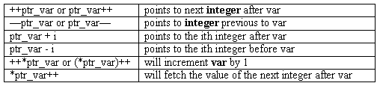
Pointer Arithmetic Operators…
Each time a pointer is incremented, it points to the memory location of the next element of its base type
Each time it is decremented it points to the location of the previous element
All other pointers will increase or decrease depending on the length of the data type they are pointing to

Slide 22
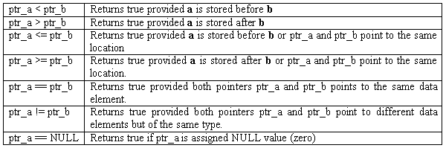
Pointer Comparisons
Two pointers can be compared in a relational expression provided both the pointers are pointing to variables of the same type.
Consider that ptr_a and ptr_b are 2 pointer variables, which point to data elements a and b. In this case the following comparisons are possible:

Slide 24
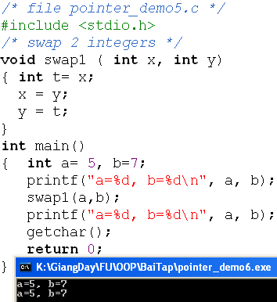
7- Pointers as Parameters of a Function
C passes arguments to parameters by values only → C functions can not modify outside data.
y = 7 →5
x = 5 → 7
t = 5
a = 5
b = 7

Slide 25
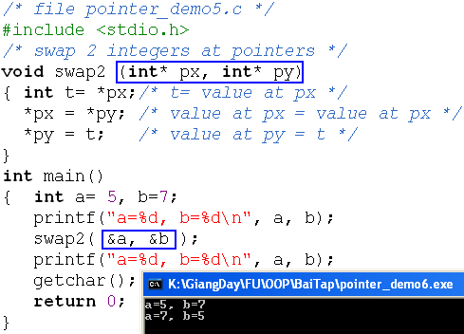
Pointer as Parameters of a Function …
Use pointer arguments, we can modify outside values.
py: 996
px : 1000
t = 5
a = 5 → 7
1000
b = 7 → 5
996

Slide 27
8- Dynamic Allocated Data
Stdlib.h
void* calloc (size_t numberOfItem, size_t bytesPerItem)
void* malloc (size_t numBytes) ;
void* realloc (void* curPointer, size_t newNumBytes);
void free(void* willBeDeletedPointer);
Data
Segment
Global
Code
Segment
Dynamic
Heap
Examples
int* p = (int*) malloc (sizeof (int)) ;
*p=2;
….
free(p);
Data
calloc: Contiguous Allocation
malloc: Memory allocation
realoc: Re allocation
Local
Stack
Segment
Size_t: Another name of the int type. It is used in case of memory allocation managing.
void is the general datatype which means that the data type is not determined yet. So, user must give an explicit casting when it is used.

Slide 28
Demo: Dynamic Allocated Data
/* file pointer_demo5.c */
#include <stdio.h>
const int MAXN =100;
int main()
{ int n; int *p1; int *p2; int *p3;
printf("Address of MAXN: %u\n", &MAXN);
printf("Main function ia allocated at: %u\n", &main);
printf("Address of n : %u\n", &n);
printf("Address of p1: %u\n", &p1);
printf("Address of p2: %u\n", &p2);
p1 = (int*)malloc(sizeof(int));
p2 = (int*)malloc(sizeof(int));
p3 = (int*)malloc(sizeof(int));
printf("Dynamic allocation (p1) at: %u\n", p1);
printf("Dynamic allocation (p2) at: %u\n", p2);
printf("Dynamic allocation (p3) at: %u\n", p3);
getchar();
free(p1);
free(p2);
return 0;
}
(1) Copy, past, compile and run the program.
(2) Draw the memory map.
(3) Show that where is data segment, code segment, stack segment and heap of the program.
(4) Give comment about the direction of dynamic memory allocation.

Slide 29
Dynamic Allocated Data- Do yourself
Use dynamic memory allocation. Develop a program that will accept two real numbers then sum of them, their difference, their product, and their quotient are printed out.
/* main() */
double *p1, *p2;
p1 = (double*) malloc ( sizeof(double));
p2 = (double*) malloc ( sizeof(double));
printf(“p1, address: %u, value: %u\n”, &p1, p1);
printf(“p2, address: %u, value: %u\n”, &p2, p2);
printf(“Input 2 numbers:”);
scanf( “%lf%lf”, p1, p2);
printf(“Sum: %lf\n”, *p1 + *p2);
printf(“Difference: %lf\n”, *p1 - *p2);
printf(“Product: %lf\n”, *p1 * (*p2));
printf(“Quotient: %lf\n”, *p1 / *p2);
(1) Run this program
(2) Draw the memory map (stack, heap).

Slide 30
Dynamic Allocated Data- Do yourself
Write a C program using dynamic allocating memory to allow user entering two characters then the program will print out characters between these in ascending order.
Example:
Input: DA
Output:
A 65 81 41
B 66 82 42
C 67 83 43
D 68 84 44
After the program executes, draw the memory map of the program.
Danh từ: 2 pointer char* pc1, *pc2;
Động từ
Cấp bộ nhớ pc1, pc2;
Nhập 2 ký tự vào pc1, pc2
Nếu (*pc1>*pc2) Hoán vị *pc1, *pc2;
char c;
For (c= *pc1; c<=*pc2; c++)
printf(“%c,%4d,%4o%4X\n”, c,c,c,c);

Slide 31
Summary
Pointer operators
Assign values to pointers
Access data through pointer
Explain pointer arithmetic
Explain pointer comparisons
Pointers as parameters of a function
Dynamic Allocated Data
Q&A

Slide 32
Extra Walkthroughs with functions
Study the following C-function:
void T (int * p, int*q)
{ int t= *p; *p=*q; *q=t;
}
Suppose the above function is used in the following code:
int a=7, b=6;
T(&a,&b);
What are the values of the a and b variables after this code is executed?

Slide 33
Extra Walkthrough with functions
Study the following C-function:
int T (int * p, int*q)
{ int t= (*p) + (*q) > 12 ? 5:6;
return 2*t%5;
}
Suppose the above function is used in the following code:
int a=3, b=4, c;
c= T(&a,&b);
What is the value of the c variable after this code is executed?

Slide 34
Programming With Menu
Notes:
Prepared by Thân Văn Sử

Slide 35
Why is Menu?
Generally, a program performs some operations and at a time only one task is carried out. ➔ A menu is usually used.
➔ How are menus implemented in C program?

Slide 36
Idea
Common Algorithm in the entry point:
int userChoice;
do
{ userChoice= getUserChoice();
switch (userChoice)
{ case 1: function1(); break;
case 2: function2(); break;
case 3: function3(); break;
}
}
while (userChoice >0 && userChoice<maxChoice);

Slide 37
Problem
Write a C program using the following menu:
1- Operation 1
2- Operation 2
Others- Quit
If user chooses 1, user will input 2 integers, the program will print out sum of integers between them including them.
If user chooses 2, user will input 2 characters, the program will print out the ASCII table between two inputted characters in ascending order.
If user chooses other options, the program will terminate.

Slide 38
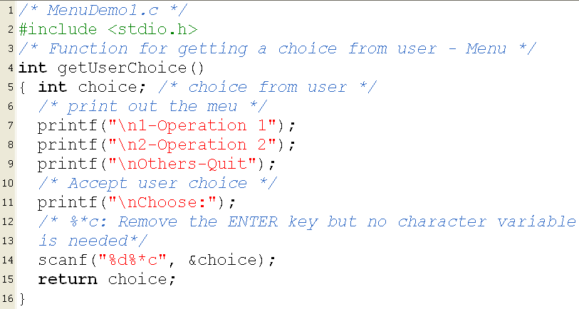
Implementation: menuDemo1.c

Slide 39
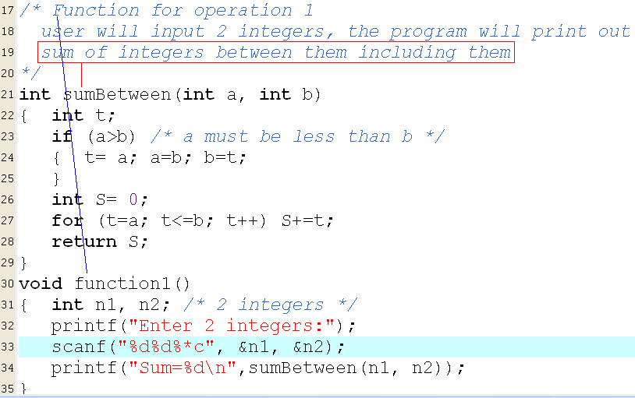

Implementation: menuDemo1.c

Slide 40
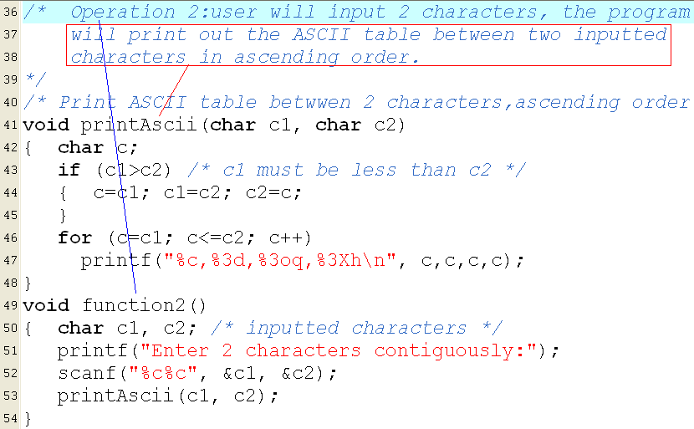
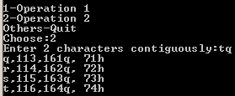
Implementation: menuDemo1.c

Slide 41
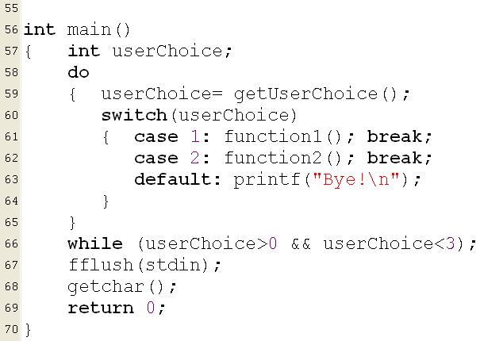
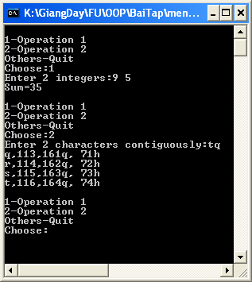
Implementation: menuDemo1.c

Slide 42
Ôn tập, Q&A
Notes:
Prepared by Thân Văn Sử

