Slide 1
Contiguous Storage
Module F: Arrays, Simple Data Structure
Contiguous Storage
Searching
Sorting
Notes:
Prepared by Thân Văn Sử

Slide 2
Objectives
How to manage a group of data?
Store
Input
Output
Search
Sort
…

Slide 3
Content
Introduction to contiguous storage
Arrays
One-dimensional Arrays
Declaration
Memory Allocation
Initialization
Accessing elements
Traversing
1-D Arrays are parameters of functions
Searching
Sorting
2-D Arrays

Slide 5
1- Contiguous Storage
Commonly, a group of the same meaning elements are considered.
They are stored in a contiguous block of memory.
Ex: Group of 10 int numbers ➔ 40 bytes block is needed.
Array is the simplest data structure which contains some items which belong to the sane data type.
Common used operations on a group: Add, Search, Remove, Update, Sort

Slide 6
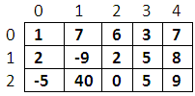
2- Arrays
Array: A group of elements which belong to the same data type. Each element is identified by it’s position (index).
index
0
1
2
3
4
5
6
7
8
9
a
(array)
5
4
8
15
90
27
34
21
152
80
a[3]
element
a[i] is an integer
column
m
m[1][3]
row
Dimension: Direction that is used to perform an action on array.
Number of dimensions: Number of indexes are used to specify an element.
Common arrays: 1-D and 2-D arrays.
Name of an array: An array has it’s name.

Slide 7
3- One Dimensional (1-D)Arrays
1-D array: a collection of items (elements, terms) which belong to the same data type and are stored contiguously in memory.
Each element is identified by a unique index of it’s position in the array (an integer from 0).
index
0
1
2
3
4
5
6
7
8
9
5
4
8
15
90
27
34
21
152
80
a
(array)
a[3]
element
a[i] is an integer

Slide 9
1-D Arrays: Declaration
If the array is stored in the stack segment → Use a STATIC array → The compiler will determine the array’s storage at compile-time.
If the array is stored in the heap → Use a pointer (DYNAMIC array) → The array’s storage will be allocated in the heap at run-time through memory allocating functions (malloc, calloc, realloc)
DataType ArrayName[NumberOfElements] ;
Examples:
int a1[5];
char s[12];
double a3[100];
How compilers can determine the memory size of an array?
NumberOfElements * sizeof(dataType)
➔ int a1[5] → 5 *sizeof(int) = 5*4 = 20 bytes
float *a;
a = (float*)calloc (10, sizeof(float)); /* allocate a block of 10 float numbers */

Slide 10
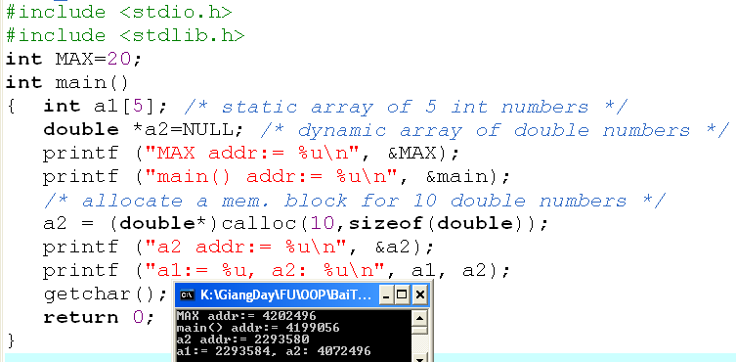
1-D Arrays: Memory Allocation
Data segment
4202496
20
The name of the array is the address of the first element.
code
Code segment
4199056
80
bytes
Heap
4072496
Stack segment
20
bytes
a1: 2293584
a2:2293580
4072496

Slide 12
1-D Arrays: Initialization & Accessing Elements
Initialize an array:
Type a[] = {val1, val2, … };
How to access the i^{th} element of the array a?
a is the address of the first element. Based on operation on pointers:
a+i : address of the i^{th} element, another way: &a[i]
*(a+i): value of the i^{th} element, another way: a[i]

Slide 13
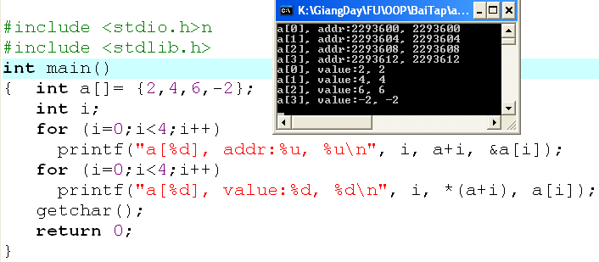
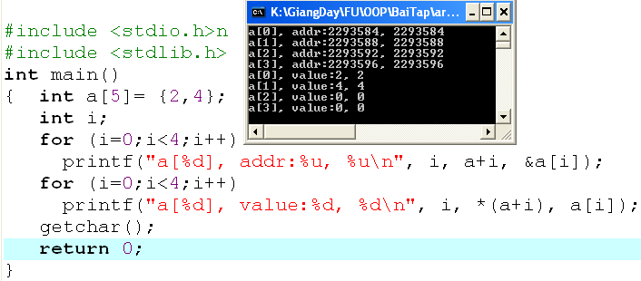
1-D Arrays: Init. & Accessing…
Compiler will automatically count number of initial values to determine the size of array memory
The size of array memory is pre-defined.
Compiler will fill 0 to elements which are not initialized.
int a[5];
Elements contain un-predictable values because they are local variables.
TEST IT !!!!

Slide 15
1-D Arrays: Traversing
A way to visit each element of an array
Suppose that the 1-D array, named a, containing n elements.
Forward traversal:
int i;
for (i=0; i<n; i++)
{ [if (condition)] Access a[i];
}
Backward traversal:
int i;
for (i=n-1; i >=0; i--)
{ [if (condition)] Access a[i];
}

Slide 17
1-D Array is a Function Parameter
The array parameter of a function is the pointer of the first element of the array.
Input an array of n integers
void input (int* a, int n)
Input elements of an array of integers which it’s number of element is stored at the pointer pn
void input (int a[], int*pn)
Output an array of n double numbers
void output (double a[], int n)
Calculate the sum of an array of n integers
int sum (int *a, int n)

Slide 18
Array Function Parameter: Demo.
Develop a C-program that will:
Accept values to an integer array that may contain 100 elements.
Print out the it’s maximum value.
Print out it’s elements.
Print out it’s even values.
Nouns:
Constant: MAXN=100
Static array of integers
→ int a[MAXN]
Real number of elements → int n
Maximum value
→ int maxVal.
Verbs:
Begin
Input n (one value)
Input a, n (function)
maxVal = get maximum value in a, n (function)
Print out maxVal (one value)
Print out a, n (function)
Print even values in a, n (function)
End

Slide 19
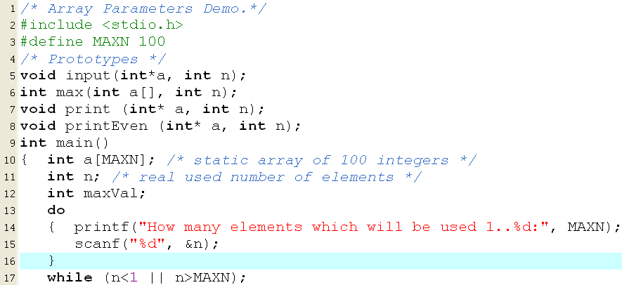
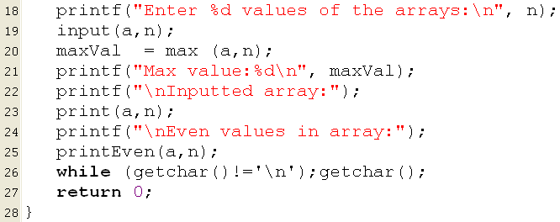
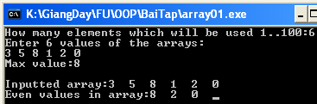
Array Function Parameter: Demo 1.

Slide 20
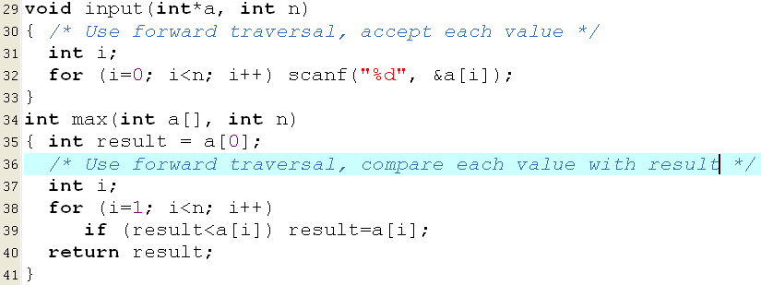
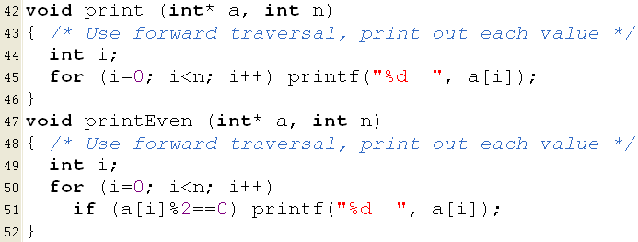
Array Function Parameter: Demo 1.

Slide 22
Array Function Parameter: Demo 1.
Comments
If you allocate an array having 100 elements but 6 elements are used then memory is wasted.
If If you allocate an array having 100 elements but 101 elements are used then there is a lack of memory.
Solution: Use a dynamic array.

Slide 23
Array Function Parameter: Demo 1.
replace
int* a
insert
a = (int*) calloc (n, sizeof(int));
Other functions are preserved.

Slide 24
Array Function Parameter: Demo 1.

