Slide 1
Contiguous Storage
Module F: Arrays, Simple Data Structure
Contiguous Storage
Searching
Sorting
Notes:
Prepared by Thân Văn Sử

Slide 2
Objectives
Ôn ý nghĩa biến tên mảng. truyền và nhận tham số mảng. (13,18,19)
Mảng động (24)

Slide 3
Content
Introduction to contiguous storage
Arrays
One-dimensional Arrays
Declaration
Memory Allocation
Initialization
Accessing elements
Traversing
1-D Arrays are parameters of functions
Searching
Sorting
2-D Arrays

Slide 5
Array Function Parameter: Demo 2.
Develop a C-program that will:
Accept values to an integer array that may contains 100 elements. The input will terminate when user enters the value of zero.
Print out the it’s maximum value.
Print out it’s elements.
Print out it’s even values.
The difference between this problem with the previous one is the input operation can terminate abruptly when 0 is accepted.
Memory block of the array needs to be allocated in excess
The function for input values of the array must be modified for this case and the number of elements is updated after each valid value is accepted.

Slide 6
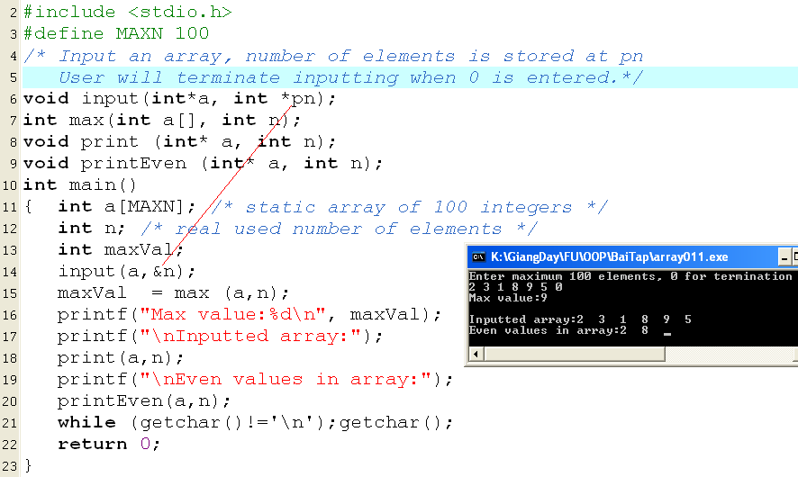
Array Function Parameter: Demo 2.

Slide 7
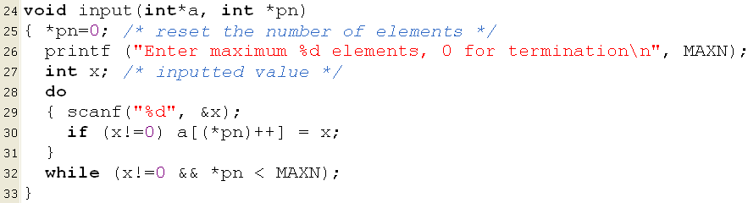
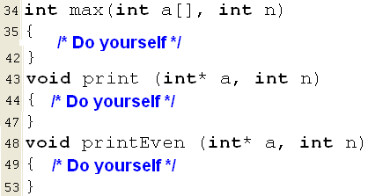
Array Function Parameter: Demo 2.
x=3
n=0 → 1
0
3
x=7
n=3→ 4
0 | 1 | 2
3 | 5 | 2

Slide 9
1-D Arrays: Searching
A search algorithm finds the record of interest using the key array
Return value: The positional index at which the interest value is found.
Two common search algorithms are
linear search
binary search

Slide 10
1-D Arrays: Searching…
Linear search: Find the position of the value x in the array a having n elements.
Search the value of 6 in the array a having 8 items.
5 | 9 | 2 | 7 | 6 | 5 | 2 | 5
i=0 | 1 | 2 | 3 | 4
There may be n comparisons performed.
Search the value of 12 in the array a having 8 items.
5 | 9 | 2 | 7 | 6 | 5 | 2 | 5
i=0 | 1 | 2 | 3 | 4 | 5 | 6 | 7
-1
int firstLinearSearch ( int x, int a[], int n)
{ int i;
for ( i=0; i<n; i++)
if ( x == a[i] ) return i;
return -1;
}
int lastLinearSearch ( double x, double *a, int n)
{ int i;
for ( i=n-1; i>=0; i--)
if ( x == a[i] ) return i;
return -1;
}

Slide 11
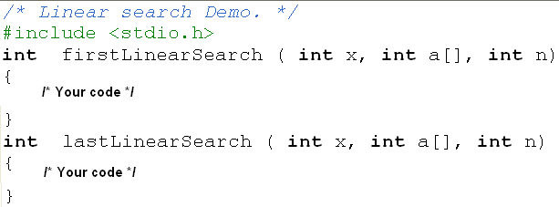
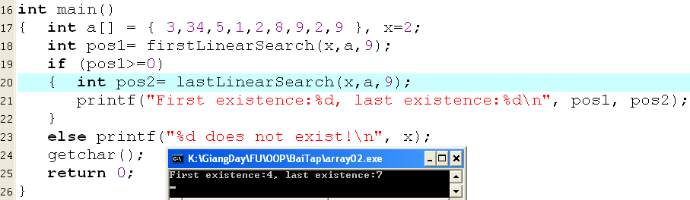
1-D Arrays: Linear Searching…

Slide 13
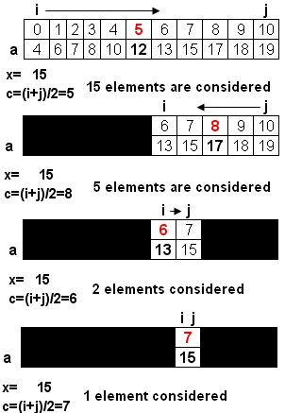
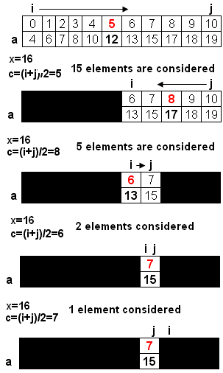
1-D Arrays: Binary Searching…
Binary search
- Condition for application: Values in the array were sorted.
int binarySearch ( int x, int a[], int n)
{ int i=0, j= n-1, c ;
while (i<=j)
{ c= (i+j)/2;
if ( x== a[c] ) return c ;
if (x < a[c] ) j = c-1;
else i = c +1;
}
return -1;
}
return c (7)
i>j → return -1

Slide 14
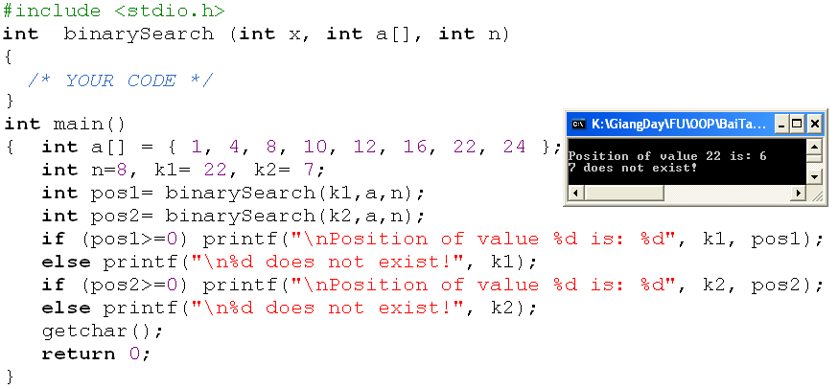
1-D Arrays: Binary Searching…
No. of elements considered | No. of comparisons
n= 2^{m} | 1
2^{m-1} | 1
2^{m-2} | 1
… | …
2⁰ | 1
Sum | m+1 = log₂(n) +1
Evaluation:

Slide 16
1-D Arrays: Sorting
Sorting: Changing positions of elements in an array so that values are in a order based on a pre-defined order relation.
Default order relation in set of numbers: Value order
Default order relation in a set of characters/ strings: Dictionary order
Only two sorting algorithms are introduced here.
Selection Sort
Bubble Sort

Slide 17
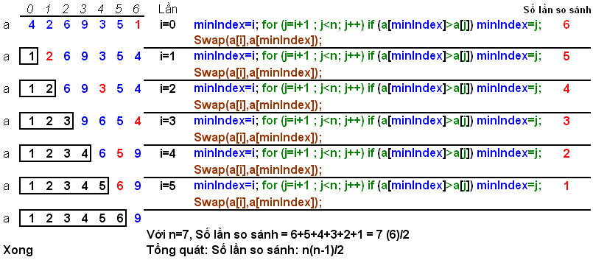
1-D Arrays: Selection Sort
Find the minimum value in the list
Swap it with the value in the first position
Repeat the steps above for remainder of the list

Slide 18
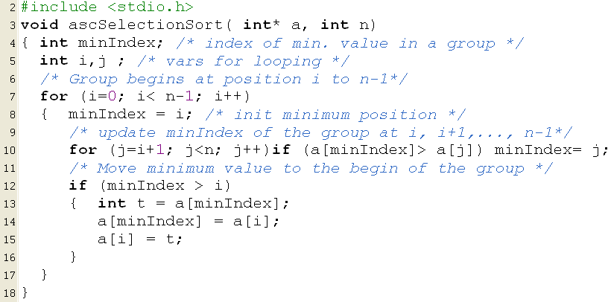
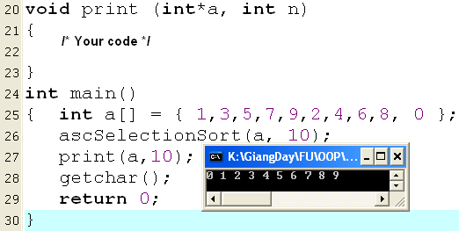
1-D Arrays: Selection Sort

Slide 20
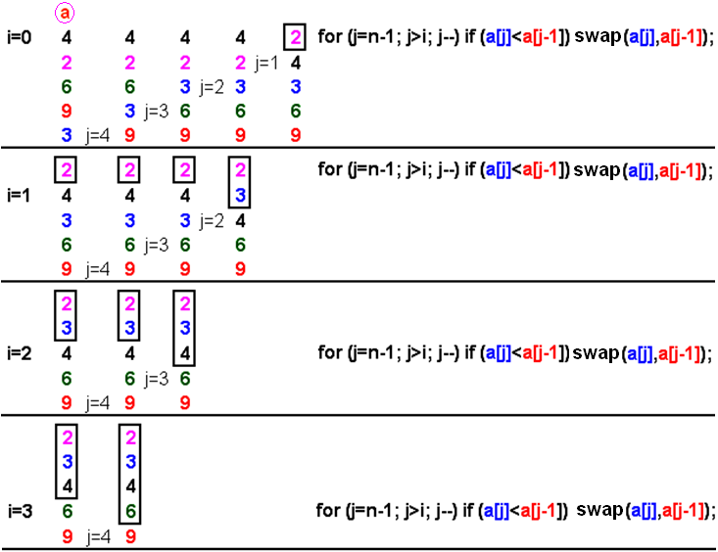
1-D Arrays: Bubble Sort
It works by repeatedly stepping through the list to be sorted, comparing two items at a time and swapping them if they are in the wrong order.
The pass through the list is repeated until no swaps are needed, which means the list is sorted

Slide 21
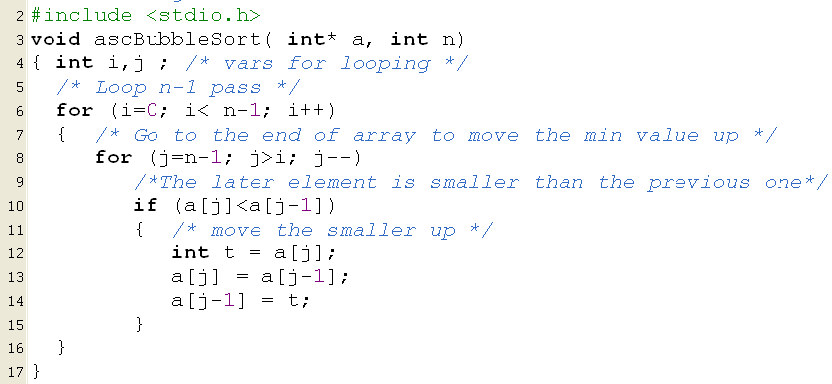
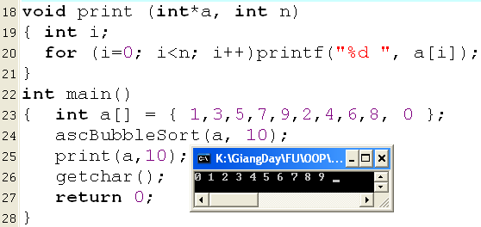
1-D Arrays: Bubble Sort…

Slide 23
1-D Arrays: A Sample
Develop a C-program that helps user managing an 1-D array of integers (maximum of 100 elements) using the following simple menu:
1- Add a value
2- Search a value
3- Remove the first existence of a value
4- Remove all existences of a value
5- Print out the array
6- Print out the array in ascending order (positions of elements are preserved)
7- Print out the array in descending order (positions of elements are preserved)
Others- Quit

Slide 24
1-D Arrays: A Sample…
In this program, user can freely add or remove one or more elements to/ from the array. So, an extra memory allocation is needed (100 items).
Data:
Array of integers → int a[100], n
searched/added/removed number → int value
Functions:
int menu() → Get user choice
int isFull(int *a, int n) - Testing whether an array is full or not
int isEmpty(int *a, int n) - Testing whether an array is empty or not
void add(int x, int*a, int*pn) → adding an element to the array will increase number of elements
int search(int x, int *a, int n) → return a position found in the array
int removeOne (int pos, int*a, int*pn) → Removing a value at the position pos will decrease number of elements → return 1: successfully, 0: fail
int remove All(int x, int*a, int*pn) → Removing a value will decrease number of elements → return 1: successfully, 0: fail
void printAsc(int*a, int n) – printing array, elements are preserved
void printDesc(int*a, int n) – printing array, elements are preserved
void print(int*a, int n)

Slide 25
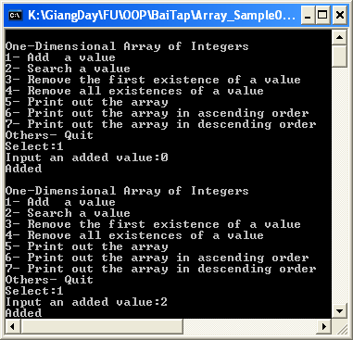
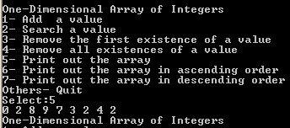
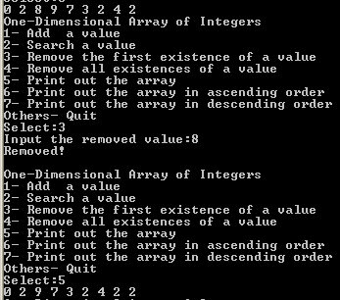
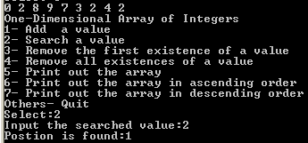
1-D Arrays: A Sample…
After values 0 , 2, 8, 9, 7, 3, 2, 4, 2 are added. Use menu 5 to view them.
Search option
Remove one option

Slide 26
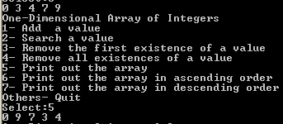
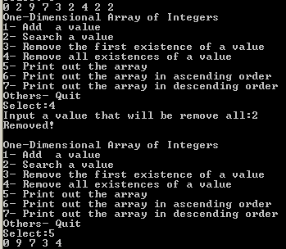
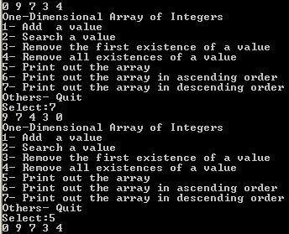
1-D Arrays: A Sample…
Print out in ascending order (elements are preserved)
Remove all option
Print out in descending order (elements are preserved)

Slide 27
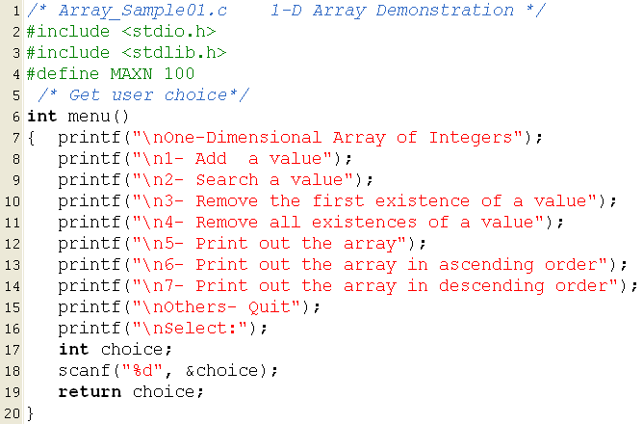
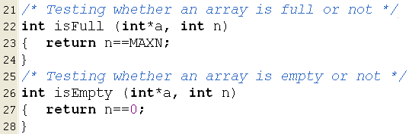
1-D Arrays: A Sample…

Slide 28
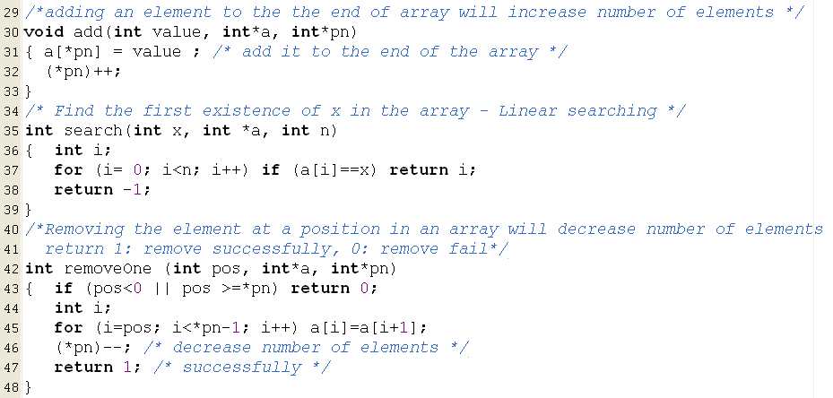
1-D Arrays: A Sample…
index
0 | 1 | 2 | 3 | 4 | 5 | 6 | 7 | 8
0 | 2 | 9 | 7 | 3 | 2 | 4 | 2 | 2
 | 9 | 7 | 3 | 2 | 4 | 2 | 2

Slide 29
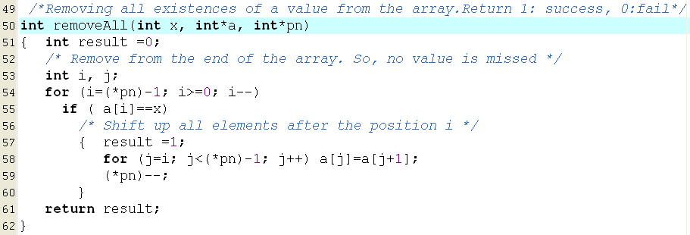
1-D Arrays: A Sample…
0 | 1 | 2 | 3 | 4 | 5 | 6 | 7 | 8
0 | 2 | 9 | 7 | 3 | 2 | 4 | 2 | 2
0 | 2 | 9 | 7 | 3 | 2 | 4 | 2
0 | 2 | 9 | 7 | 3 | 2 | 4
0 | 2 | 9 | 7 | 3 | 2 | 4
0 | 2 | 9 | 7 | 3 | 4
0 | 2 | 9 | 7 | 3 | 4
0 | 2 | 9 | 7 | 3 | 4
0 | 2 | 9 | 7 | 3 | 4
0 | 9 | 7 | 3 | 4
0 | 9 | 7 | 3 | 4

Slide 30
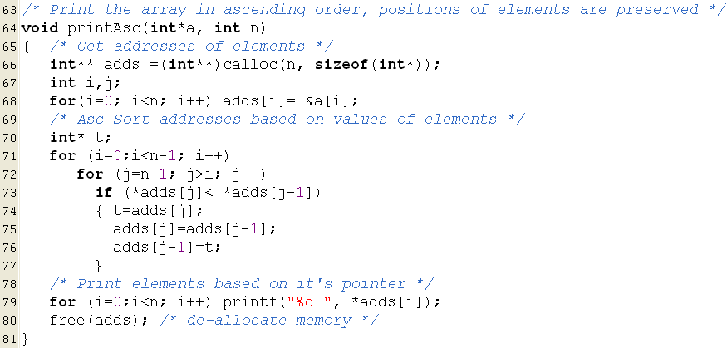
1-D Arrays: A Sample…
2293504
2293492
2293488
2293496
2293500
Values of pointers after sorting
2293504
2293500
2293496
2293492
4223516
2293488
adds
4223516
2293504
5
2293500
1
2293496
2
2293492
4
2293488
3

Slide 31
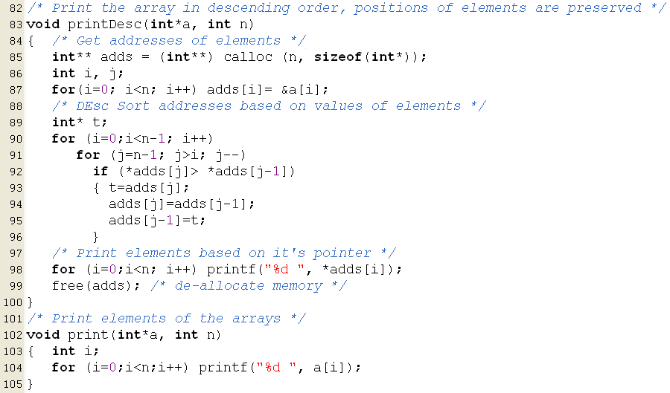
1-D Arrays: A Sample…

Slide 32
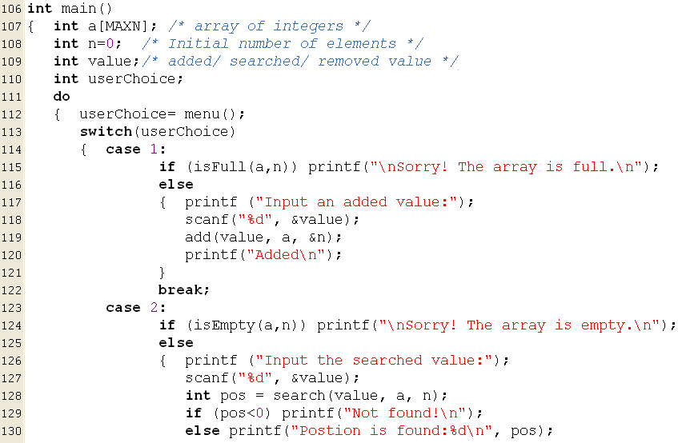
1-D Arrays: A Sample…

Slide 33
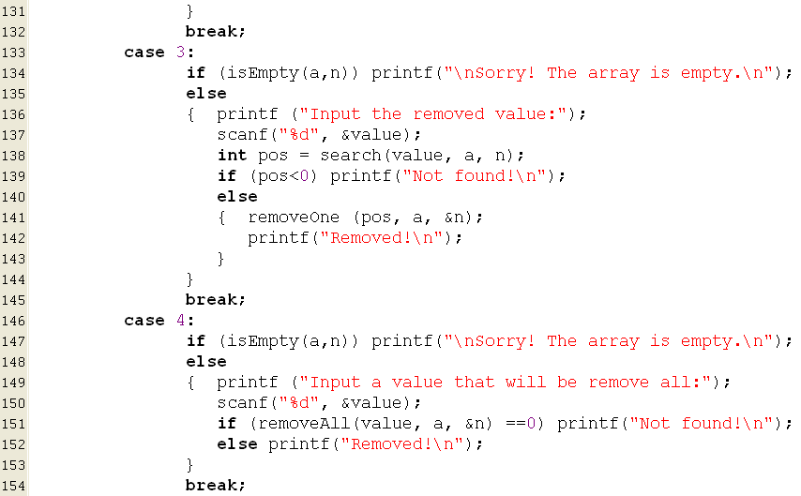
1-D Arrays: A Sample…

Slide 34
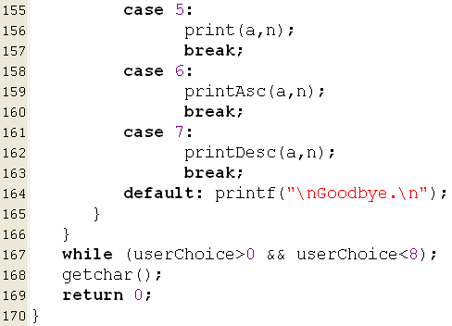
1-D Arrays: A Sample…

Slide 36
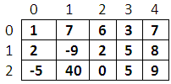
4- Two-Dimensional Arrays
A group of elements which belong the same data type and they are divided into some rows and some column (it is called as matrix also).
Each element is identified by two indexes (index of row, index of column).
column
The next slide will demonstrate how static and dynamic 2-D arrays are stored.
m
m[1][3]
row
Traversing a matrix:
for ( i =0; i<row; i++)
{ for ( j=0; j< column; j++)
[if (condition)] Access m[i][j];
}

Slide 37
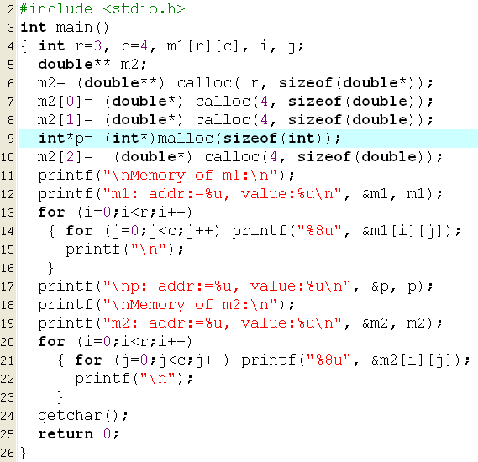
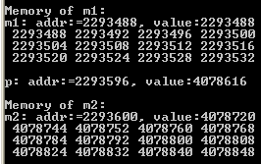
3- 2-D Arrays: Memory Structure
4078848
4078840
4078832
H
E
A
P
4078824
4078808
4078800
4078792
4078784
4078768
4078760
4078752
4078744
4078824
4078784
4078720
4078744
4078616
m2
2293600
4078720
p
2293596
4078616
S
T
A
C
K
2293532
2293528
2293524
2293520
2293516
2293512
2293508
2293504
2293500
2293496
2293492
m1
2293488

Slide 38
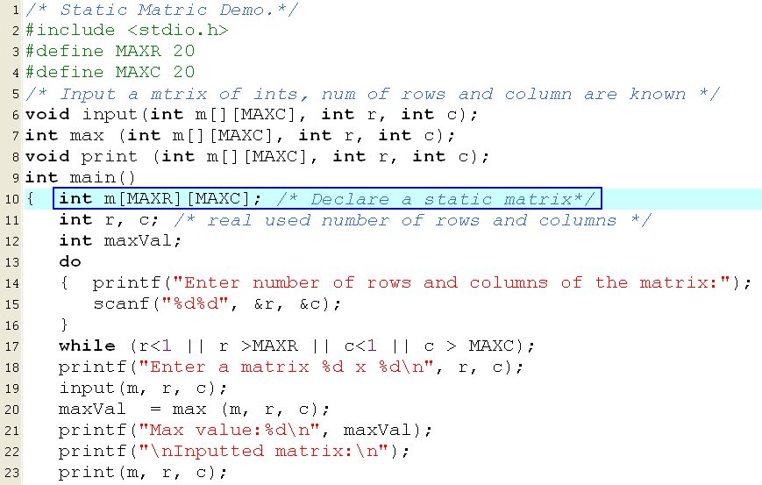

Static 2-D Arrays Demo.
Accept a matrix maximum 20x20.
Print out maximum value in it, print out the matrix.
Keep in your mind the way to specify a matrix as a parameter of a function ( the number of column must be pre-defined.).

Slide 39
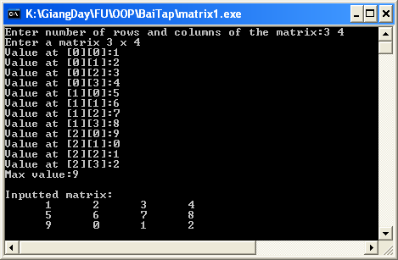
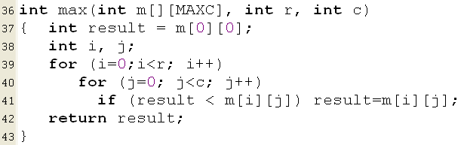
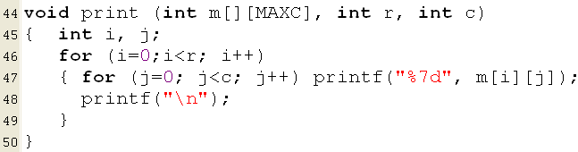
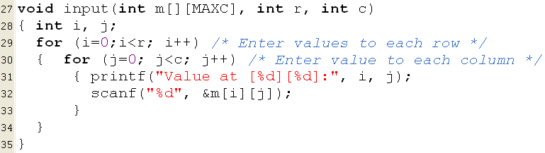
Static 2-D Arrays Demo.

Slide 40
Summary
Array is the simplest data structure for a group of elements which belong to the same data type.
Each element in an array is identified by one or more index beginning from 0.
Number of dimensions: Number of indexes are used to identify an element.
Static arrays → Stack segment
Type a[MAXN];
Type m[MAXROW][MAXCOL];
Dynamic array: Use pointer and allocate memory using functions
double *a = (double*)calloc(n, sizeof(double));
int** m = (int**) calloc(row, sizeof(int*));
for (i=0; i<row; i++) m[i]= (int*)calloc(col, sizeof(int));

Slide 42
Summary
Accessing elements in an array:
1-D Array (a) |  | 2-D Array (m)
Address | Value | Address | Value
&a[index] | a[index] | &m[i][j] | m[i][j]
a+index | *(a+index)
Compiler determines the address of an element:
a + index*sizeof(DataType) |  | m + (i*NumCol + j)*sizeof(DataType)
Common operations on arrays:
Add an element
Search an element
Remove an element
Input
Output
Sort
Base of algorithms on arrays: Traversing

Slide 43
Exercise- Do yourself
Develop a C-program that helps user managing an 1-D array of real numbers(maximum of 100 elements) using the following simple menu:
1- Add a value
2- Search a value
3- Print out the array
4- Print out values in a range (minVal<=value<=maxVal, minVal and maxVal are inputted)
5- Print out the array in ascending order (positions of elements are preserved)
Others- Quit

