Slide 1
The Debt Book
201801505 Cuong Nguyen
201610981 Danny Tran
201506554 Nina Nguyen
201607649 Stanie Cheung

Slide 2
Architectural Patterns
MVVM (Model-view-viewmodel)
MVP (Model-view-presenter)
MVC (Model-view-controller)

Slide 3
Design Choice
Flexibility for design work and development work to happen simultaneously
Unit testing
Reusable components across projects in the organization
Ability to work on the user interface without interfering with the logic in the code base

Slide 4
MVVM
Model: Represents the actual data and/or information we are dealing
View: The representation of data that the end user interacts with
ViewModel: Exposes the methods and commands that help maintin the state of the view

Slide 5
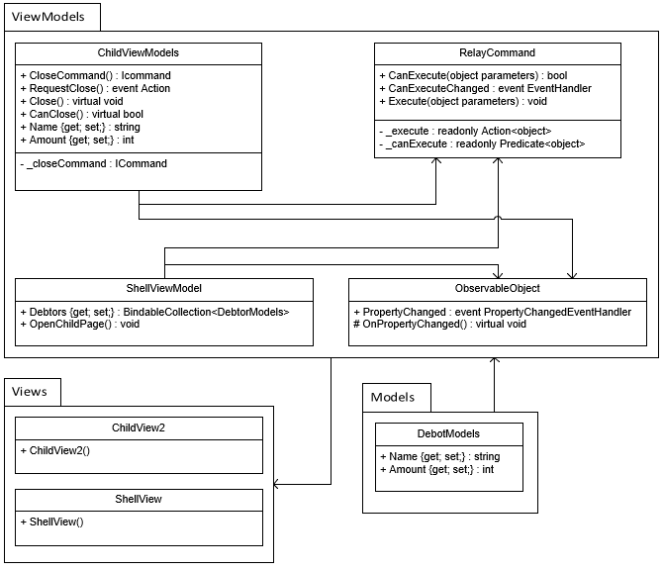
Class Diagram

Slide 6
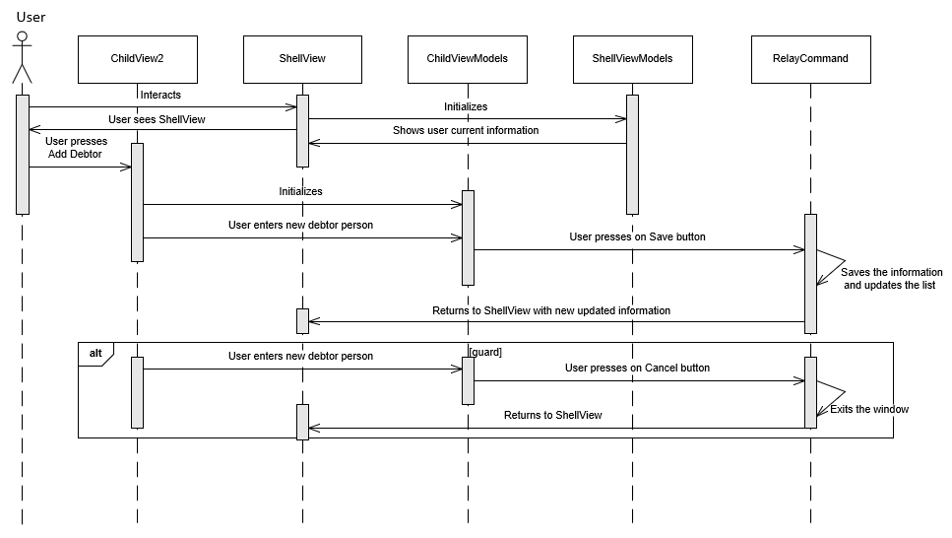
Sequence Diagram

