Slide 1

STUDY SPI CONTROLLER OF ESP32 C3
AUGUST 21st, 2023

Slide 2
Agenda
1. Overview
2. GP-SPI2
3. State Machine
5. Summary
4. Full-Duplex
2
Internal | RBVH/ECM | 2023-08-21
© Robert Bosch Engineering and Business Solutions Vietnam Company Limited 2018. All rights reserved, also regarding any disposal, exploitation, reproduction, editing, distribution, as well as in the event of applications for industrial property rights.

Slide 3
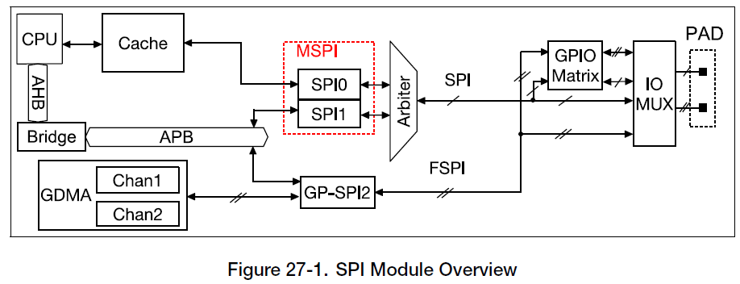
Overview
ESP32-C3 features three SPI interfaces ( SPI0, SPI1, SPI2)
SPI Memory mode : Interface with external SPI memory
SPI General – purpose SPI (GP-SPI) mode :
+ Master and slave mode
+ Can connect to GDMA.
3
Internal | RBVH/ECM | 2021-05-12
© Robert Bosch Engineering and Business Solutions Vietnam Company Limited 2018. All rights reserved, also regarding any disposal, exploitation, reproduction, editing, distribution, as well as in the event of applications for industrial property rights.

Slide 4
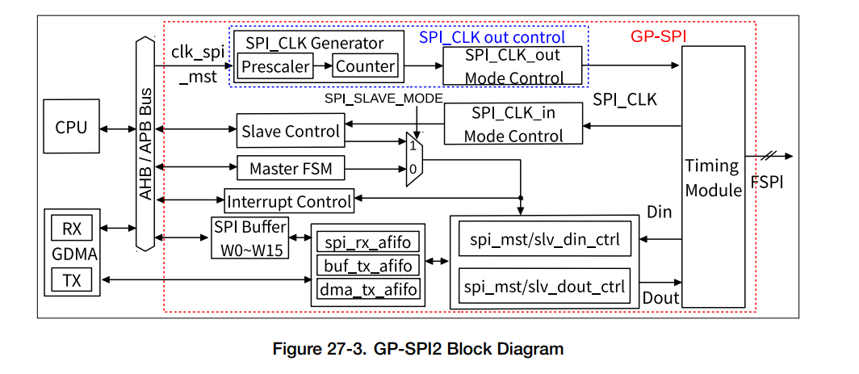
GP-SPI2
4
Internal | RBVH/ECM | 2021-05-12
© Robert Bosch Engineering and Business Solutions Vietnam Company Limited 2018. All rights reserved, also regarding any disposal, exploitation, reproduction, editing, distribution, as well as in the event of applications for industrial property rights.
Notes:
SPI Buffer : The data transferred in CPU-controlled mode is prepared in this buffer
spi_mst/slv_din/dout_ctrl : convert the TX/RX data into bytes.
spi_rx_afifo: store the received data
buf_tx_afifo: store the data to send from CPU
dma_tx_afifo: store the data from GDMA
clk_spi_mst: this clock is the module clock of GP-SPI2 and derived from PLL_CLK. It is used in GP-SPI2 master mode, to generate SPI_CLK signal for data transfer and for slaves.
SPI_CLK Generator: generate SPI_CLK by dividing clk_spi_mst. The divider is determined by SPI_CLKCNT_N and SPI_CLKDIV_PRE.
SPI_CLK_out Mode Control: output the SPI_CLK signal for data transfer and for slaves.
SPI_CLK_in Mode Control: capture the SPI_CLK signal from SPI master when GP-SPI2 works as a slave.

Slide 5
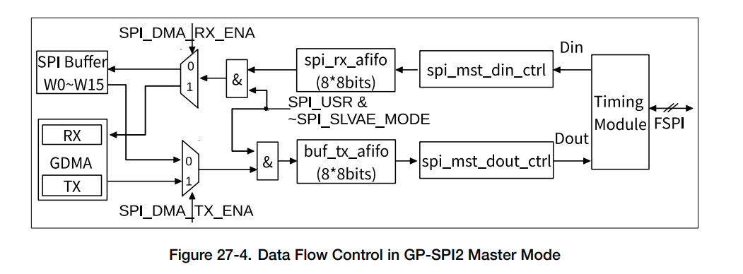
GP-SPI2
Data flow control in GP-SPI2
RX data: FSPI bus -> Timing Module, converted in units of bytes by spi_mst_din_ctrl module, and then stored in corresponding addresses according to the transfer modes.
– CPU-controlled transfer: SPI_W0_REG ~ SPI_W15_REG.
– DMA-controlled transfer: GDMA RX buffer.
5
Internal | RBVH/ECM | 2021-05-12
© Robert Bosch Engineering and Business Solutions Vietnam Company Limited 2018. All rights reserved, also regarding any disposal, exploitation, reproduction, editing, distribution, as well as in the event of applications for industrial property rights.

Slide 6
GP-SPI2
Data flow control in GP-SPI2
TX data: the TX data is from corresponding addresses according to transfer modes -> buf_tx_afifo or dma_tx_afifo.
– CPU-controlled transfer: SPI_W0_REG ~ SPI_W15_REG.
– DMA-controlled transfer: GDMA TX buffer.
The data in buf_tx_afifo is sent out to Timing Module in 1/2/4-bit modes, controlled by GP-SPI2 state machine.
6
Internal | RBVH/ECM | 2021-05-12
© Robert Bosch Engineering and Business Solutions Vietnam Company Limited 2018. All rights reserved, also regarding any disposal, exploitation, reproduction, editing, distribution, as well as in the event of applications for industrial property rights.

Slide 7
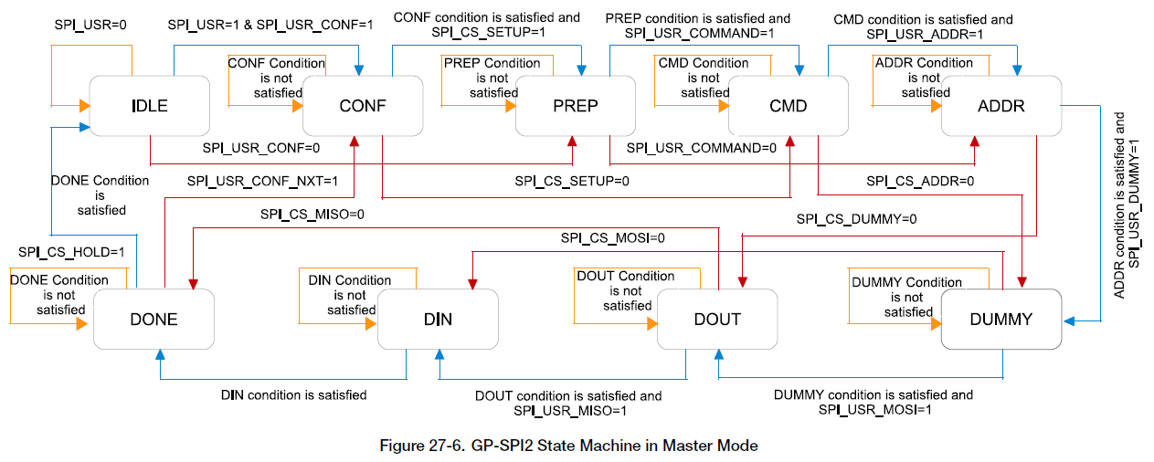
State Machine
7
Internal | RBVH/ECM | 2021-05-12
© Robert Bosch Engineering and Business Solutions Vietnam Company Limited 2018. All rights reserved, also regarding any disposal, exploitation, reproduction, editing, distribution, as well as in the event of applications for industrial property rights.
Notes:
IDLE: GP-SPI2 is not active or is in slave mode.
2. CONF: only used in DMA-controlled configurable segmented transfer. Set SPI_USR and SPI_USR_CONF to enable this state. If this state is not enabled, it means the current transfer is a single transfer.
SPI_USR: 1: enable; 0: disable
SPI_USR_CONF: 1: use DMA-controlled configurable segmented transfer.
0: transfer is a single transfer.
3. PREP: prepare an SPI transaction and control SPI CS setup time. Set SPI_USR and SPI_CS_SETUP to enable this state.
SPI_CS_SETUP: 1: enable SPI CS
0: disable
4. CMD: send command sequence. Set SPI_USR and SPI_USR_COMMAND to enable this state.
5. ADDR: send address sequence. Set SPI_USR and SPI_USR_ADDR to enable this state.
6. DUMMY (wait cycle): send dummy sequence. Set SPI_USR and SPI_USR_DUMMY to enable this state.
7. DATA: transfer data.
• DOUT: send data sequence. Set SPI_USR and SPI_USR_MOSI to enable this state.
• DIN: receive data sequence. Set SPI_USR and SPI_USR_MISO to enable this state.
8. DONE: control SPI CS hold time. Set SPI_USR to enable this state.

Slide 8
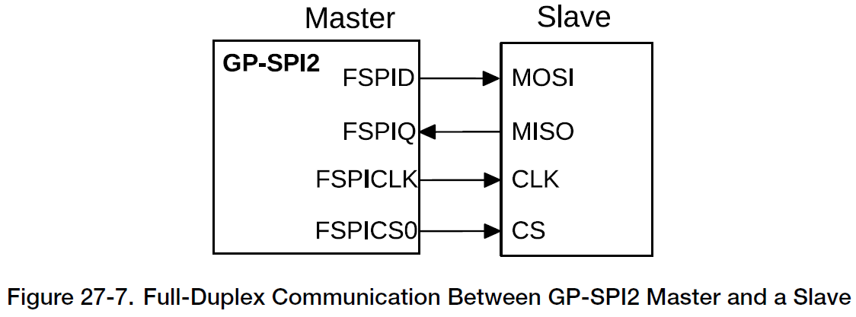
Full-Duplex
8
Internal | RBVH/ECM | 2021-05-12
© Robert Bosch Engineering and Business Solutions Vietnam Company Limited 2018. All rights reserved, also regarding any disposal, exploitation, reproduction, editing, distribution, as well as in the event of applications for industrial property rights.

Slide 9
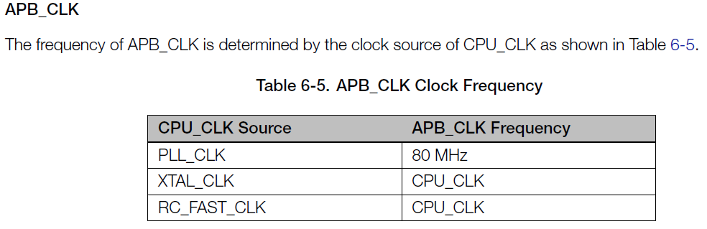
Full-Duplex
Steps to transfer data
Configure the IO path via IO MUX and GPIO matrix.
Configure APB clock and module clock (clk_spi_mst).
9
Internal | RBVH/ECM | 2021-05-12
© Robert Bosch Engineering and Business Solutions Vietnam Company Limited 2018. All rights reserved, also regarding any disposal, exploitation, reproduction, editing, distribution, as well as in the event of applications for industrial property rights.

Slide 10
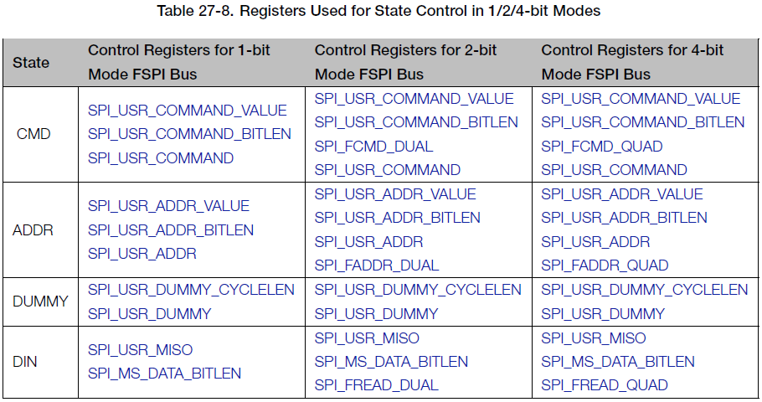
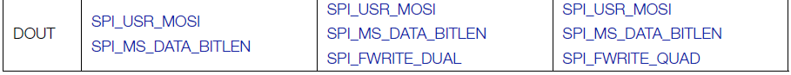
Full-Duplex
Steps to transfer data
3. Set SPI_DOUTDIN and clear SPI_SLAVE_MODE to enable full-duplex communication.
4. Configure GP-SPI2 registers listed in table 27-8.
10
Internal | RBVH/ECM | 2021-05-12
© Robert Bosch Engineering and Business Solutions Vietnam Company Limited 2018. All rights reserved, also regarding any disposal, exploitation, reproduction, editing, distribution, as well as in the event of applications for industrial property rights.

Slide 11
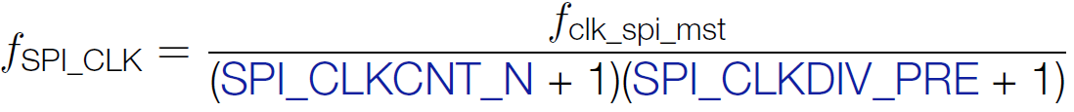
Full-Duplex
Steps to transfer data
5. Configure SPI CS setup time and hold time according to Section 27.6.
SPI CS setup time:
SPI_CS_SETUP SPI_CS_SETUP_TIME
SPI CS hold time:
SPI_CS_HOLD SPI_CS_HOLD_TIME
6. Set the property of FSPICLK
Use clock divisions, set SPI_CLK_EQU_SYSCLK is 0
11
Internal | RBVH/ECM | 2021-05-12
© Robert Bosch Engineering and Business Solutions Vietnam Company Limited 2018. All rights reserved, also regarding any disposal, exploitation, reproduction, editing, distribution, as well as in the event of applications for industrial property rights.

Slide 12
Full-Duplex
Steps to transfer data
7. Prepare data according to the selected transfer mode:
– In CPU-controlled MOSI mode :SPI_W0_REG ~ SPI_W15_REG.
– In DMA-controlled mode:
• configure SPI_DMA_TX_ENA/SPI_DMA_RX_ENA
• configure GDMA TX/RX link
• start GDMA TX/RX engine
Set the bit GDMA_INLINK_START_CHn or GDMA_OUTLINK_START_CHn to start GDMA RX/TX engine.
12
Internal | RBVH/ECM | 2021-05-12
© Robert Bosch Engineering and Business Solutions Vietnam Company Limited 2018. All rights reserved, also regarding any disposal, exploitation, reproduction, editing, distribution, as well as in the event of applications for industrial property rights.

Slide 13
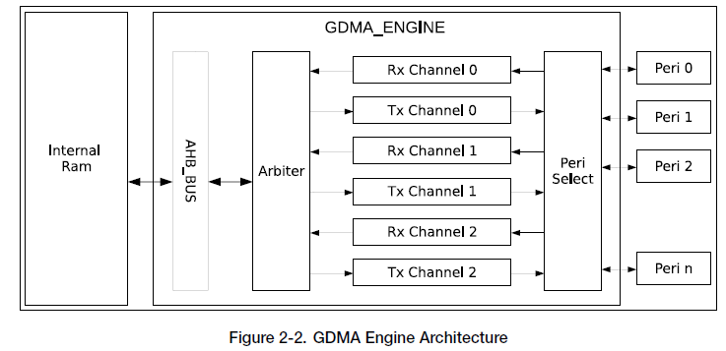
Full-Duplex
Steps to transfer data
Configure GDMA TX/RX link:
What is GDMA ?
13
Internal | RBVH/ECM | 2021-05-12
© Robert Bosch Engineering and Business Solutions Vietnam Company Limited 2018. All rights reserved, also regarding any disposal, exploitation, reproduction, editing, distribution, as well as in the event of applications for industrial property rights.
Notes:
The GDMA engine reads data from or writes data to internal RAM via the AHB_BUS.
Before this, the GDMA controller uses fixed-priority arbitration scheme for channels requesting read or write access.
Software can use the GDMA engine through linked lists.
These linked lists, stored in internal RAM, consist of outlinkn and inlinkn,
where n indicates the channel number (ranging from 0 to 2).

Slide 14
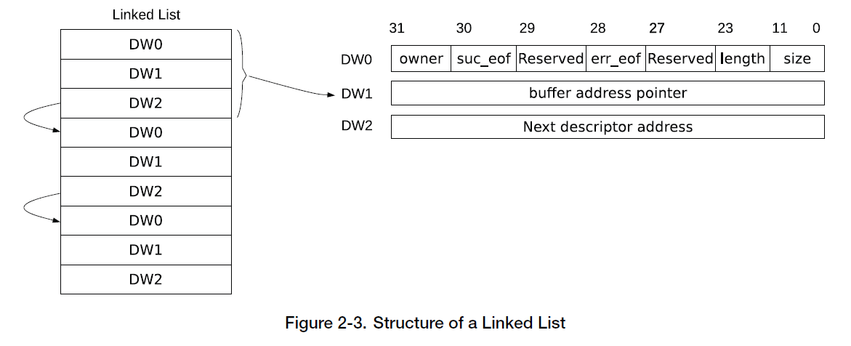

Full-Duplex
Steps to transfer data
Configure GDMA TX/RX link:
Link list
14
Internal | RBVH/ECM | 2021-05-12
© Robert Bosch Engineering and Business Solutions Vietnam Company Limited 2018. All rights reserved, also regarding any disposal, exploitation, reproduction, editing, distribution, as well as in the event of applications for industrial property rights.
Notes:
Owner:
0: CPU can access the buffer.
1: The GDMA controller can access the buffer.
Suc_eof:
0: This descriptor is not the last one.
1: This descriptor is the last one.
Err_eof: When an error is detected in the received frame or packet, this bit in the receive descriptor is set to 1 by hardware
Length: indicates how many bytes can be read from the buffer.
Size: Specifies the size of the buffer that this descriptor points to.
Buffer address pointer (DW1): Address of the buffer. This field can only point to internal RAM
Next descriptor address (DW2): Address of the next descriptor.

Slide 15
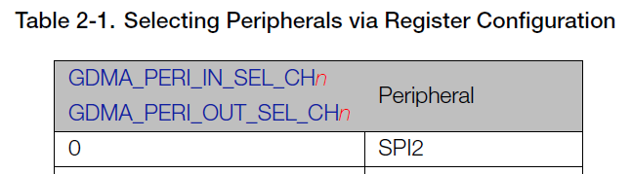
Full-Duplex
Steps to transfer data
Configure GDMA TX/RX link:
Select chanel peripherals
Enabling GDMA
Receive data:
GDMA_INLINK_ADDR_CHn field with address of the first receive descriptor
GDMA_INLINK_START_CHn bit to enable GDMA.
Transmit data:
GDMA_OUTLINK_ADDR_CHn field with address of the first transmit descriptor
GDMA_OUTLINK_START_CHn bit to enable GDMA.
15
Internal | RBVH/ECM | 2021-05-12
© Robert Bosch Engineering and Business Solutions Vietnam Company Limited 2018. All rights reserved, also regarding any disposal, exploitation, reproduction, editing, distribution, as well as in the event of applications for industrial property rights.
Notes:
Owner:
0: CPU can access the buffer.
1: The GDMA controller can access the buffer.
Suc_eof:
0: This descriptor is not the last one.
1: This descriptor is the last one.
Err_eof: When an error is detected in the received frame or packet, this bit in the receive descriptor is set to 1 by hardware
Length: indicates how many bytes can be read from the buffer.
Size: Specifies the size of the buffer that this descriptor points to.
Buffer address pointer (DW1): Address of the buffer. This field can only point to internal RAM
Next descriptor address (DW2): Address of the next descriptor.

Slide 16
Full-Duplex
Steps to transfer data
8. Configure interrupts and wait for SPI slave to get ready for transfer.
9. Set SPI_DMA_AFIFO_RST, SPI_BUF_AFIFO_RST, and SPI_RX_AFIFO_RST to reset these buffers.
10. Set SPI_USR to start the transfer and wait for the configured interrupts.
16
Internal | RBVH/ECM | 2021-05-12
© Robert Bosch Engineering and Business Solutions Vietnam Company Limited 2018. All rights reserved, also regarding any disposal, exploitation, reproduction, editing, distribution, as well as in the event of applications for industrial property rights.

