Slide 1






COVERAGE

Slide 2
Coverage
Code coverage
Coverage
Function coverage

Slide 3
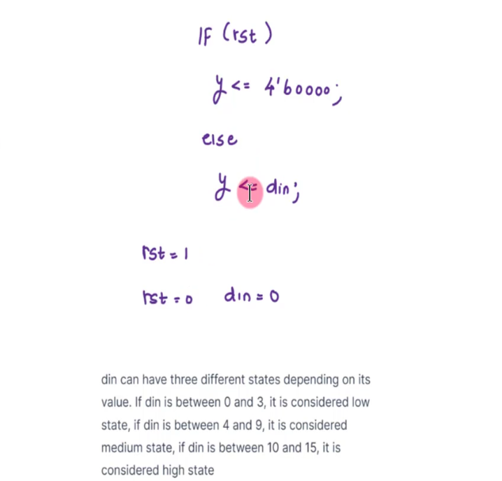
Example

Slide 4




Function coverage
Function coverage is a technique for measuring the completeness of a testbench by tracking the functional activities of the module under test. It ensures that all the important functions of the system are tested and that no function is overlooked.

Slide 5

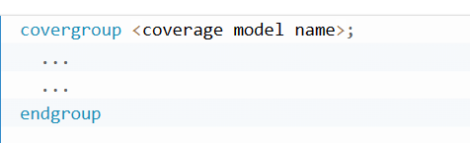
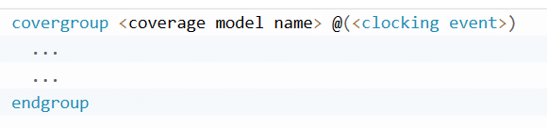

Covergroup
Basic covergroup syntax
Covergroup syntax with clocking event

Slide 6

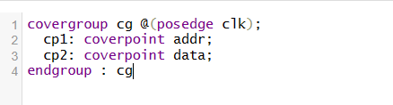
Coverpoint in Function Coverage
Coverpoint to identify conditions or sets of conditions related to the function to be tested.

Slide 7



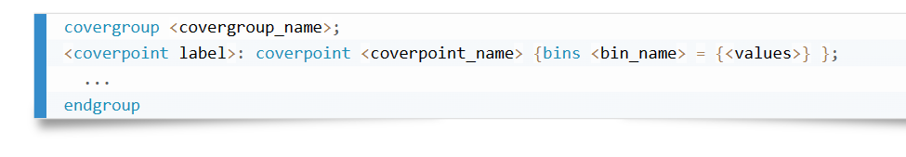



Bins in function coverage
Syntax

Slide 8
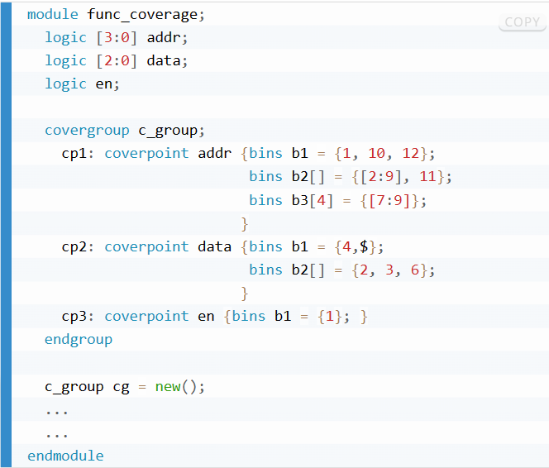
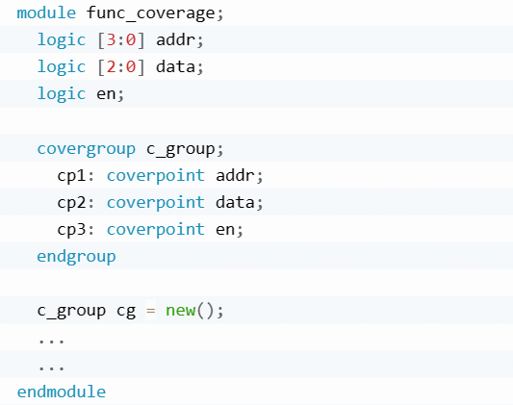
Bins in function coverage
With explicit bins declaration
Without explicit bins declaration

Slide 9
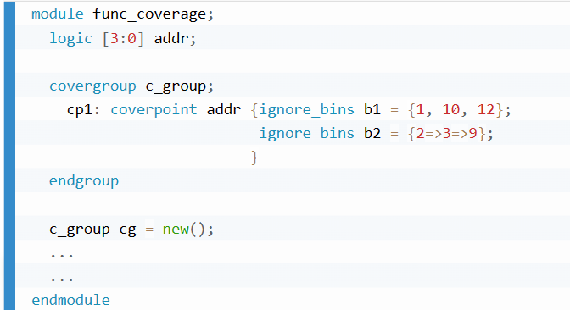
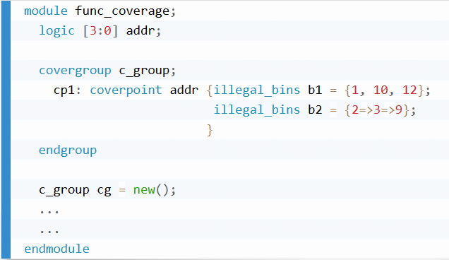
Bins
Ignore bins
Illegal bins
Ignore values

Slide 10
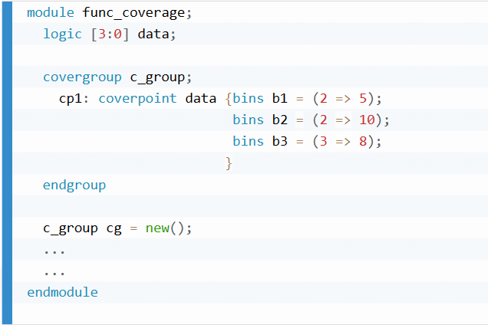
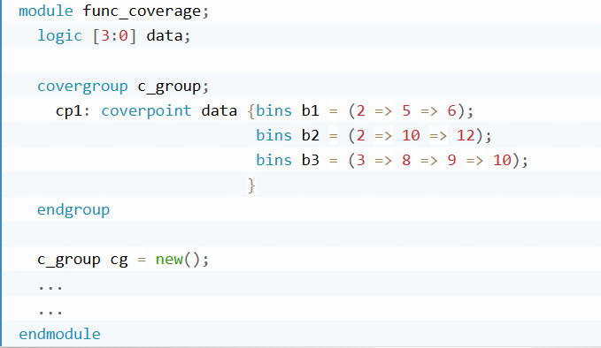
Transition Bins
Single value transitions
Sequence of transitions
<value1> => <value2> => <value3> => <value4>

Slide 11
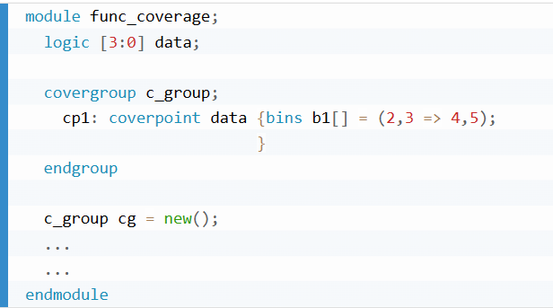
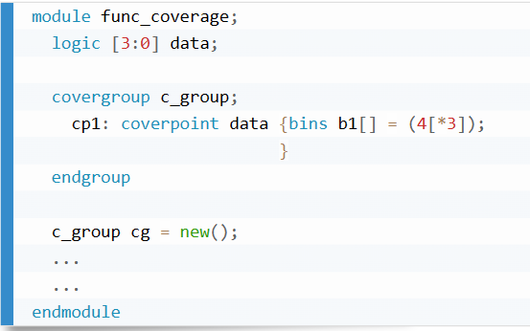
Transition Bins
Set of transitions
Consecutive transitions
It creates 4 bins: 2 => 4, 2 => 5, 3 => 4, 3 => 5.
4=>4=>4

Slide 12

Cross Coverage
Cross Coverage is specified between the cover points or variables. Cross coverage is specified using the cross construct.
Syntax:

Slide 13
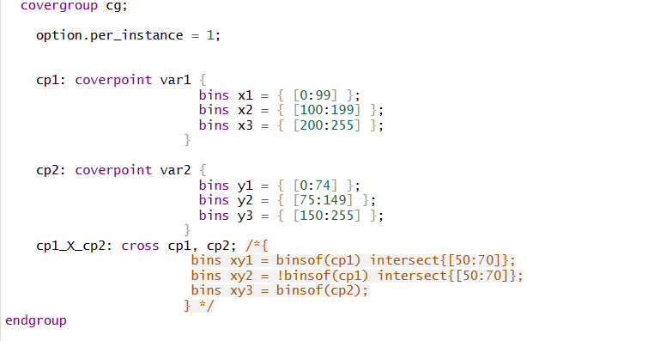
Coverage Construct
Binsof and Intersect

Slide 14




Coverage Methods
Sample() Triggers sampling of the covergroup
Start() Starts collecting coverage information
Stop() Stops collecting coverage information
Set_inst_name() Sets instance name to the given string Get_coverage() Calculates type coverage

Slide 15
Coverage Options
OPTION NAME | SYNTAX
WEIGHT | WEIGHT = NUMBER
GOAL | GOAL = NUMBER
COMMENT | COMMENT = STRING
AT_LEAST | AT_LEAST = NUMBER
DETECT_OVERLAP | DETECT_OVERLAP = BOOLEAN
AUTO_BIN_MAX | AUTO_BIN_MAX = NUMBER
PER_INSTANCE | PER_INSTANCE = BOOLEAN

Slide 16







