Slide 1
Project 8
Movie API Analysis
Project 8
Movie API Analysis
Here is my presentation of my analysis

Slide 2
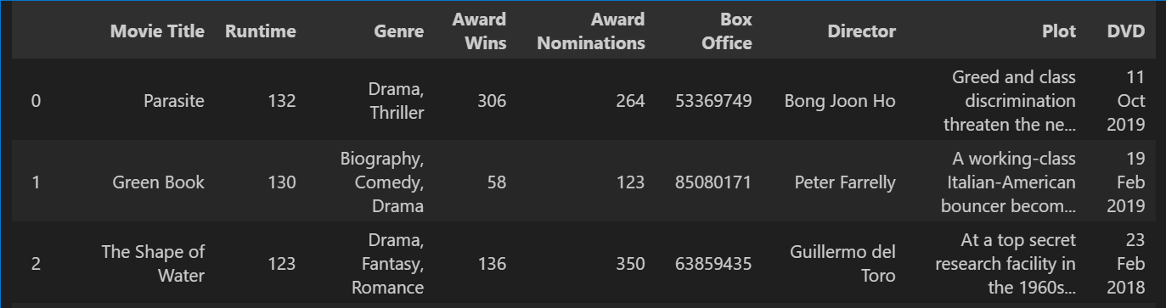
Information about my data used
There are 9 columns and 15 rows in my dataset. Here is my first 3 rows in my data

Slide 3
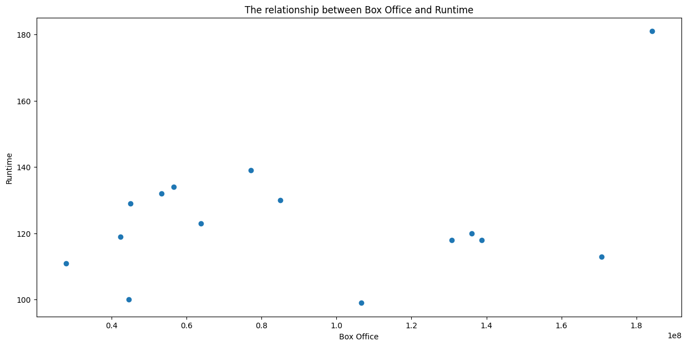
2. Details in my analysis
2.1. The relationship between Box Office and Runtime
Nearly no relationship

Slide 4
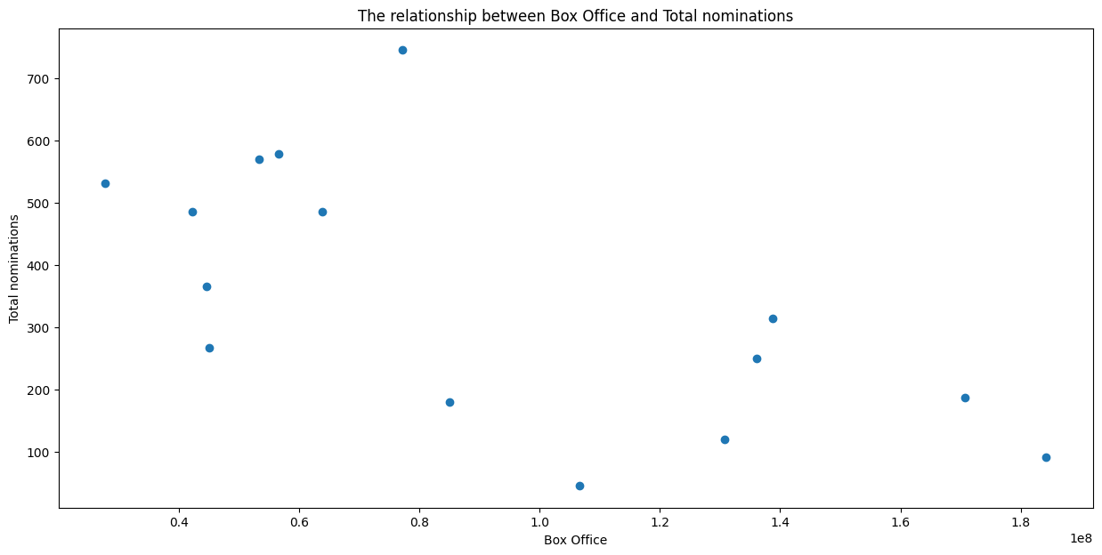
2. Details in my analysis
2.2. The relationship between Box Office and Total nominations
The larger Box Office values the smaller Total nominations

Slide 5
3. Conclusion
3.1. There is no relationship between Box Office and Runtime
3.2. There have relationship between Box Office and Total nominations

