Slide 1
WEB BASED TEAM COLLABORATION AND PROJECT MANAGEMENT
User Interface design

Slide 2
STAGE 1
SYSTEM REQUIREMENT

Slide 3
PROBLEM AND VISION
Effective management keeps an important role in raising productivity of companies especially information technology companys. Notice board, radio channels or emails are traditional communicated means but there are also problems when employees have to work out of offices or they need a general and simple vision about their tasks without a lot of papers or emails.
Managers actually need an application that employees and leaders can not only interact easily but also manage their tasks logically. They can even work well despite of at home or in forein countries.

Slide 4

BRAIN STORMING
Simple homepage.
Information of members.
Description of projects.
List of projects.
Calendar of deadline.
Communication between members.
Company info.
Contact info.
Processing bar.
Add or remove projects.

Slide 5
USER STORIES
As a team leader, I want to manage members in group, add more projects, explane to projects, assign tasks to members in team.
As a user, I want a general and detail vision about my task and my project. In additon, I want to communicate with the other teammates.
As a user, I want to observe my processing in task and project. I want to be warned about deadline.
As a customer, I want simply in registration and there are also many offers based on my demand.

Slide 6
SCENARIOS
Matt Keener is a Chief Story Officer. His broad career has given him a unique perspective of the entertainment industry. He said that one of the key success factors for a project is an experienced project manager. The goals of the team collaboration and project management application are helping his colleagues solve key roles of communication and collaboration in making successful stories. Each project team has a number of roles – Project manager, Project Manager Assistant, Analyst, Designer, Builder, Composer, Writer – each requiring a different skill set. The leader has to be a guy who waves vaguely in the right direction and gives detailed instructions and tasks to members in team. In the end, leader will collect seperate parts from working process of members and form the fully story.

Slide 7
USER NEEDS (DATA)
Admin needs:
+ List of members.
+ Personal data about members.
+ Working process of members.
Member needs:
+ Description of project.
+ Descrition of tasks.
+ Working processing bar.
+ List of members in project.
+ Calendar of deadline.

Slide 8
USER NEEDS (FUNCTIONAL)
Admin needs:
+ Add and remove projects.
+ Add and remove members.
+ Composing description of projects and tasks.
+ Add deadline for tasks or projects.
User needs:
+ Registrate to projects.
+ Edit personal info.

Slide 9
STAGE 2
INTERRACTION FRAMEWORK

Slide 10
PRODUCT FORM AND INPUT METHODS
Environment is the product for : Web application for normal PC screen.
Input methods : Keyboard, mouse, touch screen.

Slide 11
SITE MAP (BEFORE LOG IN)
Home
Features
Pricing
Login
Sign up
Introduction
Cost
Offers
Form

Slide 12
SITE MAP (AFTER LOG IN)
Home
My Project
My tasks
Projects
Lists of projects.
Button of making new projects.
Members
Calendar
Notifications
List of online members
Pictures.
Member Info

Slide 13
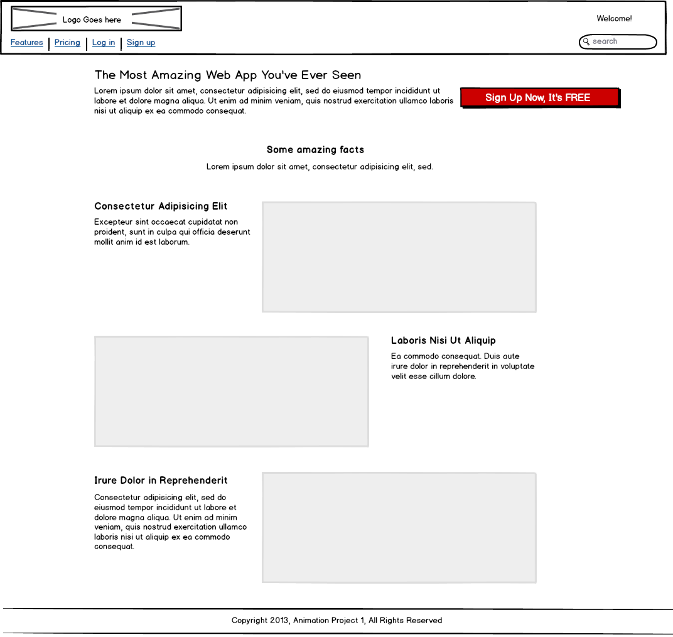
USER INTERFACE (INDEX)

Slide 14
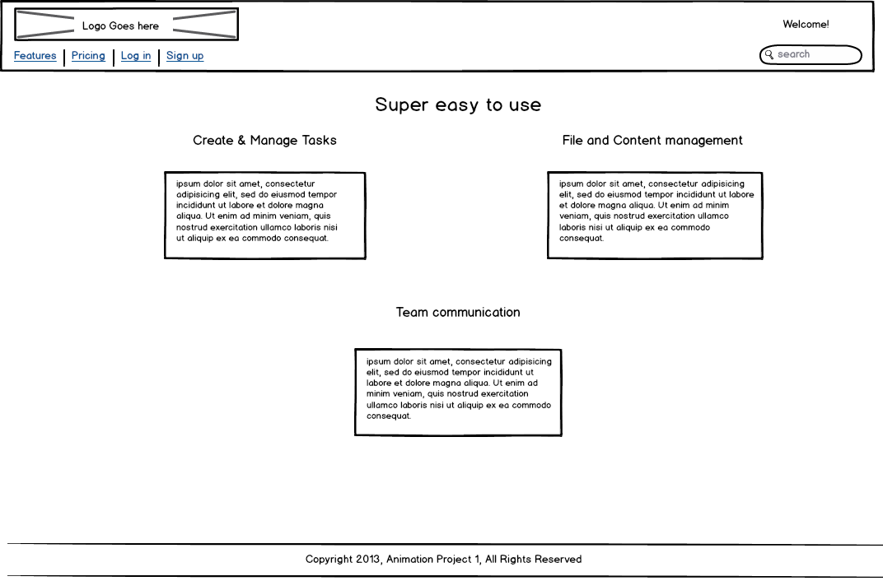
USER INTERFACE (FEATURES)

Slide 15
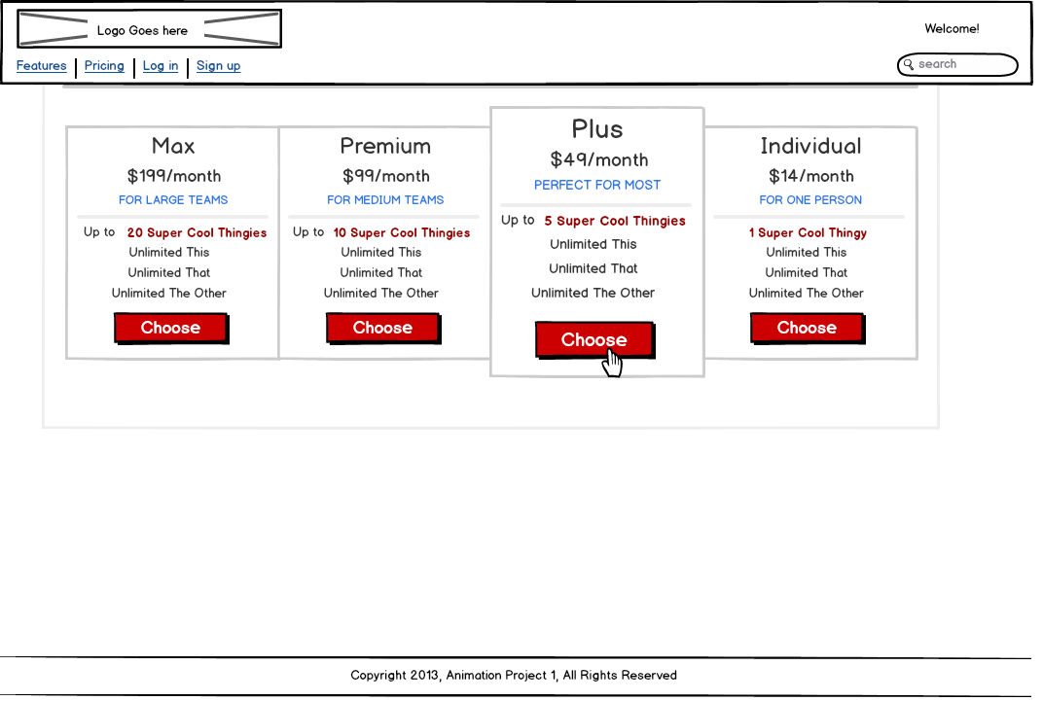
USER INTERFACE (PRICING)

Slide 16
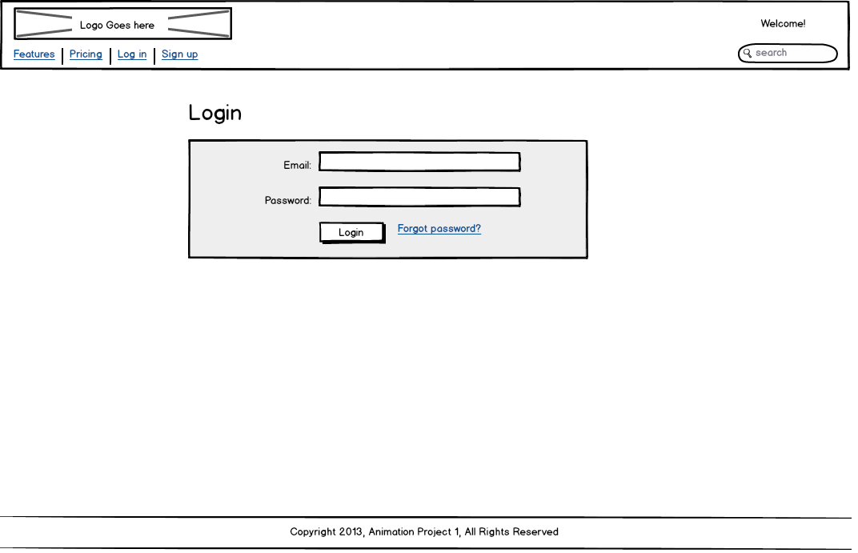
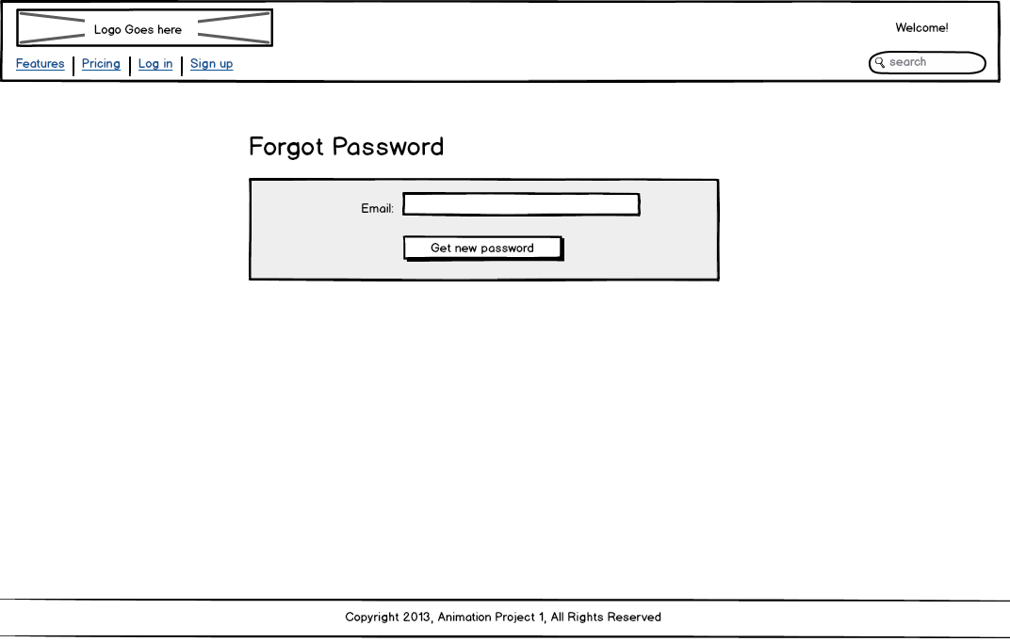
USER INTERFACE (LOG IN)

Slide 17
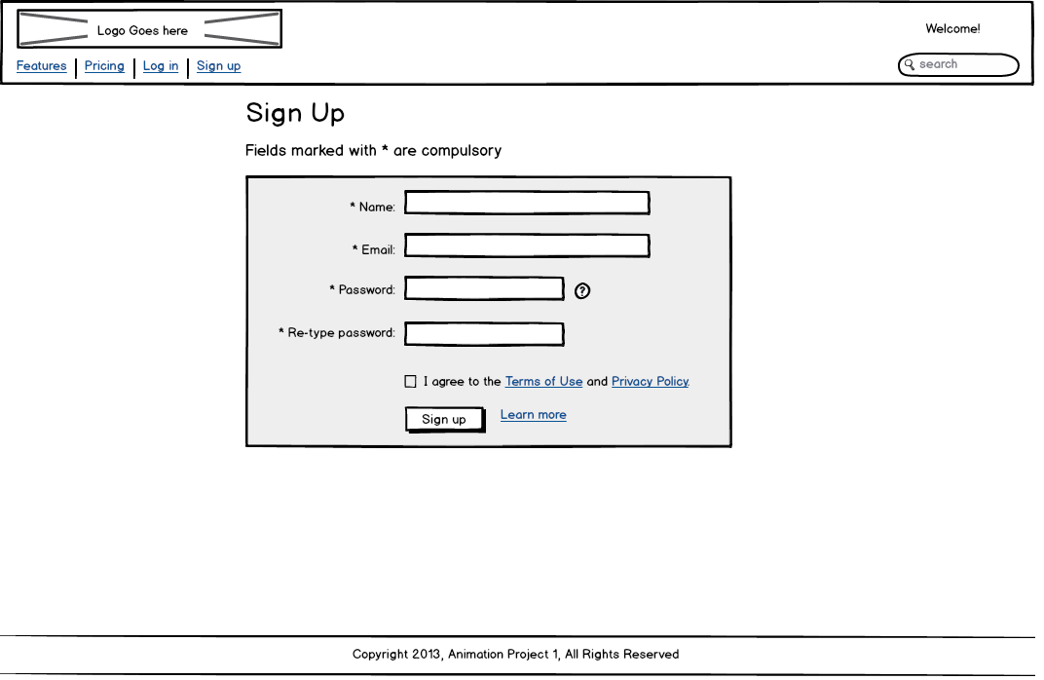
USER INTERFACE (SIGN UP)

Slide 18
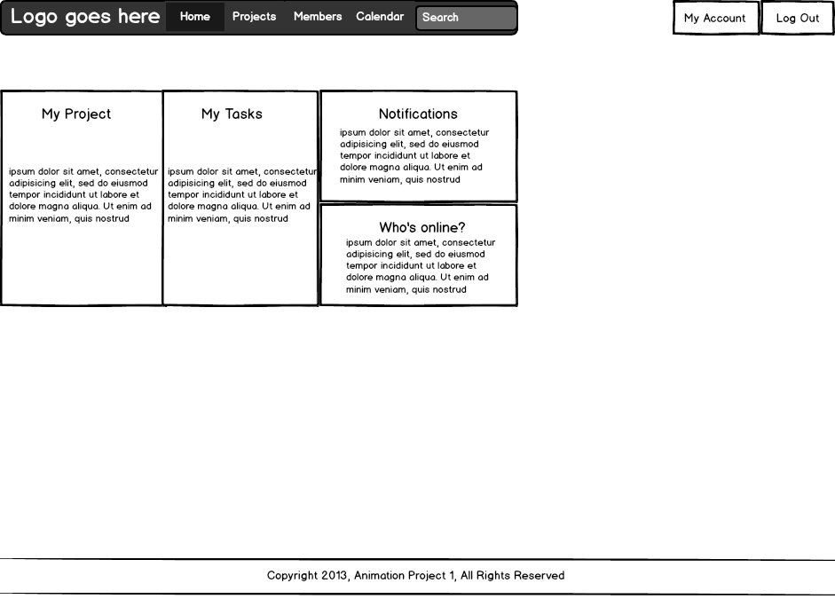
USER INTERFACE (MAIN PAGE)

Slide 19
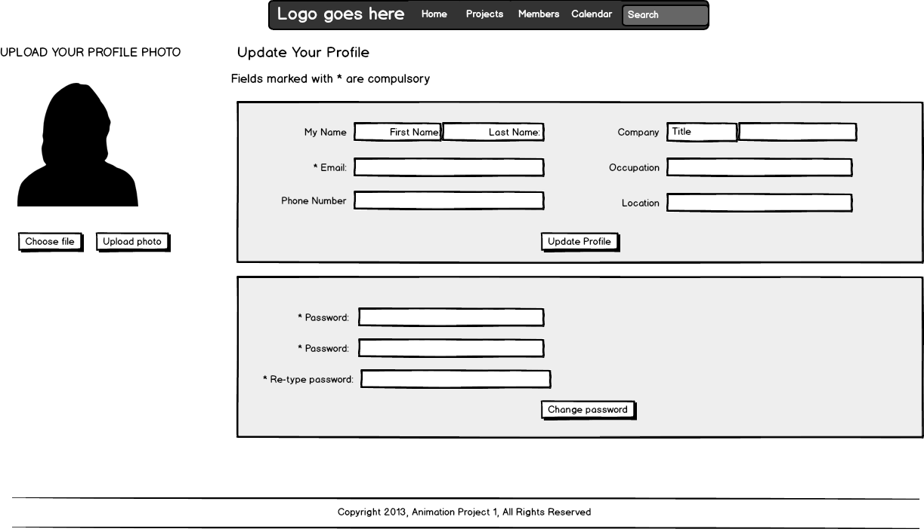
USER INTERFACE (MY ACCOUNT)

Slide 20
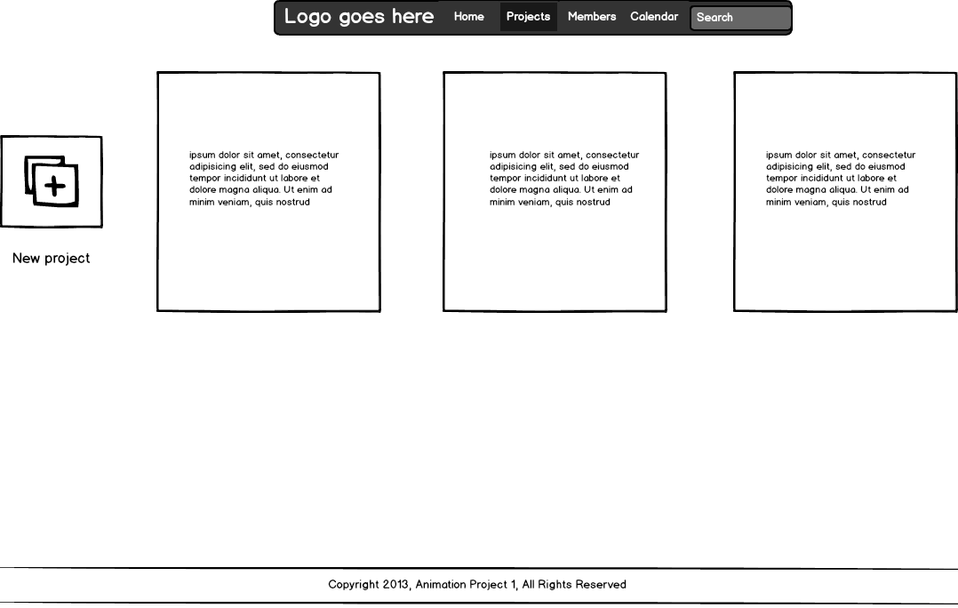
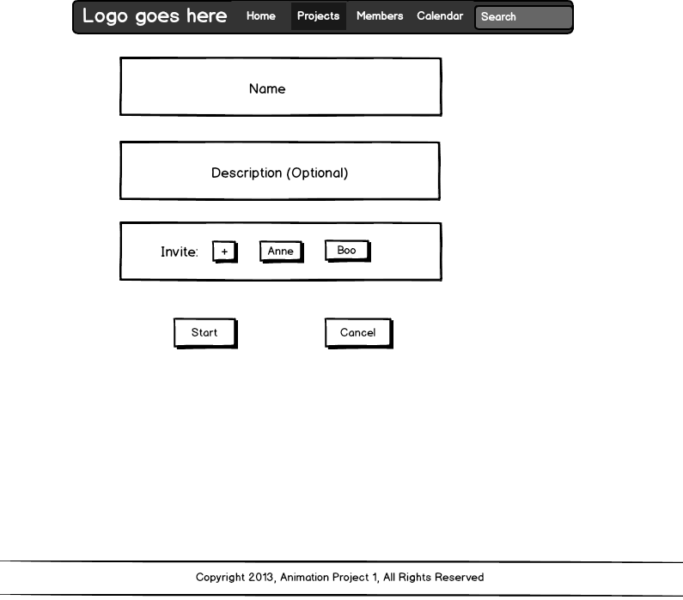
USER INTERFACE (PROJECTS)

Slide 21
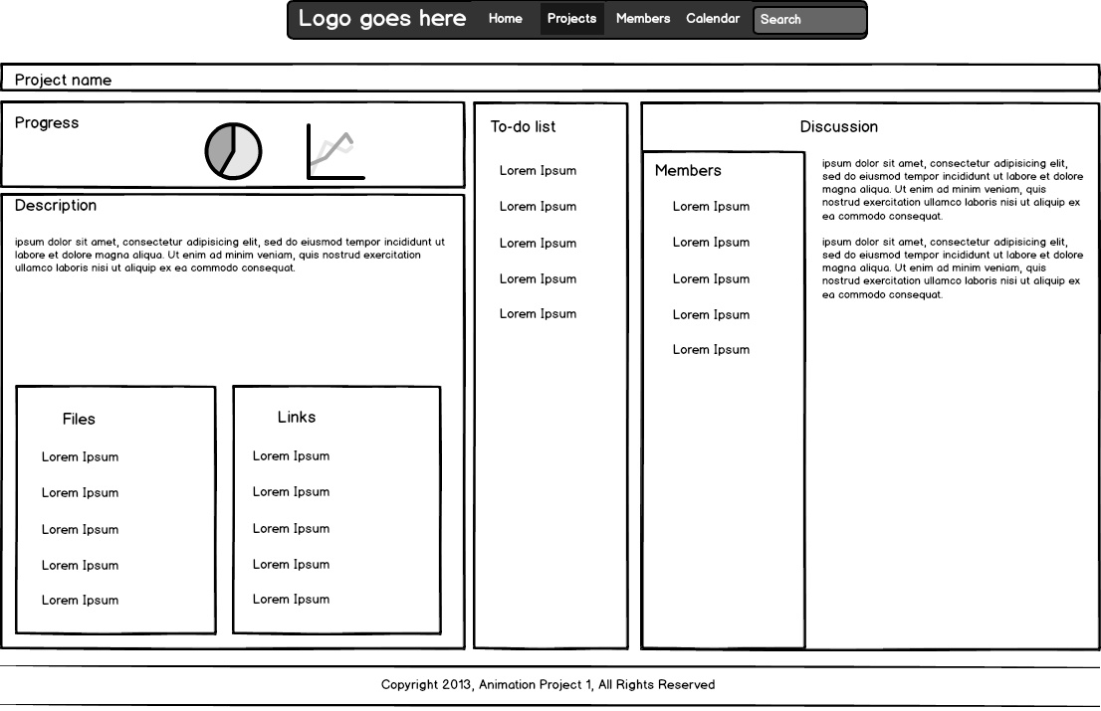
USER INTERFACE (PROJECTS)

Slide 22
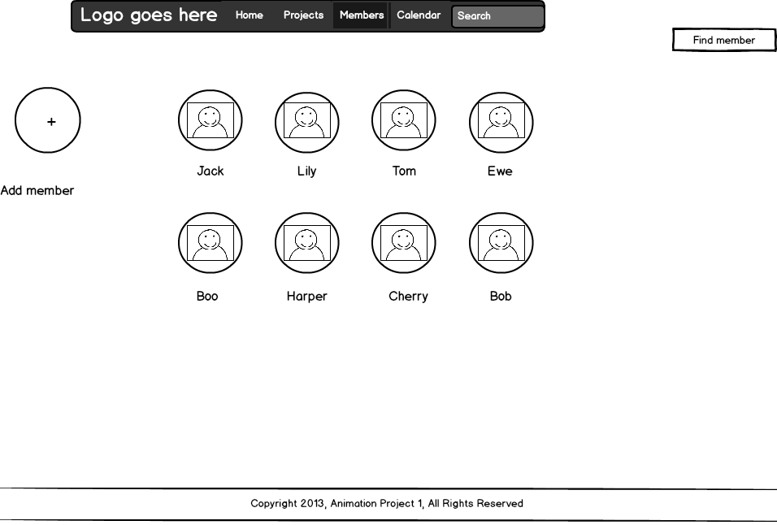
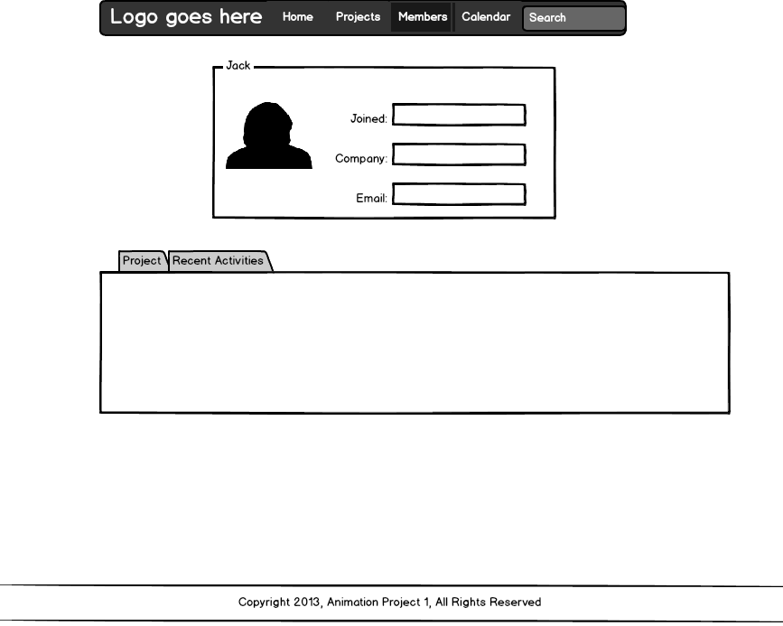
USER INTERFACE (MEMBERS)

Slide 23
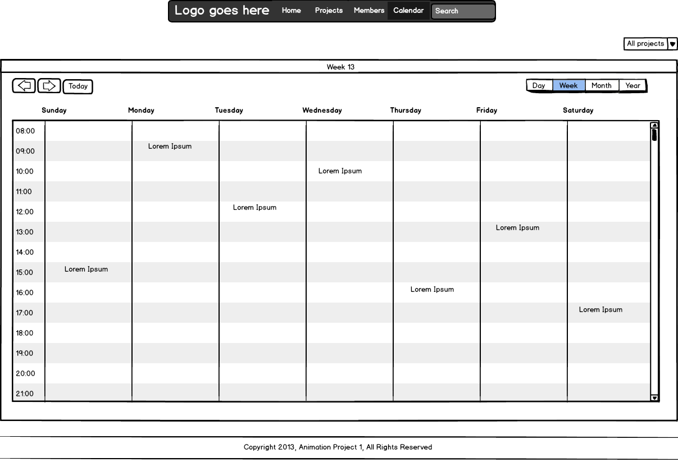
USER INTERFACE (CALENDAR)

Slide 24
THE END
THANK YOU !!!

