Slide 1

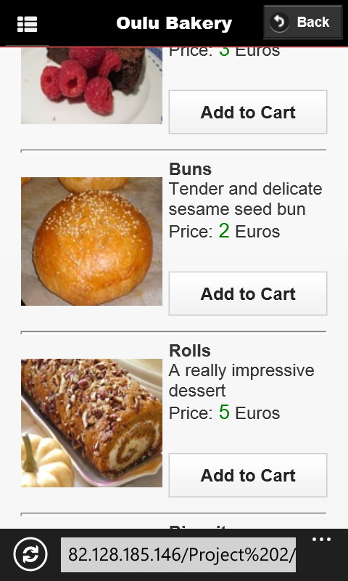
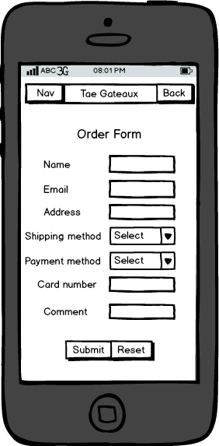
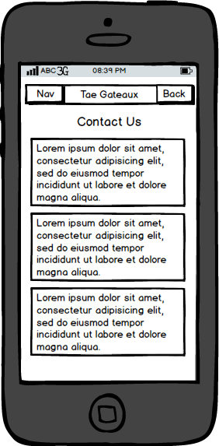

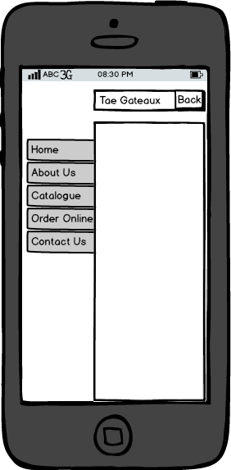
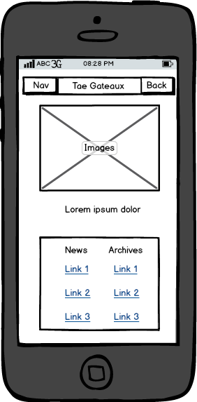
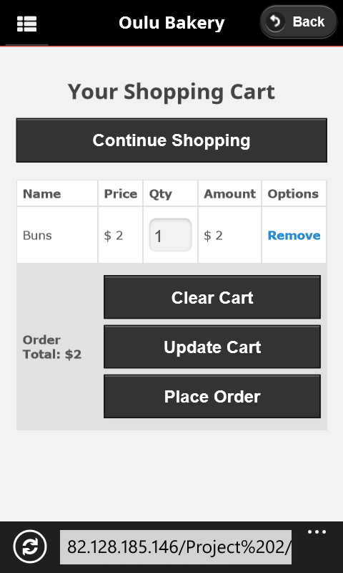
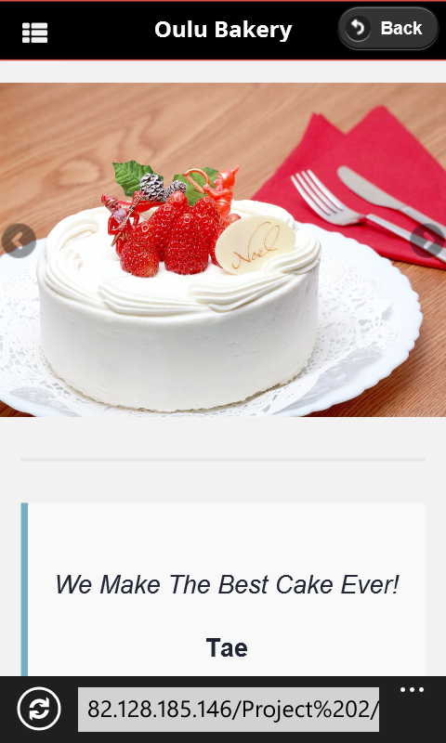
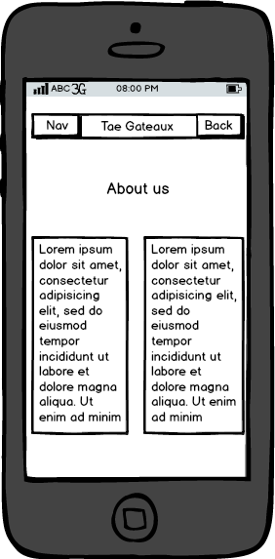
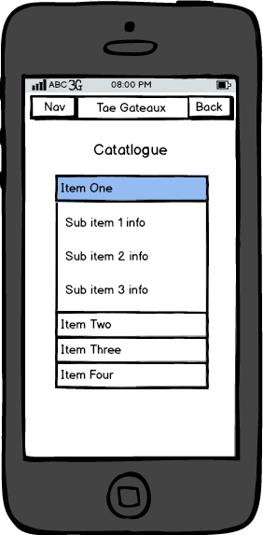
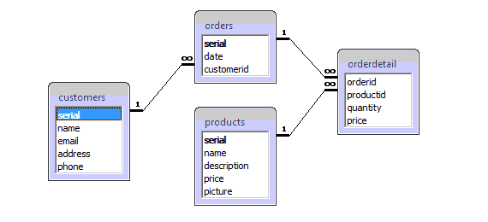
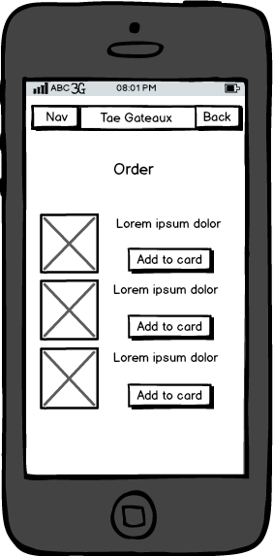
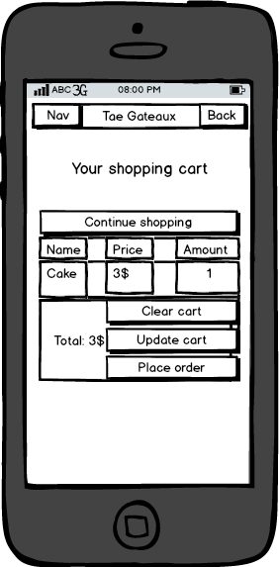
PROJECT WORK 2
Requirements, design, and demo for a cake shop
website
Requirements
Information about the shop
Information about places and opening hours
Show cake catalogue
Add/remove products to card
Add users’ information for delivery
Connection to facebook, twitter, linkedin, google plus
Design
Navigation bar Home
About us Catalogue
Order Cart
Form Contact us
Demo
Homepage’s slider:
Jquery flexslider to show the next or previous picture on the screen
Link to the page:
http://192.168.1.2/Project%202/index.html
Shopping cart
Database stucture for the shopping cart
PHP files:
The user adds a product to his/her shopping cart
The PHP script (products.php) receives this action and stores the requested product in the session array
The PHP script redirects to a different page (shoppingcart.php) which displays purchased items to the user.
Contact information: Dang Chau Nguyen, e-mail: t2ngch00@students.oamk.fi , tel. +358417516148
Van Cuong Nguyen, e-mail: markku.timonen@oamk.fi, tel. +358417559377

