Slide 1
Network Programing Project (Online System Storage)
Group 4:
Nguyễn Văn Cường BA9-011
Nguyễn Ngọc Khiêm BA9-028
Đặng Hoàng Phúc BA9-050

Slide 2
TABLE OF CONTENTS
1. What is FTP client?
2. Why we need FTP client?
3. How does FTP client work?

Slide 3

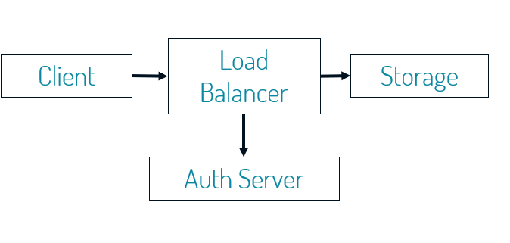
ONLINE STORAGE SYSTEM

Slide 4
CLIENT
Examples of client programs
Web browsers, FTP, telnet, ssh.
How does a client find the server?
IP address in server socket address identifies host (more precisely, an adapter on the host)
(Well-known) port in server socket address identifies service, and thus implicitly identifies server process that provides it

Slide 5
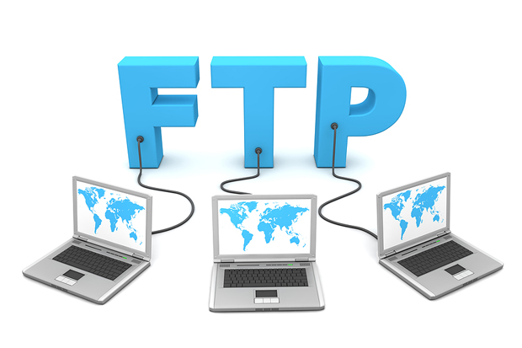
1. What is FTP Client?

Slide 6
A FTP client is a personal computer or a mobile device that is running application software that is able to communicate with and retrieve files from a FTP server.
Usually, the FTP client initiates the communication with the FTP server. which is constantly listening for incoming requests.

Slide 7

2. Why we need Client?

Slide 8
An FTP client provides an environment in which you can upload files to a server, download files from a server to your device, and view and manage files stored on your web server.
Many FTP clients allow you to do other things too, like connect to cloud storage platforms (i.e. Dropbox and Google Drive), download files from server and upload files to storage server.

Slide 9

3. How does Client work?

Slide 10
To connect with a FTP server, client first needs to provide the destination server it wants to connect to (hostname, IP address,…), enter an username and a password to prove that they have been granted access to that specific server by their host.
After the connection is set up, LB will allows the client to begin the file transferring process (upload or download)

Slide 11
CONCLUSION
While working on this project we have learnt a lot about how FTP client work and FTP system.
During the working on the process we remind about knowledge of Network Programming.
The FTP client was made to help user provides an environment to upload files, download files from a server to client's devices.

Slide 12


