Slide 1
OS overview
Jun, 2024
Rev. 1.00 by CuongNguyen

Slide 2
AGENDA
Scheduler
Memory Management
Thread and Process
Thread and Process synchronization

Slide 3
Scheduler

Slide 4
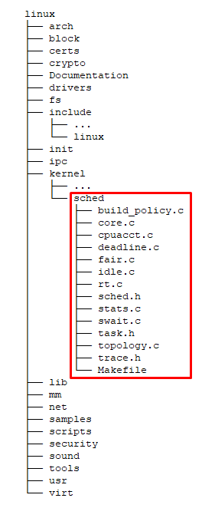
What the Scheduler?
▶ The Linux Scheduler is a crucial component of the Linux kernel responsible for deciding which processes run on the CPU at any given time.
▶ It manages process scheduling, ensuring that multiple processes can share system resources efficiently.
▶ The primary goal of the Linux scheduler is to maximize system performance and responsiveness by balancing CPU time among all running processes.

Slide 5
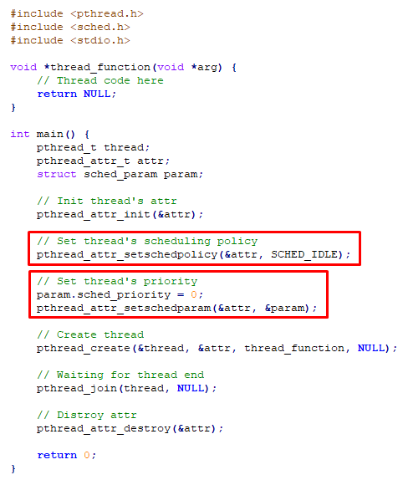
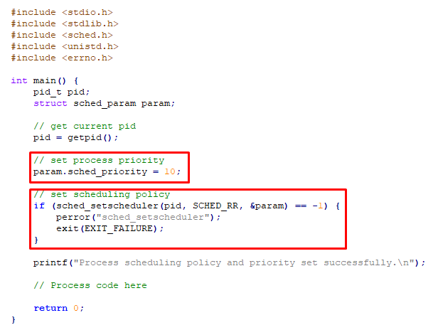
Some popular scheduling policy
Completely Fair Scheduler (SCHED_OTHER)
Real-Time Schedulers (SCHED_FIFO, SCHED_RR)
Batch Scheduler (SCHED_BATCH)
Idle Scheduler (SCHED_IDLE)
Deadline Scheduler (SCHED_DEADLINE)

Slide 6
What - Why the Memory Manager?

Slide 7
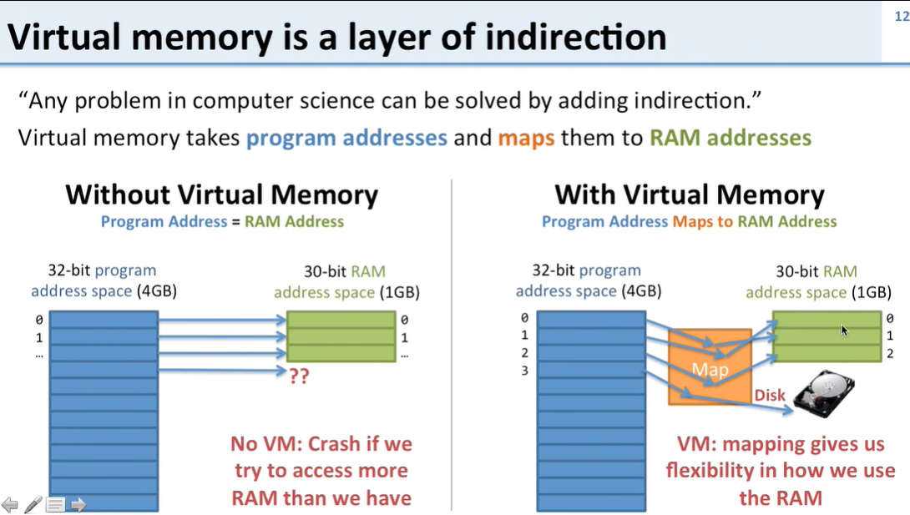
Key Concepts
Virtual Memory
Paging
Slab Allocator
Swapping

Slide 8
Thread and Process

Slide 9
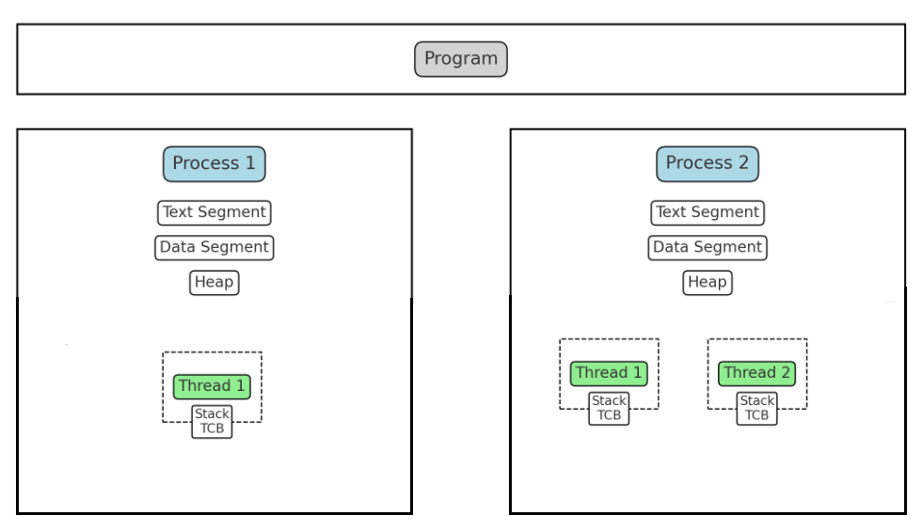
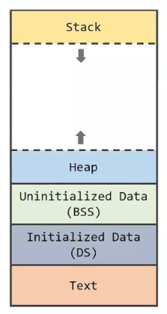
Program – Process - Thread
Process’s memory layout

Slide 10
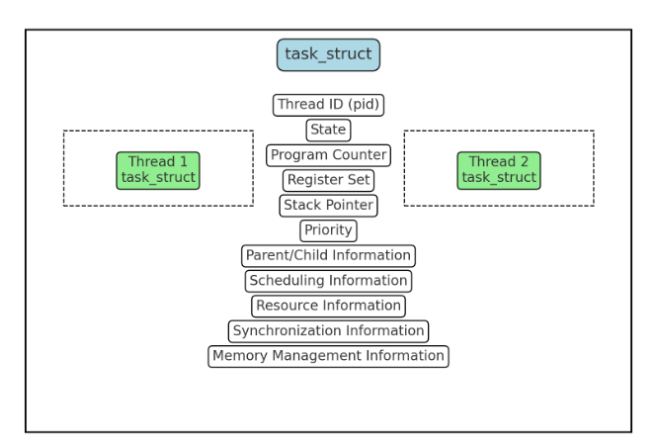
Task struct

Slide 11
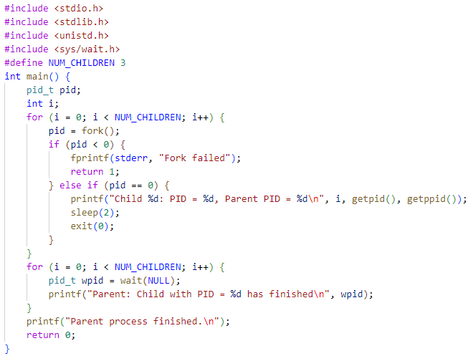
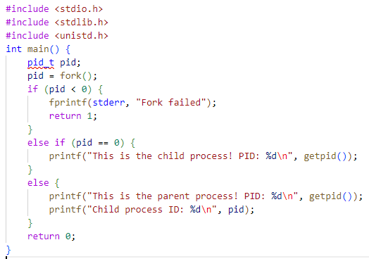
How to create a new process
- Use folk() system call to create a new process

Slide 12
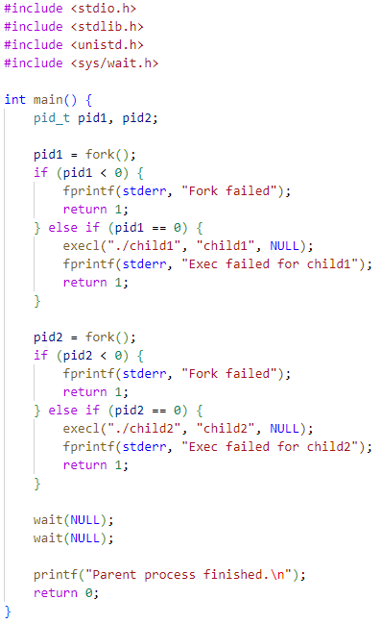
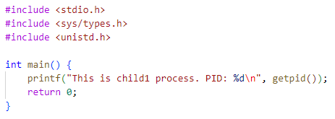
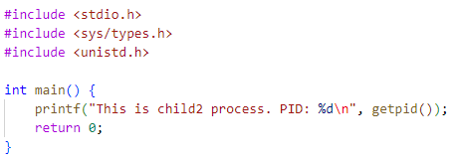
How to create a new process
- Use fork() and exec() to create child processes that execute different programs

Slide 13
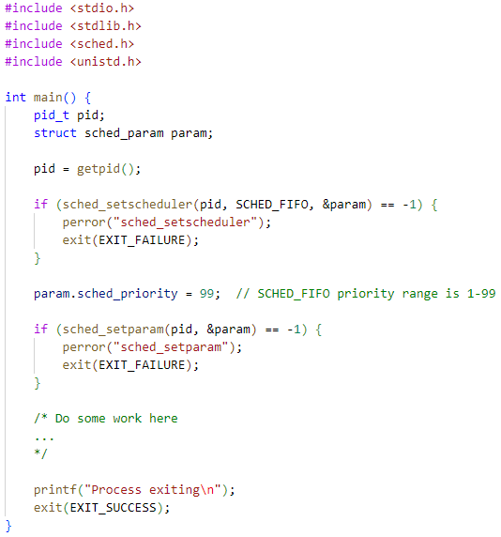
Set scheduling policy and priority for process
Use sched_setscheduler() and sched_setparam() to set scheduling policy and priority.

Slide 14
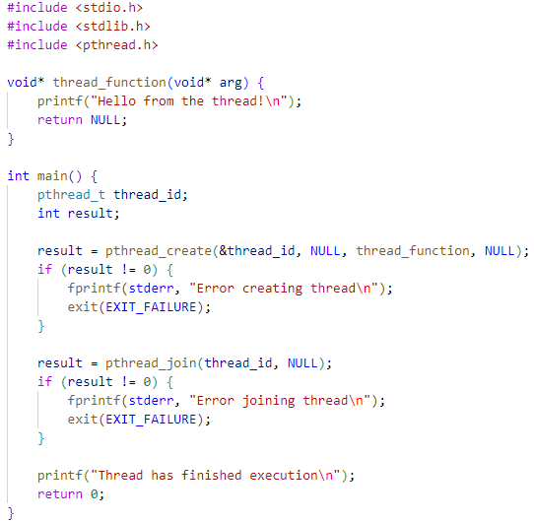
How to create a new thread
- Use pthread_create() to create a new thread. - Use pthread_join() to wait for thread end.

Slide 15
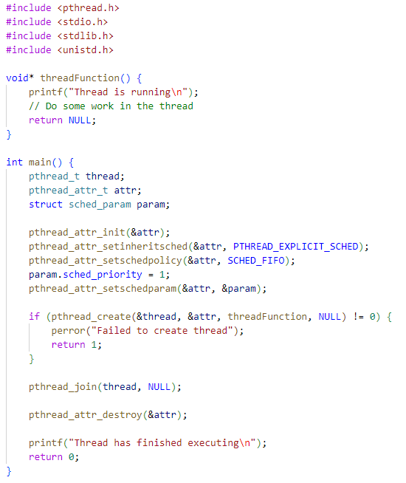
Set scheduling policy and priority for thread
- Use pthread_attr_t to configure threads

Slide 16
Thread and Process synchronization

Slide 17
Common Techniques
Some methods use to synchronize between two or more threads:
Some methods use to synchronize between two or more processes:
Mutex
Condition Variables
Barrier
Semaphore
Read-write locks
Spinlocks
Atomic
Message Queues
Semaphore
Shared Memory
Pipes
Sockets

Slide 18
Common Synchronization Problems
Deadlock
Starvation
Livelock
Race Conditions
Performance Overheads
Priority Inversion

Slide 19
Thank You!!

