Slide 1
OS overview
Jun, 2024
Rev. 1.00 by CuongNguyen

Slide 2
AGENDA
Scheduler
Memory Management
Thread and Process
Thread and Process synchronization

Slide 3
Scheduler

Slide 4
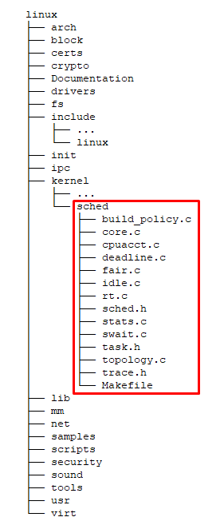
What the Scheduler?
▶ The Linux Scheduler is a crucial component of the Linux kernel responsible for deciding which processes run on the CPU at any given time.
▶ It manages process scheduling, ensuring that multiple processes can share system resources efficiently.
▶ The primary goal of the Linux scheduler is to maximize system performance and responsiveness by balancing CPU time among all running processes.

Slide 5
Why the Scheduler?
Efficient Resource Utilization: Ensures the CPU and other resources are used optimally, preventing idle times and improving overall system throughput
Fair Process Distribution: Distributes CPU time among processes fairly, ensuring no single process can monopolize the CPU and degrade system performance for other processes.
Responsiveness: Prioritizes interactive processes to enhance user experience by providing quicker responses to user inputs.
Scalability: Handles an increasing number of processes and cores efficiently, making it suitable for both small devices and large multi-core servers.
Real-time Capabilities: Supports real-time processes that require strict timing constraints, essential for applications in embedded systems, robotics, and other real-time computing environments.

Slide 6
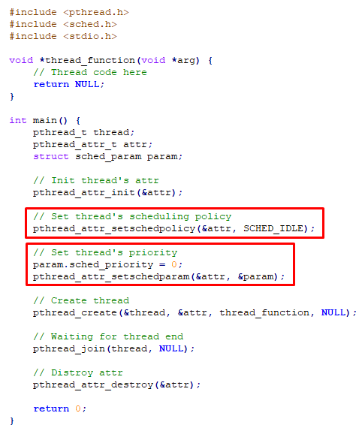
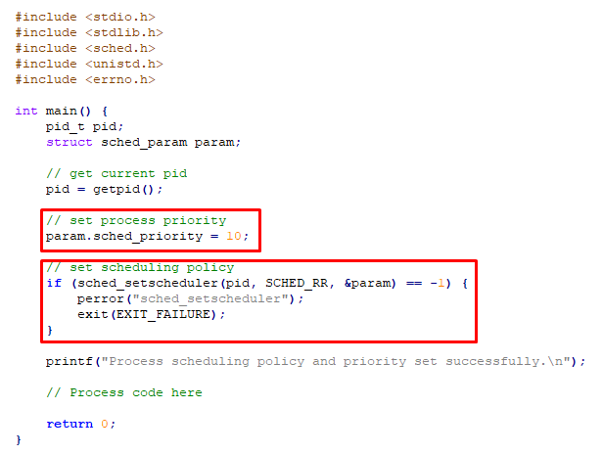
Some popular scheduling policy
Completely Fair Scheduler (SCHED_OTHER)
Real-Time Schedulers (SCHED_FIFO, SCHED_RR)
Batch Scheduler (SCHED_BATCH)
Idle Scheduler (SCHED_IDLE)
Deadline Scheduler (SCHED_DEADLINE)

Slide 7
What - Why the Memory Manager?

Slide 8
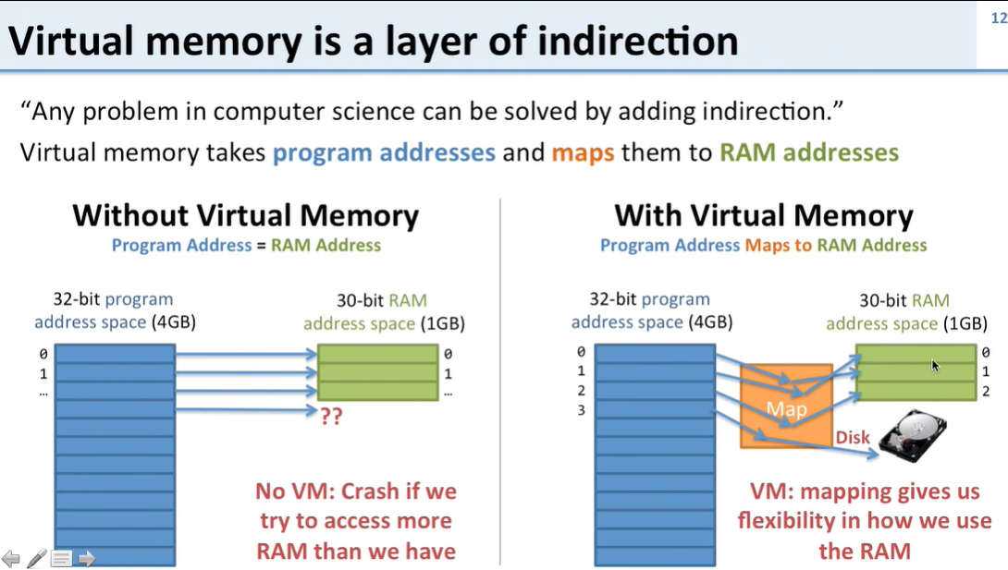
Key Concepts
Virtual Memory
Paging
Slab Allocator
Swapping

Slide 9
Thread and Process

Slide 10
Key Concepts

Slide 11
Thread and Process synchronization

Slide 12
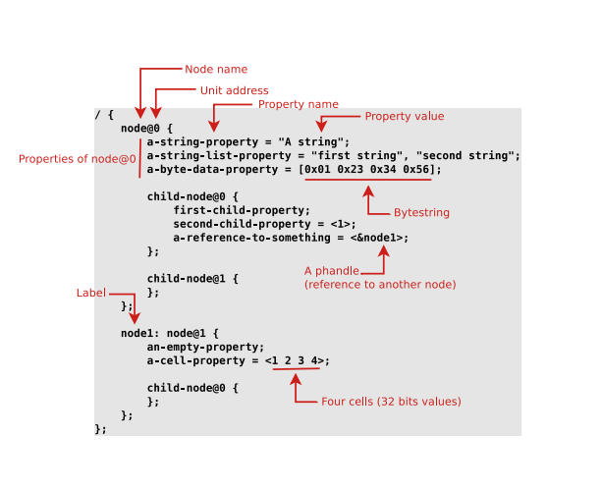

Base syntax
▶ Tree of nodes
▶ Nodes with properties
▶ A node ≈ a device
▶ Properties ≈ device characteristics
▶ dtc only does syntax checking, no semantic validation

Slide 13
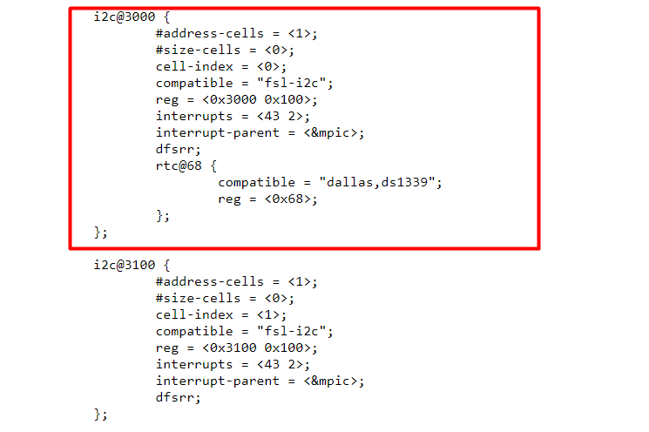

Simplified example

Slide 14
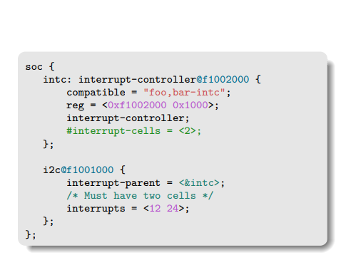
Cells concept
▶Integer values represented as 32-bit integers called cells
▶ Encoding a 64-bit value requires two cells
Ex - #interrupts-cells: how many cells are used to encode interrupt specifiers for this interrupt controller

Slide 15
Device Tree inheritance

Slide 16
Device Tree inheritance.
Device Tree files are not monolithic, they can be split in several files, including each other.
.dtsi files are included files, while .dts files are final Device Trees
Only .dts files are accepted as input to dtc
Typically, .dtsi will contain definition of SoC-level information (or sometimes definitions common to several almost identical boards)
The .dts file contains the board-level information
Uses the C pre-processor #include directive
Using the C pre-processor also allows to use #define to replace hardcoded values by human readable definitions

Slide 17
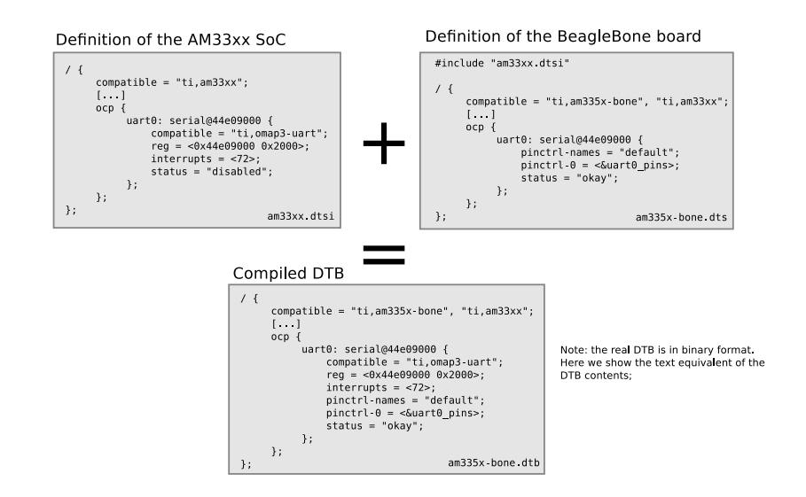
Device Tree inheritance example

Slide 18
Device Tree specifications and bindings

Slide 19
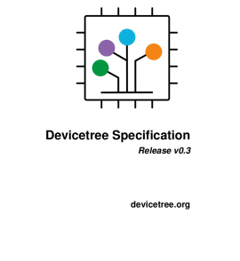
Device Tree specifications
How does one know how to write the correct nodes/properties to describe a given hardware platform ?
▶ The Device Tree Specifications at https://www.devicetree.org/specifications/ gives the base Device Tree syntax and specifies a number of standard properties.
Far from being sufficient, though.
▶ The Device Tree Bindings are documents that each describe how a particular piece of hardware.
Documentation/devicetree/bindings/ in Linux kernel sources
Reviewed by DT bindings maintainer team
Legacy: human readable documents
New norm: YAML-written specifications

Slide 20
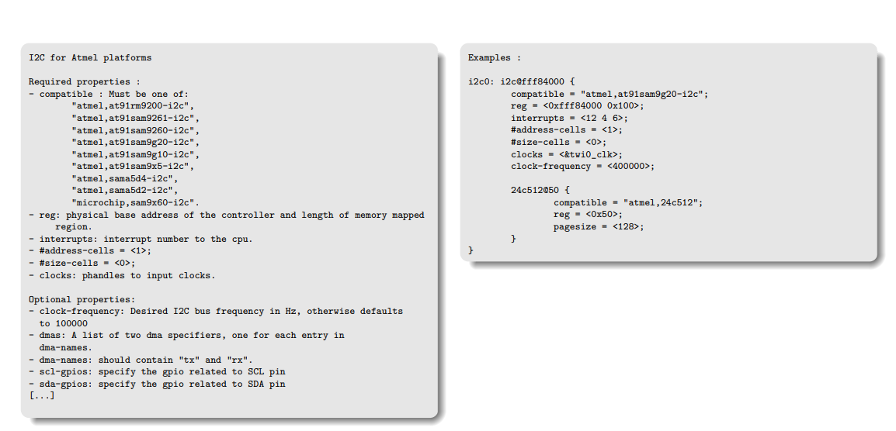
Device Tree binding: old style

Slide 21
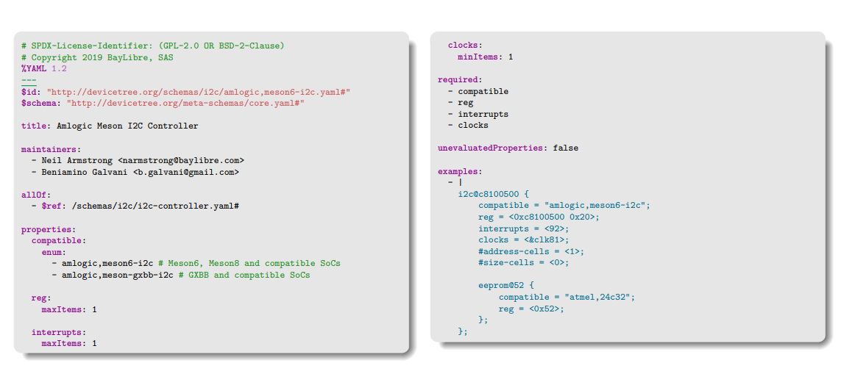
Device Tree binding: YAML style

Slide 22
Building and validating Device Trees

Slide 23
Device tree compiler.
The Device Tree Compiler (DTC) is the tool that is used to compile the source into a binary form. Source code for the DTC is located in scripts/dtc.
The output of the device tree compiler is a device tree blob (DTB).
The basic syntax of the DTC command line is: dtc [options] <input filename>
The most common options include:
-I <input format>
-O <output format>
-b <boot CPU>
set the physical boot cpu
The input format could be .dts, .dtb, or .fs (.fs would read from the current file systems /proc/device-tree). The output format could be .dts, .dtb, or .asm.
As an example, to compile the abc.dts file: dtc –I dts –O dtb abc.dts > abc.dtb
The DTC can also be used to reverse compile DTBs and make them human-readable again: dtc –I dtb –O dts abc.dtb > abc.dts

Slide 24
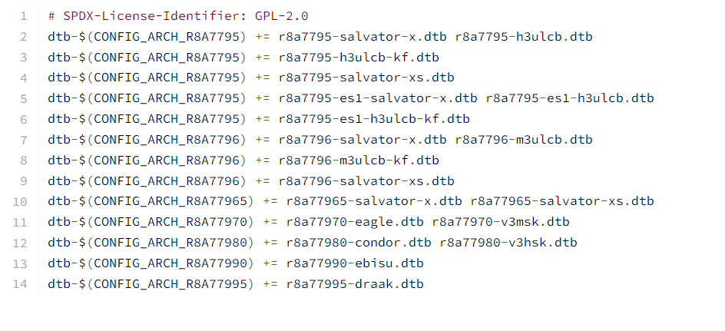
Building Device Trees in Linux.
On ARM/ARM64, arch/<ARCH>/boot/dts/Makefile or arch/<ARCH>/boot/dts/<vendor>/Makefile indicates which DT to build depending on the platform.
arch/arm64/boot/dts/renesas/Makefile
Building the kernel with make will also build the Device Trees on most architectures
Explicit make dtbs target also available

Slide 25
Validating Device Tree in Linux.
dtc only does syntaxic validation.
YAML bindings allow to do semantic validation
make dt_bindings_check → verify that YAML bindings are valid
make dtbs_check → validate DTs currently enabled against YAML bindings

Slide 26
Common properties

Slide 27
Common properties
reg
Memory-mapped devices: base address and size of the registers. Can have several entries.
I2C devices: address on the I2C bus
SPI devices: chip select number
interrupts, interrupt-parent, interrupts-extended: interrupts lines used by the device, and which interrupt controller they are connected to.
clocks: which clock(s) are used by the device, from which clock controller
dmas: which DMA controller and channels are used by the device
status: okay means the device is present and should be enabled, otherwise, the device is left unused
pinctrl-*: indicates the pin-muxing configuration requested by the device

Slide 28
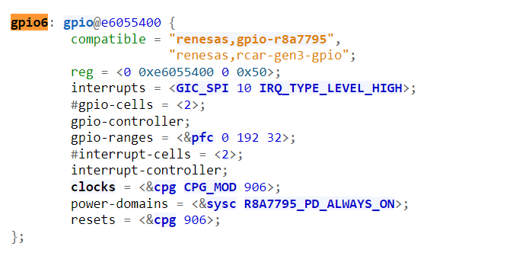
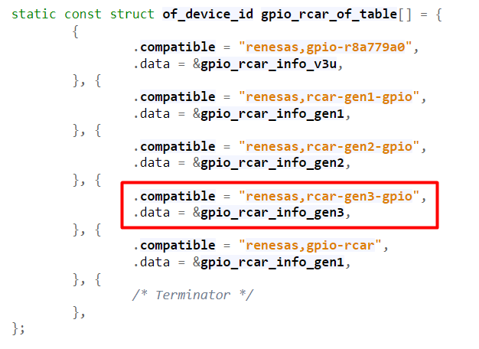

Matching with drivers in Linux: platform driver

Slide 29
REFERENCE

Slide 30
Thank You!!

