Slide 1

US Super store performance
Cuong Vo – 131116
cv131116@student.sgh.waw.pl

Slide 2


Agenda
Dataset introduction
Dataset Description
E-Commerce insight

Slide 3


Introduction
This dataset provides a detailed perspective on U.S. shop operations, covering order details, product information, and financial performance metrics.
It includes crucial data on sales, profit, cost, and discounts, offering a comprehensive view of the economic dynamics of these businesses.
Valuable for analysts and decision-makers, this dataset facilitates a deeper understanding of operational efficiency and product preferences within the U.S. retail sector.

Slide 4



Dataset import & Cleaning

Slide 5
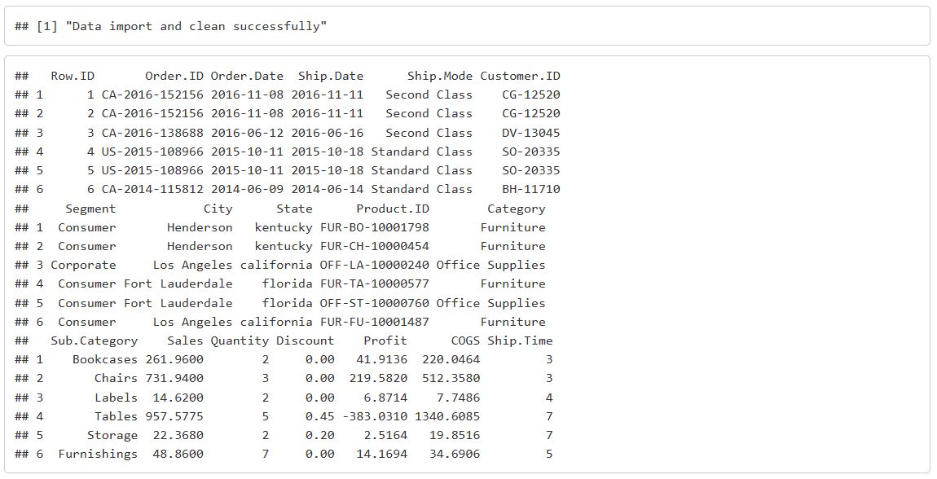

Slide 6

Data summary

Slide 7
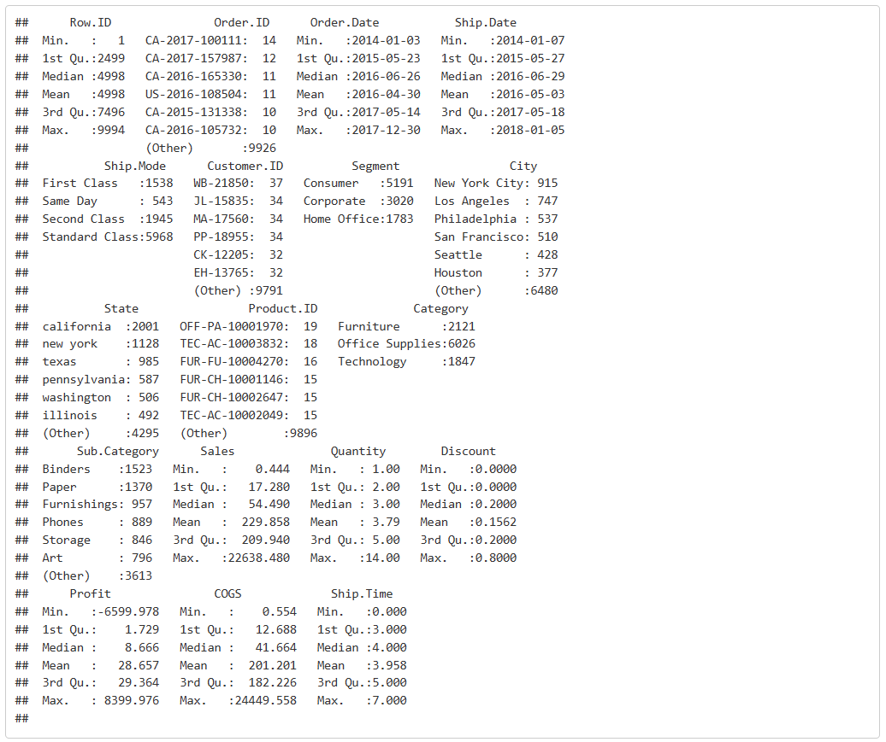

Slide 8
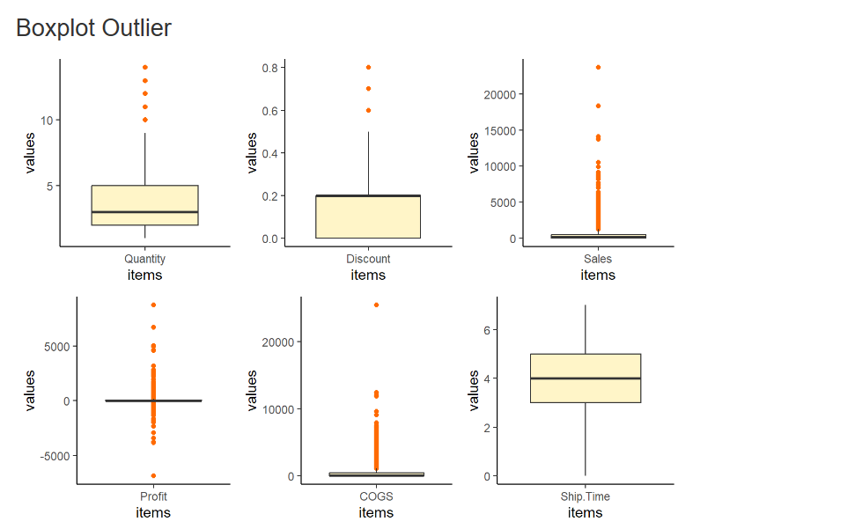

Slide 9
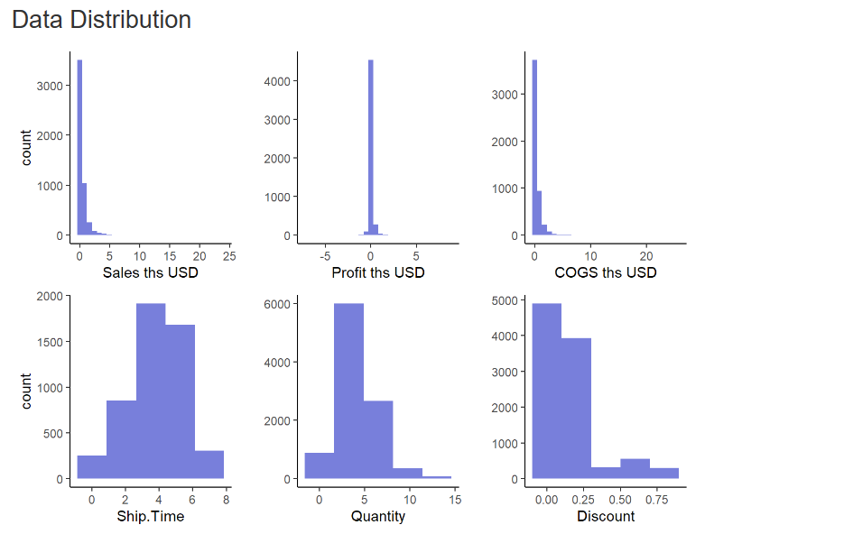

Slide 10

E Commerce insight

Slide 11
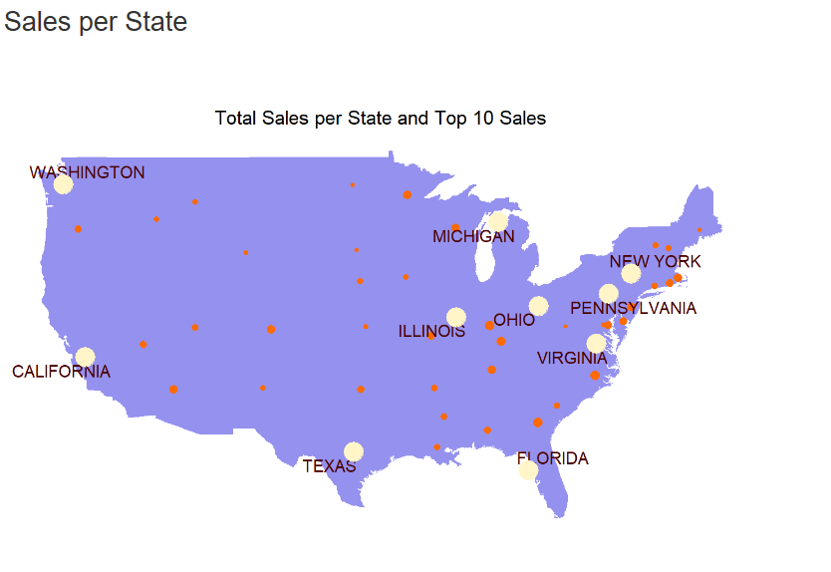

Slide 12
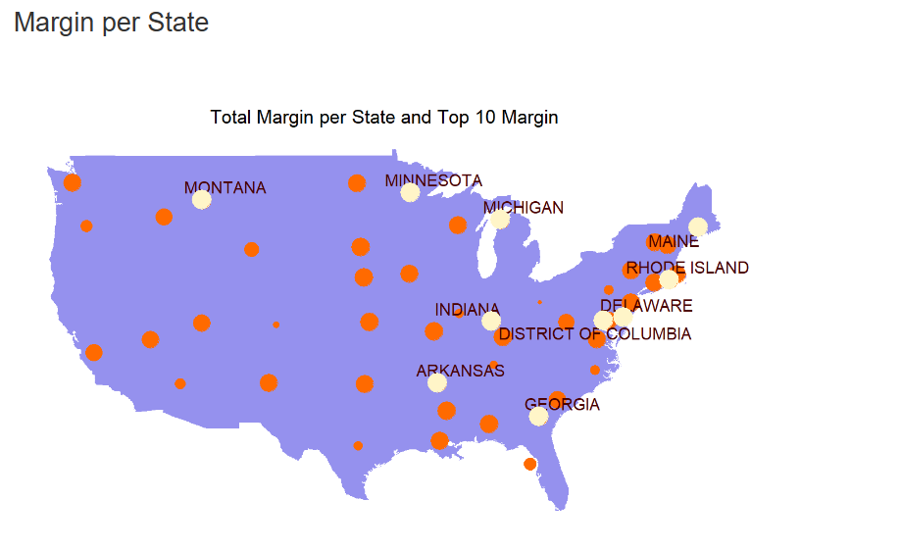

Slide 13
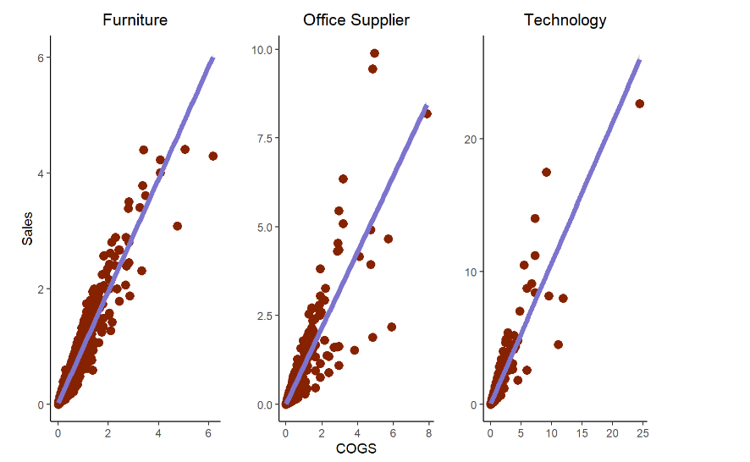

Slide 14
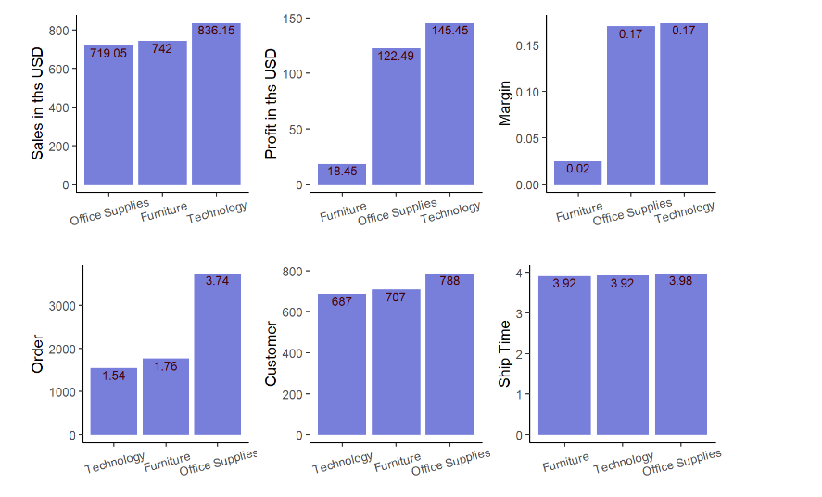

Slide 15
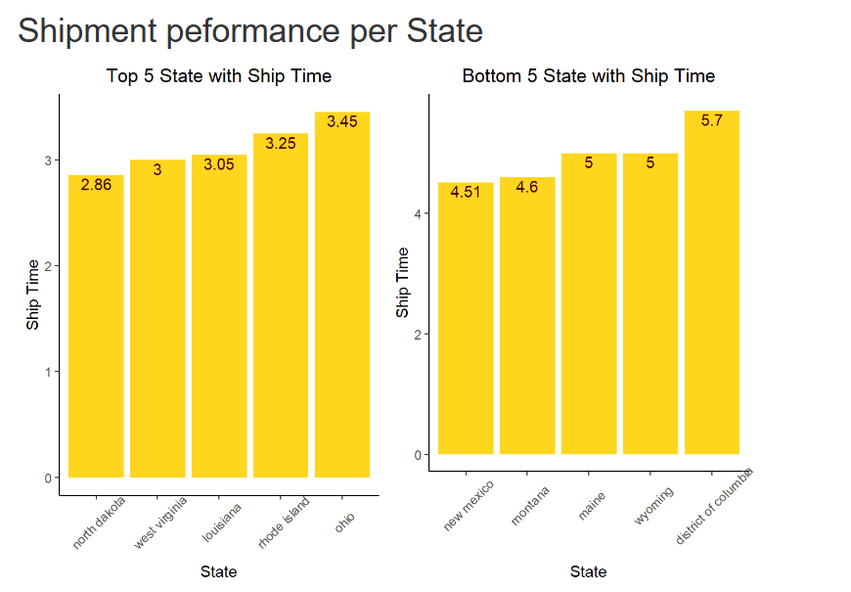

Slide 16
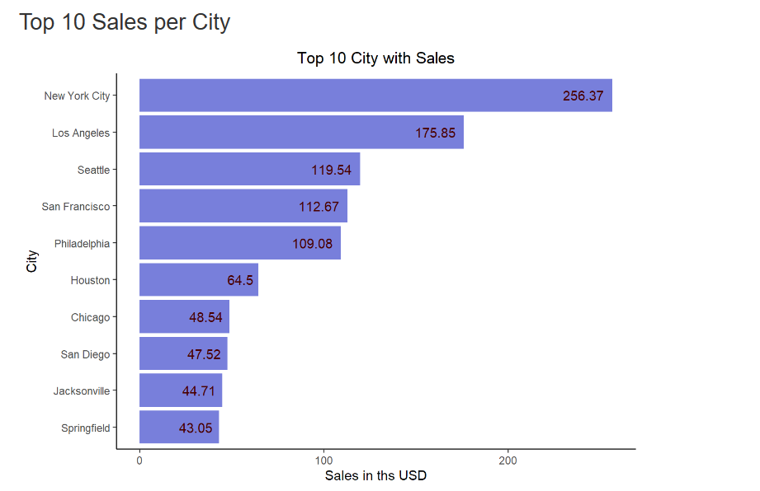

Slide 17
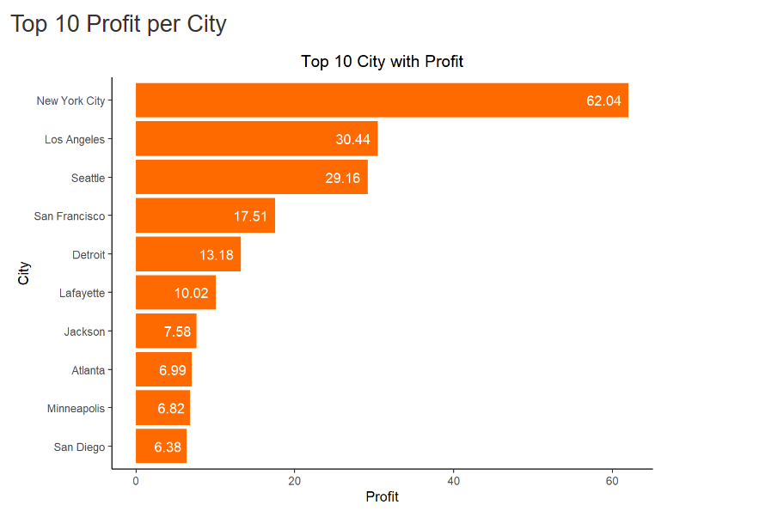

Slide 18
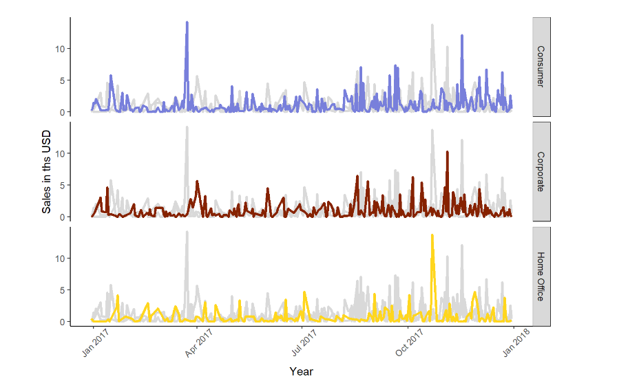

Slide 19
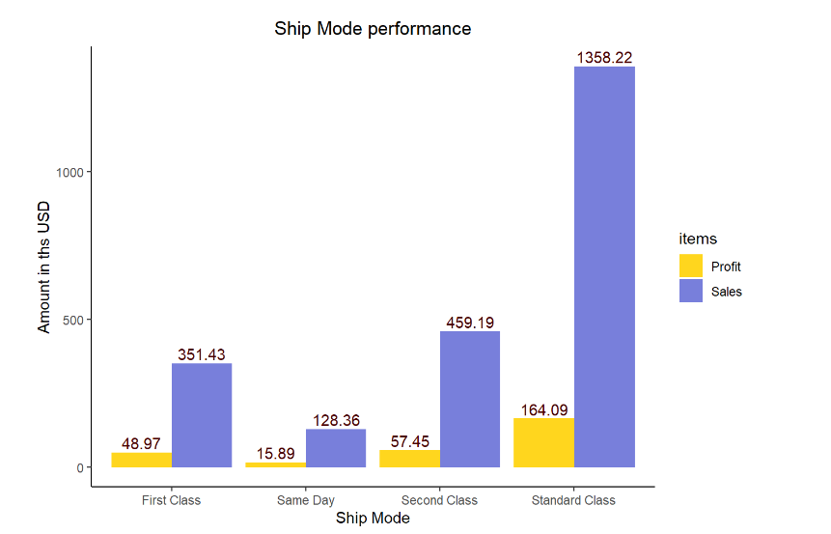

Slide 20
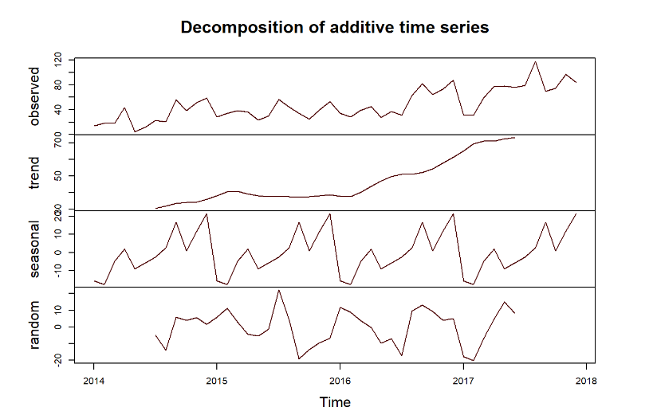

Slide 21


