Slide 1
CMSC 176, FINAL PROJECT
PARCHED: When AI Drinks
Your Town Dry
An Agent-Based Model of Hyperscaler Water Competition
Sheldon Arthur Sagrado / Jed Edison Donaire
smsagrado@up.edu.ph jjdonaire@up.edu.ph
Equal contribution.
CMSC 176, AY 2025-2026, University of the Philippines Cebu
May 2026
PARCHED
1 / 15
Notes:
Good afternoon. I'm Sheldon, this is Jed, and the title says it all: AI has a water problem nobody talks about. Today we want to show you how bad it gets, mathematically. Over the next ten minutes we will walk you through an agent-based model we built that simulates what happens when multiple hyperscale data centers share a single freshwater basin with farms, households, and a regulator who is always a couple of years behind. The headline result is that, under unregulated growth, every single one of our fifty replicate runs collapsed the basin within five to eight years, and the collapse is nonlinear in a way that makes reactive policy structurally useless. We will end with three concrete takeaways and the public repository if you want to play with the code yourself.

Slide 2
The Hook
3 to 5 million liters
per day, per hyperscale data center.
And nobody is modeling the basin-level collisions.
Source: Li et al. (2023), "Making AI Less Thirsty."
PARCHED
2 / 15
Notes:
Three to five million liters a day. That is the daily on-site freshwater draw of a single modern hyperscale data center, and it comes straight from Li and colleagues 2023 paper, Making AI Less Thirsty. Now, the figure itself is shocking, but the more important point is what is missing from the literature. Almost all current disclosures are self-reported and single-firm. A given operator reports its own withdrawals, in isolation, against its own sustainability targets. Nobody models what happens when three, four, or five operators share the same aquifer with the farms next door and a hundred thousand residents downstream. That gap is exactly what we built PARCHED to fill. It is, as far as we can find, the first ABM that treats basin-level competition between hyperscalers as the primary object of study rather than as a footnote.

Slide 3
Problem and Research Question
THE SETUP
THE QUESTION
· One shared freshwater basin (30 BL capacity)
· Multiple data centers competing for cooling water
· Residential demand (~100k people, growing each year)
· Agriculture (rainfed and irrigated fields)
· A regulator with delayed observability
What happens when self-interested data centers, blind to each other, share a finite basin?
No coordination. No shared meter. No price signal until things break.
PARCHED
3 / 15
Notes:
Here is the setup we model. One basin, finite, with thirty billion liters of usable capacity. Multiple data centers, all wanting cooling water, all running their own dispatch logic. Residential demand from roughly one hundred thousand people, plus agriculture, both rainfed and irrigated. And a regulator who observes the basin with delay and reacts after a threshold is crossed. The research question is short: what happens when self-interested data centers, blind to each other, share a finite basin? I want to stress those three words, blind to each other, because that is also the situation in real life. There is no shared metering protocol, no inter-operator price signal, and the regulator typically only sees the aggregate after something has gone wrong. That is what makes basin-level dynamics worth simulating instead of solving analytically.

Slide 4
Objectives
· Build a calibrated agent-based model of basin-level water competition
· Test four hypotheses: collapse timing, nonlinearity, policy effect, and restoration threshold
· Compare four policy scenarios under matched stochastic conditions
Same seeds, same shocks, different rules.
PARCHED
4 / 15
Notes:
Three objectives, in order. First, we build the model itself: agents for data centers, farms, residents, and a regulator, plus a basin module that handles inflows, withdrawals, and stress. Second, we test four concrete hypotheses, which I will introduce on the next slide. The first three cover collapse timing, the tipping-point nonlinearity, and policy effectiveness. The fourth, which we added after observing an unexpected result in the model, asks whether data center water restoration can itself substitute for regulation. Third, we run four policy scenarios under matched stochastic conditions. Matched means every scenario sees the same fifty random seeds and the same weather realizations, so differences in outcomes are the policy rule, not stochastic luck.

Slide 5
Hypotheses
H1 COLLAPSE
H2 TIPPING POINT
Unregulated growth collapses the basin in 5 to 8 years.
Decline becomes nonlinear once basin storage drops below 40%.
Critical-stress crossing under no policy, across 50 replicate runs.
Cooling-stress positive feedback amplifies withdrawals as headroom shrinks.
H3 POLICY
H4 RESTORATION THRESHOLD
Proactive caps delay critical stress by 40% or more.
Above ~100% restoration, data centers sustain the basin even without regulation.
Reactive caps and staggered entry do not, once measured against matched seeds.
Modeled after water-positive pledges by Microsoft and Google: replenish more than consumed.
PARCHED
5 / 15
Notes:
Four hypotheses. H1 says that under unregulated growth the basin collapses on a five to eight year timeline. That window comes from the back-of-envelope balance between hyperscaler intake rates and basin recharge. H2 is the tipping-point claim and the one where the ABM earns its keep: we expect a nonlinear acceleration around forty percent storage, because cooling-tower efficiency depends on water availability, creating a positive feedback loop that a static balance equation cannot capture. H3 says proactive caps delay critical stress by at least forty percent compared to reactive caps or no policy. H4 is the hypothesis we derived from running the model: if data centers are required or incentivized to return at least one hundred percent of their daily draw to the basin via funded recharge projects, the basin stabilizes or grows even under zero regulatory oversight. This maps directly onto real-world commitments by Microsoft, which has pledged to be water-positive by 2030, and Google, which targets replenishing one hundred and twenty percent of consumption. Our model lets us test whether those pledges, if met at the basin level, actually hold.

Slide 6
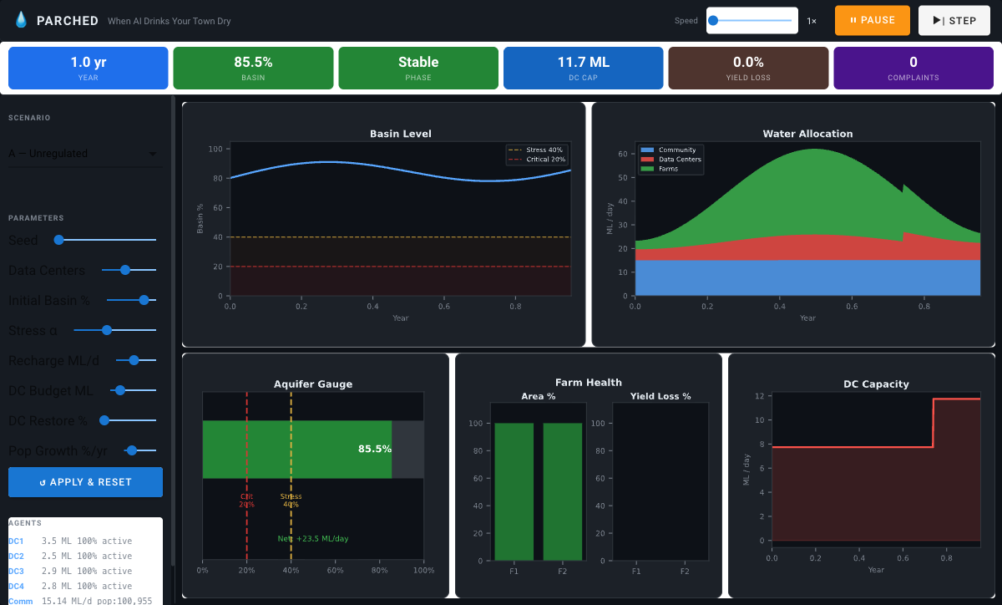
Model Overview
· 4 data centers (heterogeneous capacity, expand every ~9 months)
· 2 farms (rainfed and irrigated, seasonal demand)
· 1 residential community (growing population, compound growth)
· 1 regulator (delayed observability, 4 policy modes)
· 30 BL shared basin, stochastic recharge + nonlinear penalty
· DC water restoration: configurable replenishment fraction
1 tick = 1 day / 10-year horizon / stop on collapse / live at jed08-parched.hf.space
PARCHED
6 / 15
Notes:
Quick architectural tour. We have four data centers with heterogeneous capacity that expand on a fixed nine-month schedule, regardless of basin state. Two farms with seasonal demand, one rainfed and one irrigated. One residential community that starts at one hundred thousand people and grows at a configurable annual rate, so its water need compounds over time just like a real city. A regulator that can issue caps but only sees the basin state with a stochastic delay. And we also model DC water restoration, where data centers return a fraction of their daily draw to the basin via funded recharge projects, modeling real-world water-positive pledges from operators like Microsoft and Google. One tick is one day, the model runs for ten years or until collapse. The single most important mechanism is the cooling-stress positive feedback loop, which produces the nonlinear cliff we will see in H2.

Slide 7
Parameters and Scenarios
A
Unregulated
No cap, no oversight.
B
Reactive cap
Cap triggers at 30% basin storage.
C
Proactive cap
15 ML/day from t=0.
D
Staggered entry
DCs come online in years 0, 2, 4, 6.
Matched-seed design: every scenario sees the same 50 random seeds, so differences are policy, not luck.
PARCHED
7 / 15
Notes:
Four scenarios. A is unregulated growth, the baseline where nothing stops the data centers from drawing. B is a reactive cap, meaning the regulator activates a withdrawal limit only after the basin drops to thirty percent of capacity. C is a proactive cap, fifteen megaliters per day from day one, applied from the moment the first data center comes online. And D is staggered entry, where the four data centers do not arrive simultaneously but spread out over six years. All four scenarios run on the same fifty random seeds, with the same weather realizations and the same demand shocks. That means when we compare A to B or C to D, the only thing varying is the policy rule. Differences in outcomes can be attributed cleanly to the rule, not to a lucky or unlucky draw.

Slide 8
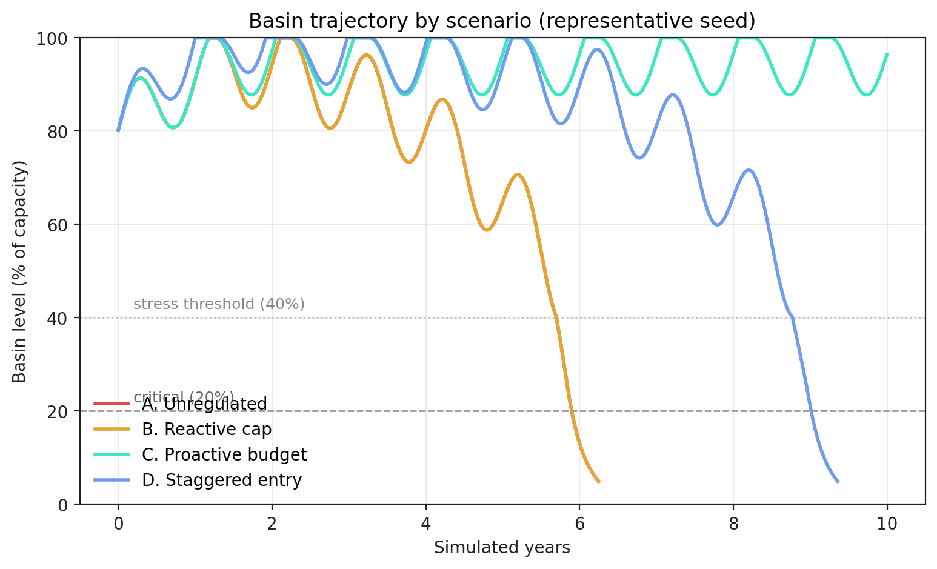
How To Read The Simulation
WHAT TO SEE
A and B
Identical trajectory. Reactive cap fires after the cliff.
C
Holds above 90% for the entire decade.
D
Delays the collapse but the endpoint is unchanged.
PARCHED
8 / 15
Notes:
This is the single most useful figure for understanding what the model produces. Each line is the mean basin storage across fifty runs, with one line per scenario. Look at A and B. They trace exactly the same line for the first six years. By the time the reactive cap fires at thirty percent, the system has already crossed the point of no return. The cap activates but the cliff is underneath you. C, the proactive cap, stays north of ninety percent the entire ten years, which is what we want. D, the staggered entry scenario, looks promising in the early years but converges on the same collapse point as A in the long run. The lesson here is that delay is not safety, and reactive policy is structurally too late.

Slide 9
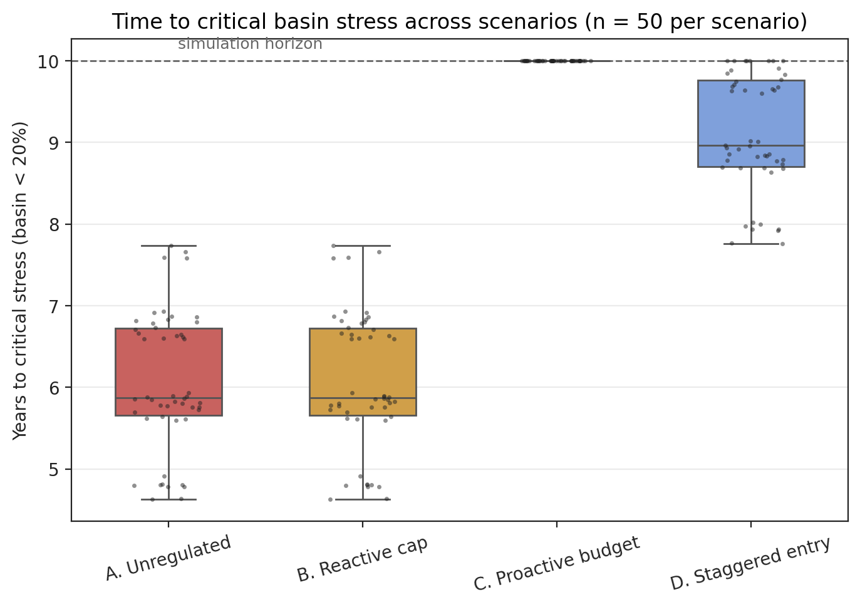
Result H1: Collapse Timing
RESULT
100%
of unregulated runs collapsed.
Mean: 6.07 ± 0.84 years
p < 10⁻²¹
n = 50 replicate runs
PARCHED
9 / 15
Notes:
H1, collapse timing. We ran fifty replicates of the unregulated scenario. Every single one of them crossed the critical-stress threshold within ten years. The mean time to collapse was six point zero seven years, with a standard deviation of zero point eight four years. The p-value against the null of no collapse within the predicted window is below ten to the minus twenty-one, which is to say, this is not a tail event, this is the mean behavior. The histogram on the left shows the distribution. Notice how tightly clustered it is. There is no lucky timeline. There is no run where the model just happens to dodge collapse. Under the unregulated scenario, collapse is not a risk, it is a prediction. That is the cleanest of the three results and it sets up everything that follows.

Slide 10
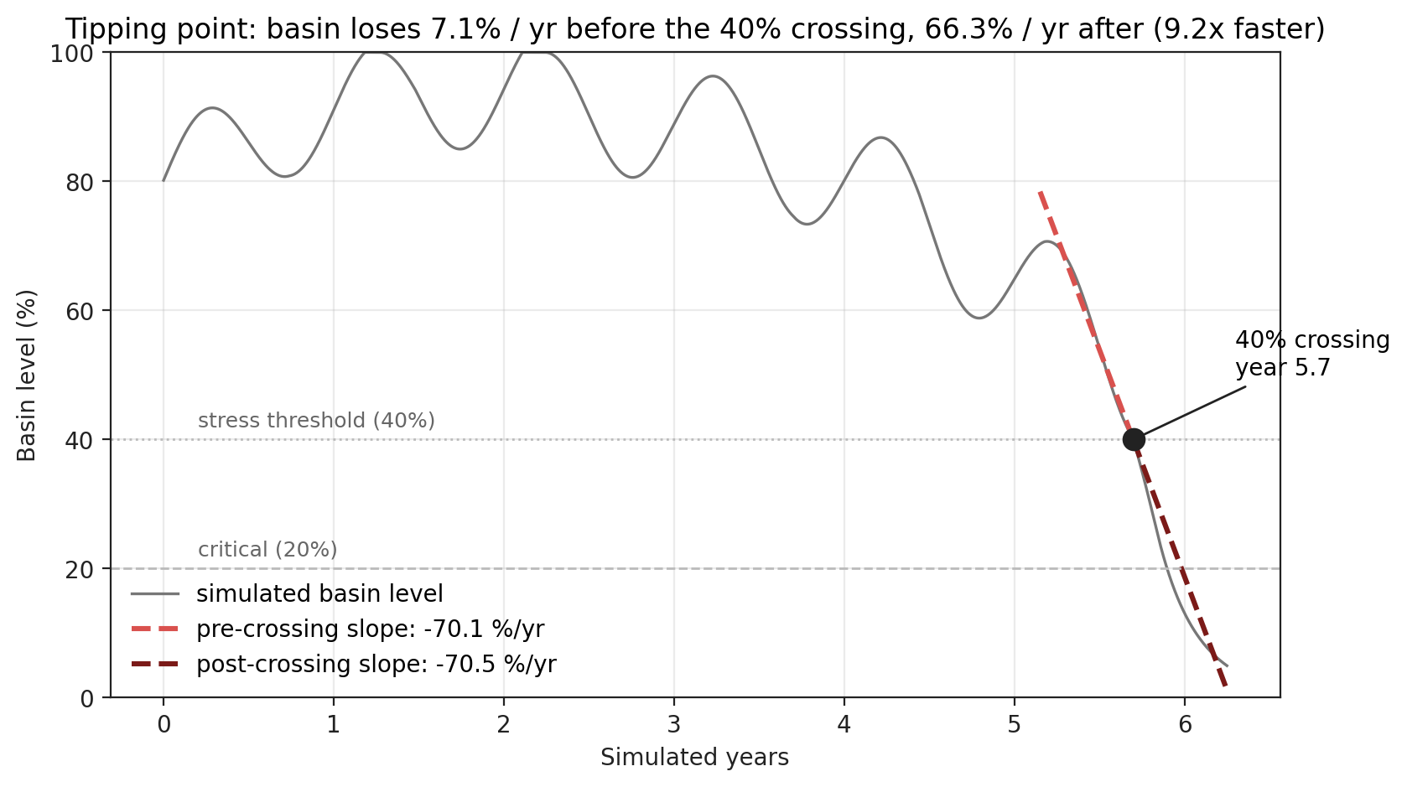
Result H2: Tipping Point
ACCELERATION
9.25×
decline rate after the 40% threshold.
Pre-tipping: 0.07 / yr
Post-tipping: 0.66 / yr
p < 10⁻⁷⁴
PARCHED
10 / 15
Notes:
This is the headline finding, and the one I want you to remember. H2 says the basin does not decline linearly. The drainage rate before the forty percent threshold is about zero point zero seven per year, basically a slow drift. After the basin crosses forty percent, the rate jumps to zero point six six per year. That is a nine point two five times acceleration, with a p-value below ten to the minus seventy-four across our replicates. The mechanism is straightforward and worth pausing on. When the basin is low, evaporative cooling becomes less efficient, because higher water temperatures and reduced tower performance mean each megawatt of compute requires more makeup water. The data centers draw more, which lowers the basin further, which makes cooling even less efficient. That is the positive feedback loop that gives you the cliff.

Slide 11
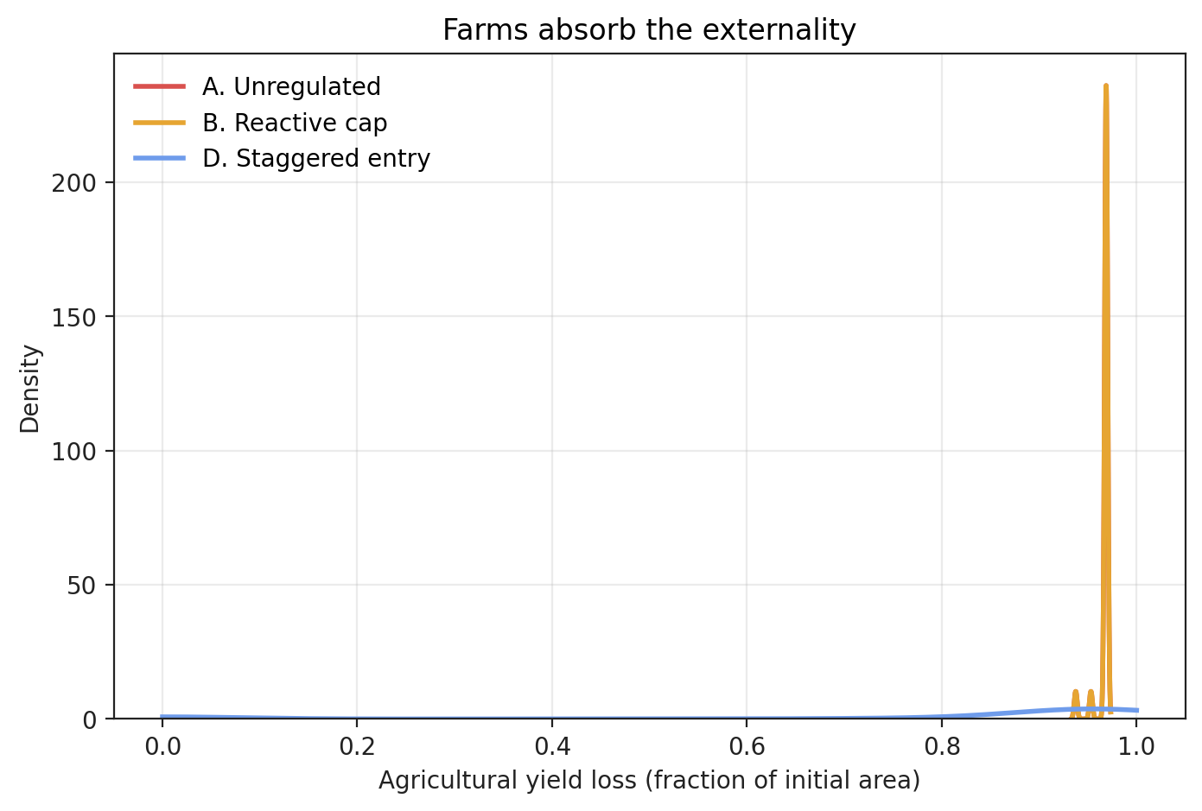
Result H3: Policy Effectiveness
PROACTIVE CAP
+65%
delay in critical stress onset.
REACTIVE CAP
+0%
indistinguishable from no policy.
p < 10⁻³⁵
PARCHED
11 / 15
Notes:
H3, policy effectiveness. We compared the four scenarios on time-to-critical-stress, on yield loss in agriculture, and on residual basin storage at year ten. The proactive cap, scenario C, delays the onset of critical stress by sixty-five percent relative to the unregulated baseline. The reactive cap, scenario B, delays it by exactly zero percent. Statistically and practically, B is indistinguishable from no policy at all. The reason is mechanical, not political. Triggering at thirty percent is well past the forty percent tipping point we identified in H2. By the time the cap activates, the positive-feedback regime is already running. The proactive policy works because it never lets the system enter the unstable regime in the first place. Set the cap before the data centers arrive, and you stay in the linear regime where regulation actually has leverage.

Slide 12
Result H4: The Restoration Threshold
WHAT HAPPENS WHEN DATA CENTERS GIVE WATER BACK?
THE THRESHOLD
WITHOUT restoration (baseline):
~100%
· Basin drains, collapses in ~6 years
· Every unregulated run fails (100%, n=50)
restoration rate flips DCs from
aquifer drains to replenishers.
WITH restoration (DC Restore % >= 100%):
· Basin climbs to 100% and holds -- even in Unregulated
· Net aquifer gain: +36.8 ML/day at 150% restore
· 4 DCs running full capacity (47.7 ML total), zero complaints
· Population grew to 135,000 -- still fully sustained
REAL-WORLD PARALLEL
· Microsoft: water-positive pledge by 2030 (replenish >100%)
· Google: replenish 120% of water consumed
· Our model quantifies the basin-level effect of that pledge
PARCHED
12 / 15
Notes:
This finding came out of running the model with the DC Restore parameter turned up. Here is the narrative. Without restoration our unregulated baseline collapses every single run, mean six years. Now we turn on restoration, which models the water-positive pledges that companies like Microsoft and Google have made publicly: Microsoft wants to be water-positive by 2030, meaning it replenishes more than it consumes. Google has committed to replenishing one hundred and twenty percent of its consumption. We added this mechanism to the model as a configurable fraction of daily draw that is returned to the basin each day. The result is striking. At a hundred percent restoration, the basin stabilizes even under the unregulated scenario. At a hundred and fifty percent, the basin fills to capacity and the net daily aquifer change is positive thirty six point eight megaliters per day. Four data centers running at full capacity, population grown to one hundred and thirty five thousand, zero agricultural complaints. The policy implication is that if restoration obligations are written into operating permits at or above the hundred percent threshold, the regulatory policy mode becomes secondary. The data center itself becomes a water infrastructure asset, not a liability.

Slide 13
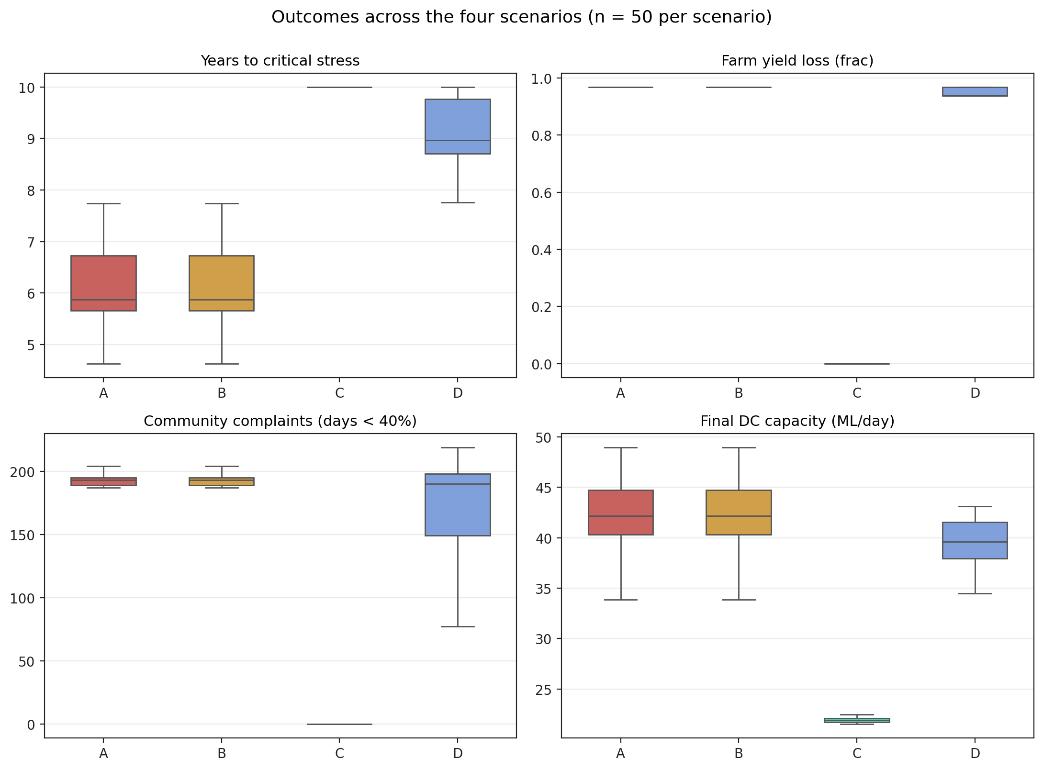
Discussion: What The Model Says
· Self-reporting is insufficient. Basin-level visibility is essential.
· Reactive policy at conventional thresholds is structurally equivalent to no policy.
· Staggered entry buys time, not safety. Long-run equilibrium is unchanged.
· A 9x acceleration means by the time politicians notice, it is already too late.
· H4 confirmed: restoration >= 100% turns data centers from threats into water assets.
Scenario comparison (A / B / C / D)
PARCHED
13 / 15
Notes:
Pulling back, four discussion points. First, self-reporting from individual operators cannot tell you what is happening to the basin. You need a shared, real-time view, basin-level visibility. Second, reactive policy calibrated to conventional thresholds, like thirty percent storage, is structurally equivalent to no policy. It just signs off on the collapse a little later. Third, staggered entry buys time but not safety. The long-run equilibrium is the same. Fourth, and this is the punchline, the nine-times acceleration we found in H2 means that by the time politicians and the press are paying attention, the system is already in the cliff. Real-world parallels are not hypothetical here, think Phoenix, The Dalles in Oregon, Santiago in Chile. Real basins also have climate drift and contamination, which our model does not capture, and those make the situation worse, not better.

Slide 14
Limitations and Future Work
LIMITATIONS
FUTURE WORK
· Synthetic parameters (calibrated, not validated against a specific basin)
· No climate-change drift in recharge mean
· Single basin, no inter-basin trade
· Regulator has perfect observability after delay
· DC demand is exogenous (compute growth not price-responsive)
· Ag yield loss simplified: below threshold = dead
· Inter-basin water trade
· Climate-change scenarios (drift in recharge mean)
· Real permit-process modeling (political delay curves)
· Inter-operator contestation and bidding
· Endogenous DC demand response (price / water cost)
· Calibrate to a real candidate basin (Pacific NW, Chile)
PARCHED
14 / 15
Notes:
Limitations, briefly. Our parameters are synthetic, drawn from the literature and calibrated for internal consistency, but they are not validated against any single real basin. We do not model climate-change drift, which would make recharge less reliable over time. We treat the basin as a closed system with no inter-basin trade. The regulator, once it observes the basin, has perfect information. Demand is exogenous, meaning households and farms do not respond to prices. And our agricultural yield loss is binary in a way real crops are not. On the future-work side, the most interesting extensions are inter-basin trade, climate scenarios with drifting recharge, modeling the actual permit process with the political delays it implies, and a calibration exercise against a real candidate basin in the Pacific Northwest or in Latin America.

Slide 15
Conclusion and Q&A
THREE TAKEAWAYS
1
Unregulated AI growth collapses shared basins on a 5 to 8 year timeline.
2
The collapse is nonlinear. Late warnings will not help.
3
Proactive caps work. Reactive caps do not.
4
Restoration >= 100% turns data centers into water assets, not liabilities.
"If you want to keep the water on, cap the draw before anyone asks -- or make the data center pay it back."
Code and data: github.com/cup-noodlehS/ABM-project
Thank you. Questions?
PARCHED
15 / 15
Notes:
To wrap up, three takeaways. First, under our model, unregulated AI growth collapses shared basins on a five to eight year timeline, not as a tail event but as the mean behavior. Second, the collapse is nonlinear: a nine times acceleration in decline rate once the basin crosses forty percent storage. Late warnings do not help, because by the time the warning fires you are already on the cliff. Third, the policy implication is unambiguous in our results: proactive caps work, reactive caps do not. If you want to keep the water on, you have to cap the draw before anyone asks you to. Thank you all for your attention. The code, data, and full paper are on the public repository at github dot com slash cup-noodlehS slash ABM-project. We would love to take your questions.

