Slide 1

Prescribe
By Jeremy Brown – Project Manager
Mitch Powell – Technical Lead
Branydn Deffinbaugh – Quality Assurance

Slide 2
Our Objective
Create a web application that allows users’ to search for artists
User inputs a band → App outputs list of related artists
Allow user to view artist’s biographies
Allow user to login to save search results

Slide 3
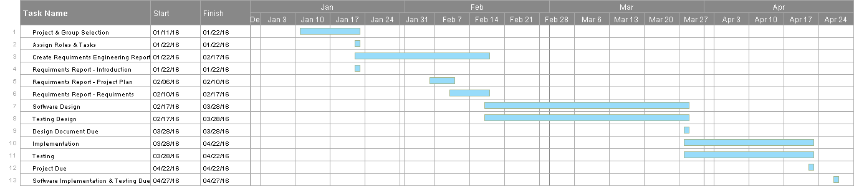
Work Breakdown Structure and Gantt Chart

Slide 4
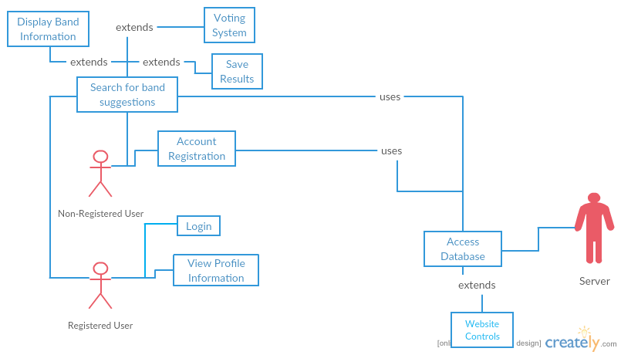
Use Case Diagram

Slide 5
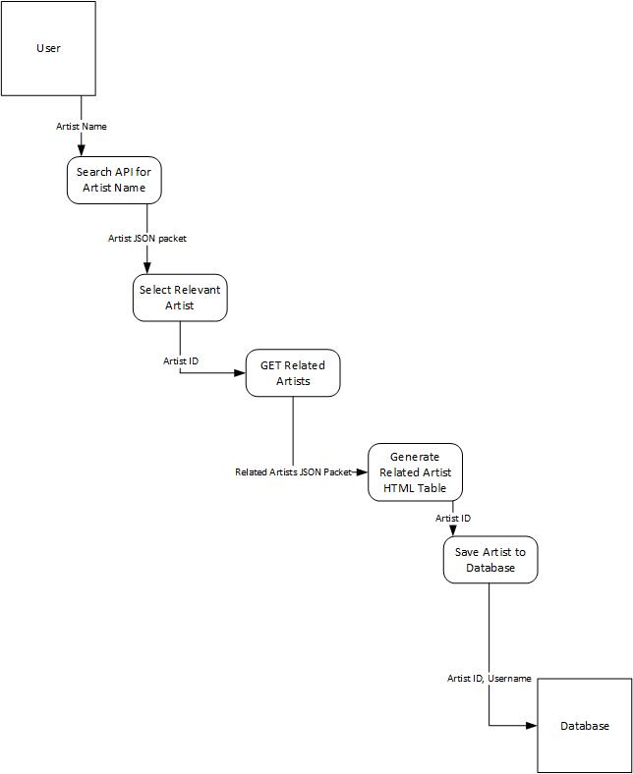
Architectural Design Model

Slide 6
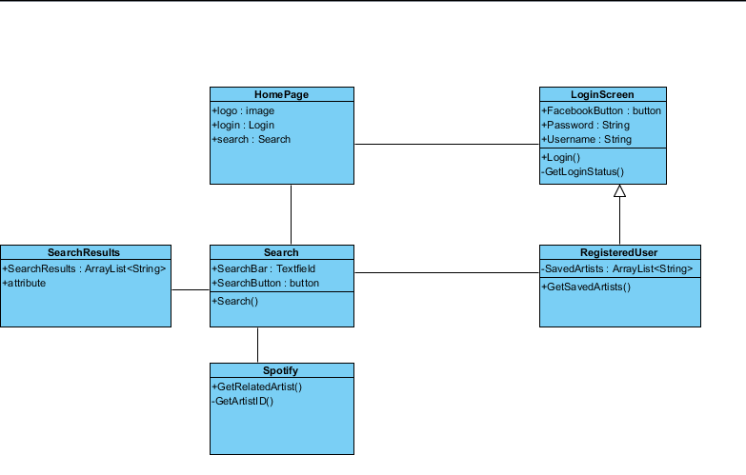
UML Class Models

Slide 7
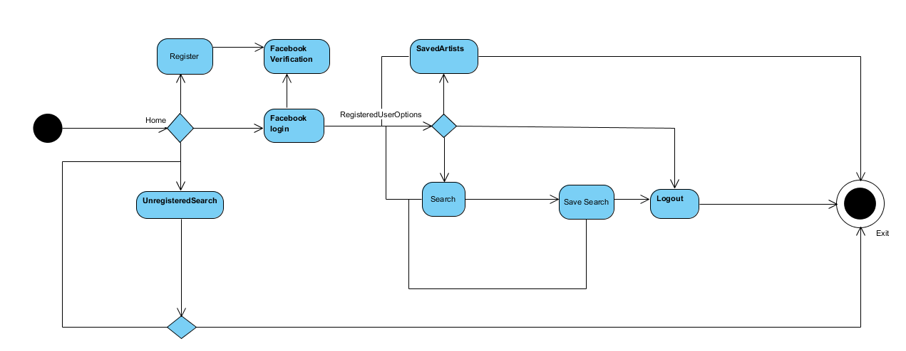
Activity Diagrams

Slide 8
Lines of Code
Our Estimate
User Interface → 460
HTML → 429
CSS → 31
Accessing Bootstrap → ???
Back End → 319
Database → 58
Auto-generated → ???
Flask
Peewee
Functions | Good LOC Est. | Average LOC Est. | Bad LOC Est.
GUI | 250 | 500 | 750
Database/API Queries | 150 | 300 | 450
Backend | 500 | 700 | 900
Log-in Support | 200 | 400 | 600
Estimated LOC (*Based on Average Case*) |  | 1900

Slide 9
Test Plan

Slide 10
Professional, Legal, and Ethical Considerations
APIs need to referenced
Biographies for artists are taken from wikipedia
May not be correct
Saving user’s information

Slide 11
Lessons Learned
Have APIs figured out before starting to code
Facebook Login
Echo Nest
Scraping from Wiki

Slide 12
PRODUCT DEMO

