Slide 1

Prescribe
By Jeremy Brown – Project Manager
Mitch Powell – Technical Lead
Branydn Deffinbaugh – Quality Assurance

Slide 2
Our Objective
Create a web application that allows users’ to search for artists
User inputs a band → App outputs list of related artists
Allow user to view artist’s biographies
Allow user to login to save search results

Slide 3
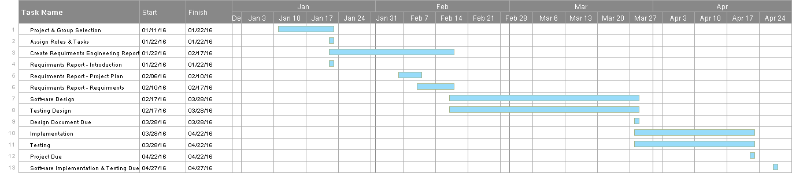
Work Breakdown Structure and Gantt Chart

Slide 4
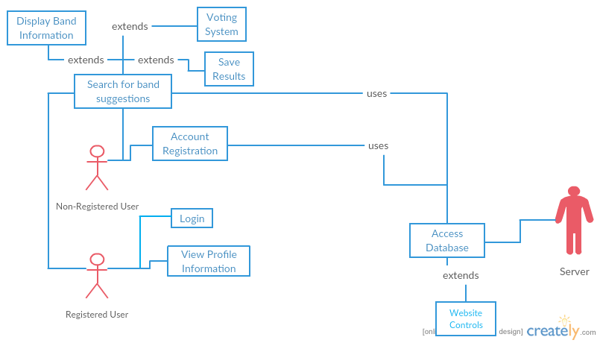
Use Case Diagram

Slide 5
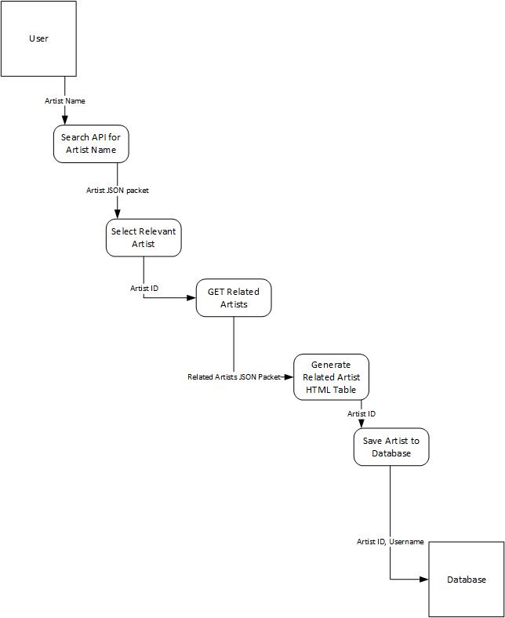
Architectural Design Model

Slide 6
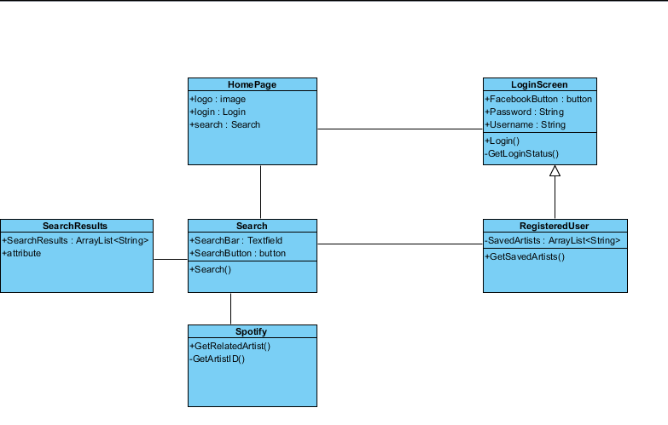
UML Class Models

Slide 7
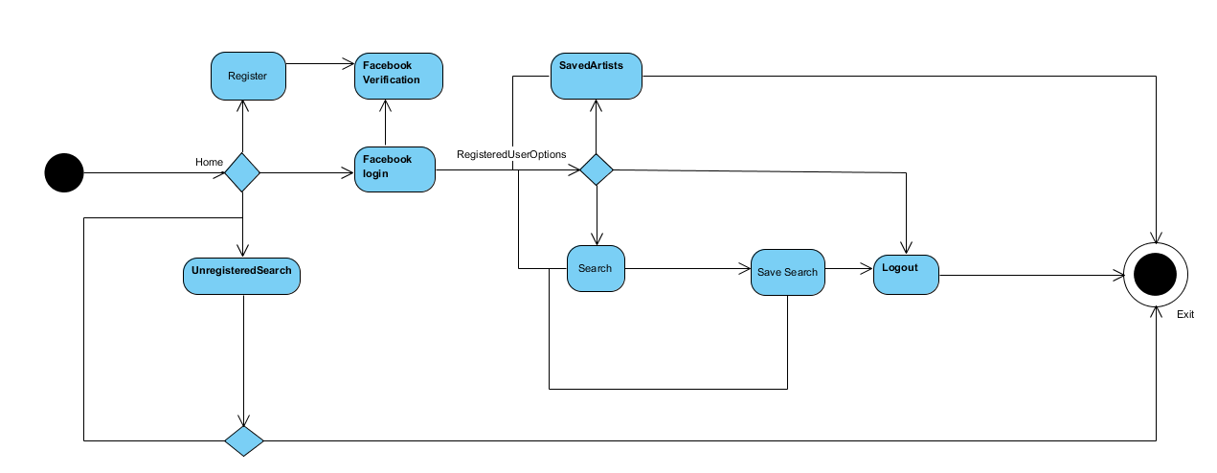
Activity Diagrams

Slide 8
Lines of Code
Our Estimate
User Interface → 460
HTML → 429
CSS → 31
Accessing Bootstrap → ???
Back End → 319
Database → 58
Auto-generated → ???
Flask
Peewee
Functions | Good LOC Est. | Average LOC Est. | Bad LOC Est.
GUI | 250 | 500 | 750
Database/API Queries | 150 | 300 | 450
Backend | 500 | 700 | 900
Log-in Support | 200 | 400 | 600
Estimated LOC (*Based on Average Case*) |  | 1900

Slide 9
Test Plan
Test # | Action | Expected Result | Actual Result | Date | Who
1 | Attempt to create user | User will be created | User was created | 20-Apr-16 | Mitch Powell
2 | Attempt to create user with pre-existing user information | It tells you that information has been used. | It returned that the information is in use by another user. | 21-Apr-16 | Jeremy Brown
3 | Search for an Artist | Returns Artist | Artist index was out of range. Fixed by increasing allowed index | 22-Apr-16 | Mitch Powell
4 | Search for an Artist that isn't in the database | Returns Artist not found | Returned Artist not found. | 23-Apr-16 | Brandyn Deffinbaugh
5 | Login with previously created user | Logs in | Logs in | 24-Apr-16 | Jeremy Brown
6 | Login with wrong information or non-created information | Returns login error | Returns login error | 24-Apr-16 | Mitch Powell
7 | Save a band while logged in | Saves the band to your saved bands | Band was saved | 24-Apr-16 | Brandyn Deffinbaugh
8 | Look at saved bands | See list of saved bands | Saved bands were found | 24-Apr-16 | Brandyn Deffinbaugh
9 | Find band biography | See biography of a band | Biography took a long time to find, but was found. Fixed runtime problem by loading biography only when needed. | 24-Apr-16 | Mitch Powell

Slide 10
Professional, Legal, and Ethical Considerations
APIs need to referenced
Biographies for artists are taken from wikipedia
May not be correct
Saving user’s information

Slide 11
Lessons Learned
Have APIs figured out before starting to code
Facebook Login
Echo Nest
Scraping from Wiki

Slide 12
PRODUCT DEMO

