Slide 1
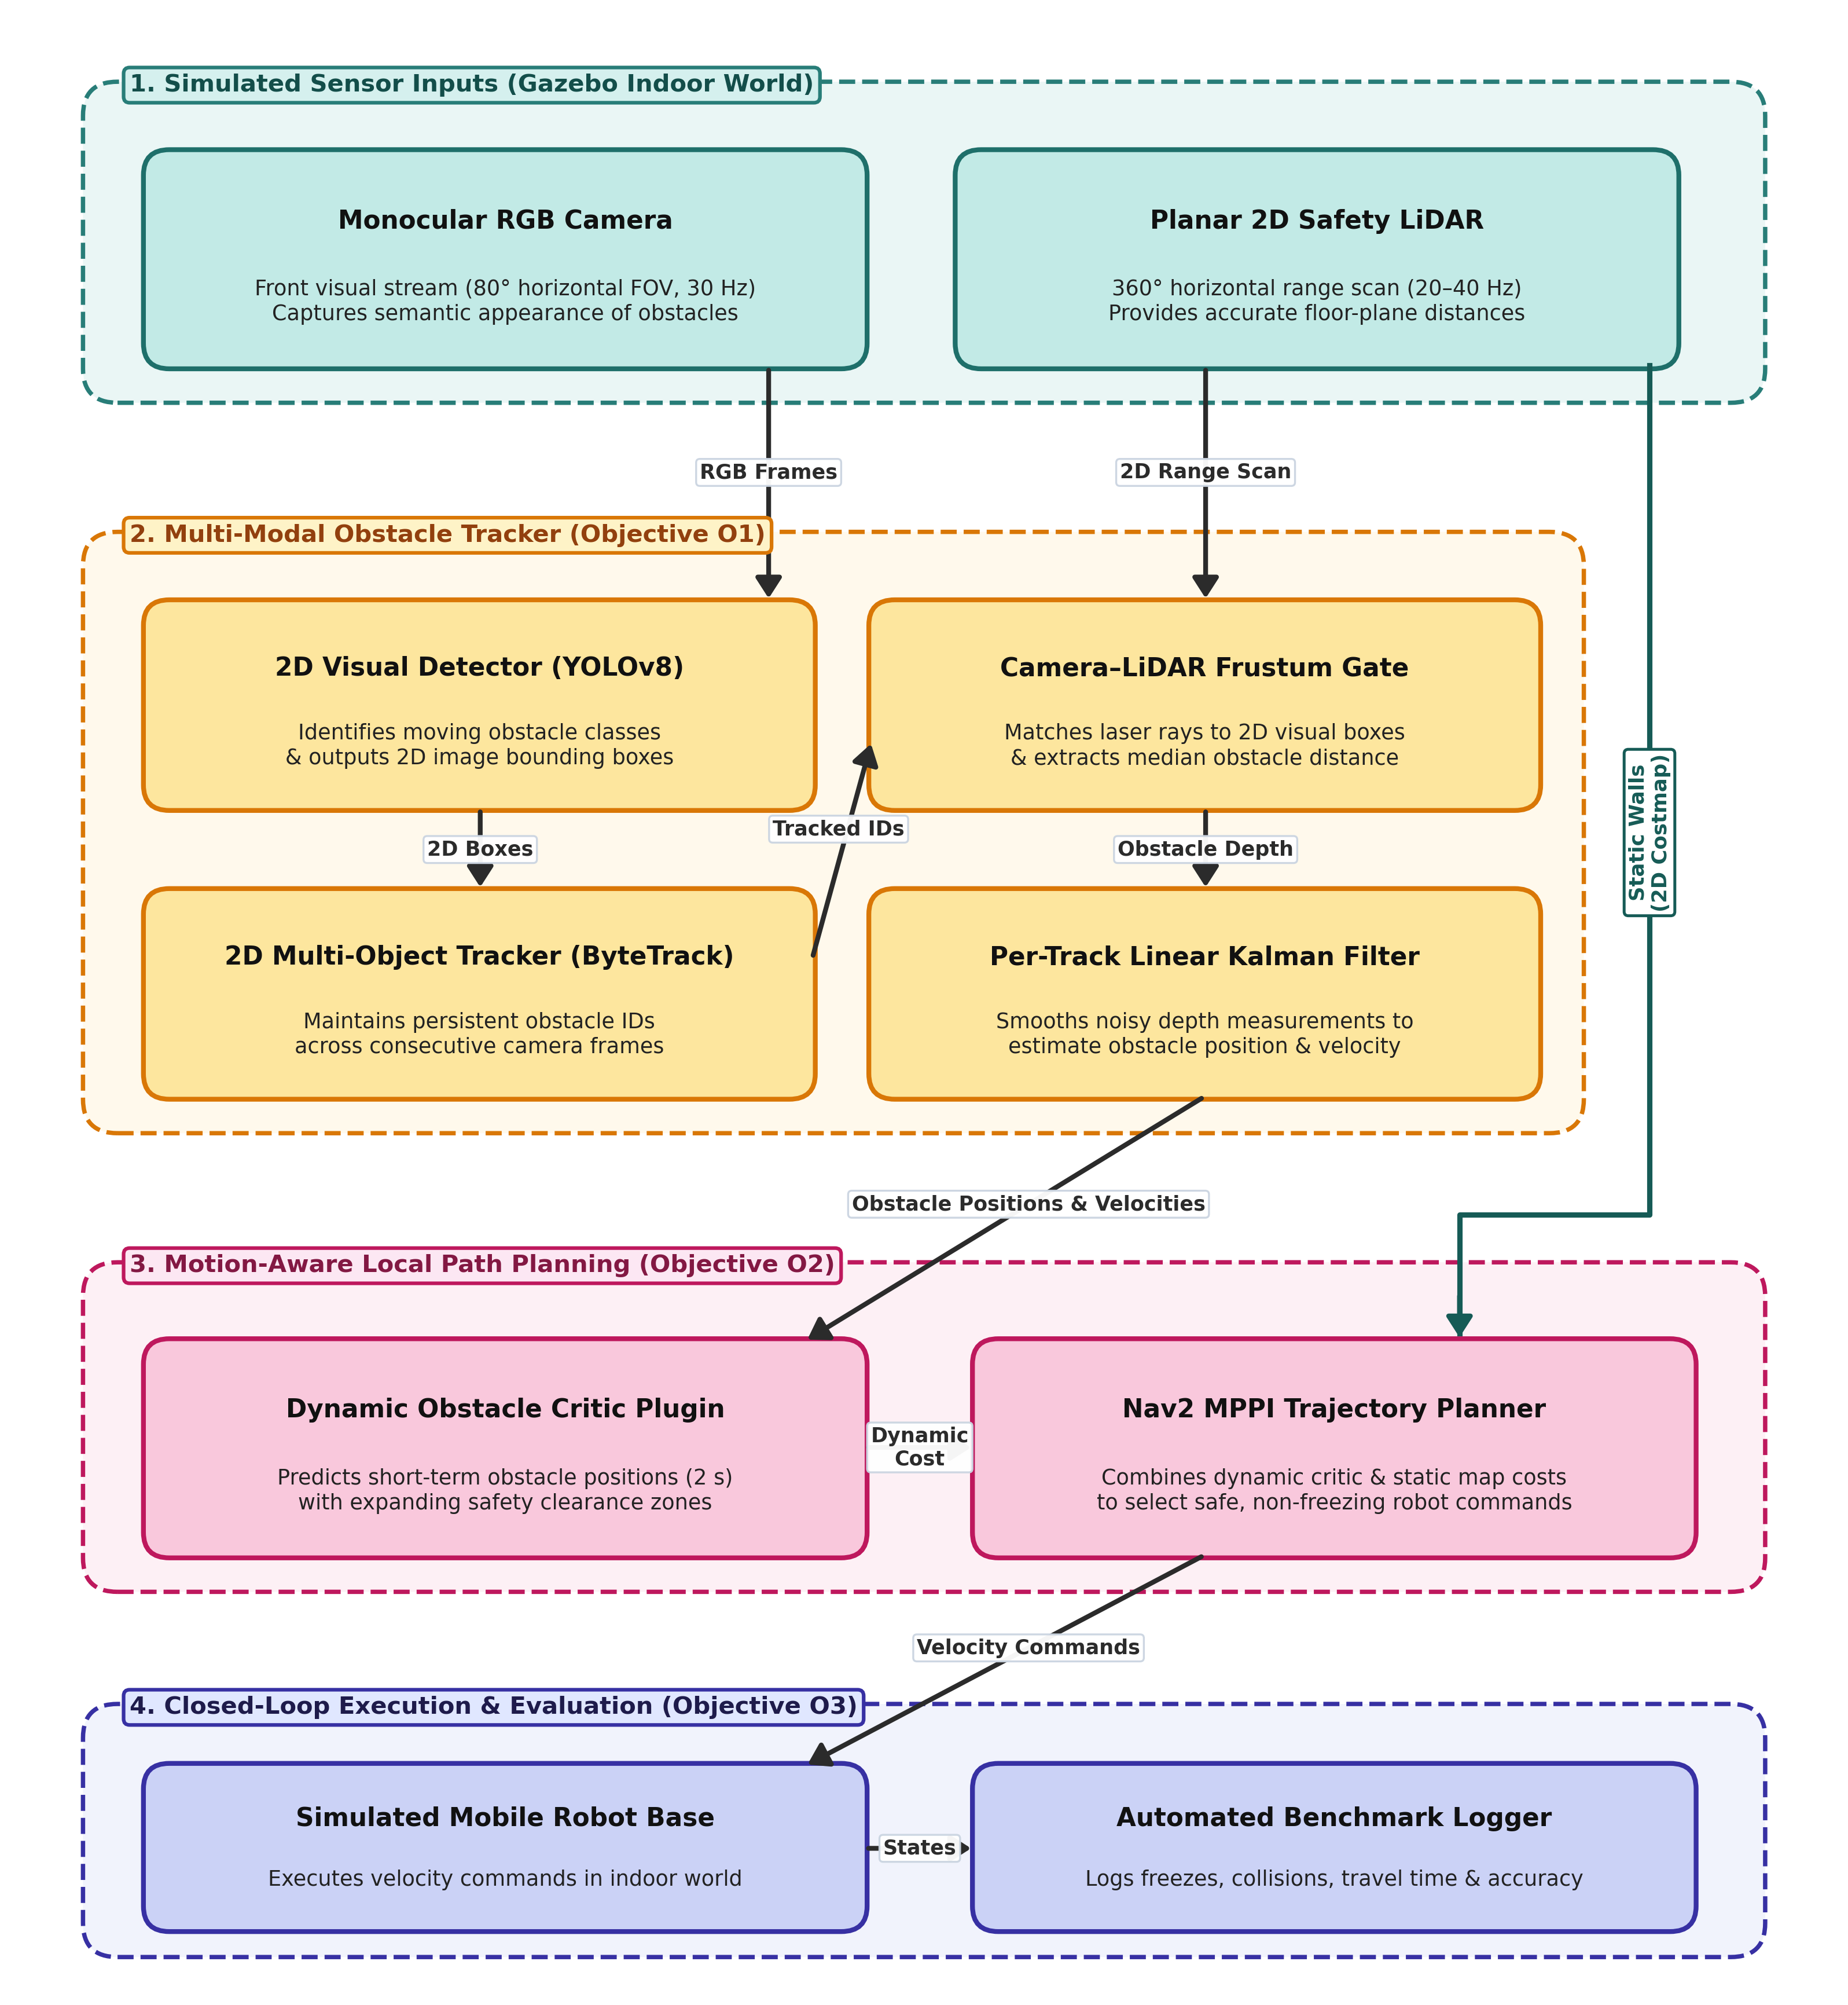
FINAL YEAR PROJECT DEFENCE | EEEE4077
Vision-Augmented Mobile Robot Navigation in Dynamic Environments
Nicholas Khor Han Le
Supervisor: Dr. Shalini Darmaraju
Moderator: Ir Dr. Daniel Pu
The problem: 2D LiDAR sees a person as two dots, so the robot freezes
The fix: Camera tracking + Kalman velocity lets MPPI steer behind them
Notes:
"Good morning Dr. Shalini, Ir Dr. Daniel Pu. My name is Nicholas Khor, and today I'm presenting the plan for my Final Year Project: 'Vision-Augmented Mobile Robot Navigation in Dynamic Environments'.
To give some quick context: in modern warehouses and factories, thousands of autonomous mobile robots share narrow aisles with human workers and carts. Most of these robots use a standard 2D safety laser scanner mounted near the floor.
The big issue with this setup is what researchers call the 'Freezing Robot Problem'. Because a 2D laser scanner only cuts across a person's legs at ankle height, the navigation system just sees two random dots. It treats those dots as an immovable brick wall. So whenever someone walks across a hallway, the robot panics, freezes in place, or spins around trying to find an exit.
My project aims to solve this freezing issue in simulation by pairing the existing 2D laser scanner with an inexpensive monocular camera.
Looking at the system architecture diagram here:
- On the left, the camera detects people using lightweight YOLO and keeps track of them across frames using ByteTrack.
- We then match the camera box with the laser scan to find exactly how far away the person is, and feed that into a Kalman filter. This gives us the person's real-time walking speed and direction.
- Finally, over on the right, we pass these predicted movements into a custom plugin for the Nav2 MPPI controller. Instead of assuming the obstacle is stuck where it is right now, the controller predicts where the person will be over the next two seconds and gently steers the robot behind them.
This lets the robot navigate smoothly around moving traffic without expensive 3D sensors and entirely on normal CPU compute."
IF YOU GET STUCK:
"In short: 2D laser alone makes the robot freeze when people cross; adding camera tracking lets the planner anticipate their motion and steer smoothly around them."

Slide 2
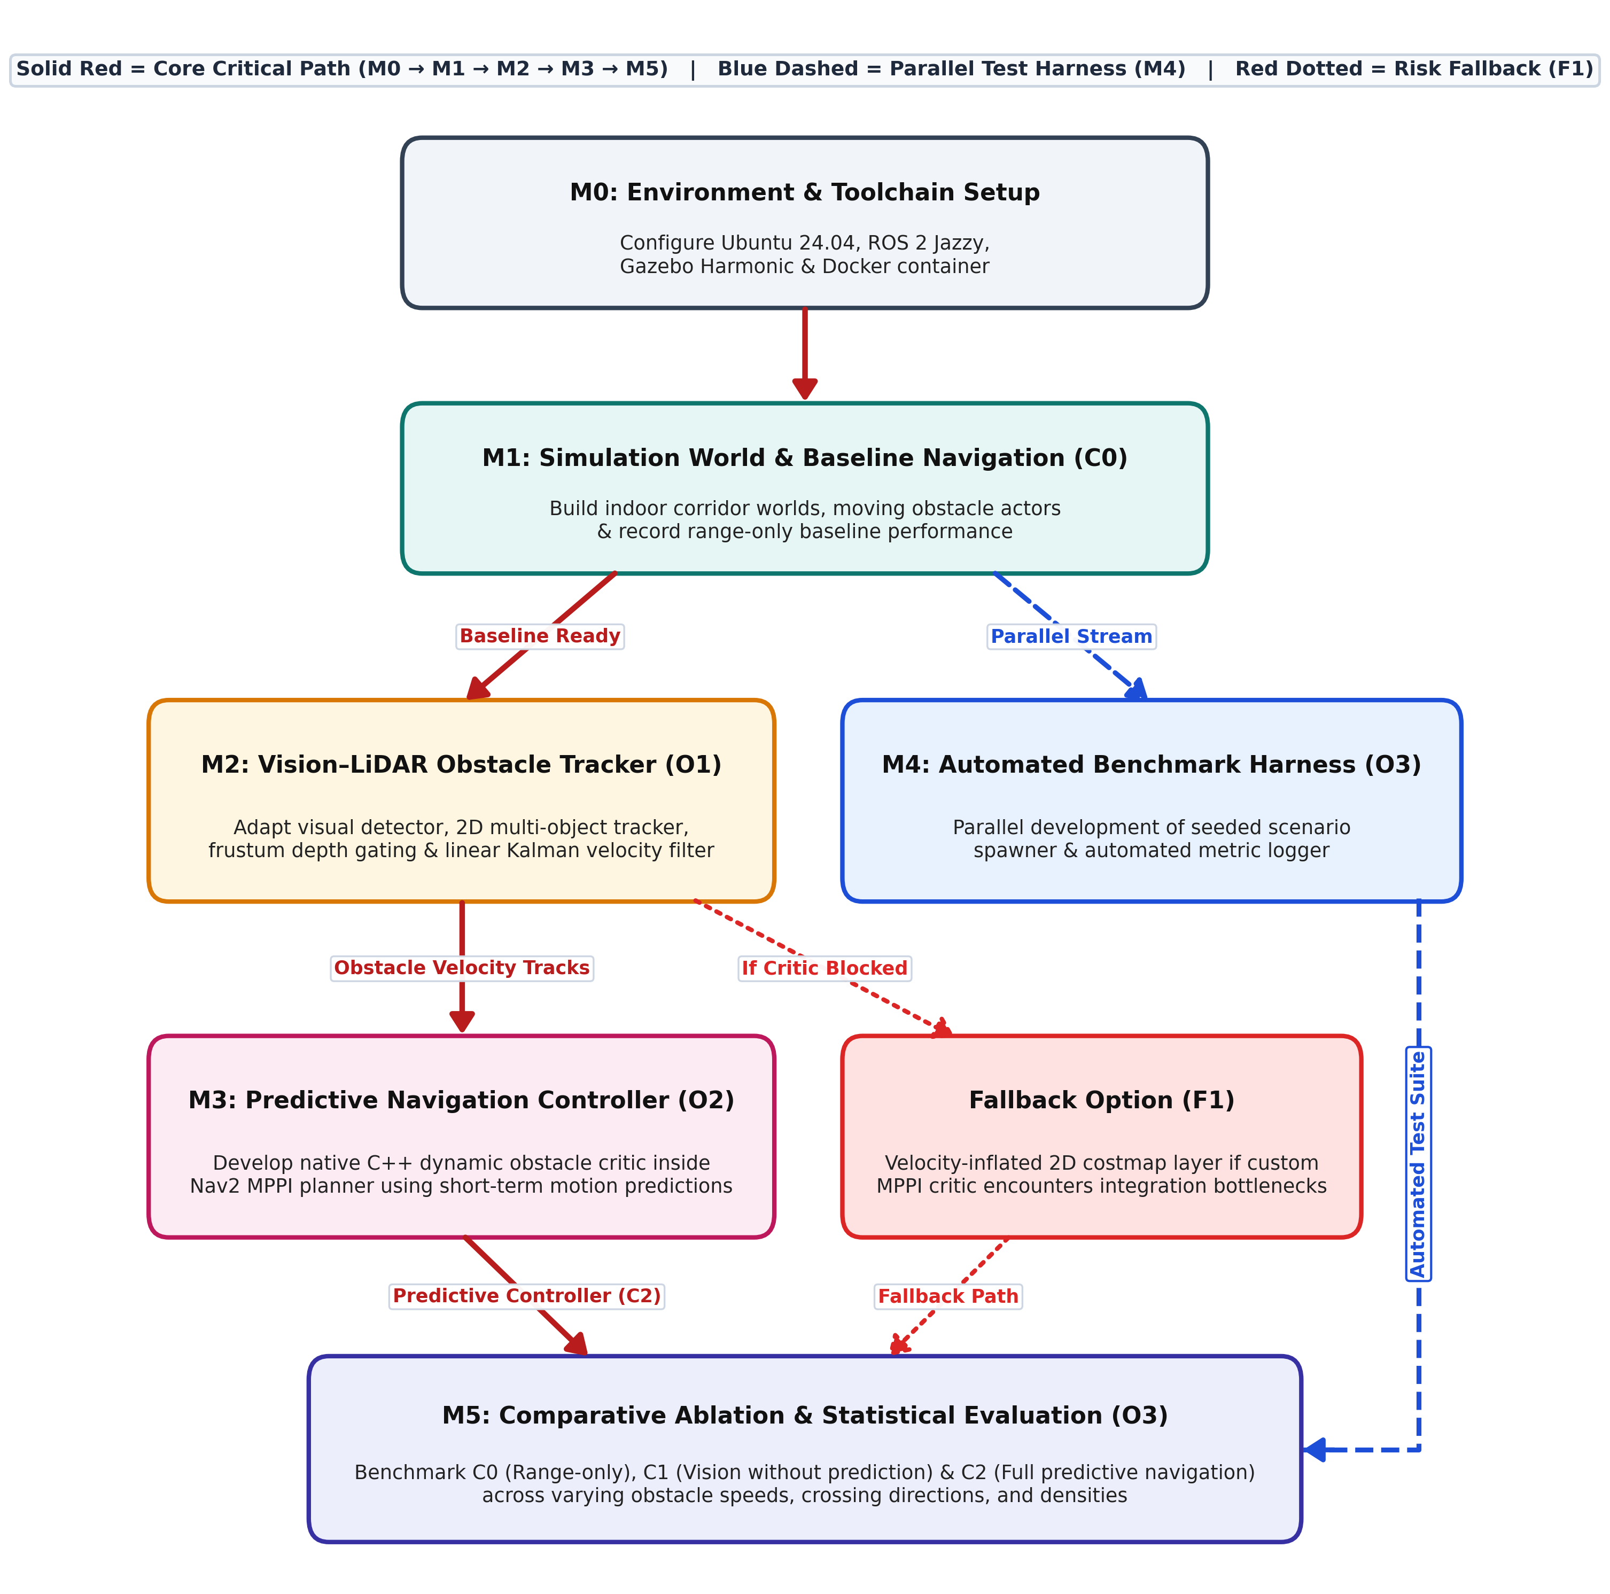
Six milestones
M0
Setup
Docker, ROS 2 Jazzy, Gazebo Harmonic
M1
Baseline (C0)
Corridor world, walking actors, measure freezing
M2
Perception (O1)
YOLOv8, ByteTrack, LiDAR depth, Kalman velocity
M3
Controller (O2)
C++ dynamic obstacle critic in Nav2 MPPI
M4
Test harness
Automated scenario runner, built in parallel
M5
Analysis (O3)
450 runs: C0 vs C1 vs C2
Fallback F1: velocity-inflated costmap if the C++ critic stalls
Notes:
"Moving on to our methodology and approach.
As shown in the workflow diagram, the project is broken down into six practical milestones, marked M0 through M5.
We follow the red critical path:
- We start in M0 and M1 by creating our simulation environment inside Docker using ROS 2 Jazzy and Gazebo Harmonic. Here, we build virtual hallway worlds, add animated walking pedestrians, and record the baseline performance—called Condition C0—to see how often the standard robot freezes when people walk past.
- Next, in M2, we build Objective O1: the perception pipeline. We use YOLOv8 for object detection and ByteTrack for multi-object tracking because they run fast on normal CPUs. We then match the camera detection box with the laser scan to find the obstacle's depth, and feed that into a Linear Kalman Filter to get clean, smoothed velocity estimates.
- In M3, we implement Objective O2: the predictive controller. We write a custom plugin in C++ for the Nav2 MPPI local planner. Every control cycle, this plugin projects where the moving person will be over the next two seconds and steers the robot safely around them.
- To make testing manageable, M4 is an automated Python testing harness that runs in parallel. It automatically spawns trials, resets the world, and logs data in the background.
- Finally, in M5, we run 450 automated test runs comparing our predictive system against the baseline, measuring collision rates, route completion times, and how many times the robot stopped or froze.
I should also mention that writing a custom C++ plugin for Nav2 is a technical challenge for me. To manage this safely, I have an early prototype scheduled for Week 13, and a complete backup plan—Fallback F1. If the C++ plugin ever gets blocked, F1 draws velocity-stretched safety bubbles directly into the existing costmap, ensuring the project finishes smoothly either way."
IF YOU GET STUCK:
"To summarize the approach: we build the perception in M2, plug it into the controller in M3, automate the testing in M4, and compare our results against the baseline in M5."

Slide 3
Four risks and mitigations
Risk | Mitigation | Score
R1 C++ MPPI plugin Hard to write or too slow | Prototype in Week 13, cap prediction at 2 s, Fallback F1 | 20 → 6
R2 Laser bleed Beams slip between legs, hit wall | Median depth in camera box, reject jumps in Kalman | 12 → 4
R3 Simulation crashes Gazebo fails during 450 runs | Docker, headless Gazebo, Python watchdog restarts | 12 → 4
R4 Occlusion Track IDs swap when people cross | ByteTrack low-confidence matching, 1 s Kalman coasting | 9 → 3
Score = Likelihood × Impact (each 1 to 5), shown before → after mitigation
Notes:
"Next is Risk Management and Mitigation.
To make sure the project finishes on schedule, I identified the four main technical risks shown in this table, rated by Likelihood and Impact on a 1-to-5 scale.
Our highest initial risk is R1, which scored a 20. This is the risk of the custom C++ MPPI controller plugin being difficult to integrate or taking too much CPU time. To prevent this, I have an early prototype scheduled for Week 13, I keep the forward prediction strictly capped at two seconds, and we have Fallback F1: if the C++ plugin ever gets stuck, we simply inject safety bubbles into the standard costmap.
Our second risk, R2, is that 2D laser rays can pass between a person's legs and hit the background wall, which would mess up our distance calculation. We fix this by taking the median depth inside the camera box and filtering out sudden jumps in the Kalman filter.
Third is R3: simulation instability during our 450 batch test runs. Running hundreds of simulation trials can sometimes crash Gazebo. We mitigate this by locking our environment in a Docker container, running Gazebo headless without graphical display to save memory, and using a Python watchdog script that automatically detects stalls and restarts the trial.
Finally, R4 covers occlusion—when two people walk past each other and block the camera view. We use ByteTrack's two-stage matching to hold onto occluded detections, and let the Kalman filter coast the obstacle forward at its last known speed for up to one second.
With these mitigations in place, every single risk drops down to a low rating, meaning the project is well-protected against unexpected setbacks."
IF YOU GET STUCK:
"The main takeaway is: our biggest technical risk is the C++ plugin, but we have early prototyping and a clear costmap backup plan so the project is fully protected."

Slide 4
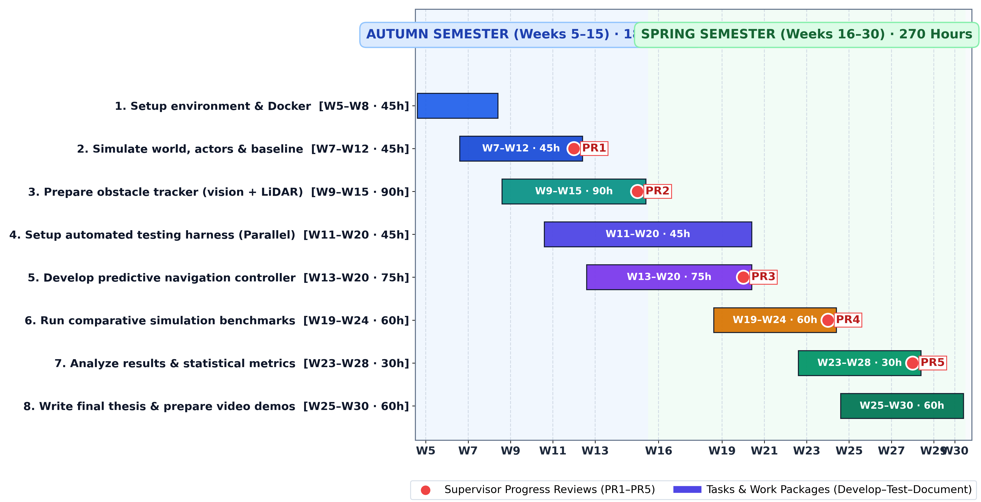
Planned Work Schedule
450
planned hours
16 to 18
hours per week
PR1 to PR5
supervisor reviews
2 weeks
thesis buffer
Notes:
"Finally, here is our planned work schedule and project timeline.
Our project officially began with topic allocation in Week 5 and runs until Week 30, so there are no Weeks 1 to 4 on this chart. That gives us 26 active project weeks and a total of 450 planned working hours.
This breaks down very comfortably across both semesters:
- In the Autumn semester—shown in blue—we have 180 hours, which is about 16 hours a week. Here, we set up our Docker environment, build our simulation corridor, record our baseline C0 metrics, and build the vision-laser tracker.
- In the Spring semester—shown in green—we have 270 hours, or about 18 hours a week. This is where we develop our predictive MPPI controller, run our comparative benchmarks, and write the thesis.
An average of 16 to 18 hours a week is very manageable alongside my fourth-year lecture modules and courseworks.
To keep our progress on track and stay aligned with Dr. Shalini, the schedule is anchored by five formal supervisory progress reviews, marked as PR1 through PR5 in red:
- At PR1 in Weeks 11 to 12, we review the baseline corridor simulation.
- At PR2 in Weeks 13 to 15, we demonstrate the multi-modal tracker publishing live obstacle speeds.
- At PR3 in Weeks 19 to 20, we demonstrate the closed-loop controller steering smoothly behind moving people.
- At PR4 in Weeks 23 to 24, we review our full 450-trial benchmark dataset.
- And at PR5 in Weeks 27 to 28, we review our statistical plots and thesis draft.
To make sure we don't get rushed at the end, Task 4—our automated testing harness—runs in parallel across Weeks 11 to 20. By the time our controller is ready, the testing scripts will already be tested and waiting, allowing us to run our 450 trials automatically overnight.
All simulation experiments finish by Week 28, giving us a dedicated two-week buffer before the final deadline in Week 30 to polish the dissertation and produce video demonstrations.
Thank you very much for your time, and I'd be happy to answer any questions."
IF YOU GET STUCK:
"In summary: the project runs from Week 5 to 30, averaging 16 to 18 hours a week, with 5 checkpoints with Dr. Shalini and a 2-week buffer before final submission."

