Slide 1
SECURITY, WITH A SAFETY CATCH
SecClaw
GB10
Local security operations that can explain, ask, act, and prove.
Local AI.
Human authority.
Verifiable results.
Dell × NVIDIA AI Hackathon • San Francisco • 2026
Built for enterprise IT and SecOps teams
All inference runs locally on the GB10

Slide 2
THE PROBLEM
Security teams are stuck between speed and control.
Sensitive infrastructure data should stay on site. Remediation needs explicit authorization.
01
02
03
Blind spots
Cloud exposure
Unsafe automation
Small IT teams cannot continuously inspect every internal device and exposed service.
Topology, versions, findings, and conversations are too sensitive for remote LLM workflows.
A plausible suggestion is not permission to change production state.

Slide 3
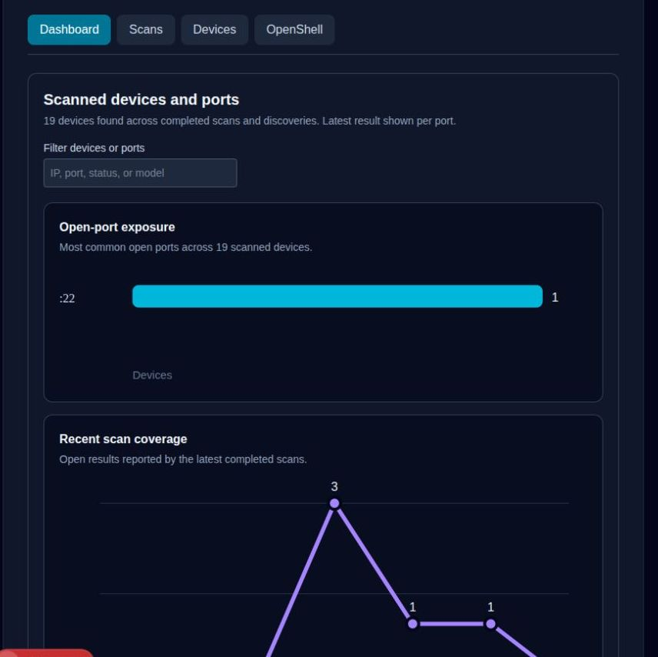
SECClaw live product evidence
Unified Security Dashboard
●
19 unique devices consolidated in PostgreSQL
●
Live exposure and scan coverage charts
●
One inventory shared across every workflow
LOCAL FIRST • POLICY GOVERNED

Slide 4
THE ASK
Let SecClaw watch the risk while humans keep the authority.
Built today on Dell Pro Max with GB10
gpt-oss-120b • vLLM • OpenShell • Next.js • PostgreSQL
github.com/cupertinose/SecClaw

Slide 5
THE SOLUTION
Discover. Explain. Approve. Act. Verify.
SecClaw turns observations into controlled action, with local reasoning on GB10.
1
2
3
4
5
DISCOVER
EXPLAIN
APPROVE
ACT
VERIFY
Fixed, scoped scans and mDNS inventory
Evidence grounded local risk analysis
Human decision bound to a plan hash
OpenShell sandbox with explicit policy
Rescan results and preserve an audit trail

Slide 6
ARCHITECTURE
Everything important stays on the Dell Pro Max with GB10
128 GB unified memory supports the local model and full application stack.
SECCLAW DASHBOARD
Next.js • PostgreSQL • structured audit timeline
AGENT + POLICY
Scoped tools • approval gate • plan hashing • rollback
LOCAL INFERENCE
gpt-oss-120b via vLLM • no cloud LLM calls
GUARDED EXECUTION
OpenShell sandbox • read-only inventory • network policy

Slide 7
LIVE DEMO
From exposed service to verified remediation
The walkthrough shows the working system, including the refusal path.
1
Scope
Admin authorizes a host, ports, time window, and policy.
2
Detect
SecClaw finds an exposed service and preserves evidence.
3
Reason
Local gpt-oss-120b proposes safe validation.
4
Approve
A human reviews the change summary and plan hash.
5
Act + verify
OpenShell acts under policy; a rescan confirms the outcome.

Slide 8
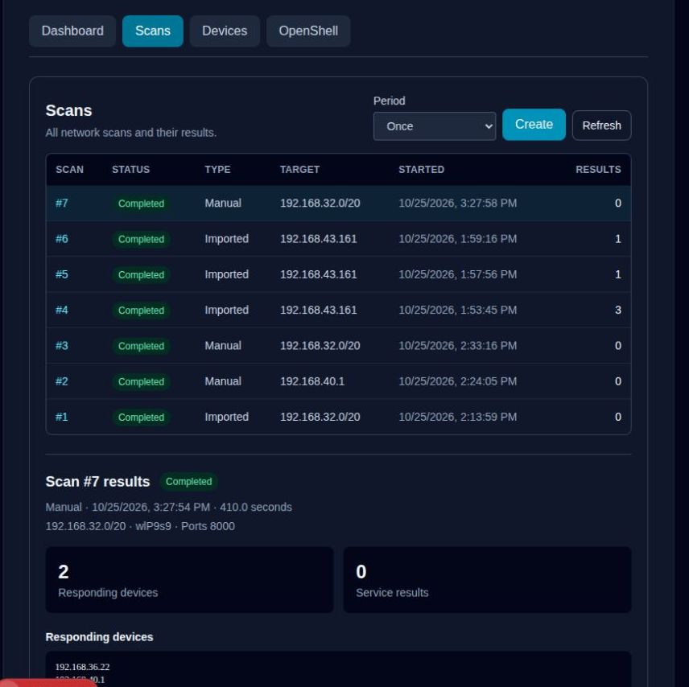
SECClaw live product evidence
Auditable Scan History
●
Manual, imported, and scheduled scans
●
Responding hosts and service evidence
●
Every completed result persists to PostgreSQL
LOCAL FIRST • POLICY GOVERNED

Slide 9
BUSINESS VALUE
A security analyst in a box, with humans in charge.
Reduce time to understand and remediate while preserving accountability.
LOCAL
SAFE
FAST
Private by design
Approval gated
One workflow
Infrastructure evidence and inference remain on premises.
Every state change is scoped, time bound, and auditable.
Discovery, explanation, verification, and rollback live in one place.

Slide 10
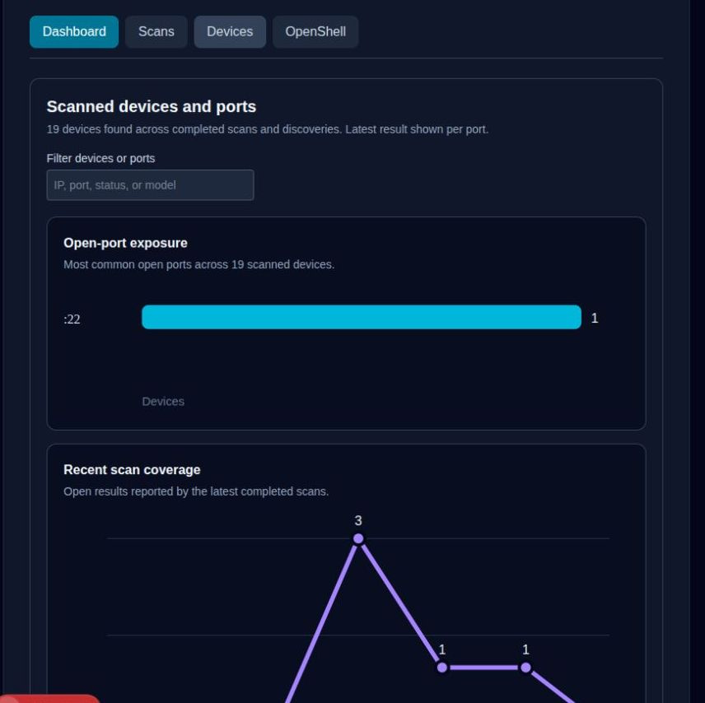
SECClaw live product evidence
Device Discovery & Actions
●
mDNS hostnames and advertised services
●
19 device unified inventory
●
One click remediation and SSH reporting
LOCAL FIRST • POLICY GOVERNED

Slide 11
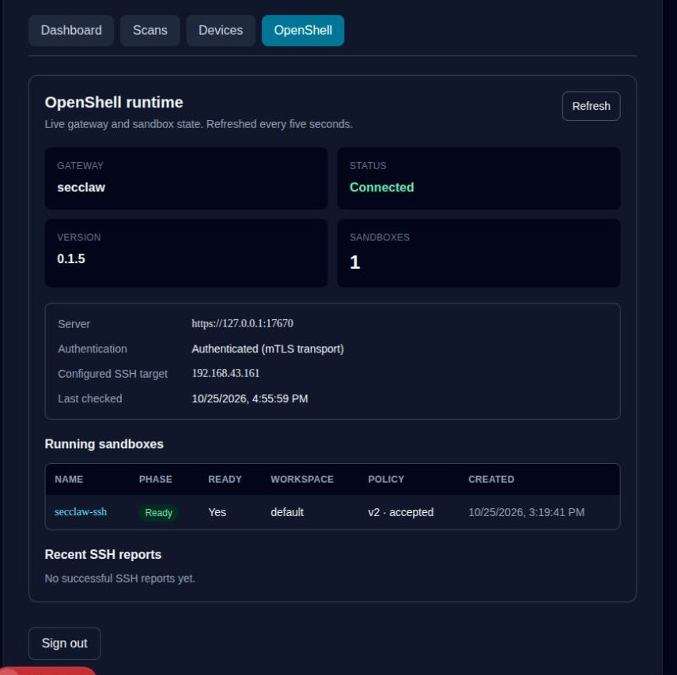
SECClaw live product evidence
OpenShell Governed SSH
●
Gateway connected with mTLS transport
●
Sandbox ready under accepted policy v2
●
Configured SSH target: 192.168.43.161
LOCAL FIRST • POLICY GOVERNED

