Slide 1

Health & Safety I HS100 – DAILY DEVOTION
HS100.01-Personal Awareness
https://kowear.org/course/health-safety-i/
Prepared by Elliot KAB Yamoah
Diploma in Management Studies 2019
+233-024-288-4262
eltkabymh@kowear.org
For Ghana Police Church YPG
03/11/2019

Slide 2
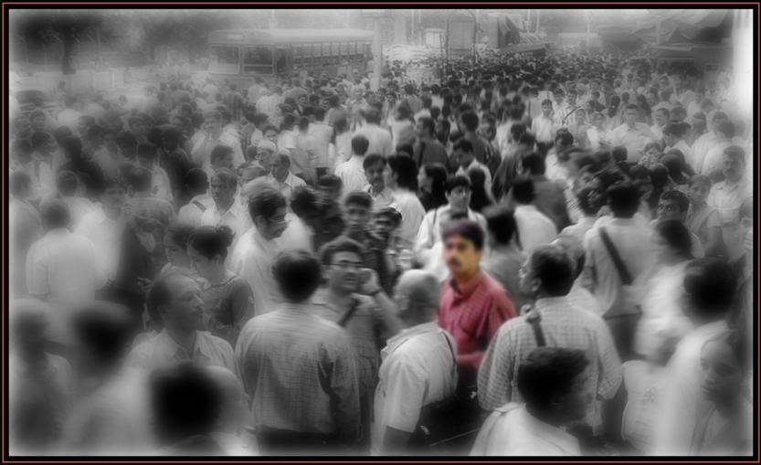
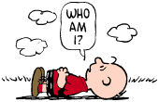
Personal Awareness
Consciousness
Skill

Slide 3
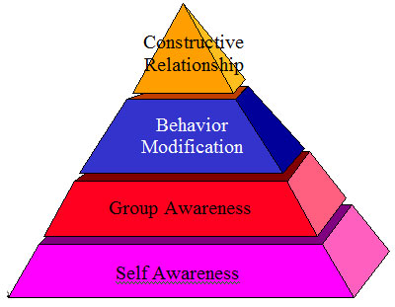
Types of Self-Awareness
Public Self-Awareness
Private Self-Awareness
Self-Consciousness;
A Heightened State of Self-Awareness
Ego Complex
Existence Level of Communication
Aggression Level of Communication

Slide 4
The Johari Window
Known Self Things we know about ourselves and others know about us. | Hidden Self Things we know about ourselves that others do not know.
Blind Self Things others know about us that we do not know. | Unknown Self Things neither we nor others know about us.

Slide 5
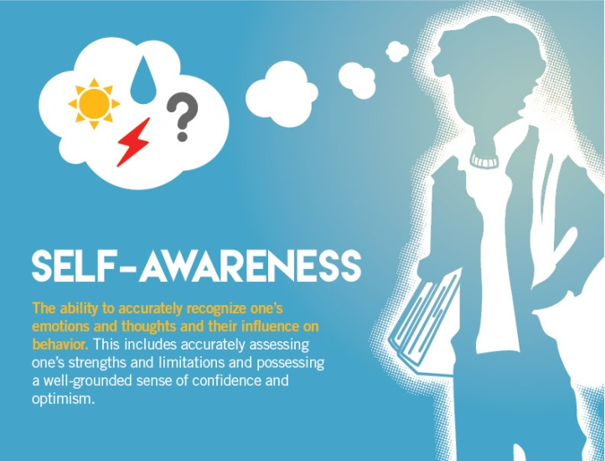
Key Areas for Self-Awareness
Personality
Values
Habits
Needs
Emotions

Slide 6
Self-Awareness and Effectiveness
Can greatly affect a person's mood or persona
Can improve health and a person's wellbeing
Skill development
Knowing your strengths and weaknesses
Developing intuitive decision-making skills
Stress
Motivation
Leadership

Slide 7
Developing Self Awareness
Discovery Level of Communication
Progressive Processes
Regressive Processes

Slide 8

Practicing This Management Skill
Practising personal awareness activities frequently can produce physically evident results.
Ask somebody
Questionnaires
Seek professional help

Slide 9
Try this Challenge: Meditation
Refreshed Breathing: Physical-Qigong Breathing:
Aligned Flow: Etheric Emotion-Balanced Emotions:
Eight Flex Resolves: Mental -Resolving blockages:
Eternal Pulsation: Psychic –Being at peace:
Spiral Expansion: Casual Karmic –Expanding self-awareness:
Channelled Aspirations: Individuality Essence -Channelling chi in the body:
Tantien Harmony: Patience – Synchronizing Tantiens:
The Eight Virtues: Unity –The Eight Virtues:

Slide 10
Summary
Self-awareness involves being aware of different aspects of the self including traits, behaviours, and feelings. Essentially, it is a psychological state in which oneself becomes the focus of attention. Once you begin to understand this concept you then have the opportunity and freedom to change things about yourself, enabling you to create the life that you want. It is almost impossible to change and become self-accepting if you are unsure as to who you are. It is empowering and gives the confidence to make changes.
Having awareness creates the opportunity to make changes in behaviour and beliefs; it is the first step in creating what you want and mastering your life. Where you focus your attention, your emotions, reactions, personality and behaviour determine where you go in life. Having self awareness allows you to see where your thoughts and emotions are taking you. It also allows you to take control of your emotions, behaviour, and personality so you can make the changes you want. Until you are aware in the moment of your thoughts, emotions, words, and behaviour, you will have difficulty making changes in the direction of your life.

Slide 11
End of Session
Thank you

