Slide 1
Design Issues in Hybrid Embedded Systems
Irvin R. Jones Jr., Ph.D.
United States Air Force Academy
Systems Engineering
Irvin.Jones@usafa.edu

Slide 2
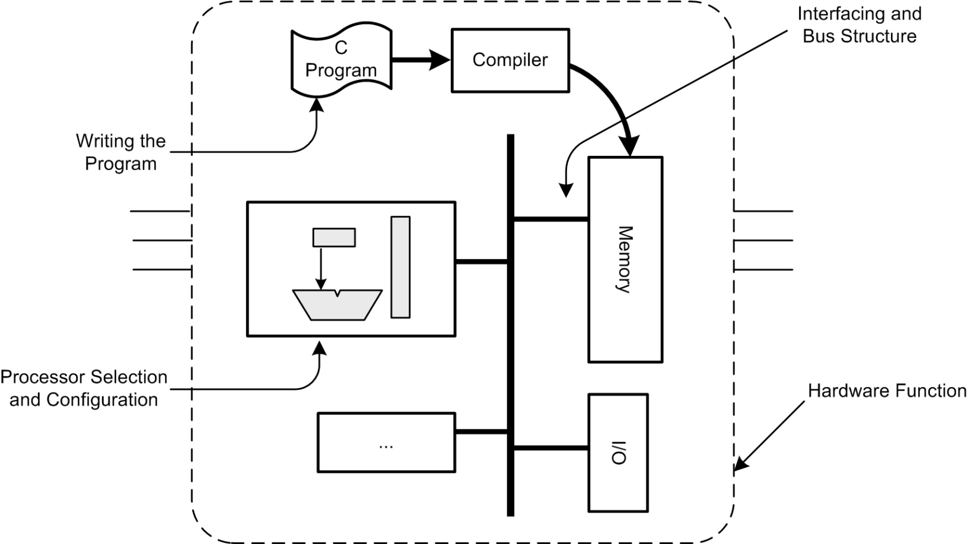
Embedded System Design Steps
Hardware Function Implemented by Embedded Processor

Slide 3
The “Push”
Increasing performance demands have exceeded the capabilities of conventional single processors in providing effective solutions.
Solution: multiprocessors or co-processors.
“Core-based design” drives multiprocessor implementation. With soft-core processors designers have a diversity of options to meet the cost/performance needs of a system.
High clock speeds require expensive semiconductor process technologies, precision board layout and manufacturing, and sophisticated heat removal to handle increased power demands.

Slide 4
Embedded Computing Platform
Types of Processors:
Microprocessor – an integrated circuit (IC) implementation of a computer’s CPU, e.g. Pentium, Power PC, SPARC.
Integrated processor – a microprocessor or processing device with integrated peripherals
• single board computers
• FPGA (Field Programmable Gate Array): softcore and hardcore
• Customized hardware with high NRE: ASIC (Application Specific
Integrated Circuit) / SOC (System-on-a-Chip) /
ASIP (Application Specific Instruction-set Processor)
• DSP (Digital Signal Processor) – a type of ASIP designed to perform
common operations on digital signals.
Microcontroller – an IC that includes a microprocessor and I/O subsystems, but may or may not include a memory subsystem.

Slide 5
Hybrid Embedded System
A hybrid embedded system is an embedded system with at least one processor that implements a hardware function that is part or all of the embedded system. This implies multiple (heterogeneous) processors and/or multiple (heterogeneous) processing cores.
Advantages to this approach are
Design flexibility
Design customization
Design Issues:
Partitioning of a system into hardware and software components is less distinct.
Determination and implementation of system timing, synchronization, and control are more complex.

Slide 6
Definitions and Terms
Multiprocessor – a computer that has more than one processor. Multiprocessing is a programming technique that uses more than one processor to perform work concurrently.
Multiprogramming – a scheduling technique that allows more than one job (or process) to be in an executable state at any one time. In a multiprogrammed system, all processes share the system resources.
Parallel Computing/Processing – a form of computation in which many calculations, tasks, or instructions are carried out simultaneously. A parallel computer or processor has hardware that supports parallelism.
Thread – a sequence or stream of executable code within a process that is scheduled for execution by the operating system on a processor or core. All processes have a primary thread or flow of control. A process with multiple threads is multithreaded. Each thread executes independently and concurrently with its own sequence of instructions.
Multicore – an architecture that places multiple processors on a single die (i.e. chip). Each processor is called a core. Also known as Chip Multiprocessors (CMPs) or single chip multiprocessors.
Hybrid Multicore Architecture – a mix of multiple processor types and/or threading schemes on a single package.

Slide 7
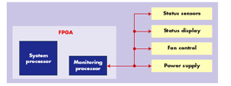
Embedded Multiprocessing Architectures
(Independent Processors)
Use of independent processors, each dedicated to performing a single function.
Typical system would have a main processor to handle the application code (e.g. receiving and processing data) with secondary processors to handle system functions.
Best for applications that require little coordination between tasks.

Slide 8
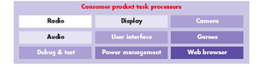
Embedded Multiprocessing Architectures
(Multiple Distributed Processors)
The assignment of individual processors to major tasks that would otherwise be running on one embedded processor. In the consumer product example (shown above), a complex application has tasks that independent and exchange substantial amounts of data.
Instead of using a single high-performance processor, this approach uses a collection of processors each matched in performance to the task requirements.
Benefits: lower power consumption, better design reuse, reduced software complexity, better software maintainability, and simpler software debug.

Slide 9
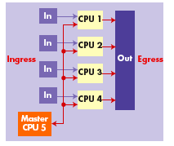
Embedded Multiprocessing Architectures
(Channelization)
Multiple processors on a single chip each dedicated to handling a portion of the over all channel throughput.
Each processor may run the exact same code (parallelism) or change algorithms on the fly to adapt to system requirements.
The master processor handles general housekeeping such as initialization, and error handling.
This approach achieves high data throughput, and offers scalability by increasing the number of channels.

Slide 10
Embedded Multiprocessing Architectures
(Coprocessor)
Use an ordinary CPU as an additional processor. This can be a fixed device or a soft core on an FPGA. Developers program the device to handle tasks off-loaded from the main processor.
Use application-specific logic as the coprocessor. Examples: graphics processor for high-performance displays, or a DSP to handle audio or image processing.
Use hard-wired logic for high speed execution of a specific operation. The logic can be fixed in silicon or programmed on an FPGA.
Use hardware acceleration also known as algorithmic IP (Integrated Processor). Examples: graphics accelerator, floating point accelerator, Freescale QUICCEngine – implements different communication protocols.

Slide 11
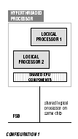
Multicore Architectures
A hyperthreaded processors allows two or more threads to execute on a single chip.
The processors are logical not physical (i.e. a single processor running multiple threads). There is some sharing of hardware.

Slide 12
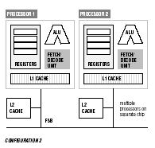
Multicore Architectures
Classic multiprocessor, each processor is on a separate chip with its own hardware.

Slide 13
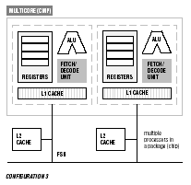
Multicore Architectures
Current trend; complete processors on a single chip

Slide 14
Challenges to Hybrid Embedded Design
Software decomposition into instructions or sets of tasks that need to execute simultaneously.
Communication between two or more tasks that are executing in parallel.
Concurrently accessing or updating data by two or more instructions or tasks.
Identifying the relationships between concurrently executing pieces of tasks.
Controlling resource contention when there is a many-to-one ratio between tasks and resources.
Determining optimum or acceptable number of units that need to execute in parallel.
Creating a test environment that simulates the parallel processing requirements and conditions.
Recreating a software exception or error in order to remove a software defect.
Documenting and communicating a software design that contains multiprocessing and multithreading.
Implementing the operating system and compiler interface for components involved in multiprocessing and multithreading.

Slide 15
Embedded System Design Flow
Hardware/Software Partitioning
Hardware Part
Software Part
Interconnection Specification
Common Hardware/Software Simulation
Hardware Synthesis
Software Compilation
Interconnection Hardware Generation

Slide 16
Hybrid Embedded System Design Flow
Design flow: Implement hardware functions in hardware/software then merge the result into one hardware realization.
To do this
Hardware/Software partitioning
Implement the hardware (generally on an FPGA)
Software is compiled into the machine language of the given processor
Interconnect hardware and software components (e.g. bus, wire)
Test, verify and validate the system.

Slide 17
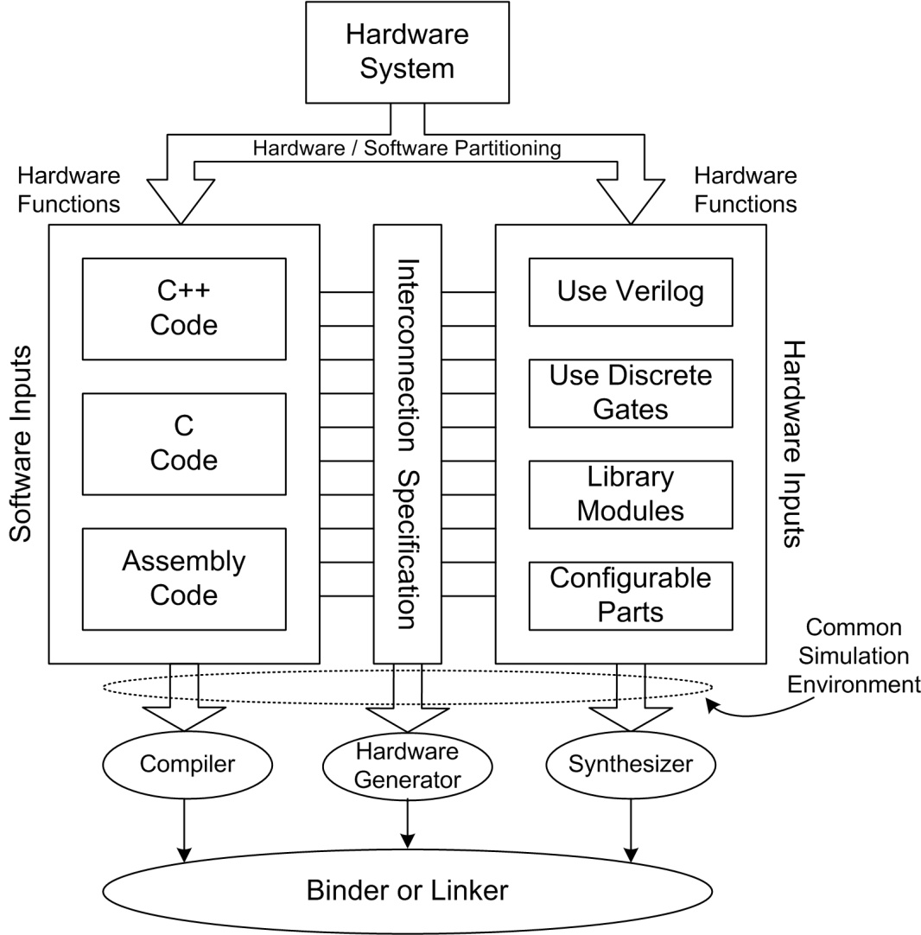
Hybrid Embedded System Design Flow

Slide 18
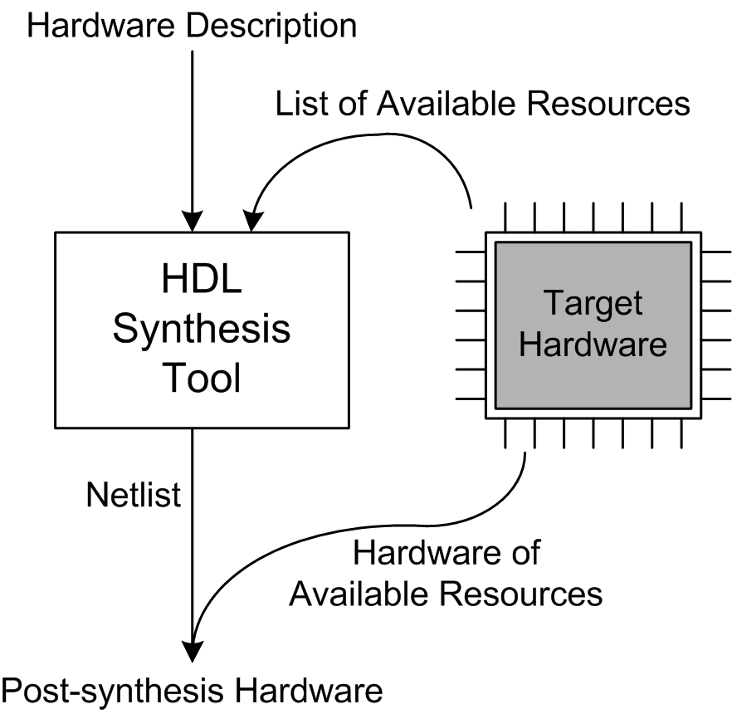
Hybrid Embedded System Design Flow
Hardware Synthesis

Slide 19
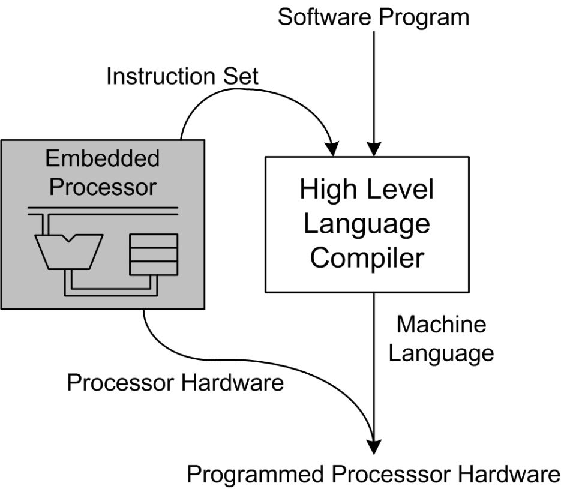
Hybrid Embedded System Design Flow
Software Compilation

Slide 20

Hybrid Embedded System Design Flow
Interconnection Hardware Generation – (bussing and communication) this hardware is automatically generated by the design environment.
Design Integrator – the binder or linker that integrates the hardware, software, and bus structures.

Slide 21
Design Tools
Block Diagram Description
HDL and Other Hardware Simulators
Programming Language Compilers
Netlist Simulator
Instruction Set Simulator
Hardware Synthesis Tool
Compiler for Machine Language Generation
Software Builder and Debugger
Embedded System Integrator

Slide 22
Multicore Programming Problems
Parallel programming has been around for decades. Problems are classified as a timing, a synchronization, or a control issue.
Common problems are:
Too many threads.
Data races.
Deadlocks and livelocks.
Heavily contended locks.

Slide 23
Too Many Threads
Too many threads degrade program performance. Impact in two ways:
Partitioning a fixed amount of work among too many threads gives each thread too little work so that the overhead of starting and terminating threads overshadows the useful work (a.k.a. granularity problem).
Having too many concurrent software threads incurs overhead from having to share fixed hardware resources.

Slide 24
Too Many Threads (cont.)
When there are more software threads than hardware threads, the operating system typically resorts to round robin scheduling.
Time slicing ensures that all software threads make some progress. Otherwise, some software threads might hog all the hardware threads and starve other software threads.
Equitable distribution of hardware threads incurs overhead. When there are too many software threads, the overhead can severely degrade performance.
• Saving and restoring a threads register state.
• Thrashing virtual memory (i.e. software thread use virtual
memory for stack and private data structures).

Slide 25
Too Many Threads – Solutions
Use a thread pool. A thread pool is a collection of tasks which are serviced by the software threads in the pool. Each software thread finishes a task before taking on another.
Thread pools eliminate the overhead of initialization process of threads for short lived tasks.
Ex. Windows: QueueUserWorkItem()
Clients add tasks by entering items on the work-queue
with a callback and a pointer that define the task.
Write your own task scheduler. The method of choice is work stealing. When a thread runs out of tasks, it steals from another thread’s collection.
This balances the workload on the system.

Slide 26
Data Races

Slide 27
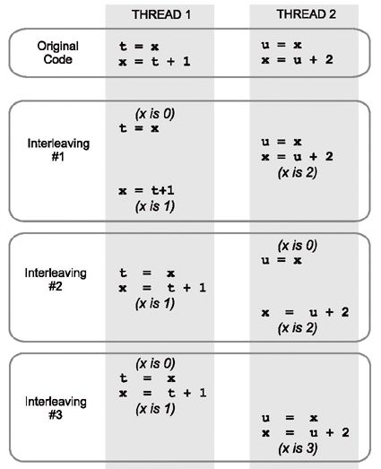
Data Races
Unsynchronized access to shared memory introduces race conditions.
Program results are nondeterministic, due to the relative timing between two or more threads

Slide 28
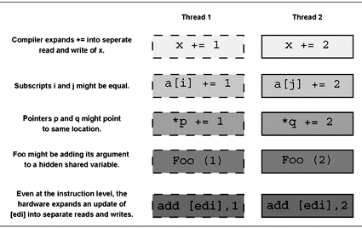
Data Races
Data races can be hidden by language syntax.
x += 1; is shorthand for temp = x; x = temp + 1;
Care must be taken such that reads and writes are atomic.

Slide 29

Data Races
Data races can arise not only from unsynchronized access to shared memory, but also from synchronized access that was synchronized at too low a level.
The example below uses a list to represent a set of keys. Each key should be in the list at most once. Even if the individual list operations have safeguards against races, the combination suffers a higher level race.
If two threads both attempt to insert the same key at the same time, they may simultaneously determine that the key is not in the list, and then both would insert the key. What is needed is a lock that protects not just the list, but that also protects the invariant "no key occurs twice in list."

Slide 30
Deadlock

Slide 31
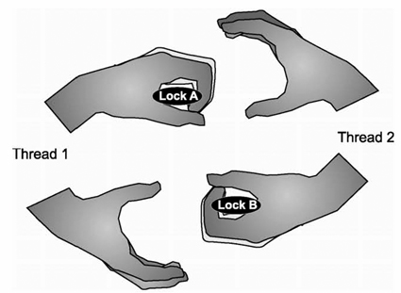
Deadlock
A lock is used to protect an invariant that might otherwise be violated by interleaved options.
Deadlock: Example – Thread 1 / Thread 2 each must acquire Locks A and B in order to proceed. Thread 1 and 2 have each acquired one of the locks.

Slide 32
Deadlock
Deadlock can only occur only if the following conditions hold true.
Access to each resource is exclusive.
A thread is allowed to hold one resource while requesting another.
No thread is willing to relinquish a resource that it has acquired.
There is a cycle of threads trying to acquire resources, where each resource is held by one thread and requested by another.
Deadlock can be avoided by breaking any one of these conditions.

Slide 33
Deadlock – Solutions
Replicate a resource that requires exclusive access, so that each thread can have its own private copy.
If replication cannot be done, always acquire resources (locks) in the same order.
Have threads give up its claim on a resource if it cannot acquire the other resources.

Slide 34
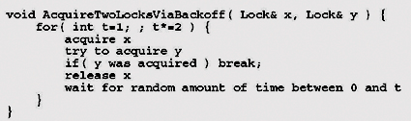
Live Lock
Live lock occurs when threads continually conflict with each other when trying to acquire the shared resources it needs.
To avoid live-lock: if a thread cannot acquire all of the locks on the resources it needs, it releases any that it has acquired and waits for a random amount of time and tries again. (Note: the wait time increases after each failed attempt).
Example “Try and Back=Off” Logic

Slide 35
Heavily Contended Locks

Slide 36
Heavily Contended Locks
Proper use of locks to avoid race conditions can invite performance problems if the lock becomes highly contended.
- Threads from a “convoy” waiting to acquire the lock
because threads are trying to acquire the lock faster than
the rate at which the thread can execute the
corresponding critical section.
- Priority Inversion: A high priority task is blocked from
execution due to a low priority task holding a shared
resource that is required by a high priority task.

Slide 37
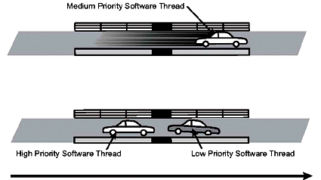
Priority Inversion
This situation occurred with the Mars Pathfinder mission.
This problem could be solved by raising the priority level of the block process (with locks: priority inheritance).

Slide 38
Solutions for Heavily Contended Locks
1. Initial response: Implement a faster lock.
Locks are inherently serial. A faster lock improves
performance by a constant factor, but does not scale
with the application.
- To improve scalability, eliminate the lock or spread
out the contention.
2. Eliminate the lock by replicating the resource.
3. If the resource cannot be replicated, then consider
partitioning the resource and using a separate lock to
protect each partition. Partitioning can spread out
contention among the locks.

Slide 39
Non-Blocking Algorithms

Slide 40
Non-Blocking Algorithms
Problems caused by locks can be eliminated by not using locks. A non-blocking algorithm is designed to not use locks.
Characteristic of a non-blocking algorithm: Stopping a thread does not prevent the rest of the system from making progress.
Non-block guarantees:
1. A thread makes progress as long as there is no
contention; but live-lock is possible.
2. The system as a whole make progress.
3. Every thread makes progress, even when faced with
contention.

Slide 41
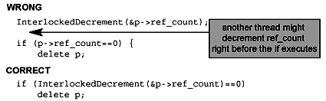
Non-Blocking Algorithms
Non-blocking algorithms are immune form lock contention, priority inversion, and convoying.
Non-blocking algorithms are based on atomic operations. Algorithms are complex because they must handle all possible interleaving of instruction streams from contending processors. Hence, we have race conditions.
Example:

Slide 42
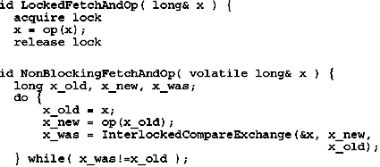
Non-Block Code Example
Blocking Code
Non-Blocking Code
The non-blocking code reads location x into a local temporary and computes a new value. If x is not different than x_old, the InterlockedCompareExchange() routine stores the new value of x. If the code fails, start over until success.

Slide 43
Resolving Timing, Synchronization, and Control Issues via Hardware Interconnects

Slide 44
Avalon (® Altera Corporation) Switch Fabric
A switch and not a shared bus – The switch fabric is a collection of interconnect (wires) and logic resources.
Binds together components of a processor based system by providing interfaces for “Avalon type” Master and Slave ports on components in a system.
Encapsulates connection details

Slide 45
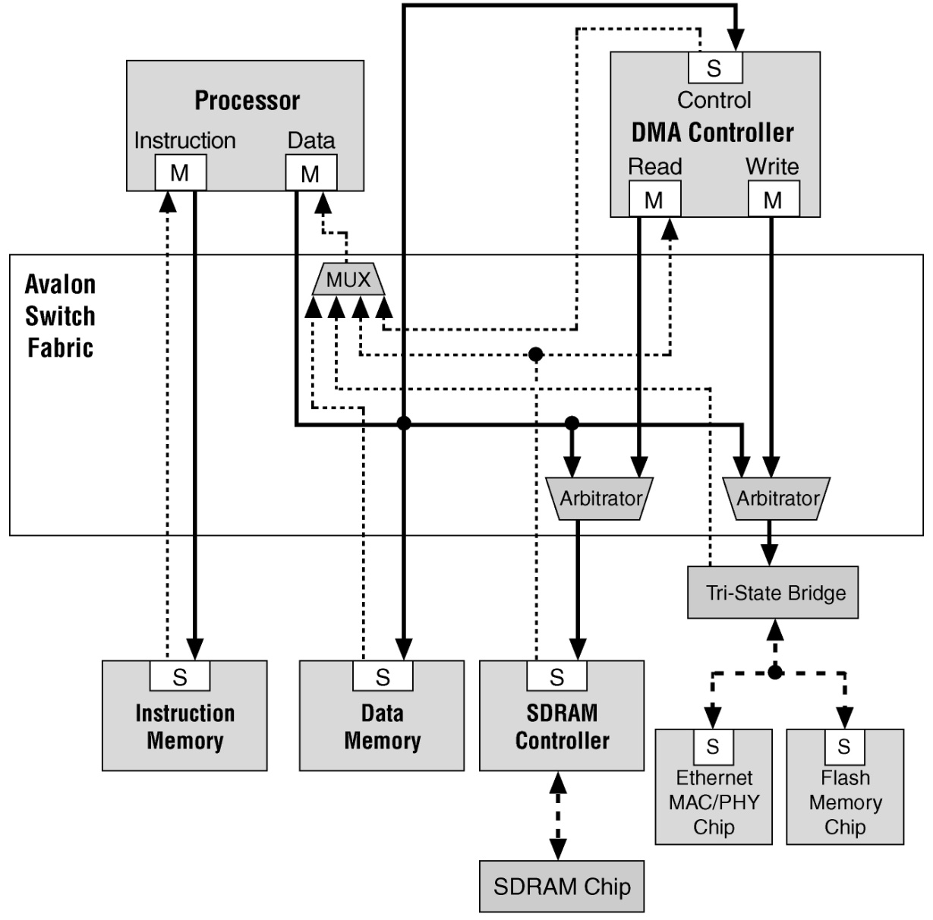
Avalon Switch Fabric
M: Master
S: Slave
Uses different clocks
Facilitates master writing and reading slave
Some components use multiple ports like processor and DMA
Datapath multiplexing.
Arbitration happens when multiple master attempt to access the same slave. The slave decides which master is given access.

Slide 46
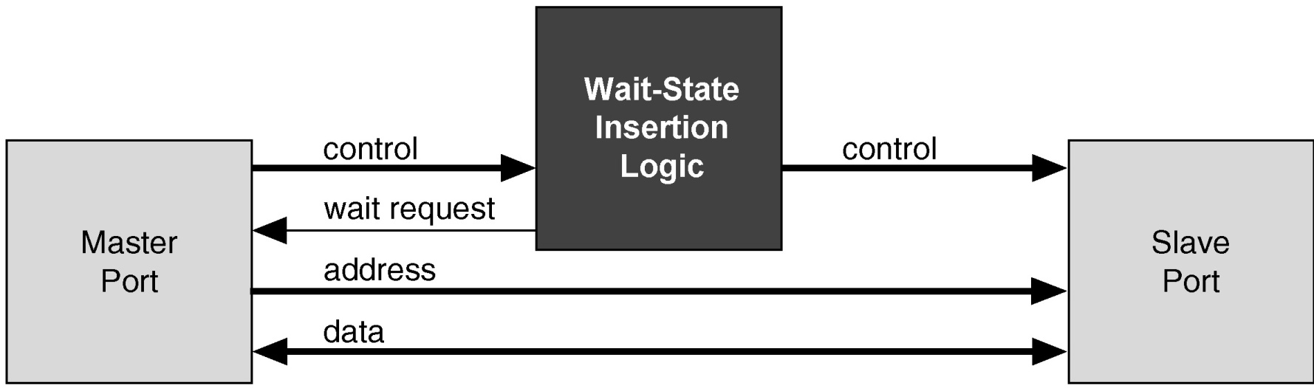
Clock Domain Crossing
D
Q
D
Q
Avalon functions
  Clock domain crossing (CDC)
    Two finite state machines use hand shaking
      One for each clock domain
      Handles read request, write request, and wait requests
    Wait states are automatically inserted so that a Master can talk to slaves without having to worry about their clocking
    Master cannot tell between clock difference or just arbitration or wait states
Clock-1
Q
Q
Clock-2

Slide 47
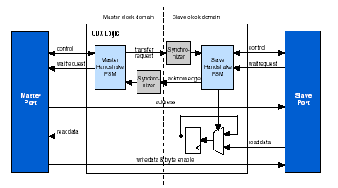
Clock Domain Crossing
Synchronizer uses multiple stages of flip-flops to eliminate the propagation of metastable events in the control signals that enter the handshake FSMs

Slide 48
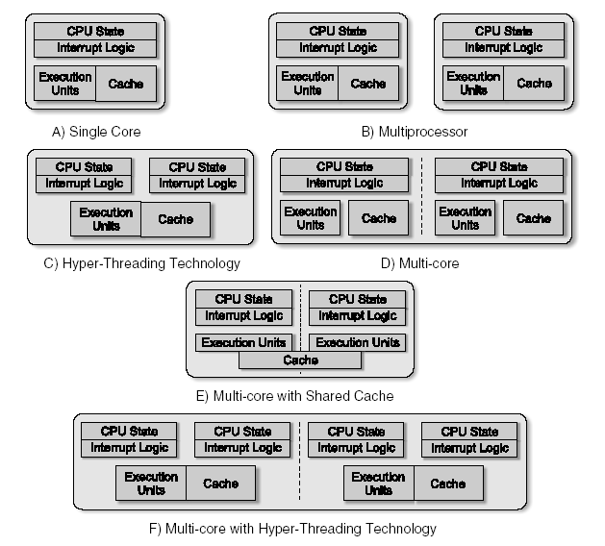
Summary
Consider the complexity of timing, synchronization, and control issues for the various embedded system architectures.

Slide 49
Some Design Trends for Future Research
Configurable Processors
Processors that can be adjusted to optimize performance for the applications they are running.
Standard Bus Structure
Hardware/software interaction requires well defined communication protocols and hardware implementations. With a standard bus structure, designers can focus on functionality not communication mechanisms.
Configurable Compilers
Compilers that can be modified to compile programs for a variety of processors.

Slide 50
Questions?

