Slide 1

InDepth Knockout Validation
Module 2: Basic Validation
Derik Whittaker
http://bit.ly/DerikWhittaker
derik@graudo.com
@DerikWhittaker
Notes:
Hello and welcome to Module 2 of InDepth Knockout Validation, I am your host Derik Whittaker.
This module kicks off our training of how to use the Knockout Validation library. We will go from 0 to 60 in learning how to use the basics of Knockout validation. The focus of this module will be 2 things, first learning how to set up our binding context in order to leverage the validation library. The 2nd will be how to use many of the validators which are built into the library.

Slide 2
Agenda
Validating your first observable
Using Required Validator
Working with Built In Validators
Using Min/Max Validators
Using Equal/Not Equal Validators
Using Min/Max Length Validators
Using Pattern (aka Regular Expression) Validator
Notes:
This module is going to be broken into 2 parts. The first part we will cover the basics needed to get knockout validation up and running and the 2nd part will cover many of the build in validators.
learn how to setup our binding context to hook into the validation library. We will also learn how to setup validation on our first observable. The validation rule we will be using will be the ‘required’ validator. The Required validator does exactly as the name implies, it will require that the bound observable is populated with some data
IN our first demo will
[show animation]
Now that we understand how to use the required validator we might as well spend some time taking a look at how to use some of the other built in validators. The next validators we will learn to use will be the min and max validators. These will ensure that our bound observable is not below or above the rule value.
[show animation]
The next 2 validators we will learn to use will be the equals and not equals validators. These can be used to ensure that our observable value is either equal to or not equal to our rule value.
[show animation]
The 3rd set of validators we will explore will be the min and max length validators. These 2 validators are used to ensure that a string value does not dip below a specified minimum length or exceed a maximum length
[show animation]
The last validator we will explore is the pattern validator. This validator leverages the power of regular expressions and can be used to perform pattern match validation on an observable.

Slide 4
Agenda
Validating your first observable
Using Required Validator
Working with Built In Validators
Using Min/Max Validators
Using Equal/Not Equal Validators
Using Min/Max Length Validators
Using Pattern (aka Regular Expression) Validator
Notes:
Lets hit the ground running w/ knockout validation and learn to validate our first observable.
IN order to accomplish this we are going to need to learn 2 different items. We will first need to know how to enable knockout validation to monitor our observables and next we will need to know how to wire up our first validator to our observable.

Slide 5
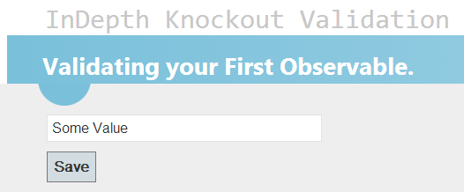
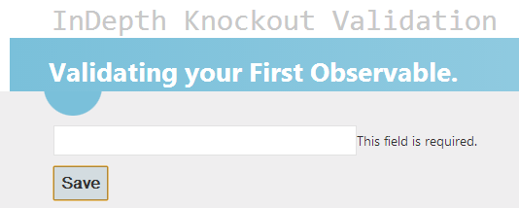
First Validator: Required Field
Example
Valid State:
Invalid State:
Validation Triggers Error Message
Notes:
Looking at the screen here you will see that I have a very simply data entry form which is consists of a input box and a button. What I want to be able to do is have a message be displayed next to my input box if the text box is empty
[show animation]
Here is our same data entry form once the validation has been applied
[show animation]
You can see that once I have enabled validation our message appears and informs our users that they must provide some data in order to continue.
Now that we understand what we expect to build let learn how to actually build it.

Slide 6
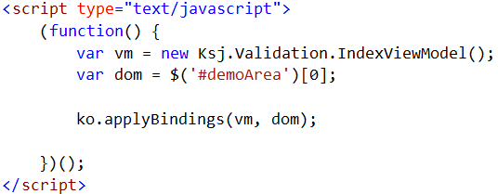

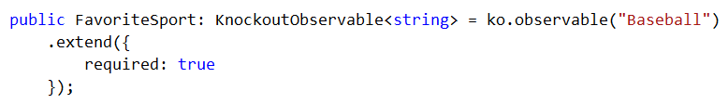
First Validator: Required Field
Coding
Setup the Binding
Triggers the validation
Setup the Rule
Extend the Observable to setup the rule
Notes:
When using knockout and knockout validation the first thing you have to do is bind your view model to your view. If we are using just straight up knockout your bindings would look something like what you see on the screen.
[show animation]
However, once you introduce knockout validation you need to change the way you setup your binding. Notice that I am no longer using ‘applyBindings’ but rather I am calling ‘ko.applyBindingsWithValidation’. This will trigger the validation framework and allow all of its magic to take place
[show animation]
Now that we have our bindings setup lets take a look at how we setup a validator on an observable.
Looking at the code here the first part should look normal to you, I am simply creating an instance of an observable.
[show animation]
However, the next bit of code may be new to you. What I am doing is calling the .extend method and passing in an object, which is how we initialize the validator for the observable. In our case I passed in an object w/ a property called required and a value of true. This will tell the validation library I want to use the required validator and that its turned on.

Slide 8
Agenda
Validating your first observable
Using Required Validator
Working with Built In Validators
Used Min/Max Validators
Used Equal/Not Equal Validators
Used Min/Max Length Validators
Used Pattern (aka Regular Expression) Validator
Notes:
We have seen how to enable the required validator on our observable. Next we want to learn how to use many of the other built in validators in the library
We are going to look at 4 different sets of validators. We will start off by learning about the min/max validator
[show animation]
We will then move to the equal/not equal validator
[show animation]
After this we will learn about the min/max length validator
[show animation]
And we will end by learning about the pattern or regular expression validator

Slide 9
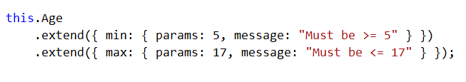
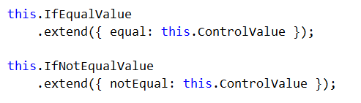
Built In Validators
Coding
Using the Min/Max Validators
Using the Equal/Not Equal Validators
Notes:
In order to use the Min/ Max validators you would setup your code as you see here on the screen
[show animation]
The Min Validator is used by min key word and the max validator by using the max key word
[show animation]
Another thing I want to point out is the fact that I am providing a custom error message. Because the out of the box message may not suit your needs knockout validation does have a facility to allow you to specify your own message. To do this you would provide the property/value pair as you see here and any time the validation is triggered your custom message will be displayd.
[show animation]
In order to use the equal or not equal validators you would set the validation as shown.
[show animation]
You can see that we are following our typical wiring convention and are using either the equal keyword or the notEqual key word. Play attention to the fact that because not equal is 2 words we are using camel casing, this is important

Slide 10
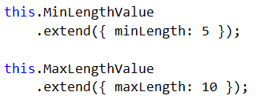
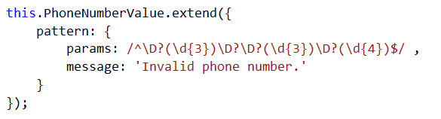
Built In Validators
Coding
Using the Min/Max Length Validators
Using the Pattern Validator
Notes:
The next 2 validators are the min and max length validators.
[show animation]
To enable either of these we still follow our binding convention but now we will use either the minLength or the maxLength values to enable our validators
[show animation]
The last validator we are going to explore is the pattern, or regular expression validator.
[show animation]
To use this validator you would use the pattern keyword and then provide it any valid regular expression statement. In our case here have provided it a statement which will validate that the data is formatted correctly to match US phone formats

Slide 12
Summary
Validate our first observable
Used Required Validator
Learned to use the Built in Validators
Used Min/Max Validators
Used Equal/Not Equal Validators
Used Min/Max Length Validators
Used Pattern (aka Regular Expression) Validator
Notes:
This module was dedicated to providing you with enough knowledge to allow you to get up and running w/ the basics on how to use the Knockout validation library.
[show animation]
We started off by learning the basics. This included learning how to setup our bindings to allow for the knockout validation to work with our knockout bindings as well as learning how to use the required validator.
[show animation]
Once we understood how to use the required validator we moved on to learn about some of the other built in validators. The next validators we will learned to use was the min and max validators. These validators can be used to ensure that our observable is not above or below some predetermined value.
[show animation]
The next 2 validators we will learned to use were the equals and not equals validators. We learned these validators could be used to ensure that our observable value is either equal to or not equal to our rule value.
[show animation]
The 3rd set of validators we will explored was min and max length validators. These 2 validators can be used to ensure that a string value does not dip below a specified minimum length or exceed a maximum length
[show animation]
Finally we wrapped up the module by leaning how to use the pattern validator. We learned that this validator leverages the power of regular expressions and can be used to perform pattern match validation on an observable.

